Slide 1
Epileptic Seizure Detection Based on EEG Signals and Machine Learning
BSc Thesis

Slide 2
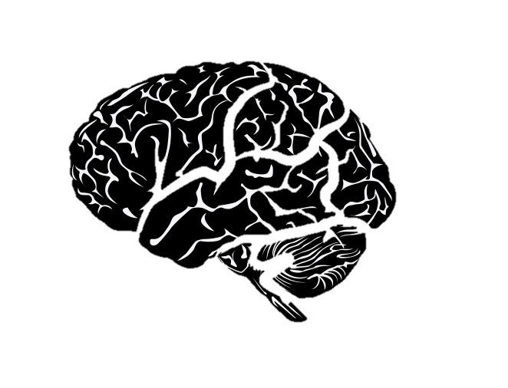
Overview
Introduction
Data
Method
EEG Signals
Feature Extraction
Machine Learning Problem
Performance Evaluation
Results and Discussion
Conclusion and Reflection

Slide 3
Introduction
50 million people suffer from epileptic seizures today
Electroencephalography (EEG)
Statistical Features extracted from DWT coefficients by Chen et al., but of rather a high dimension
Recreate Features based on Chen et al.
Investigate if reduced features can be used.

Slide 4
Data

Slide 5
EEG Signals

Slide 6
Feature Extraction

Slide 7
Machine Learning Problem

Slide 8
Performance Evaluation

Slide 9
Results and Discussion

Slide 10
Conclusion and Reflection

