Slide 1
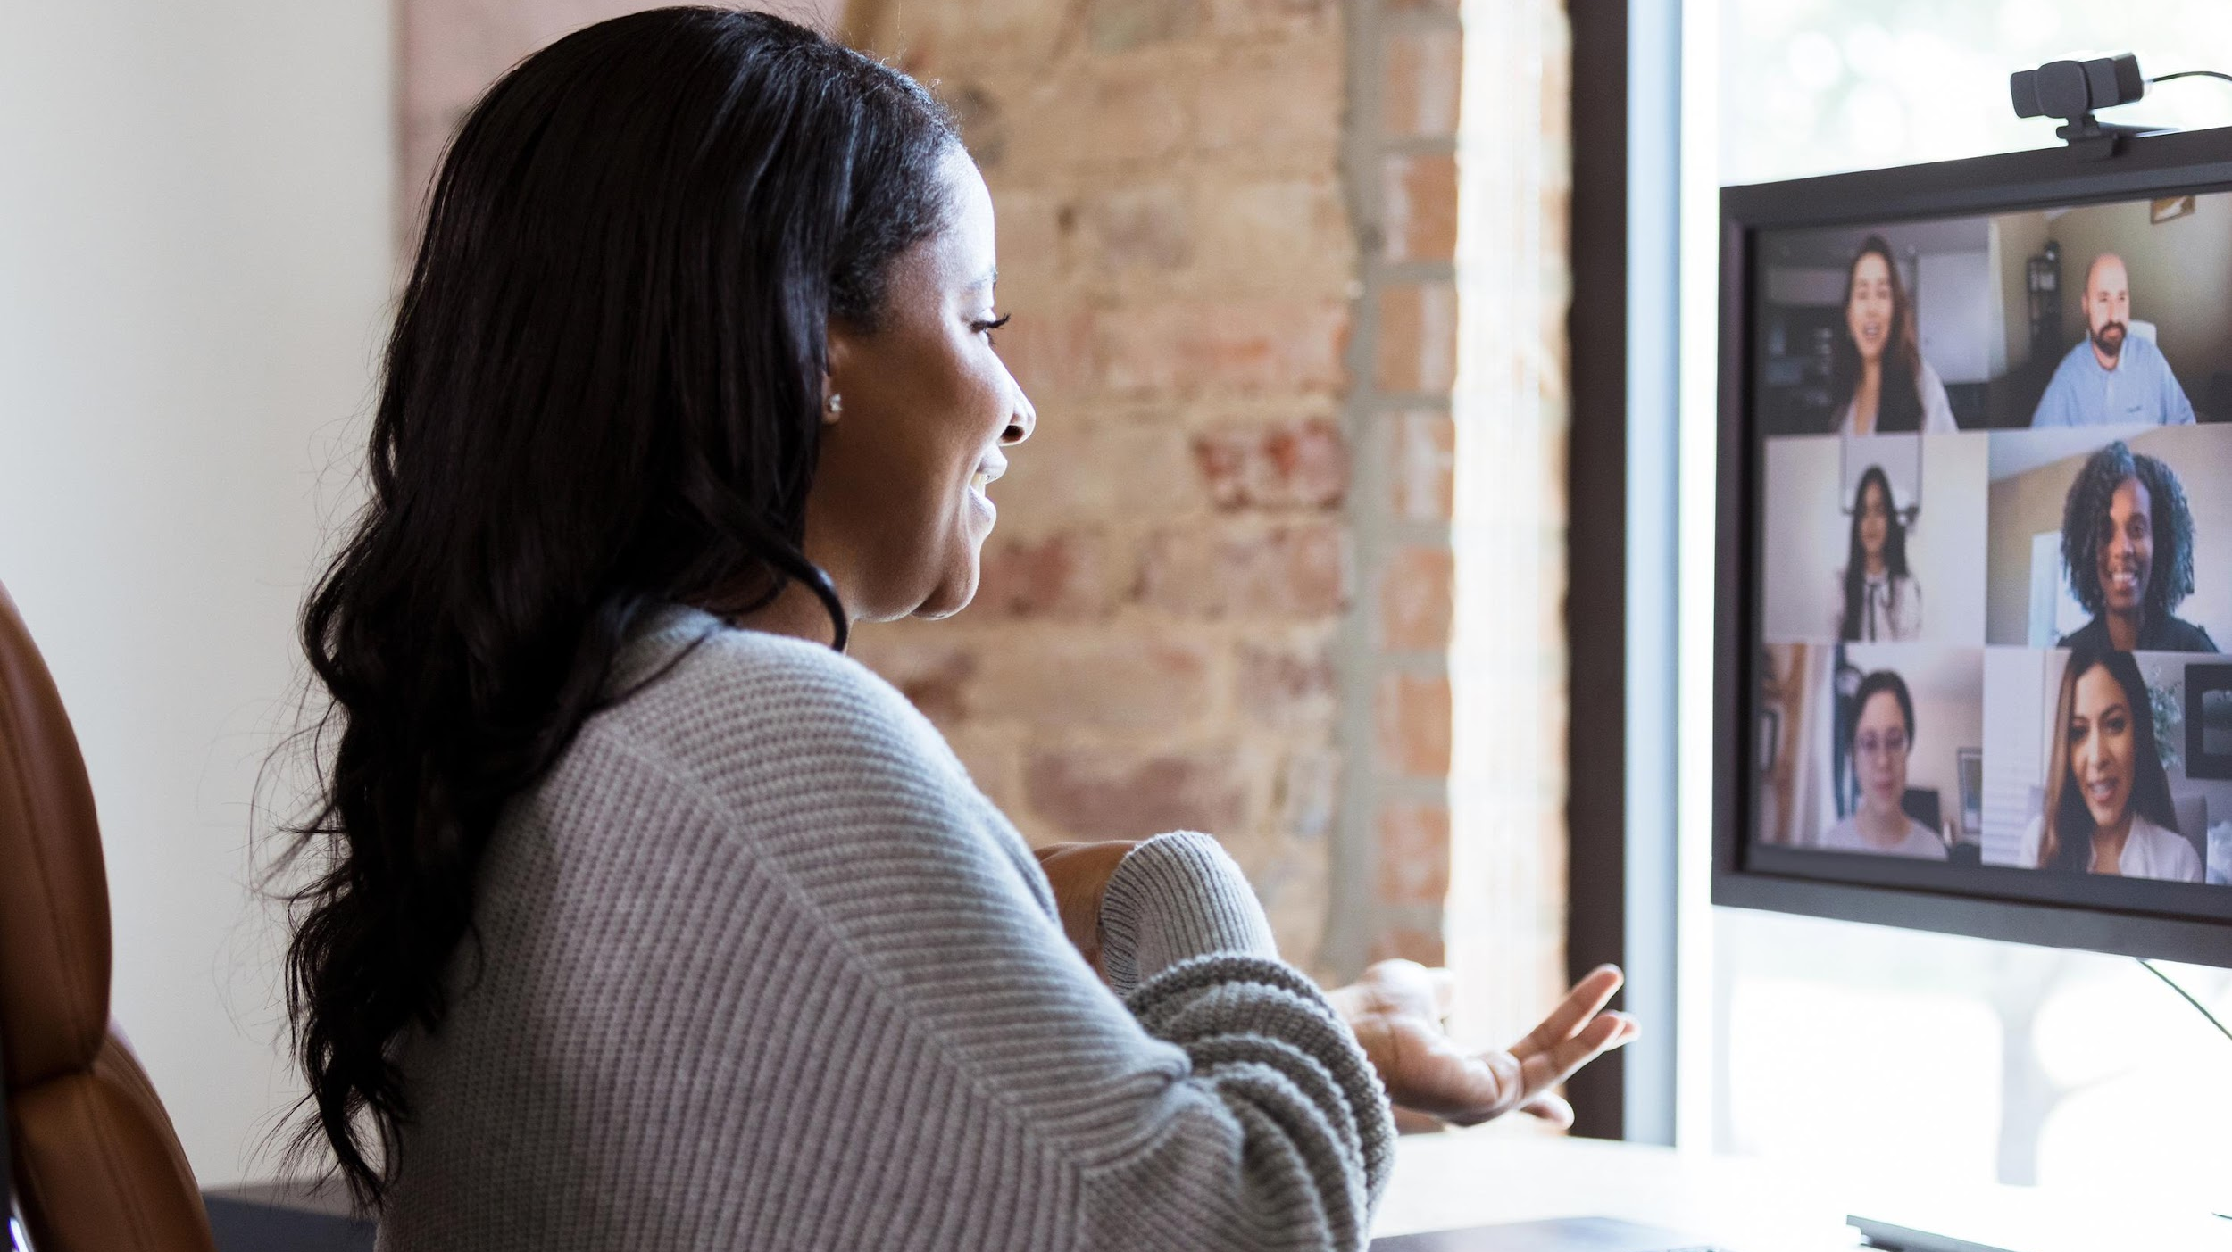
OpenPosture
The ultimate solution for improving your seated posture and reclaiming your comfort and confidence.
By: Ally Ryan, Mike Nweke, Parisha Rathod

Slide 2

WHAT IS OPENPOSTURE?
OpenPosture is an innovative application that aims to enhance seated posture and productivity of busy students and the corporate workforce by alleviating back and neck pain through real-time video monitoring or photo submission.

Slide 3

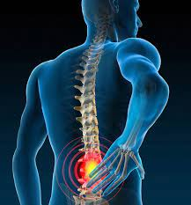
Problem
54% of office workers experience neck pain due to inadequate seated posture
Low back pain is the leading cause of disability across the globe
80% of people will experience debilitating lower back pain during their lifetime.
The Big 4 Accounting Firms do not offer a seated posture tool to enhance corporate wellness and productivity.

Slide 4
SOLUTION
To utilize OpenPosture, users simply open the app on any device equipped with a camera and capable of downloading apps. They position the device laterally to their desk, ensuring their full body is captured in the camera frame. OpenPosture then detects the user's posture and provides 1) tailored recommendations to improve their posture and 2) exercises to alleviate pain caused by poor posture.
Posture Recommendations
Workout Recommendations
Object Detection Recommendations

Slide 5
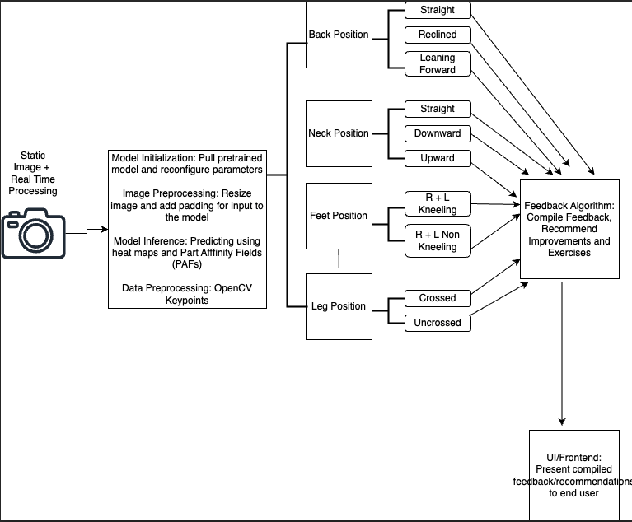
Conceptual Diagram

Slide 6

Data Cleaning And Transformation

Slide 7
Data Cleaning and Transformation
Image Rescaling
Padding
Image Normalization
Gaussian Blurring
Peaks Detection
Image Display

Slide 8

Model Implementation

Slide 9

DATA ANALYSIS

Slide 10
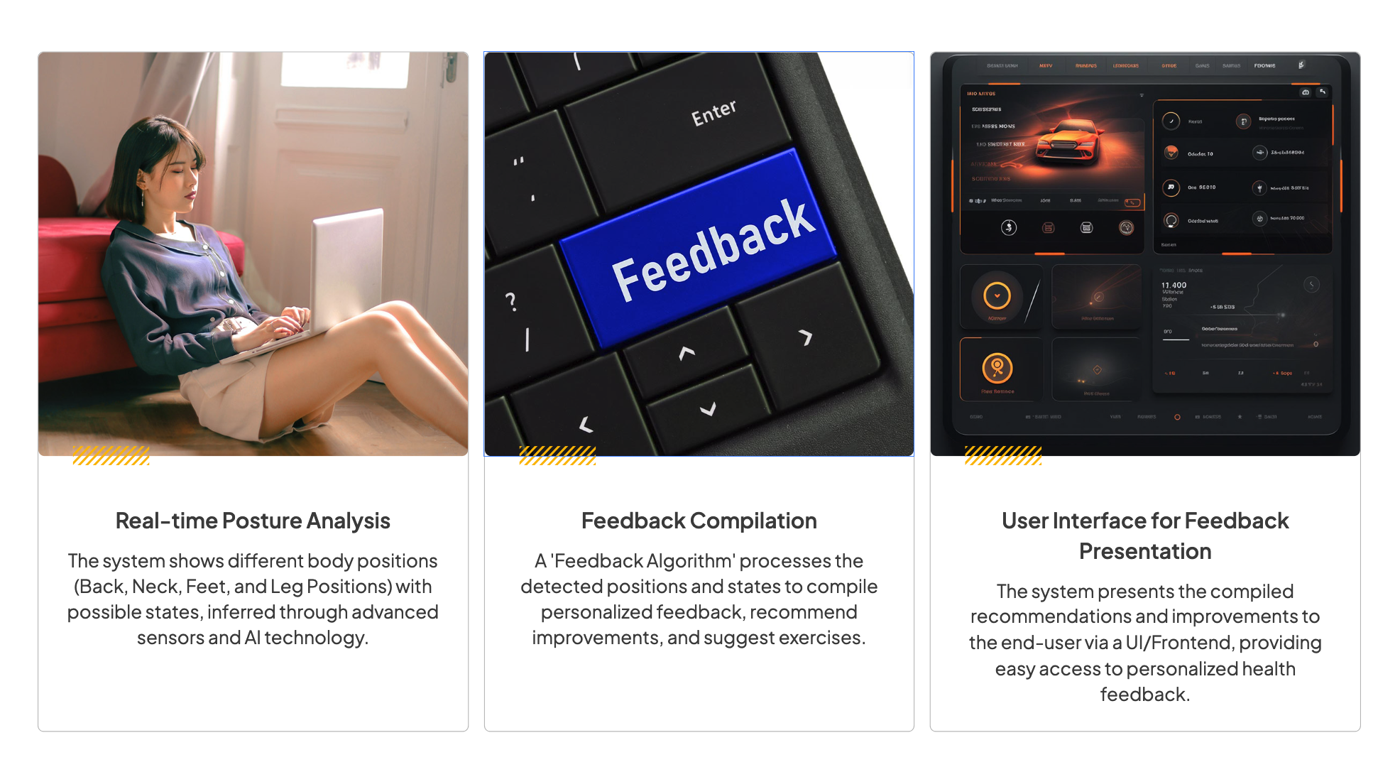

Slide 11
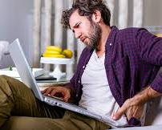
MODEL IMPLEMENTATION: 20+ WORKOUT RECOMMENDATIONS TO MITIGATE PAIN FOR THE FOLLOWING POSTURAL ELEMENTS:
Back Position
Neck Position
Crossed Legs
Feet on Floor
Legs Kneeling

Slide 12
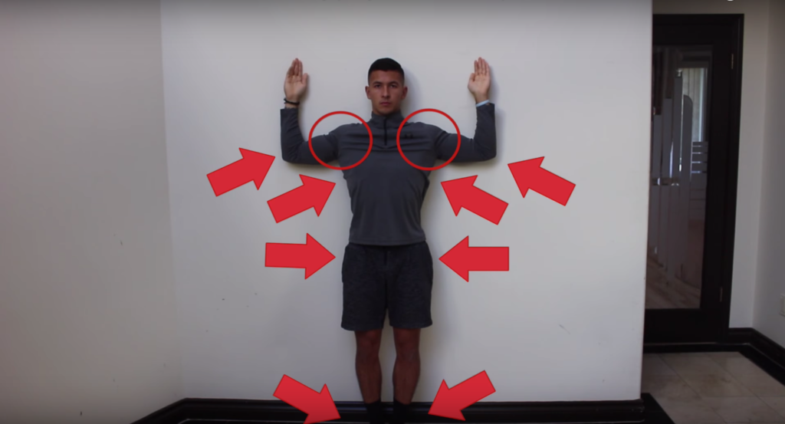
Model Implementation: Hunchback Workout Recommendation – Wall Slides

Slide 13
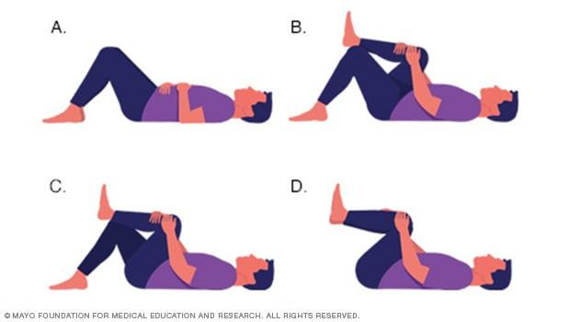
Model Implementation: Crossed Legs Workout Recommendation – Knee to Chest

Slide 14

Next Steps

