Slide 1
What is the absolute best or worst role combination of team members ?
M. Ochi / Y. Fukasawa
2016/05/08

Slide 2
What is the best team in LoL?
Introduction
In League of Legends, there are so many combinations in team construction
In this study, we pay attention to three factors to understand the best team combinations
Champion’s
Role
Timeline
Lane
Timeline
Role
Assassin
Fighter
Mage
Marksman
Support
Tank
TOP
MIDDLE
BOTTOM
JUNGLE
SOLO
DUO_SUPPORT
DUO_CARRY
DUO
NONE

Slide 3
Our Method
Method
FeaturedGamesで最近のゲームを取得
２．ParticipantsのSummonerNamesを取得
３．SummonerNamesを使ってSummonerIdを取得
４．SummonerIdを使ってSummonerGamesを取得
５．SummonerGamesからMatchStatsを取得
featured-games-v1.0
stats-v1.3
match-v2.2
Get Match Stats through some APIs
From data, extract
champion’ role, timeline lane, timeline role
on each teams of matches
Use 9778 matches
Season2015
Using these three factors,
classify each teams into 30 clusters
through K-means method
Through each match result,
estimate potential of each clusters
using ” TrueSkill™ Model”

Slide 4
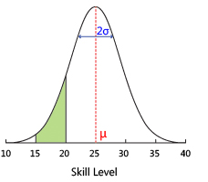
TrueSkill™ Ranking System
Method
Developed by Microsoft Research
“The purpose of a ranking system is to both identify and track the skills of gamers in a game (mode) in order to be able to match them into competitive matches.”
Sigma decreases with the increase in the number of games
When a cluster wins, mu of the cluster increases
When a cluster loses, mu of the cluster decreases
Source: http://research.microsoft.com/en-us/projects/trueskill/

Slide 5
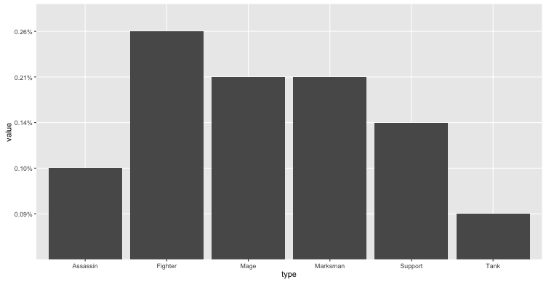
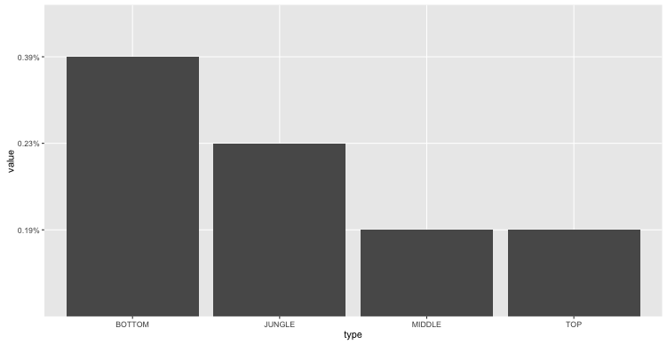
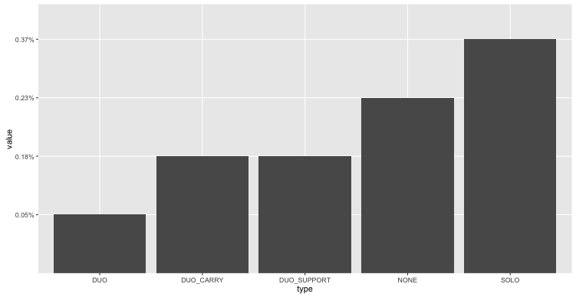
Best Teams Combinations
Results
0.26%
Cluster | Mu | Sigma
11 | 22.589 | 0.782
22 | 22.428 | 0.781
5 | 22.398 | 0.779
0.21%
0.21%
0.14%
0.10%
0.09%
Assassin
Fighter
Mage
Marksman
Support
Tank
0.37%
0.39%
0.23%
0.23%
0.18%
0.18%
0.19%
0.19%
0.05%
BOTTOM
JUNGLE
MIDDLE
TOP
DUO
DUO_
CARRY
DUO_
SUPPORT
NONE
SOLO

Slide 6
Best Example -Cluster 11-
Results
0_champion_attr | 0_lane | 0_role | 1_champion_attr | 1_lane | 1_role | 2_champion_attr | 2_lane | 2_role | 3_champion_attr | 3_lane | 3_role | 4_champion_attr | 4_lane | 4_role
Support | Bottom | DUO_SUPPORT | Marksman | Bottom | DUO_CARRY | Mage | Middle | SOLO | Fighter | Jungle | NONE | Fighter | TOP | SOLO
Support | Bottom | DUO_SUPPORT | Fighter | Bottom | DUO_CARRY | Mage | Middle | SOLO | Fighter | Jungle | NONE | Fighter | TOP | SOLO
Marksman | Bottom | DUO_CARRY | Assasin | Bottom | DUO_SUPPORT | Mage | Middle | SOLO | Assasin | Jungle | NONE | Assasin | TOP | SOLO
Tank | Bottom | DUO_SUPPORT | Marksman | Bottom | DUO_CARRY | Mage | TOP | SOLO | Fighter | Jungle | NONE | Mage | Middle | SOLO
Marksman | Bottom | DUO_CARRY | Support | Bottom | DUO_SUPPORT | Mage | Middle | SOLO | Fighter | Jungle | NONE | Support | TOP | SOLO
Marksman | Bottom | DUO_CARRY | Support | Bottom | DUO_SUPPORT | Mage | Middle | SOLO | Assasin | Jungle | NONE | Fighter | TOP | SOLO
Marksman | Bottom | DUO | Assasin | Bottom | DUO | Fighter | TOP | SOLO | Fighter | Jungle | NONE | Mage | Middle | SOLO

Slide 7
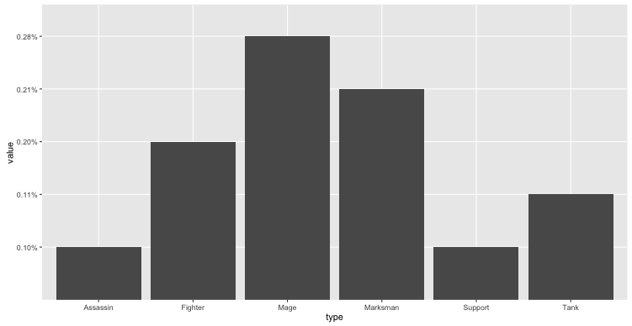
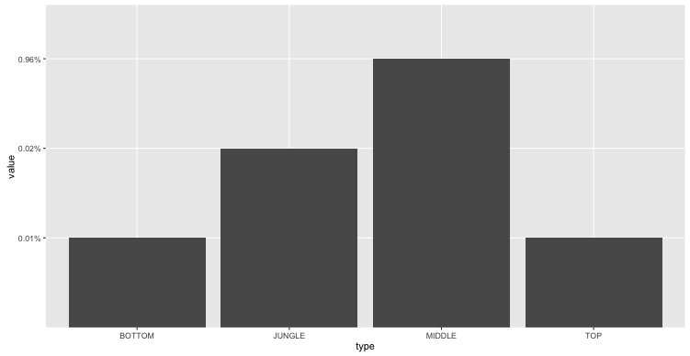
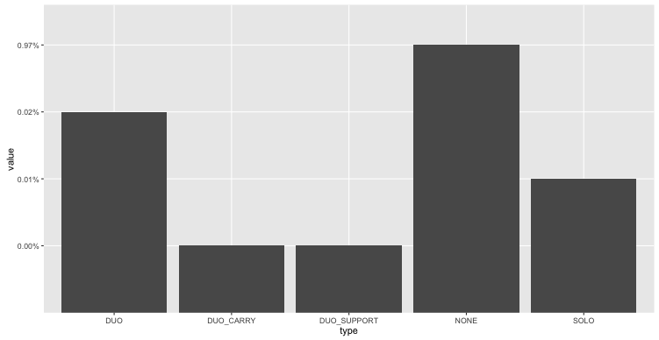
Worst Teams Combinations
Results
0.28%
Cluster | Mu | Sigma
21 | 6.665 | 0.782
12 | 8.131 | 0.782
9 | 8.148 | 0.784
0.21%
0.20%
0.11%
0.10%
0.10%
Assassin
Fighter
Mage
Marksman
Support
Tank
0.96%
0.97%
0.02%
0.02%
0.01%
0.01%
0.01%
0.001%
0.001%
BOTTOM
JUNGLE
MIDDLE
TOP
DUO
DUO_
CARRY
DUO_
SUPPORT
NONE
SOLO

Slide 8
Worst Example -Cluster 21-
Results
0_champion_attr | 0_lane | 0_role | 1_champion_attr | 1_lane | 1_role | 2_champion_attr | 2_lane | 2_role | 3_champion_attr | 3_lane | 3_role | 4_champion_attr | 4_lane | 4_role
Fighter | Middle | NONE | Mage | Middle | NONE | Marksman | Middle | NONE | Marksman | Middle | NONE | Mage | Middle | NONE
Fighter | Middle | NONE | Tank | Middle | NONE | Assasin | Middle | NONE | Fighter | Middle | NONE | Mage | Middle | NONE
Mage | Middle | NONE | Mage | Middle | NONE | Mage | Middle | NONE | Support | Middle | NONE | Fighter | Middle | NONE
Fighter | Middle | NONE | Support | Middle | NONE | Assasin | Middle | NONE | Mage | Middle | NONE | Marksman | Middle | NONE
Mage | Middle | NONE | Fighter | Middle | NONE | Fighter | Middle | NONE | Mage | Middle | NONE | Marksman | Middle | NONE
Mage | Middle | NONE | Mage | Middle | NONE | Mage | Jungle | NONE | Mage | Middle | NONE | Mage | Jungle | NONE

