Slide 1
IBM Data Science Professional Certificate Capstone Project
Analyzing And Clustering Toronto Neighborhoods To Find The Best Place Gym/Fitness Center
By: Mohammad Odeh

Slide 2
Introduction
Toronto is the largest city in Canada, the capital of Ontario, and the home to more than five million people, this gives it a big advantage for businessmen and investors who want to establish a profitable business.
An investor is interested in opening a gym/fitness center in Toronto and requested further analysis of the area and the businesses around it.

Slide 3
Data
Web scrape the lists of neighborhoods from Wikipedia page :
https://en.wikipedia.org/wiki/List_of_postal_codes_of_Canada:_M
Coordinates of each neighborhood using a csv file contains all coordinates of Toronto neighborhoods:
http://cocl.us/Geospatial_data
List of available gyms in each neighborhood by using Foursquare API.

Slide 4
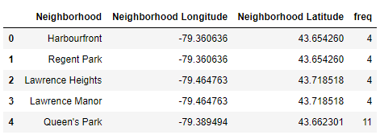
Methodology
a clustering algorithm (K-Means clustering) is applied which will cluster the neighborhoods into clusters depending on the number of gyms in that neighborhood.
The data that will be used for that is the cleaned/edited list of neighborhoods with their corresponding coordinates and number of gyms on each one :

Slide 5
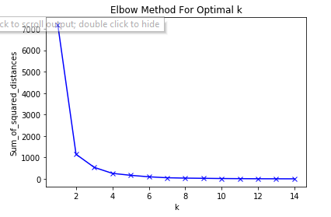
in order to find the optimal K ( number of clusters ), elbow method is used by applying k means for different sets of “ K “, then the sum of square distance ( Inertia ) is calculated for each “ K “
So, K=3 is the optimal number of clusters, there for we apply the algorithm to the data with k=3

Slide 6
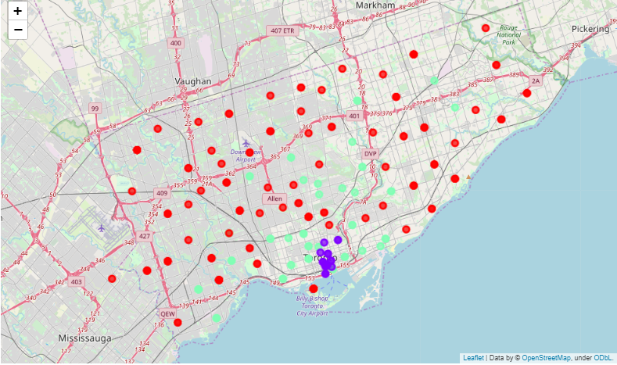
Result
The resulted clusters showed in the map below, show that there is a concentration of gyms on a specific area while there is a lot of neighborhoods that could be a potential place for opening a gym on.

Slide 7
Conclusion
the heart of the gym business is concentrated near the coast and the more we go to the edge of the city the more opportunity there will be for new gym/fitness center
Adding the population and demographic distribution data among the neighborhoods, will have more accurate prediction of the most profitable area and the one that will serve more people

