Slide 1
WizAud
Useful for wizards, audits and inspection apps

Slide 2
Key Features
Define wizard, audit, inspection fields in admin app
Canvas app renders WizAud based on these
Users can use Canvas app completely offline, and submit WizAud when connected

Slide 3
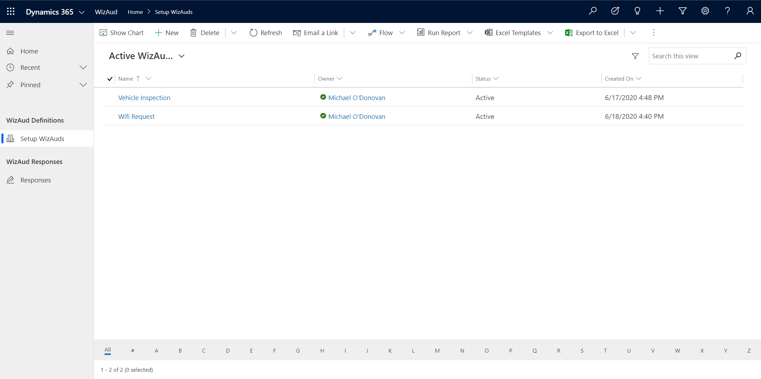

Slide 4
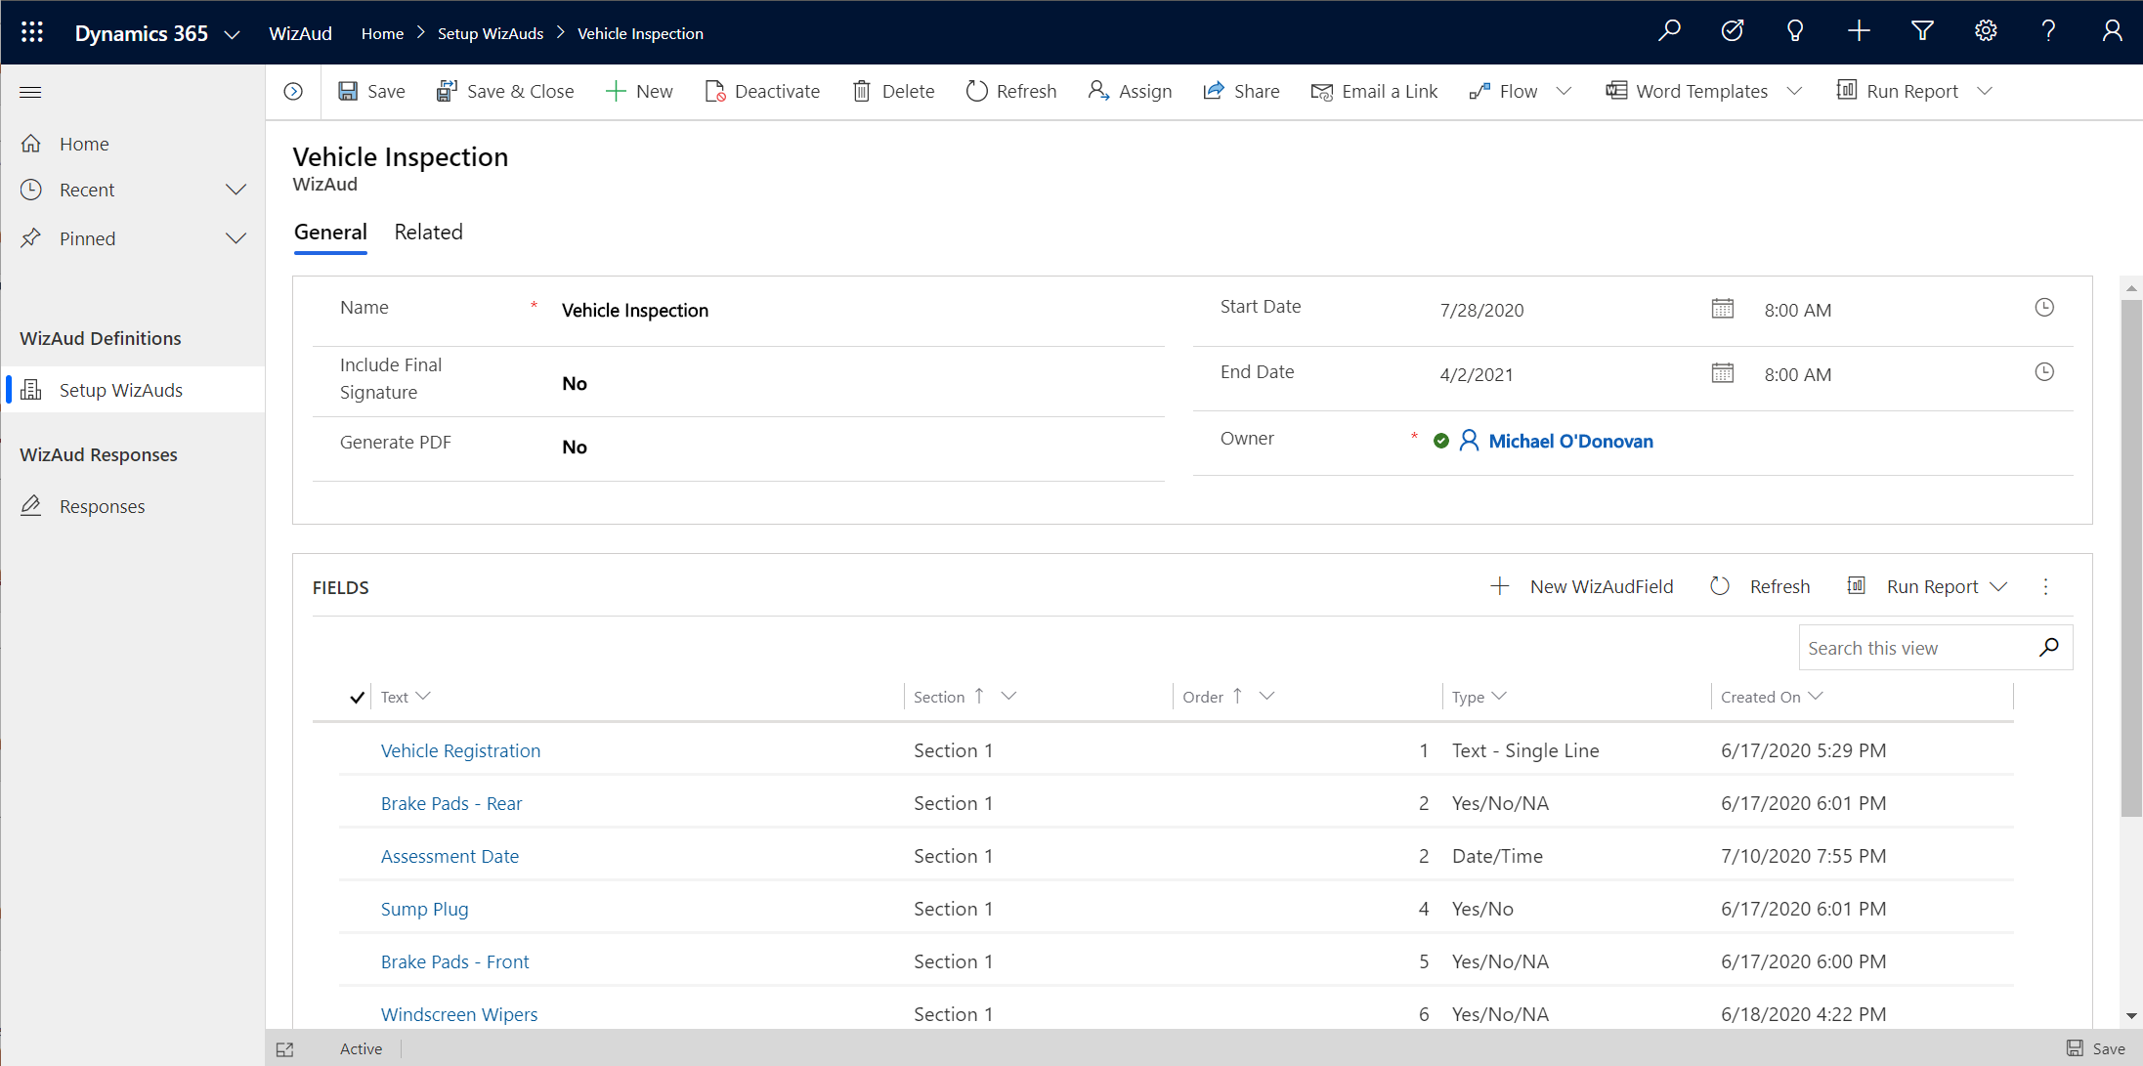

Slide 5
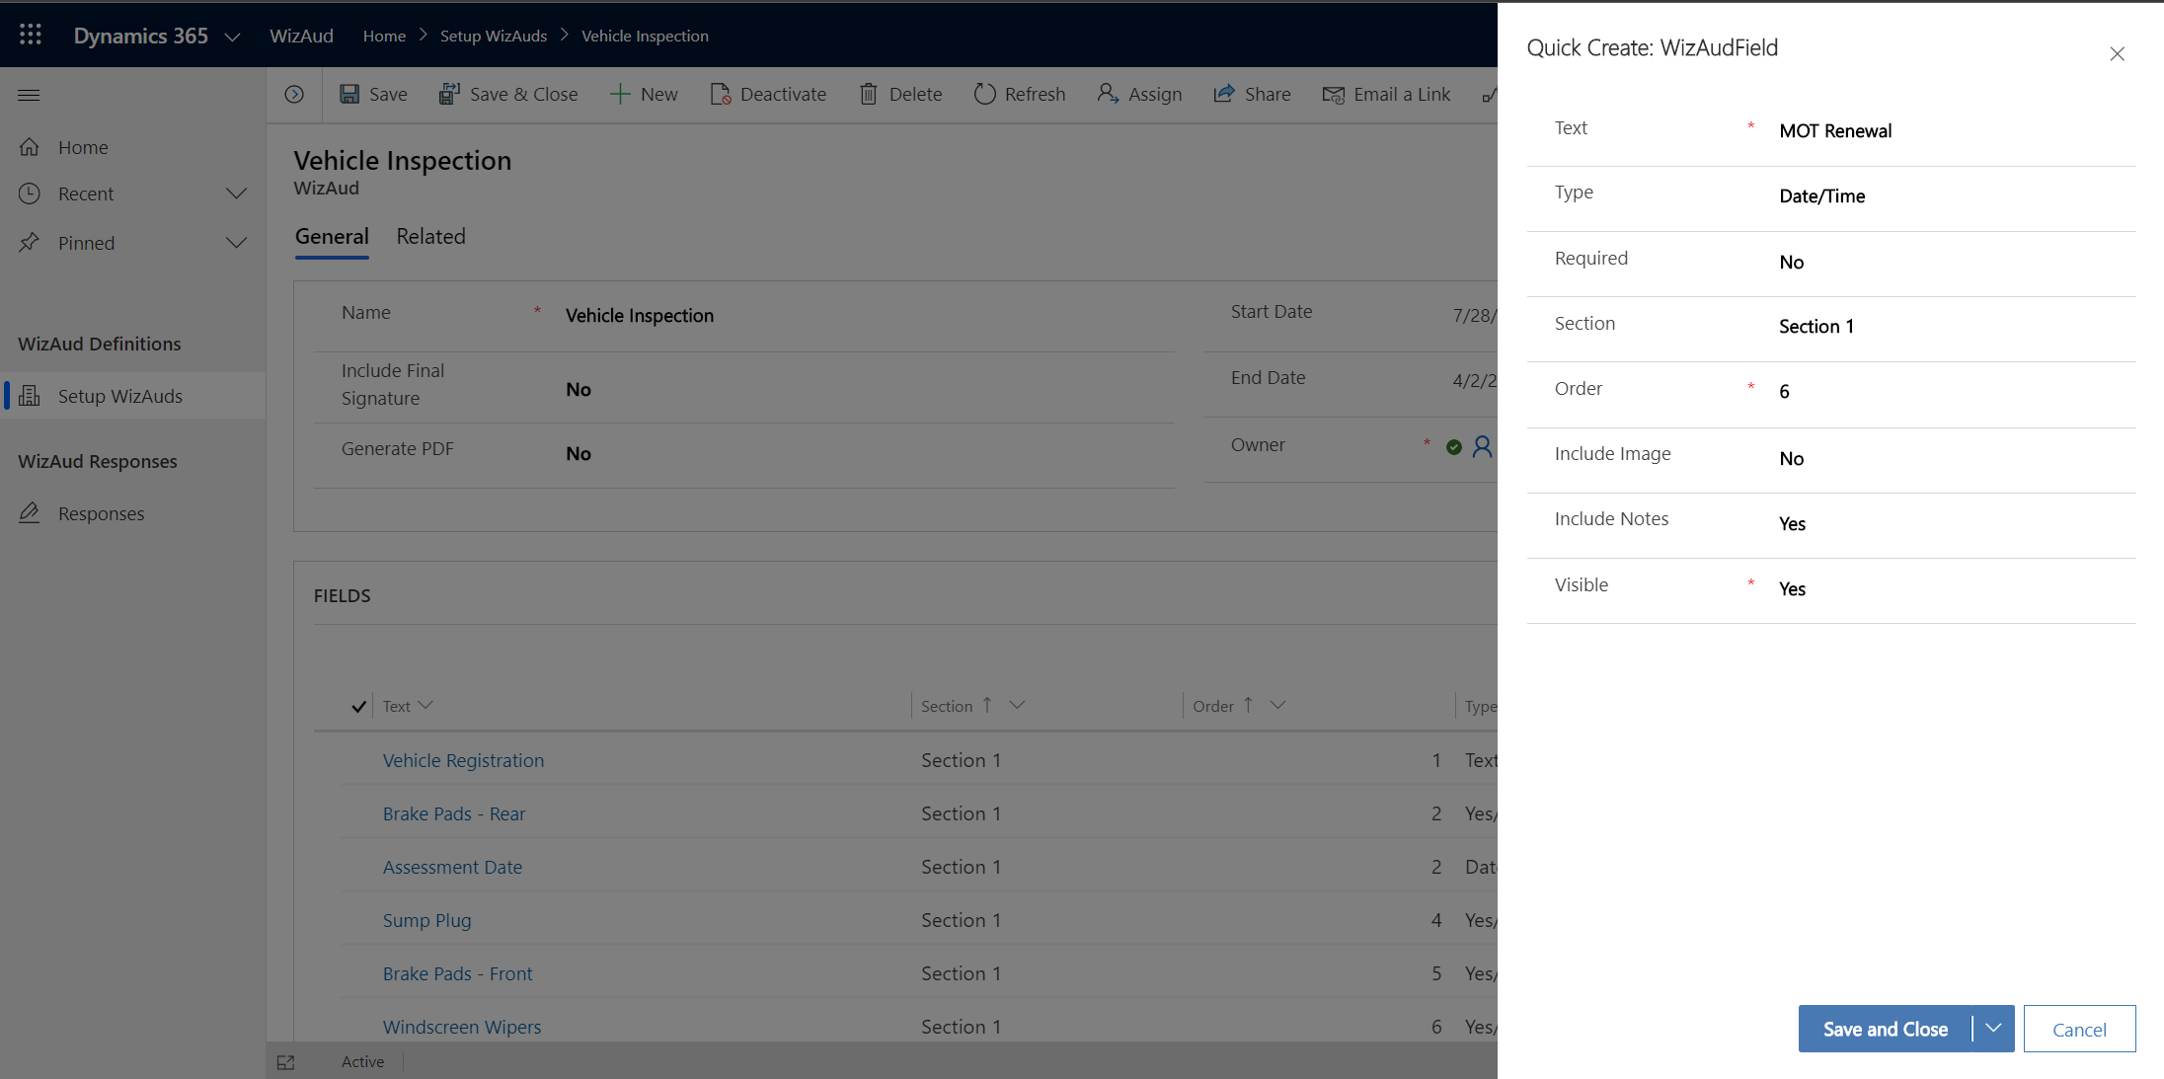

Slide 6
This generates …

Slide 7
