Slide 1


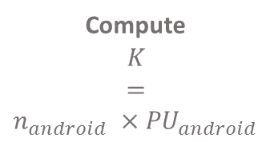
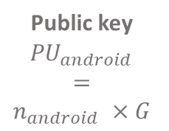
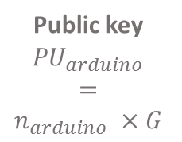





PUBLIC PARAMETERS
P and G
Private key
$${PR}_{arduino}$$
Private key
$${PR}_{android}$$
Public key
$${PU}_{arduino}$$
$$=$$
$$n_{arduino} ×G$$
$${PU}_{arduino}$$
Public key
$${PU}_{android}$$
$$=$$
$$n_{android} ×G$$
$${PU}_{android}$$
Compute
$$K$$
$$=$$
$$n_{android} ×{PU}_{android}$$
Compute
$$K$$
$$=$$
$$n_{android} ×{PU}_{android}$$
Communication

Slide 2
Host
Generic Access Profile (GAP)
Generic Attribute Profile (GATT)
Security Manager (SM)
Attribute Protocol (ATT)
Logical Link Control and Adaptation Protocol (L2CAP)
Controller
Host Control Interface (HCI)
Link Layer (LL)
Physical Layer (PHY)

