Slide 1

Paper Review :
Bayesian Optimization for CVaR-based portfolio optimization
Present by
Mohammad Rachman
Original Author Paper :
Robert Millar
Jinglai Li
University of Birmingham
Birmingham, UK
https://doi.org/10.48550/arXiv.2503.17737

Slide 2


“High risk, high return”
“Don't put all your eggs in one basket”
THE ADAGIUM OF INVESTMENT

Slide 3

Based on the adagium before, imagine you have a portfolio of 10 assets. You want to minimize your risk, but at the same time you also want higher return. If you simply put the same weight of allocation in every asset, it might look “safe”, but…
Some assets may be too risky and pull the portfolio down.
Others may have low returns that dilute the overall gain.
In the end, you don’t really get the best balance

Slide 4

Which brings us to the big question: How do we allocate our portfolio to get enough return, but at the same time minimize the worst-case risk (CVaR)?

Slide 5
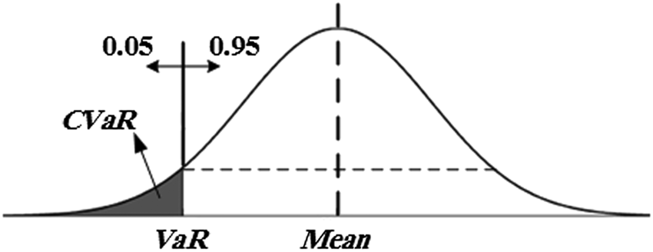
Core Concepts for Estimating CVaR
CVaR (Conditional Value at Risk) = measures worst-case losses.
Bayesian Framework = update beliefs as new evidence comes in
Gaussian Process as model surrogate = predicts outcomes and quantifies uncertainty.
Expected Improvement = smart method that picks the next portfolio to test by predicting a lower risk (CVaR) than the current best

Slide 6
Workflow: Baseline Bayesian Optimization
Step 1
Step 2
Step 3
Set Parameters
Choose risk level (α), e.g. 95%.
Define minimum return (R_MIN), e.g. 9%.
Define upper return bound (R_MAX) (typically 105–110% of R_MIN).
Initial Design
Generate a few random portfolios (different allocations).
Compute expected return and CVaR for each (no filtering).
Use results to train initial Gaussian Process (GP) models
Iteration
Compute expected return and CVaR for the chosen candidate.
Update GP models with new data.
Every new candidate selected by EI (Expected Improvement) must have its CVaR computed (expensive step).
Drawbacks of Baseline BO (EI)
High computational cost
Every portfolio candidate must have its CVaR computed.
CVaR is expensive, since it requires many return simulations → very time and resource intensive.
Inefficient exploration
EI only focuses on the probability of improvement, but does not account for the fact that the optimal solution often lies near the return constraint boundary.
As a result, many tested candidates turn out irrelevant.
Slower convergence
Because CVaR must be evaluated for many “weak” candidates, the baseline method needs more iterations to approach the optimum.
There is no mechanism to prioritize feasible candidates (those meeting the expected return constraint).
Step 4
Final Output
From all evaluated portfolios, select the one with the lowest CVaR among those that meet the return constraint (checked at the end).

Slide 7
Calculating CVaR is very computationally expensive, since it requires many simulations. On top of that, many portfolio candidates turn out to be irrelevant or infeasible, which means a lot of effort is wasted.
That’s why we need a smarter workflow — one that is efficient in computation and also filters out unpromising candidates before training the Gaussian Process model.
This is exactly the problem the paper tries to solve !

Slide 8
How can we solve it smarter?
Reduce CVaR evaluations
Avoid computing CVaR for every random candidate.
Instead, use a surrogate model (Gaussian Process) to approximate risk.
Two-Stage Filtering
Stage 1: Check feasibility via expected return bounds → discard infeasible portfolios early.
Stage 2: Only compute CVaR for candidates likely to satisfy constraints.
Smarter Acquisition Function
Move beyond plain EI (Expected Improvement).
Use constraint-aware weighting (ACW-EI) to prioritize feasible portfolios near the return boundary.

Slide 9
Workflow: Bayesian Optimization Two-Stage Filtering + Active Constraint Weighting
Step 1
Step 2
Step 3
Set Parameters
Choose risk level (α), e.g. 95%.
Define minimum return (R_MIN), e.g. 9%.
Define upper return bound (R_MAX) (typically 105–110% of R_MIN).
Initial Design
Generate a few random portfolios (different allocations).
Compute expected return for each.
Filter: keep only those within [R_MIN, R_MAX].
For those that pass → compute CVaR (expensive step).
Smart Candidate Selection
Use a Gaussian Process (GP) to model the relationship between portfolio weights → return & CVaR.
Predict mean & uncertainty for new candidates.
Calculate Expected Improvement (EI) = probability a candidate outperforms the current best.
Add weights for feasibility: prioritize candidates that are both feasible and near the return boundary (ACW-EI).
Select the best candidate → check expected return → if feasible, compute CVaR.
Saving Computation: Two-Stage Filtering
Stage 1: Quick & cheap check → Expected return (Step 2)
Stage 2: Only then compute CVaR (expensive) (Step 3–4)
Step 5
Step 4
Final Output
From all feasible portfolios, pick the one with the lowest CVaR.
This is the optimal portfolio.
Iteration
Update GP models with the new data.
Repeat Step 3 → propose the next candidate.
Continue until iterations are complete or the solution stabilizes.

Slide 10
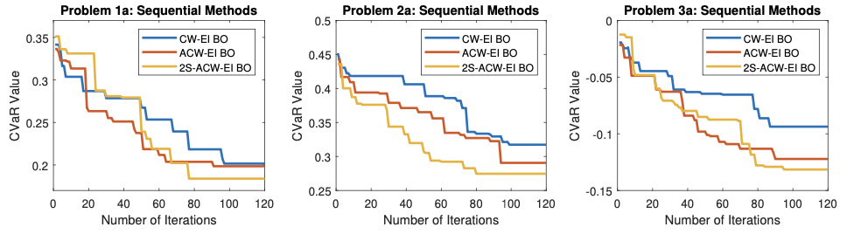
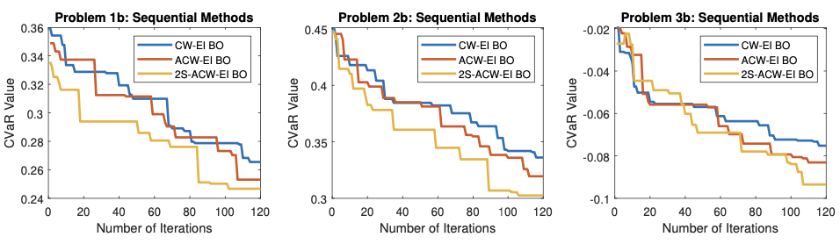
Baseline vs Proposed Method (2S-ACW-EI)
Results: Which Method Wins?
Across all 6 benchmark problems, 2S-ACW-EI (yellow) consistently finds portfolios with lower CVaR and does so with fewer iterations.
In contrast, CW-EI (blue) converges the slowest, while ACW-EI (red) improves but still wastes effort on infeasible portfolios.
Takeaway: The two-stage filtering makes Bayesian Optimization faster, smarter, and more reliable.

Slide 11
Limitations of the Approach
Normal Distribution Assumption
The model assumes that asset returns follow a normal distribution.
In reality, markets often show “fat tails” (extreme events occur more frequently than normal).
This can make risk estimates overly optimistic.
Small Sample Size at Start
The method begins with only 10 initial portfolio weights before optimization.
This may limit result quality if the initial data is not representative.
Heavy Computation on CVaR
Although the new method reduces the number of CVaR evaluations, the calculations remain costly as the number of iterations or batches increases, particularly for large portfolios.
Scalability Issue
The method is best suited for portfolios with a limited number of assets.
Scaling to hundreds of assets in real-world portfolios remains a major challenge.

Slide 12
Open Questions
Beyond Normal Assumption
What happens if we model returns with heavy-tailed or non-Gaussian distributions?
Would the optimization still work as well?
Robustness of the Algorithm
How can this algorithm be adapted to handle cases where the optimal solution does not lie on the constraint boundary, without significantly increasing computational cost?
Scalability
Can this approach handle portfolios with hundreds of assets efficiently?
What adaptations would be needed for large-scale investing?
Parameter Sensitivity
How sensitive are the results to choices like r𝓶а𝒙 or the initial sample size?
Could adaptive tuning improve performance?

