Slide 1
Visualization Tools Instructor: Md Rafiul Islam
Three advance data visualization tools in python:
Waffle Chart
Word Clouds
Seaborn
Download:
https://tinyurl.com/yw6kv866
https://github.com/m-rafiul-islam/uiw-ds
https://www.dropbox.com/sh/xpul6b8610mep88/AACS1W-eQfaAzraN40Th5JDBa?dl=0

Slide 2
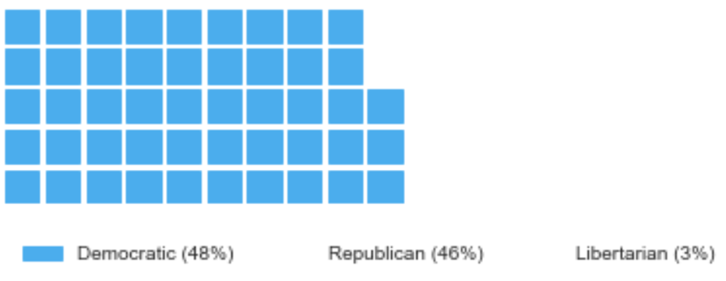
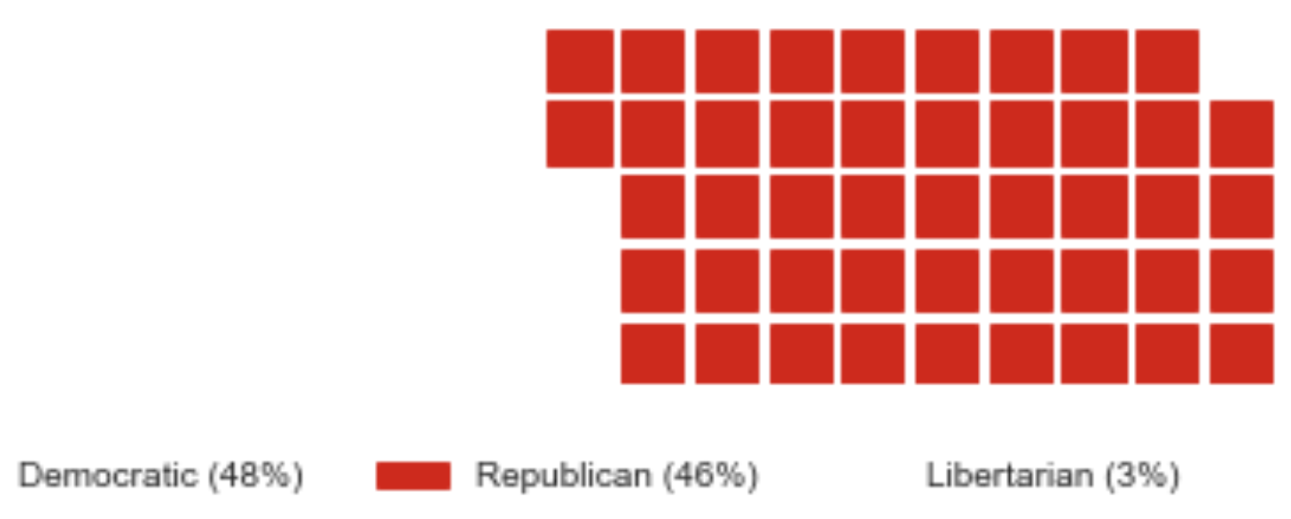
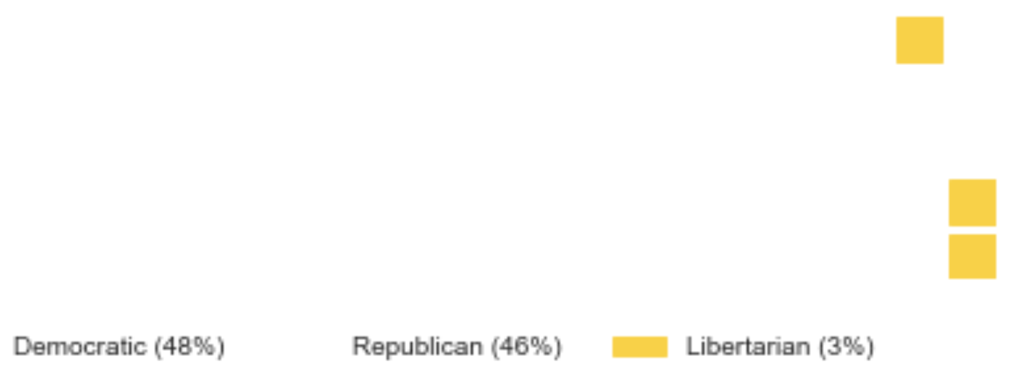
Waffle Charts:
What is a waffle charts?
- A waffle chart is a great way to visualize data in relation to a whole or to highlight progress against a given threshold.
Vote Percentage in 2016 US Presidential Election
Democratic: 48
Republican: 46
Libertarian: 3

Slide 3
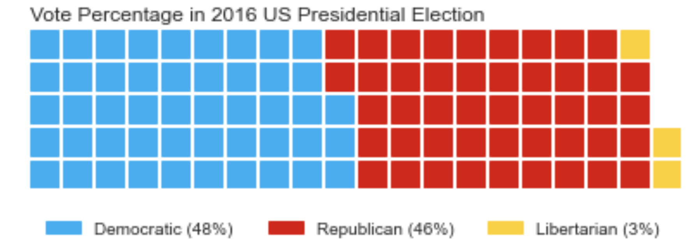
Waffle Charts:
What is a waffle charts?
- A waffle chart is a great way to visualize data in relation to a whole or to highlight progress against a given threshold.
Vote Percentage in 2016 US Presidential Election
Democratic: 48
Republican: 46
Libertarian: 3

Slide 4
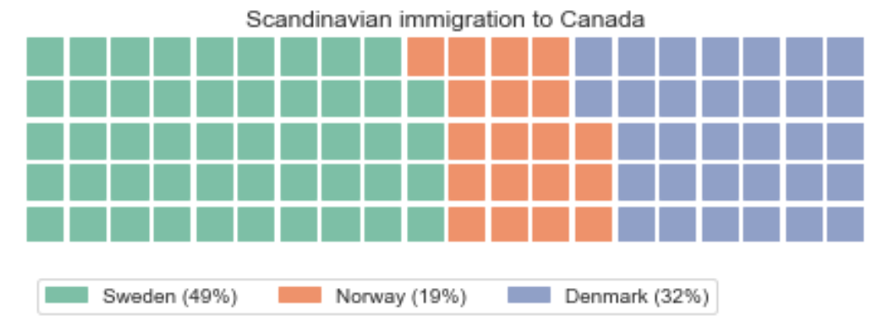
Contribution of Scandinavian immigration to Canada
Country | Contribution
Sweden | 49%
Norway | 19%
Denmark | 32%

Slide 5
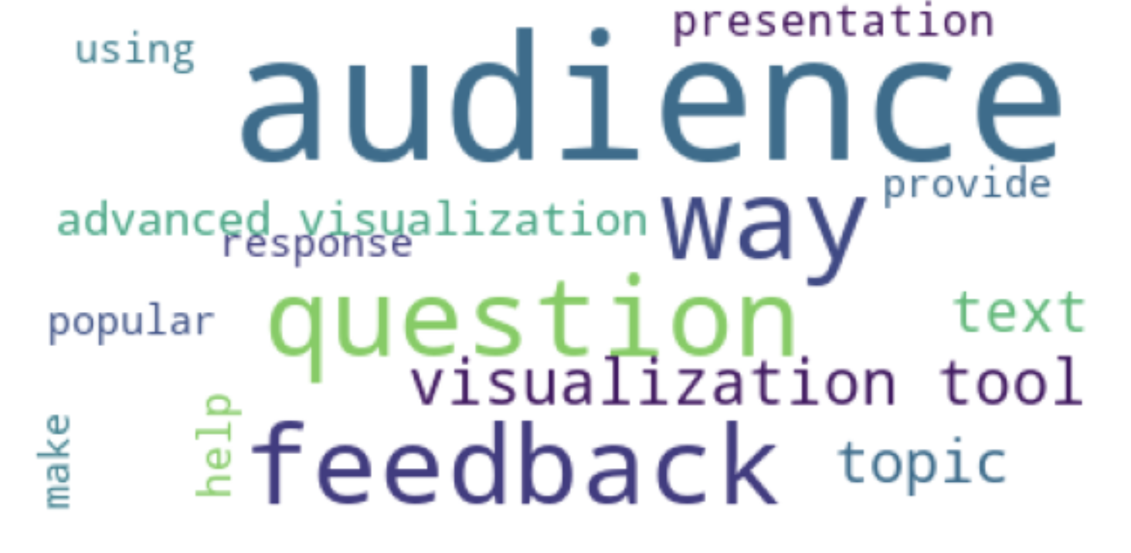
Word Clouds
What is a Word Cloud?
A word cloud (also known as a tag cloud) is a visual representation of words (some textual data).
This word could is crated using one of the text that shared with you.
Can you get an idea about the topic of the text file?

Slide 6
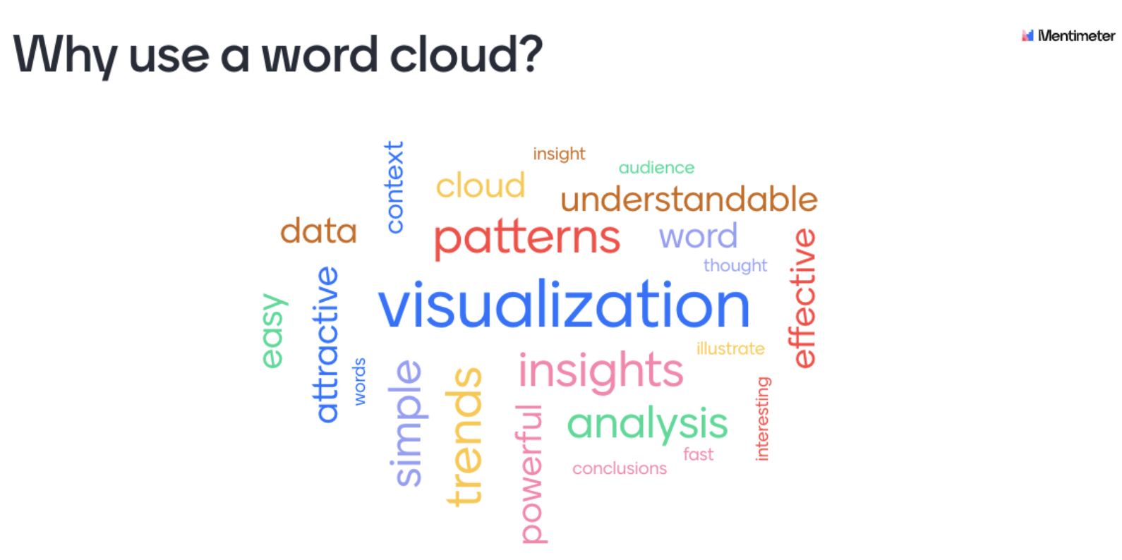

Slide 7
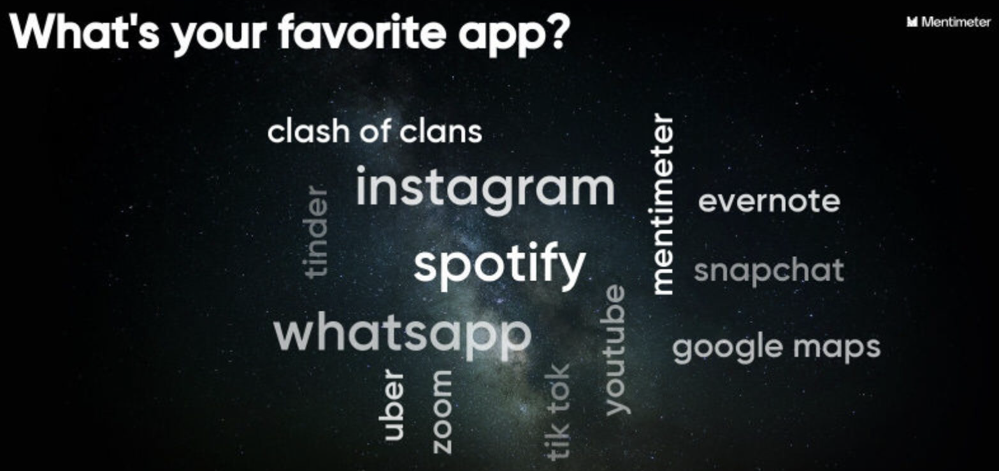

Slide 8
Seaborn
Seaborn is based on Matplotlib
It provides a high-level interface for drawing attractive and informative statistical graphics.
Regression plot
Heatmap
Scatter plot
Bar plot
Facet grid and many more
Advantages of seaborn:
A lot of build-in datasets
Easy to code and easy to customize using all the matplotlib features

Slide 9
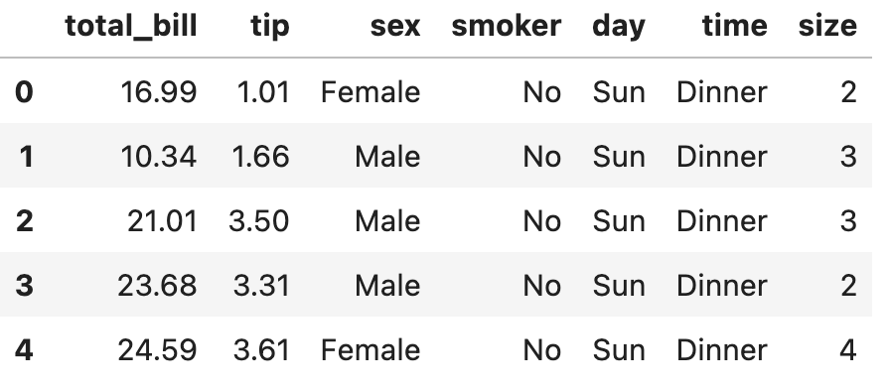
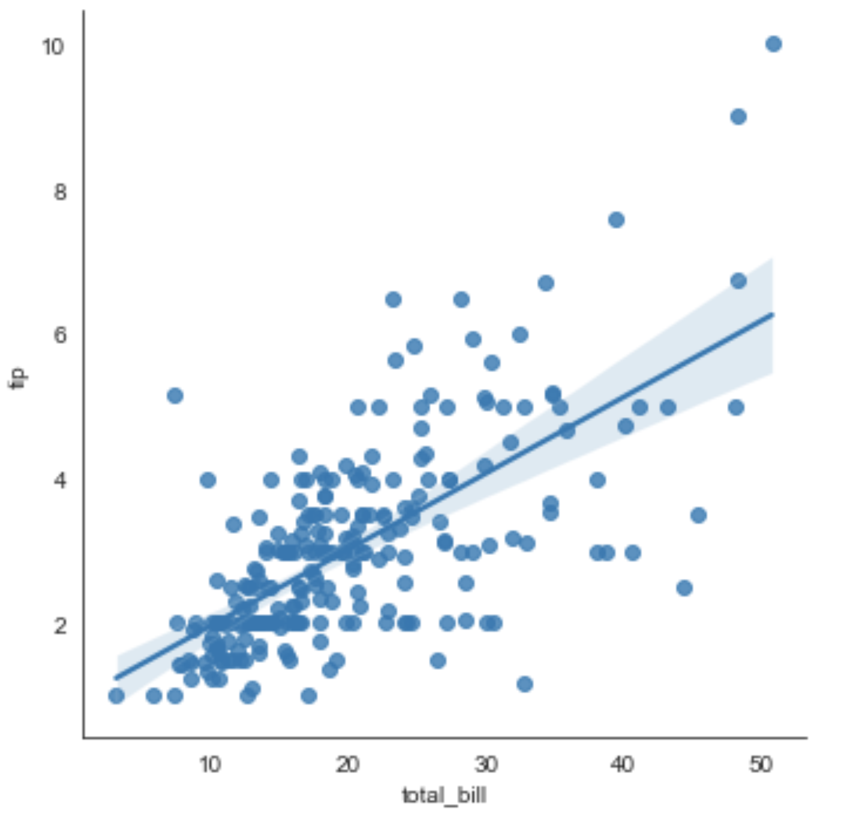
Regression Plots (lmplot)

