Slide 1
Welch-T-Test
Meli & Vlad & Gui

Slide 2
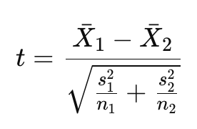
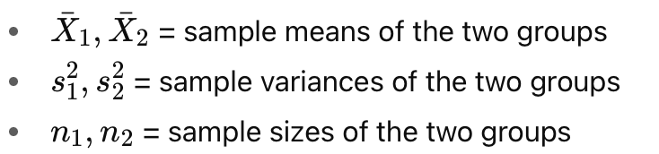
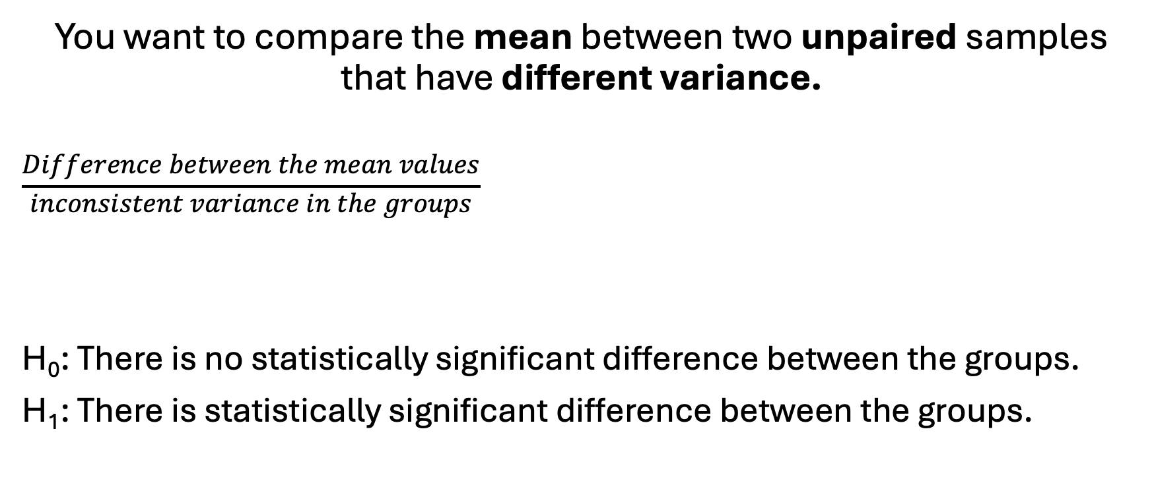
Definition
You want to compare the mean between two unpaired samples that have different variance.
$$\frac{Difference between the mean values}{inconsistent variance in the groups}$$
H₀: There is no statistically significant difference between the groups.
H₁: There is statistically significant difference between the groups.

Slide 3
Example:
We want to know if the result to a test is significant between two classes that have two different teacher for the same statistic course.
H₀: There is no statistically significant difference between the grades of class A and class B.
H₁: There is statistically significant difference between the grades of class A and class B

Slide 4
Process
Sample have to be >50
Variable should be normally distributed
Test using q-q plot
Test using probability density function (PDF)
T-Test
T-Value = wich mean is the biggest
P-Value = significance level:
if p<0.05 then we reject H₀

Slide 5
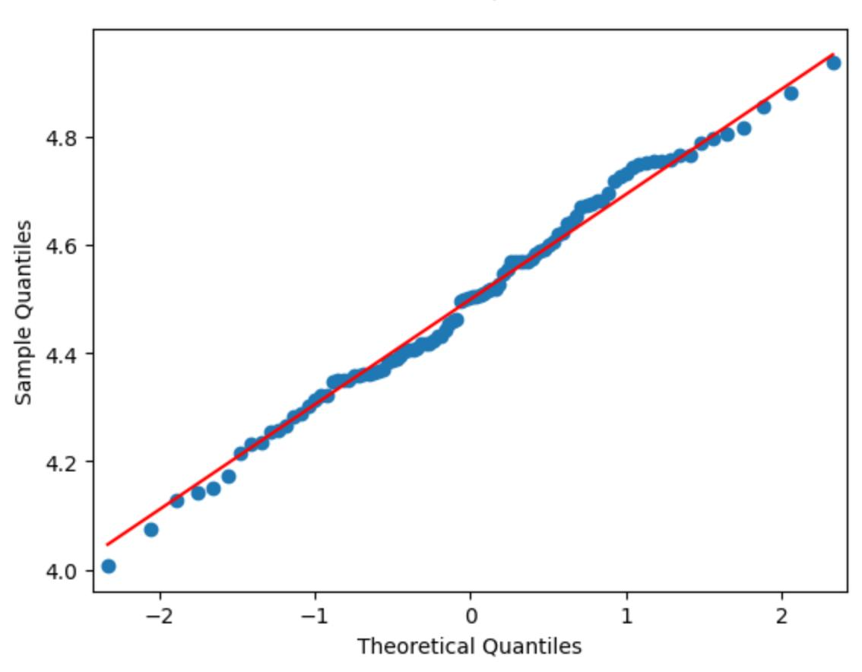
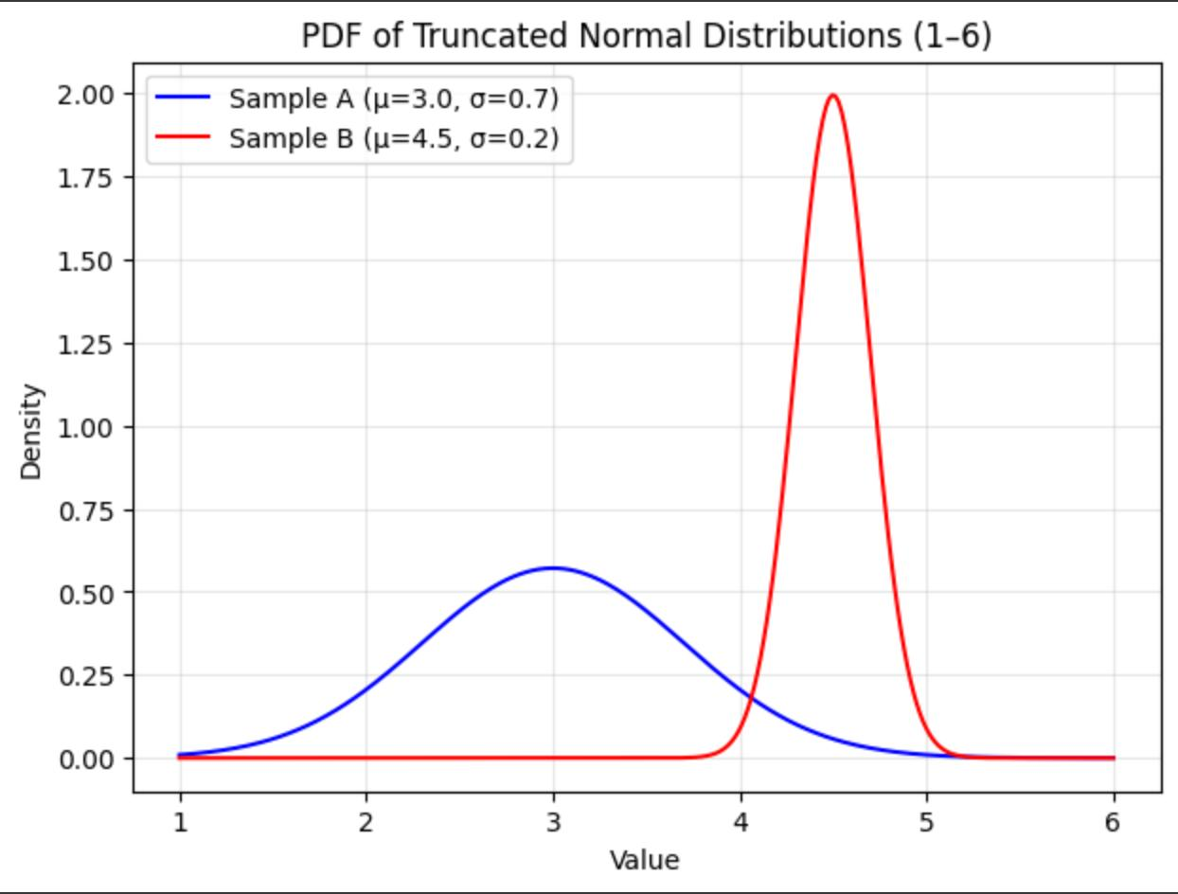
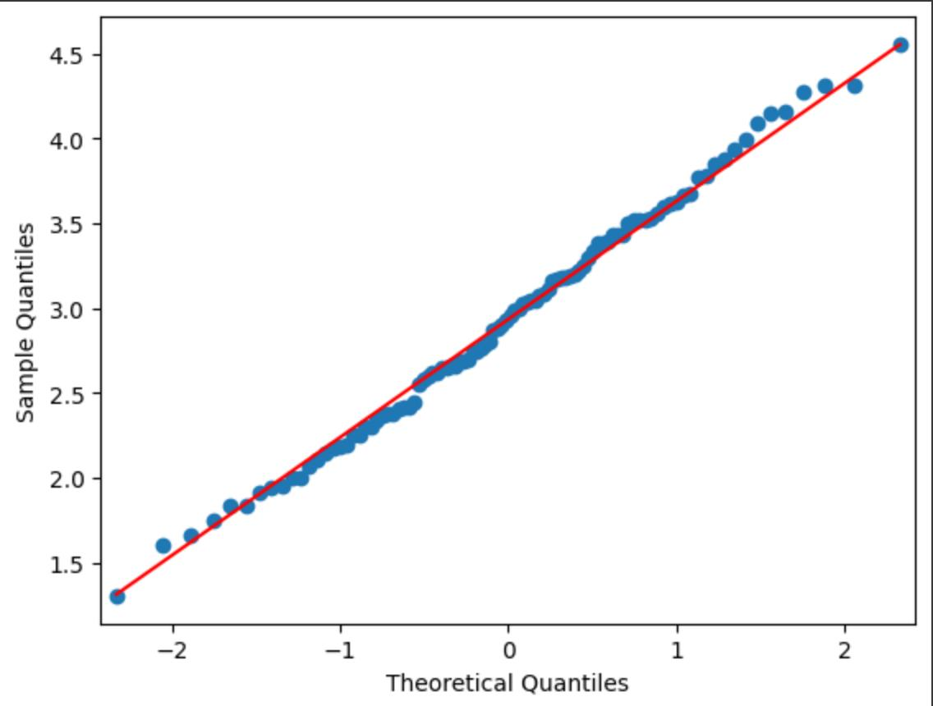
Example with data
Sample have to be >50
Variable should be normally distributed
T-Test
n₁ = 100
n₂ = 100

Slide 6

Example with data
Sample have to be >50
Variable should be normally distributed
T-Test
H₀: There is no statistically significant difference between the grades of class A and class B.
H₁: There is statistically significant difference between the grades of class A and class B
P-value < 0.05 so we can reject H₀

Slide 7
Code in Python:
import numpy as np
import matplotlib.pyplot as plt
from scipy.stats import truncnorm, ttest_ind
import statsmodels.api as sm
# --- Function to generate truncated normal sample ---
def normal_tronquee(n, mu, sigma, min_val, max_val):
a, b = (min_val - mu) / sigma, (max_val - mu) / sigma
return truncnorm.rvs(a, b, loc=mu, scale=sigma, size=n)
# --- Parameters ---
np.random.seed(42)
n = 100
mu_A, sigma_A = 3.0, 0.7 # Sample A : mean=3.5, low variance
mu_B, sigma_B = 4.5, 0.2 # Sample B : mean=4.5, higher variance
min_val, max_val = 1, 6
# --- Generate samples ---
notes_A = normal_tronquee(n, mu_A, sigma_A, min_val, max_val)
notes_B = normal_tronquee(n, mu_B, sigma_B, min_val, max_val)
print("Sample A: mean =", notes_A.mean(), "var =", notes_A.var(ddof=1))
print("Sample B: mean =", notes_B.mean(), "var =", notes_B.var(ddof=1))
# --- PDF Plot ---
x = np.linspace(min_val, max_val, 300)
pdf_A = truncnorm.pdf(x, (min_val-mu_A)/sigma_A, (max_val-mu_A)/sigma_A, loc=mu_A, scale=sigma_A)
pdf_B = truncnorm.pdf(x, (min_val-mu_B)/sigma_B, (max_val-mu_B)/sigma_B, loc=mu_B, scale=sigma_B)
plt.figure(figsize=(7,5))
plt.plot(x, pdf_A, label=f"Sample A (μ={mu_A}, σ={sigma_A})", color="blue")
plt.plot(x, pdf_B, label=f"Sample B (μ={mu_B}, σ={sigma_B})", color="red")
plt.title("PDF of Truncated Normal Distributions (1–6)")
plt.xlabel("Value")
plt.ylabel("Density")
plt.legend()
plt.grid(True, alpha=0.3)
plt.show()
# --- QQ-plot comparing the two samples ---
plt.figure(figsize=(6,6))
sorted_A = np.sort(notes_A)
sorted_B = np.sort(notes_B)
figA=sm.qqplot(sorted_A, line='s')
figB=sm.qqplot(sorted_B, line='s')
# --- Welch t-test ---
t_stat, p_val = ttest_ind(notes_A, notes_B, equal_var=False)
print("t-statistique =", t_stat)
print("p-valeur =", p_val)

