Slide 1
Tourism Recommender system
Toronto Downtown

Slide 2
Business Goal:
Analyse and suggest the place to establish a set up centre for an International Tourism company in Toronto with detailed statistics..

Slide 3
Data Sources:
Postal codes and boroughs data in Toronto with all Neighbourhoods.
Latitude and Longitude details
Foursquare location API(Third party Tool) to get the venue details and some python packages

Slide 4
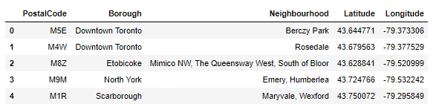
The Typcial Data Format

Slide 5
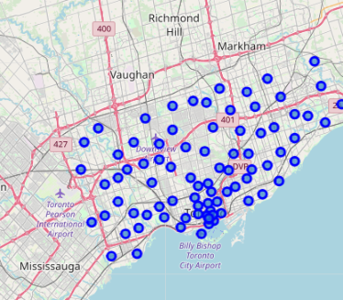
Geographical Representation

Slide 6
Deep drive to Toronto

Slide 7
Key Statistics:
Downtown Toronto is one of popular business place.
It has more than 190 commercial places in 1000 radius
Famous Restaurant and visiting places
Good Travel facility and it has near Airport
‘Berczy Park’ is one of the most favourable neighbourhood in downtown area.

Slide 8
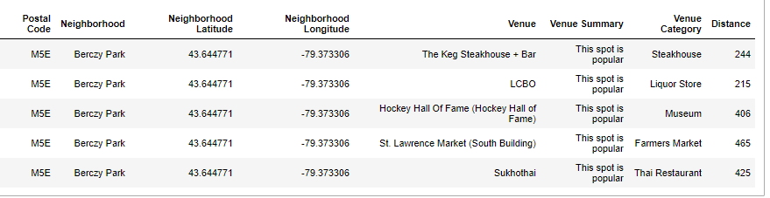
Neighborhood:Berczy Park

Slide 9
Most visited Venues near downtown Toronto
Museum
Steakhouse
Art Gallery
Lake
Harbor / Marina
Indian Restaurant, etc,,m

Slide 10
Result:
Downtown Toronto:
one of the main businesses spot
huge business culture
various attractive tourism places of different kinds

Slide 11
Conclusion:
It is indeed a good choice to set up the tourism branch in downtown Toronto
It is also good business destination for food and supply chain vendors.
Analysis says it has satisfactory levels.

Slide 12
THANK YOU

