Slide 1
03
Achleshwar Luthra: achleshl
Jay Karhade: jkarhade
Richa Mishra: richamis

Slide 2
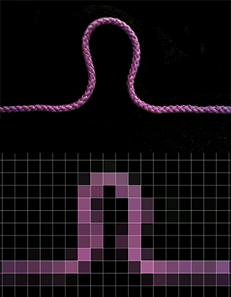
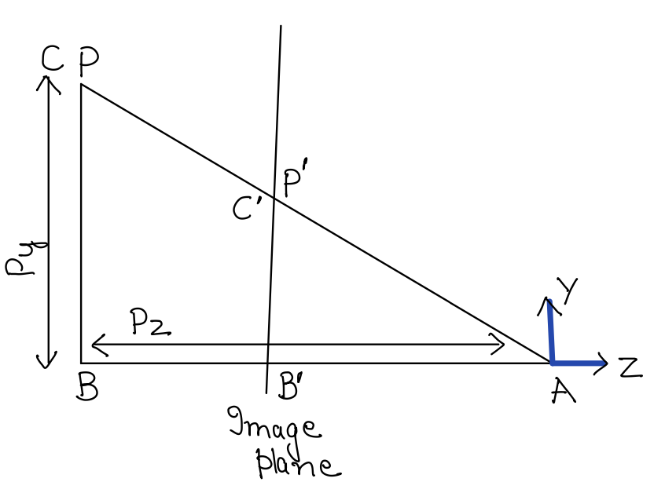
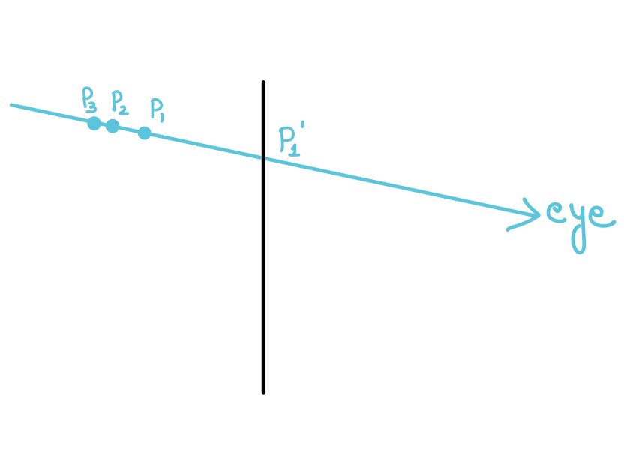
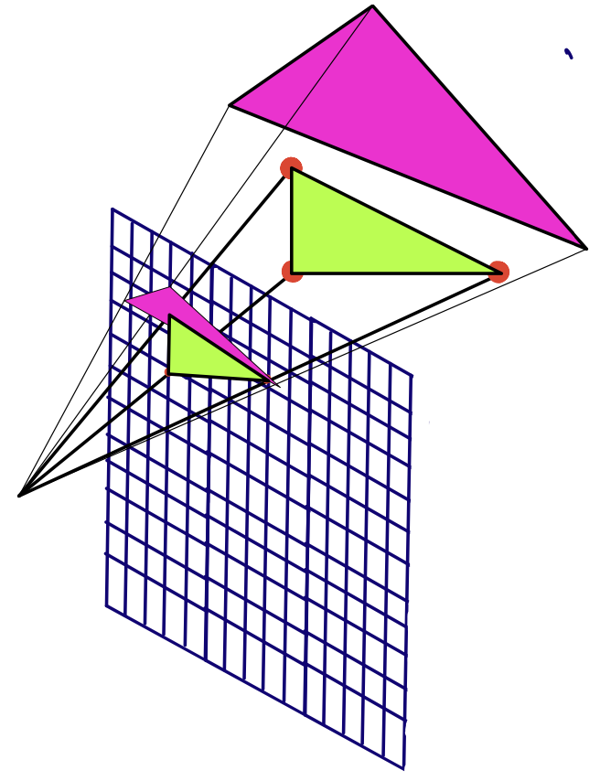
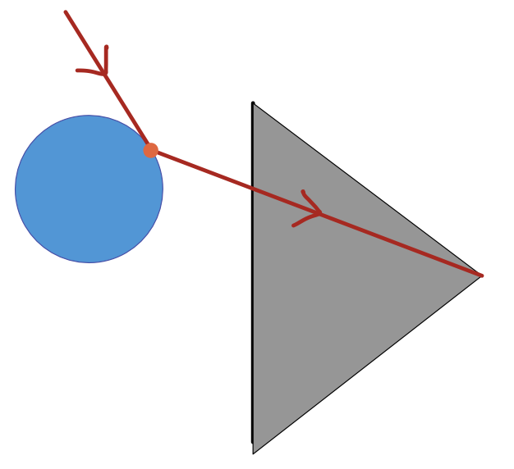
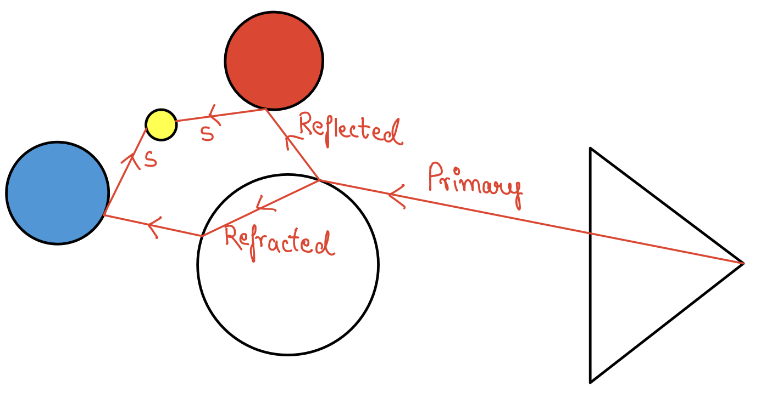



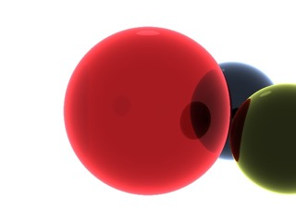



Photorealistic images
Foreshortening effect → Perspective projection
Visibility problem → Ray tracing and rasterization
Light simulation → Shading reflection and refraction(light transport); Fresnel equations
3D scene (geometry)
Camera
Light
Fig: 1
Simple ray- tracer
Fig1: https://www.scratchapixel.com/lessons/3d-basic-rendering/rendering-3d-scene-overview

Slide 3
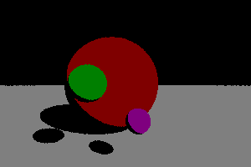
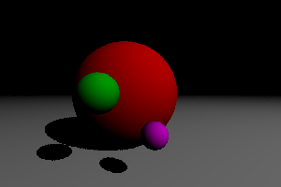
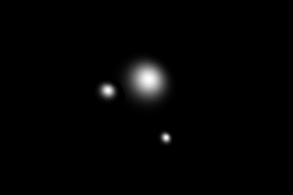

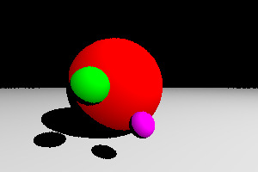
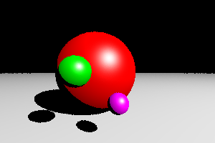
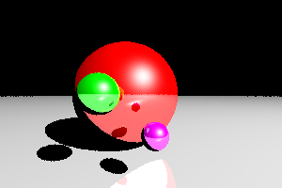
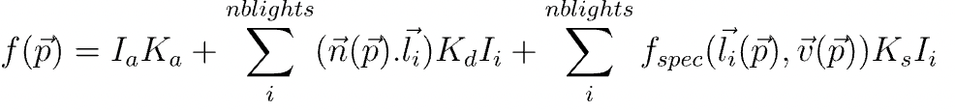
Blinn-Phong Shading
Ambient
Diffuse
Specular
Reflection

Slide 4
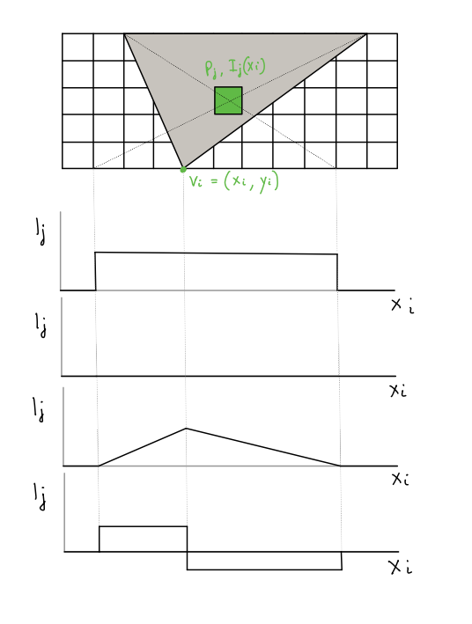
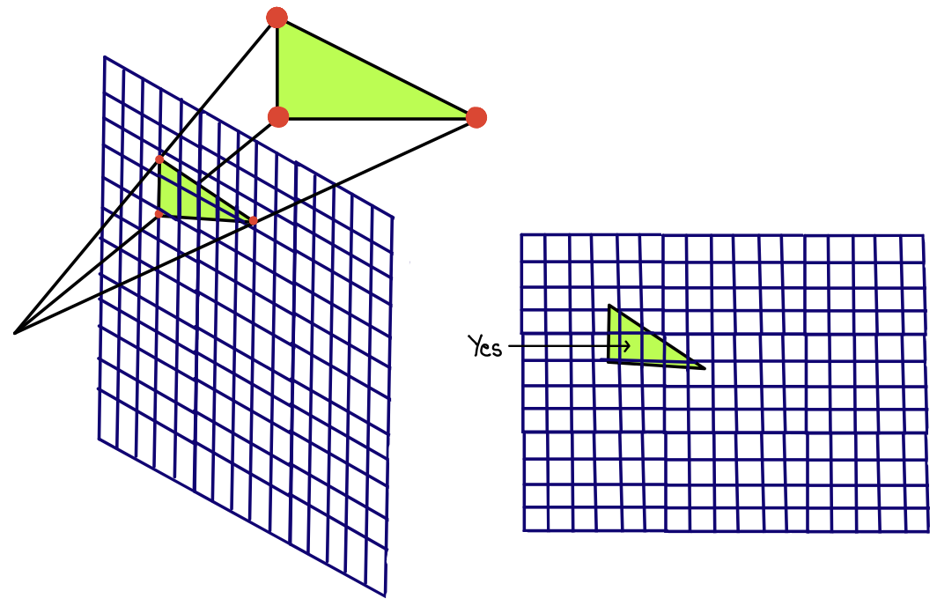
Rasterization & Differentiable Rendering
Frame-buffer
Z-buffer
Visibility
Shading
Forward pass of rasterization
Derivative of A
Modification of A
Derivative of C

