Slide 1






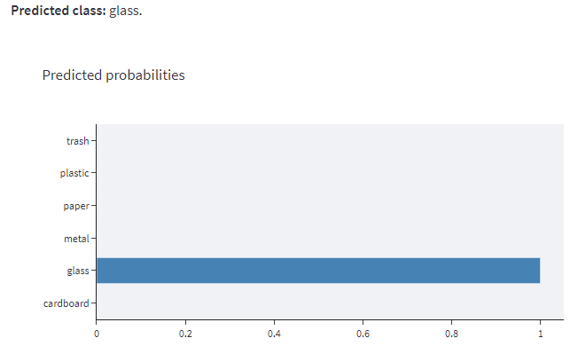
APPLICATION
Amazon EC2
USER
Accesses URL and uploads an image
Docker
Front-end Streamlit
Sends predicted probabilities and class
Classification model

