Slide 1

mat-PLOT-lib
MATLAB($) + plot + library
https://matplotlib.org/stable/
Making figures
with python (free)
observational data
2D CCD image data
MUSE 3D data cube
spectroscopy
photometry techniques
raw data from telescopes
archival data
simulate observations
Dr. Maria B. Stone
Astronomer and writer in Helsinki
astronomygo.com
python self-learner
my experience

Slide 2

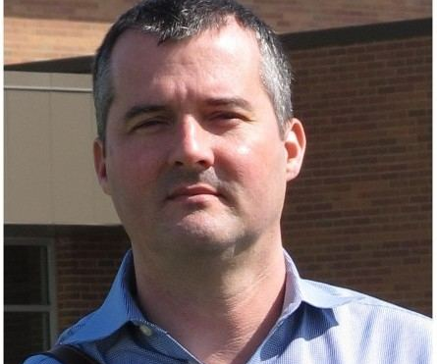
CONNECT with the human behind the software
John Hunter (1968-2012)
matplotlib
Code/Astro workshop
2025
neurobiologist
@Article{Hunter:2007,
Author = {Hunter, J. D.},
Title = {Matplotlib: A 2D graphics environment},
Journal = {Computing in Science \& Engineering},
Volume = {9},
Number = {3},
Pages = {90--95},
abstract = {Matplotlib is a 2D graphics package used for Python for
application development, interactive scripting, and publication-quality
image generation across user interfaces and operating systems.},
publisher = {IEEE COMPUTER SOC},
doi = {10.1109/MCSE.2007.55},
year = 2007
}
University of Chicago
If Matplotlib contributes to a project that leads to a scientific publication, please acknowledge this fact by citing J. D. Hunter, "Matplotlib: A 2D Graphics Environment", Computing in Science & Engineering, vol. 9, no. 3, pp. 90-95, 2007.
Source: matplotlib website and wikipedia

Slide 3
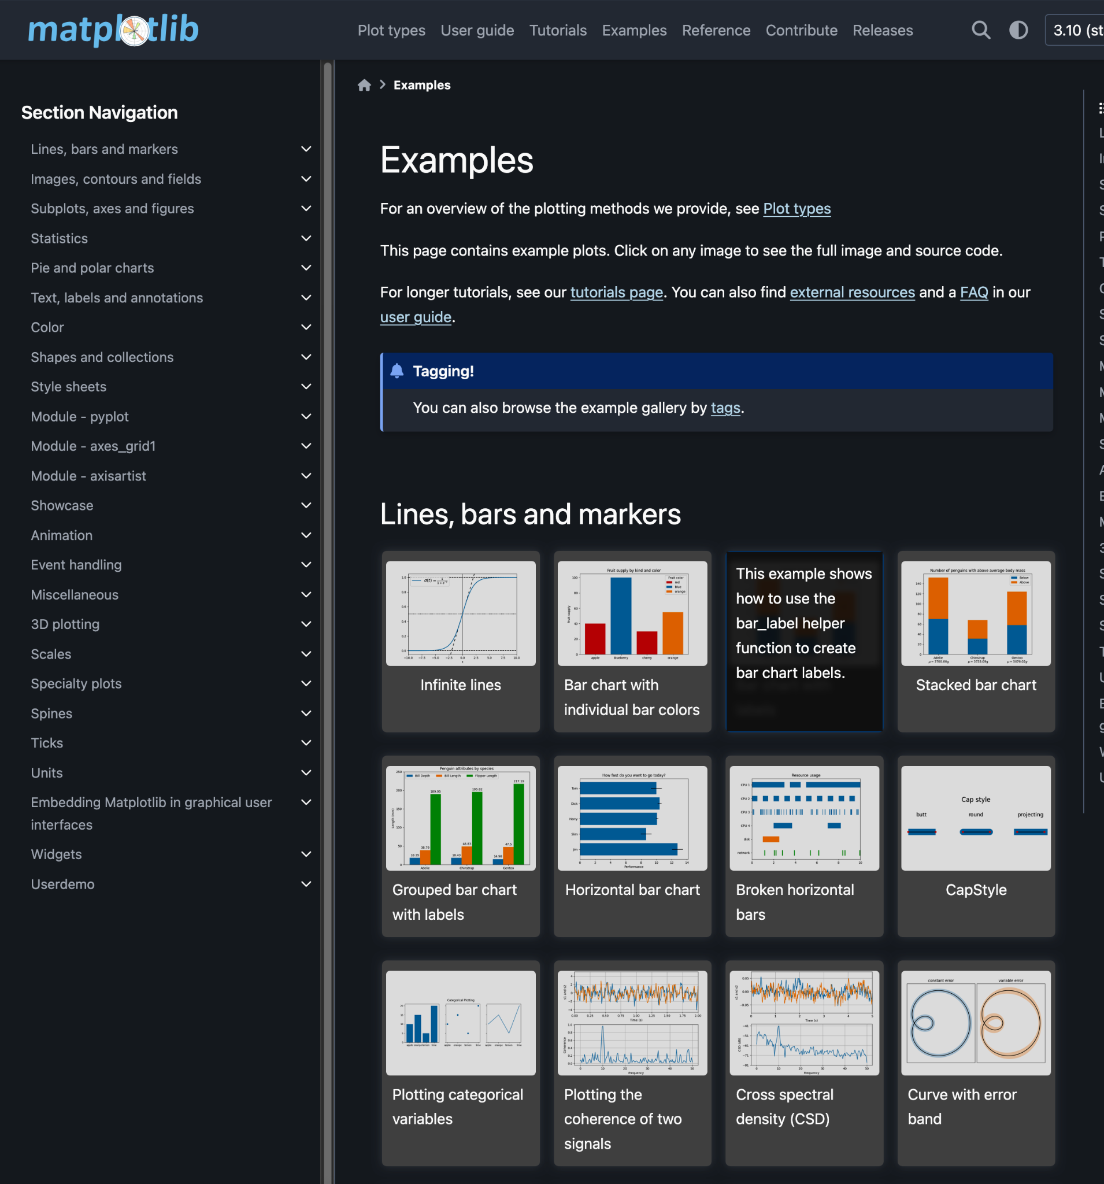
CONNECT with the human behind the software
John Hunter (1968-2012)
matplotlib
Code/Astro workshop
2025
Tip 1
Learning by doing
matplotlib
examples
neurobiologist
@Article{Hunter:2007,
Author = {Hunter, J. D.},
Title = {Matplotlib: A 2D graphics environment},
Journal = {Computing in Science \& Engineering},
Volume = {9},
Number = {3},
Pages = {90--95},
abstract = {Matplotlib is a 2D graphics package used for Python for
application development, interactive scripting, and publication-quality
image generation across user interfaces and operating systems.},
publisher = {IEEE COMPUTER SOC},
doi = {10.1109/MCSE.2007.55},
year = 2007
}
University of Chicago
If Matplotlib contributes to a project that leads to a scientific publication, please acknowledge this fact by citing J. D. Hunter, "Matplotlib: A 2D Graphics Environment", Computing in Science & Engineering, vol. 9, no. 3, pp. 90-95, 2007.
Source: matplotlib website and wikipedia

Slide 4
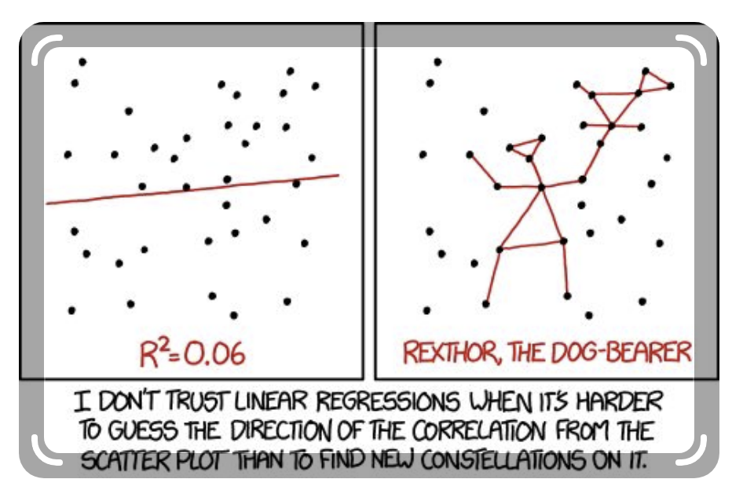
CONNECT with the human behind the software
John Hunter (1968-2012)
matplotlib
Code/Astro workshop
2025
Tip 2
It’s not
voodoo,
it’s API!!
two styles of using matplotlib, be mindful when searching online for solutions!
https://matplotlib.org/stable/users/explain/figure/api_interfaces.html#api-interfaces
neurobiologist
University of Chicago
If Matplotlib contributes to a project that leads to a scientific publication, please acknowledge this fact by citing J. D. Hunter, "Matplotlib: A 2D Graphics Environment", Computing in Science & Engineering, vol. 9, no. 3, pp. 90-95, 2007.
Comic from Pinterest
https://medium.com/@nikhil_garg/a-compilation-of-comics-explaining-statistics-data-science-and-machine-learning-eeefbae91277
Source: matplotlib website and wikipedia

Slide 5
Plan : 3 activities tips
matplotlib
Code/Astro workshop
2025
Outline
What is going to happen in this session?
Independent practice with LIVE TAs :D
Activities A, B, C
Simple to more Complex
You can
choose your activity
start from whichever one you want
follow basic to more complex A-B-C
You can move forward independently

Slide 6
Choose from 3 activities
matplotlib
Code/Astro workshop
2025
Advanced details
Just a graph
Side Panels
Customize
Scatter plot
Histogram

Slide 7
Make a simple scatter plot with both APIs
matplotlib
Code/Astro workshop
2025
Just a graph
Scatter plot

Slide 8
words matter
We are building a histogram, but using “bars”
matplotlib
Code/Astro workshop
2025
Distributions
Histogram

Slide 9
In the rest of the tutorial,
we dive into
nitty-gritty details of matplotlib
matplotlib
Code/Astro workshop
2025
Details, details

Slide 10
Accessibility
matplotlib
Code/Astro workshop
2025
Visuals and beyond
Awareness (Enchroma site)
There are many different types of color vision deficiencies
More common than you think!
Main tip: Use symbols, patterns (Harvard article).
Accessibility of your data visualization matters!
Color-blindness simulator
Pilestone.com simulator
Contrast checker

Slide 11
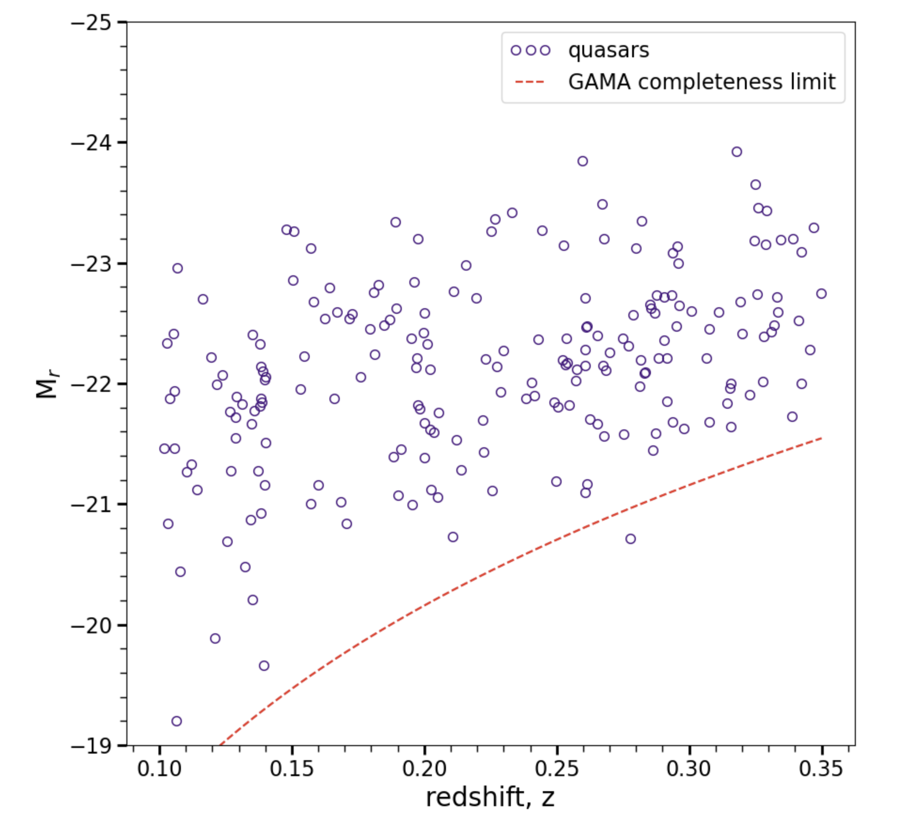
Tips
matplotlib
Code/Astro workshop
2025
Do’s
steal like an artist
Don’ts
more bright magnitudes on the top, while the value is more negative
%matplotlib inline
Use matplotlib examples to find solutions.
alpha parameter (transparency of the color)
Save figures, e.g., for publications: plt.savefig("figure_z_vs_Mr.pdf")
$\AA$ for Angstrom units symbol in labels, etc.
check examples in other papers to see how your plot is designed, e.g. magnitudes from dim to bright
Don’t forget to acknowledge / cite.
Don’t ignore accessibility tips, e.g. for color-blind.
Don’t worry if your solution is different, as long as it works for you, it’s okay!
figure from M. Stone PhD Thesis

Slide 12
Other tips - pretty plots :)
import matplotlib.gridspec as gridspec
from matplotlib.colorbar import Colorbar
import seaborn as sns
Accessibility
https://www.a11y-collective.com/blog/accessible-charts/
https://www.highcharts.com/blog/tutorials/10-guidelines-for-dataviz-accessibility/
https://itaccessibility.uiowa.edu/dataviz#accordion-item-436-3
https://dataservices.library.jhu.edu/wp-content/uploads/sites/41/2024/03/24LDW_AccessibleDataViz_02-2024_NancyShin.pdf (good examples in the end)

Slide 13
Vote (20 seconds to write in comments)
matplotlib
Code/Astro workshop
2025
Which style do you prefer?
A
ax.plot
B
plt.plot
C
____ (other thoughts)

