Slide 1
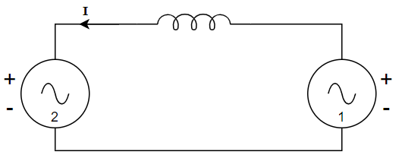






$$jx_{s}$$
$$|E|∠δ_{2}$$
$$V_{g}∠0$$
infinite bus
$$jx_{s}$$
$$|E_{2}|∠δ_{2}$$
$$|E_{1}|∠0$$

