Slide 1

Car Market Trends Analysis with CarDekho Data
AICTE STU ID : STU6a59f4de962011784280286
MUHAMMAD SHAFEEQ

Slide 2

PROBLEM STATEMENT
Used-vehicle buyers and sellers on platforms like CarDekho have no easy way to judge whether a listed price is fair.
Resale value depends on many interacting factors — age, mileage, fuel type, transmission, ownership history — and guessing leads to overpaying or underselling.
Goal: analyze 301 real CarDekho listings (cars + two-wheelers) to quantify these price and depreciation patterns and answer 25 concrete business questions about the market.

Slide 3
Project Description
This project evaluates 301 real vehicle listings from CarDekho using 200 car and 101 two-wheeler samples with Python and Pandas. After cleaning and profiling the data, 25 business questions covering price brackets, missing data, fuel/transmission/ownership type, and most importantly, what causes depreciation, were answered. Correlation analysis helps to understand the impact of age, mileage, and ownership on resale value, whereas a simple regression baseline identifies listings that sold above the expectations, and thus identifies the best deals in the given dataset.

Slide 4

WHO ARE THE END USERS?
Used-vehicle buyers — checking whether an asking price is reasonable for the age/mileage.
Individual sellers — pricing their car or bike competitively before listing.
Dealers & CarDekho's own pricing team — calibrating valuation models.
Insurance & finance companies — estimating depreciation for loan/insurance valuations.

Slide 5

Technology Used
Python 3 + google colab
Pandas & NumPy — data cleaning, grouping, correlation, regression
Matplotlib — charts and visualizations
CSV — CarDekho dataset (301 records, 9 fields)

Slide 6
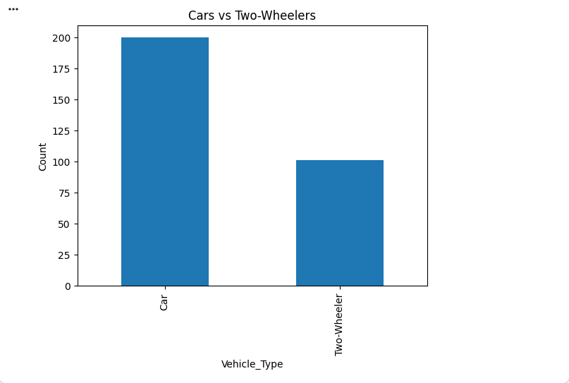
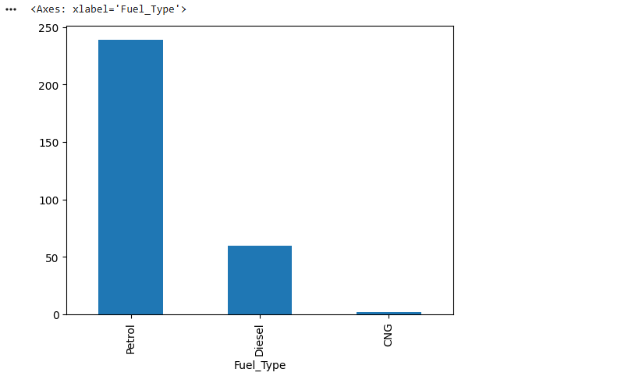
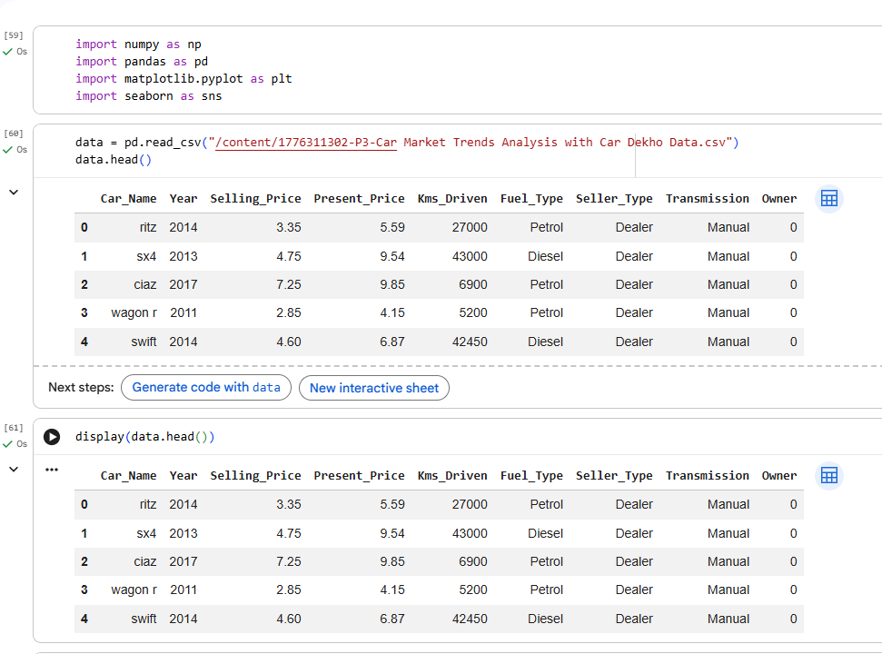
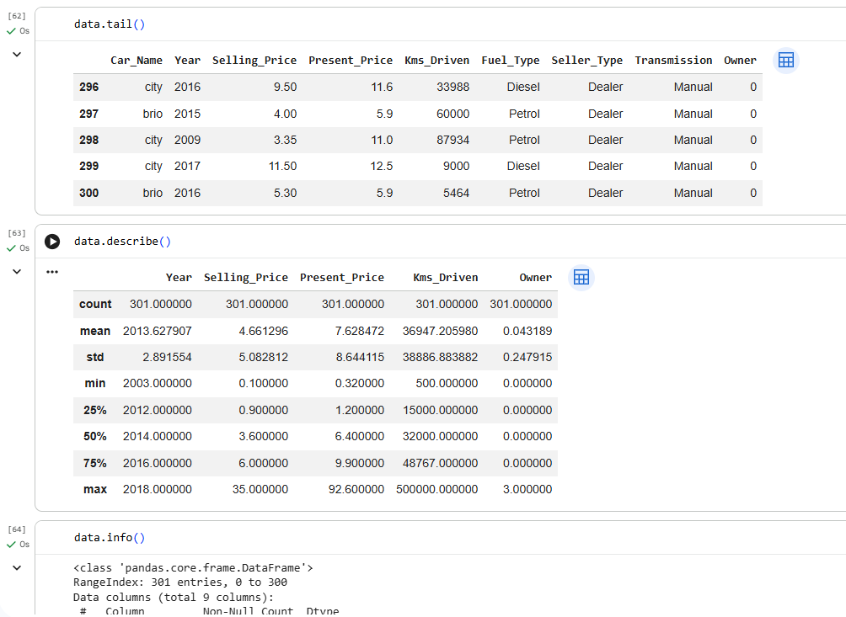
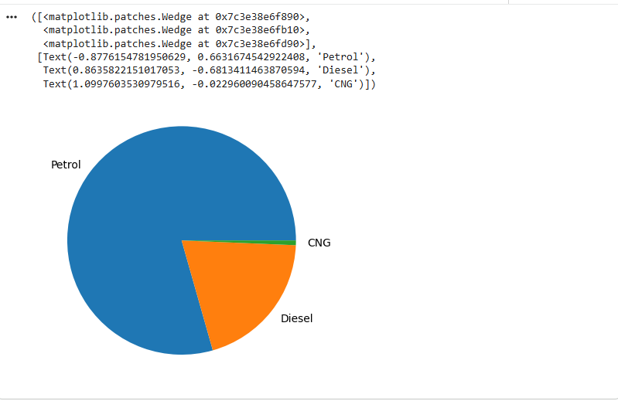
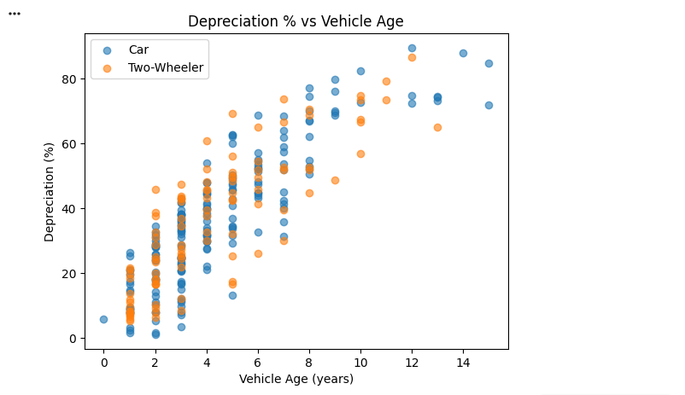
RESULTS
https://github.com/m-shafeeq/Car-Market-Trends-Analysis-with-Car-Dekho-Data
https://colab.research.google.com/github/m-shafeeq/Car-Market-Trends-Analysis-with-Car-Dekho-Data/blob/main/Copy_of_Car_Market_Trends_Analysis_with_Car_Dekho_Data.ipynb

Slide 7
Thank you
.
.

