Slide 1
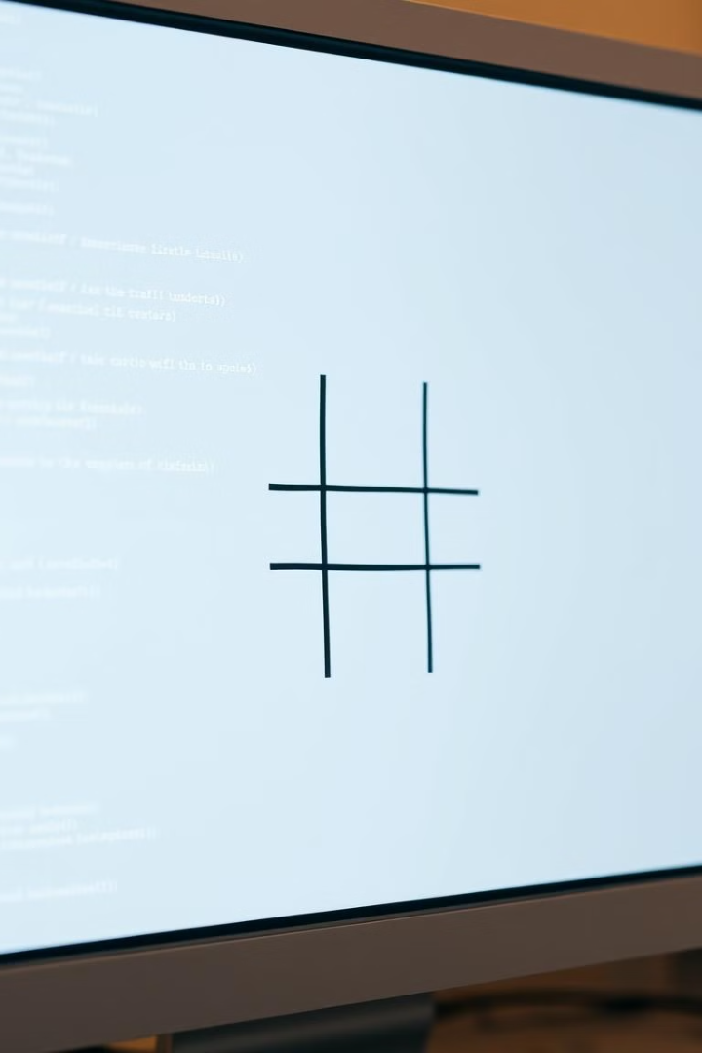
Tic-Tac-Toe Game in DSA
BY :
M SHALOM VISHAL
O SAKETH KUMAR REDDY

Slide 2
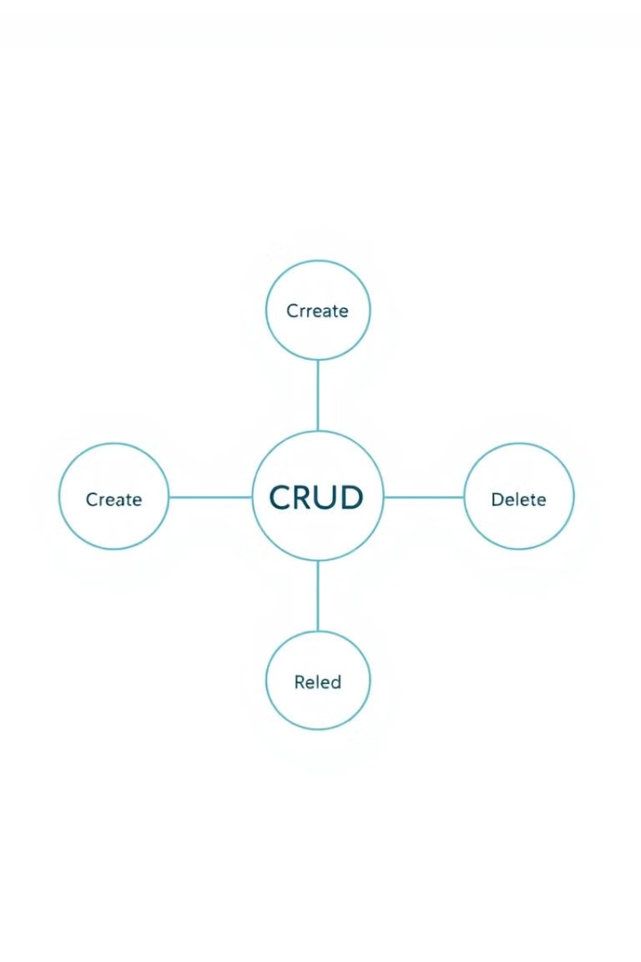
CRUD Operations
The game uses CRUD operations. These operations are fundamental to the game's logic.
Create
Initializes the game board. Sets up the game state.
Read
Displays the current board state to players.
Update
Modifies the board when a player makes a move.
Delete
Resets the game board after a game.

Slide 3
Key Functions
Several functions drive the game logic. Each function has a specific role.
display_board()
player_move()
check_win()
check_draw()
Renders the Tic-Tac-Toe board on the screen.
Handles player input. Updates the game board.
Evaluates the board. Determines if there is a winner.
Determines if all spaces are filled.

Slide 4
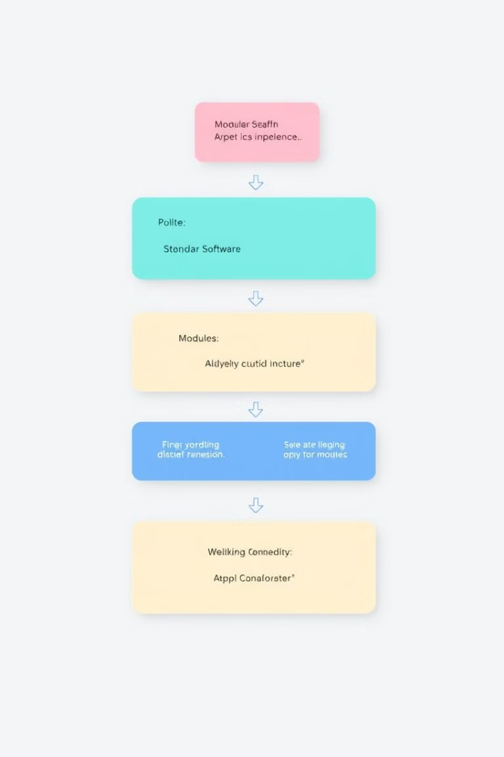
Code Structure
The code is structured for clarity. It uses modules for maintainability.
1
Modular Design
2
Specific Tasks
Enhances readability.
Functions handle input, display, and win checks.
3
Commenting
Documentation standards are followed.

Slide 5

Challenges and Solutions
We faced challenges during development. We overcame them with careful solutions.
1
Input Validation
Ensured valid coordinates from the user.
2
Win Condition Logic
Correctly identified a winner.
3
Handling Draws
Detected when the game ended in a draw.

Slide 6


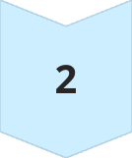

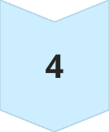
Conclusion and Enhancements
The project achieved its objectives. There's scope for future enhancements.
AI Opponent
Implement an AI to play against.
GUI
Create a Graphical User Interface.
Multiplayer
Enable playing against another person.
Score Tracking
Keep track of scores and statistics.

