Slide 1
GitLyzer: Enabling efficient and simple program analysis of Software Repositories
Muhammad Shayan

Slide 2
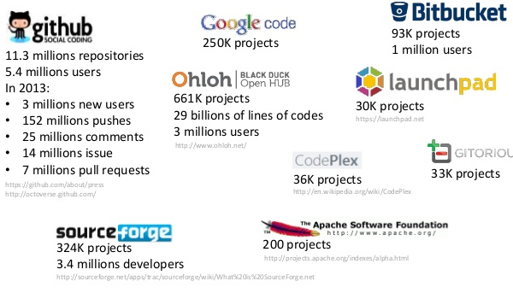
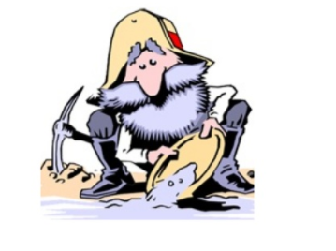
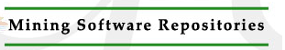
Repositories of Repositories

Slide 3
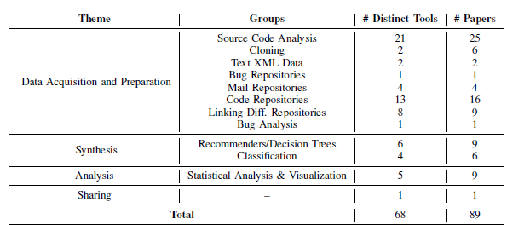
Source Code Analysis is KING

Slide 4
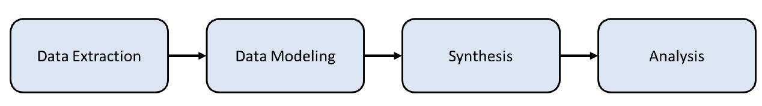
Anatomy of a MSR Paper
Github API
GHTorrent
Static/Dynamic analysis
using various tools
Classification
Similarity Matching
Clustering
Manual verification
of results

Slide 5
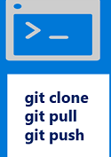

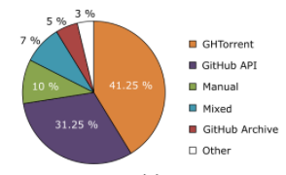
Tools Available
Git API
GHTorrent DB
Tools used in MSR papers

Slide 6

Anatomy of a MSR Paper
???
Github API
GHTorrent
Static/Dynamic analysis
using various tools
Classification
Similarity Matching
Clustering
Manual verification
of results

Slide 7
The Problem: Lack of a general purpose API to help MSR researchers analyze source code quickly and efficiently

Slide 8
Anatomy of a MSR Paper
Lets package these tasks together as an API and provide them with
MSR Researchers to use

Slide 9
Project objective:
Design and implement a general purpose API that allows MSR people to perform static analysis on github repos

Slide 10





Architecture
GH Torrent
MSR
Researcher
Query
Engine
Intermediate
Representation
Static
Analysis
Source Code
Github

Slide 11
Trend analysis
Evaluation
Get source code of papers using one of the static analysis tasks in an MSR paper in the last 5 years
Implement same static analysis task using GitLyzer API
Compare LOC to see if less work needed

Slide 12
Benefits
Ability to query source code and identify when particular objects were introduced.
Low barrier to entry into MSR by providing an API that will enable rapid prototyping
Allows for development of complicated tools based on analysis of source code

