Slide 1
Smart Snakes
Observation on AI playing snake
By
Mihail Shinder

Slide 2
Game itself
Vector — class implimenting 2d vector with all neccessary methods
Snake and SnakePart — representing snake with position and direction
SnakeController — incapsulates method for getting new direction
FoodProvider — incapsulates method for placing food
SnakeGame — control game rules and score
The game can be played by humans
By running file snake.py

Slide 3
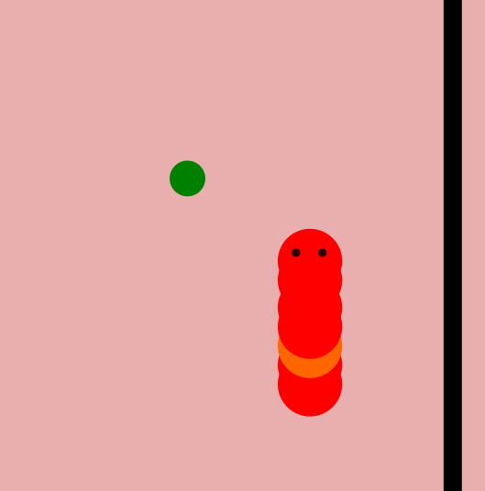
Snake’s brain options
Image recognition
Raycast distance
Raycast objects

Slide 4
Snake’s brain
Raycast distance
New classes:
RaycastSnakeGame — have a raycast method
NeuroController — uses provided network to choose direction
New functions:
get_random_network(shape) — return network of given shape
modify_network(network) — return mutated network
Example can be runned with file neural.py

Slide 5
Harder, Better, Faster, Stronger
Genetic algorithm in a nutshell:
For every generation we choose several best candidates
It is an alternative for fitness function
On next generation every candidate is a modificated version of his ancestor
And should preform a bit different (better or worse)
Via repeating this steps we can gradually increase performance just like evolution

Slide 6
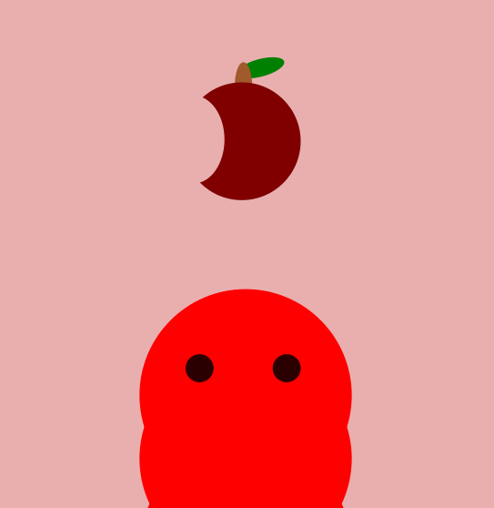
Meet the Adam
Adam is a snake with manually adjusted
(and so way smaller) brain
The modification function does not affects Adam
All snakes on every generation have Adam’s brain
Adam’s brain have shape 5-2-1

Slide 7
Erst kommt das Fressen, dann kommt die Moral.
No matter what fitness function we have choose,
in this kind of network we have to understand what REALLY
are factors of success
In this particular case success depends not on “how smart snake is”
But on “Is food placed well for this snake”.
And since food position is random. Success depends only on it’s luck
Lets make them equal with SequentialFoodProvider

Slide 8
∀ε>0∃N … Limits
Adam’s brain is qute small and does not require many resources.
Even though it turned out that code is unscalable and cannot be runned with many snakes or high speed

Slide 9
Future updates
Use external math library and add off-screen learning
Do propper model saves and loads
Create some tools and visualisation
Add more food
Change fitness function
Make brain symmetrical
Allow snakes fight each other

