Slide 1

Vel Tech Rangarajan Dr. Sagunthala R&D Institute of Science and Technology
School of Computing
Department of Computer Science and Engineering
10211CS224 / FULL STACK APPLICATION DEVELOPMENT (JAVA)
PROJECT REVIEW : MILESTONE PROJECT – 2
Date: 22-04-2026
Events Campus Portal
SDG: 4 – Quality Education
Courses Handling Faculty:
Dr. S.Hemamalini.,M.E.,Ph.D
Assistant Professor(enior Grade)
Presented By:
K LIKITH KUMAR – VTU24742– 23UECS1104.

Slide 2
INTRODUCTION
-The Smart Campus Event Management System is designed to simplify and automate the process of organizing campus
It provides a centralized platform for students, faculty, and organizers to create, manage, and participate in events efficiently.
The system reduces manual work by handling event scheduling, registrations, and notifications digitally.
It enhances communication between organizers and participants through real-time updates and alerts.
The platform ensures better coordination and avoids scheduling conflicts among multiple campus events.
It promotes student engagement by making event discovery and participation easier and more accessible.
The system also maintains event records, attendance, and feedback for future improvements.
Overall, the project aims to create a smart, organized, and technology-driven campus environment aligned with modern digital solutions.
1
2
3
4
5
6
7
8
9

Slide 3
Overall, the absence of a smart digital system reduces student participation and event effectiveness.
Overall, the absence of a smart digital system reduces student participation and event effectiveness.
PROBLEM STATEMENT
Campus event management is often handled manually, leading to inefficiency and delays.
There is no centralized platform to manage all events in one place.
Students frequently miss event updates due to poor communication channels.
Event scheduling conflicts occur because of lack of proper coordination.
Managing registrations and participant data is time-consuming and error-prone.
Organizers face difficulty in tracking attendance and maintaining records.
Feedback collection and analysis after events are not properly managed.
Overall, the absence of a smart digital system reduces student participation and event effectiveness.
1
2
3
4
5
6
7
8
9

Slide 4
OBJECTIVE(S)
1
To design and develop a centralized Smart Campus Event Management System for efficient event scheduling and coordination.
To implement a digital platform that improves event participation, communication, and record management
To improve the accuracy and efficiency of event registration and attendance tracking in campus events.
To evaluate the performance of the system in reducing scheduling conflicts and enhancing user experience.
2
3
4
5
6
7
8
9

Slide 5
PROPOSED SYSTEM
The proposed system is a web-based Smart Campus Event Management platform that centralizes all event-related activities.
It allows organizers to create, schedule, and manage events through a single interface.
Students can easily browse events, register online, and receive instant notifications.
The system uses automated scheduling to avoid clashes between multiple events.
It eliminates manual processes, reducing paperwork and human errors.
Real-time communication features ensure that users stay updated about event changes.
Compared to existing systems, it provides better data management, including attendance tracking and feedback collection.
Overall, the system improves efficiency, increases student participation, and offers a user-friendly and scalable solution.
1
2
3
4
5
6
7
8
9

Slide 6
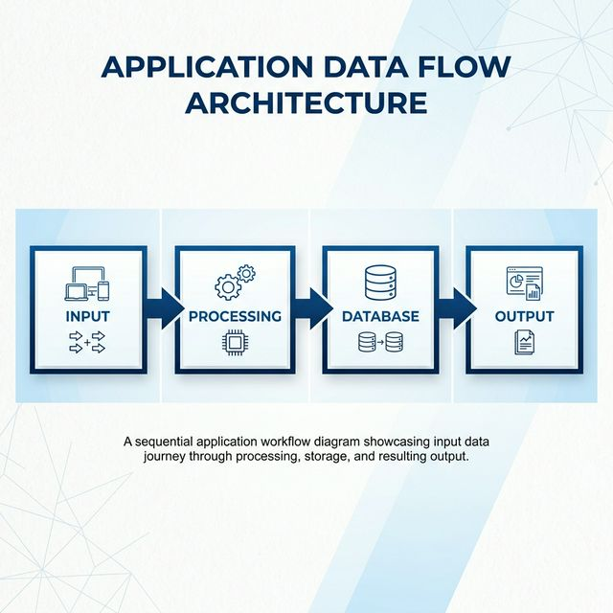
PROPOSED SYSTEM ARCHITECTURE
1
2
3
4
5
6
7
8
9

Slide 7
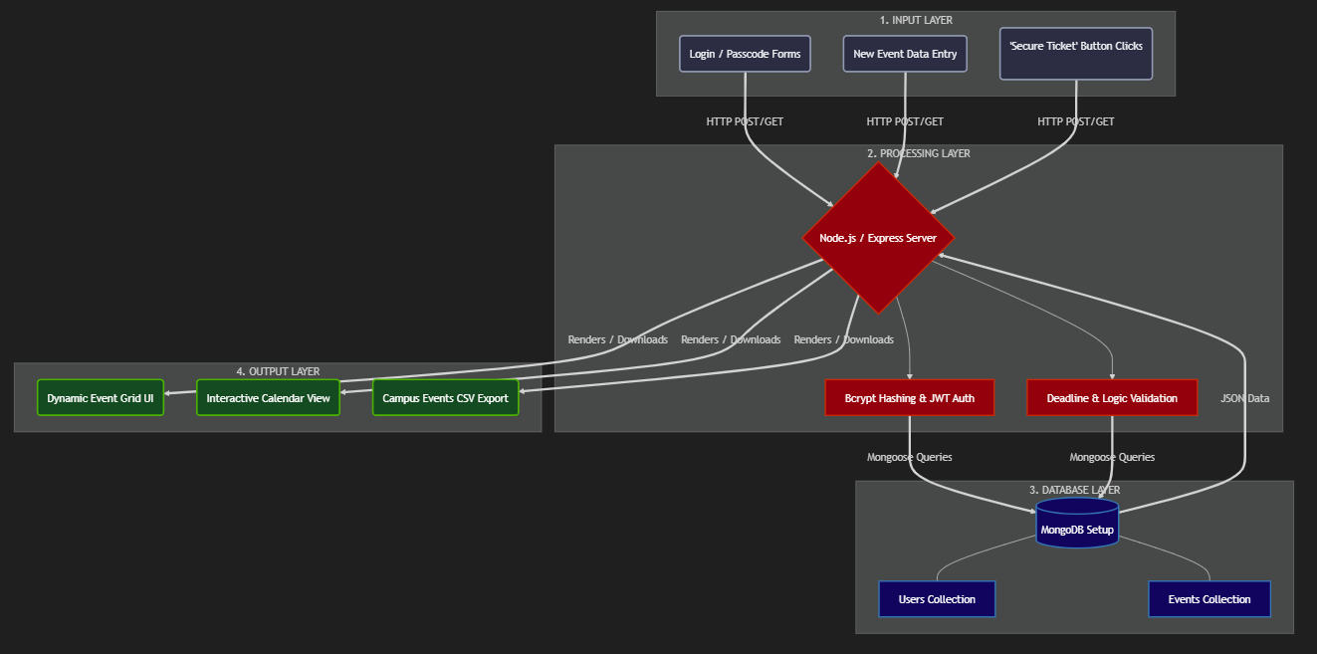
WORKFLOW
1
2
3
4
5
6
7
8
9

Slide 8
TECHNOLOGIES USED
-Frontend:HTML5: Used for styling the application structure (index.html, login.html, create.html).
CSS3: Built using Vanilla CSS for UI elements, layouts, and visual aspects.
JavaScript : Implements dynamic interactions on the frontend without relying on extensive frontend frameworks
-Backend : Node.js: The underlying JavaScript runtime environment executing the server code.
Express.js: Used as the web application framework to handle routing and backend API logic securely and efficiently.
-Database :MongoDB: A NoSQL database being used to store users, events, and other system data.
Mongoose: An Object Data Modeling (ODM) library used to structure database schemas and interact easily with MongoDB
from Node.js.
Tools: express - To set up API routes quickly.
mongoose - To model database object schemas.
bcryptjs - To encrypt user passwords.
jsonwebtoken - To handle secure logins.
dotenv - To keep secrets hidden.
cors - To allow the frontend to safely talk to the backend.
Hardware/Software Requirements: Node.js ,Node Package Manager (npm), MongoDB, Code Editor, Web Browser
CPU: Standard Dual-core processor (1.6 GHz or faster is recommended).
RAM: Minimum of 4GB (8GB recommended for running IDE + Node + DB + Browser 0
storage: at least 500mb of disk space
1
2
3
4
5
6
7
8
9

Slide 9
MODULE DESCRIPTION
1
User Management: Handling registration, login, and profile management.
Core Processing: Implementing main business logic and input processing.
Database Management: Managing data storage, retrieval, and integrity.
Reporting & Analytics: Generating reports and visual insights.
2
3
4
5
6
7
8
9

Slide 10
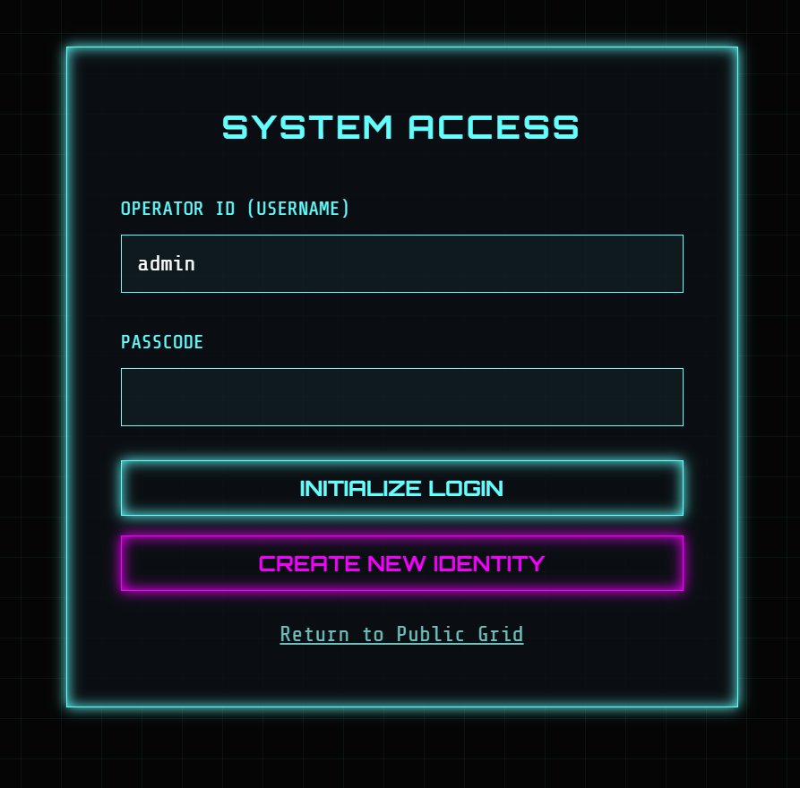
IMPLEMENTATION SCREENSHOTS
1
2
3
4
5
6
7
8(A)
9

Slide 11
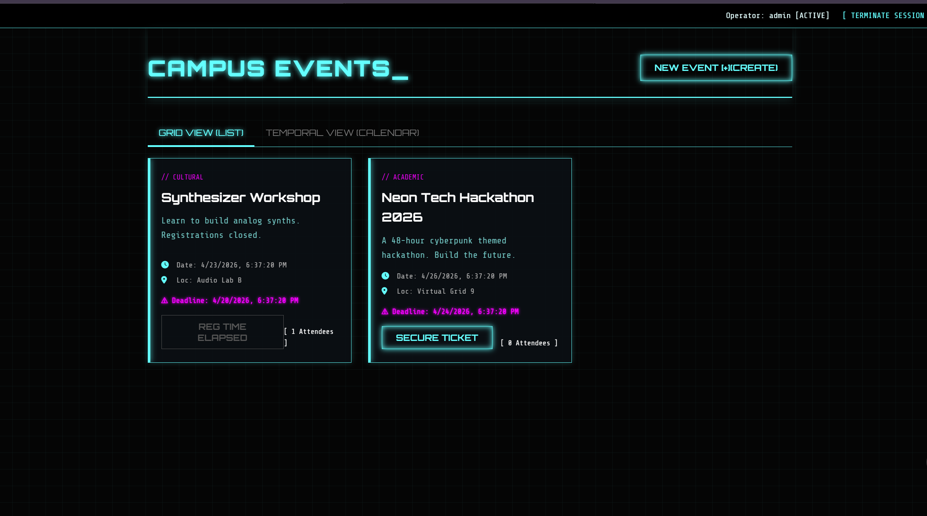
IMPLEMENTATION SCREENSHOTS
1
2
3
4
5
6
7
8(B)
9

Slide 12
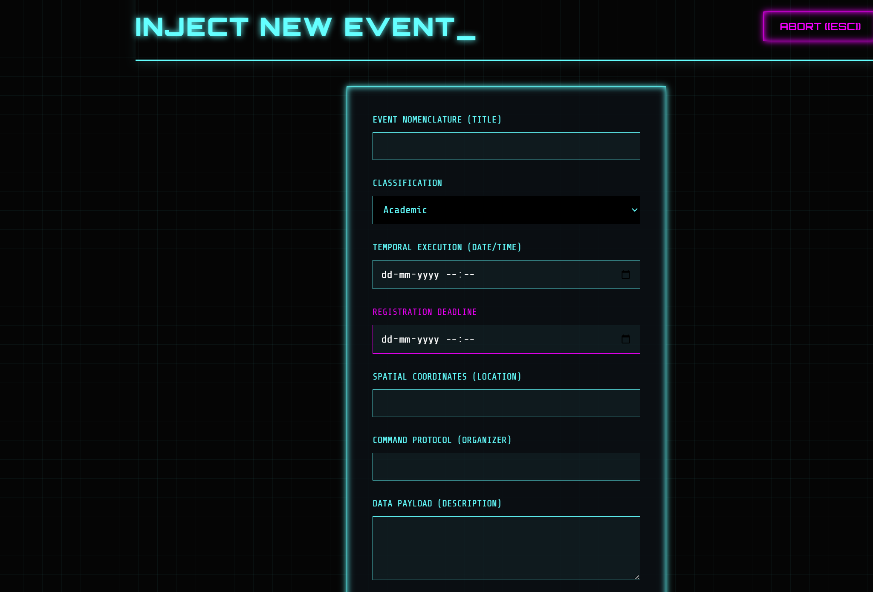
IMPLEMENTATION SCREENSHOTS
1
2
3
4
5
6
7
8(C)
9

Slide 13
ADVANTAGES & LIMITATIONS
Advantages:
- Centralized platform for managing all campus events efficiently.
- Reduces manual work and paperwork through automation.
- Improves communication via real-time notifications and updates.
- Avoids scheduling conflicts with proper event planning features.
tag
Advantages
1
2
3
4
5
Limitations:
-Requires internet connectivity for access and usage.
- Initial setup and development cost may be high.
- Users may need training to use the system effectively.
- System failures or bugs can disrupt event management.
- Data security and privacy concerns must be handled properly.
alizelatform for managing all campus events efficiently.
Reduces manual work and paperwork through automation.
Improves communication via real-time notifications and updates.
Avoids scheduling conflicts with proper event planning features.
6
7
8
9

Slide 14
Thank you

