Slide 1

Columbian Asian Hospital
Tammana Sai Manikanta

Slide 2

About us
Columbia Asia Hospital is committed to delivering quality healthcare while optimizing its operations.
In this project, I analyze hospital data to uncover insights on revenue generation, patient satisfaction, and departmental efficiency. By understanding key metrics, I aim to provide actionable recommendations that can enhance patient experience and improve the hospital’s overall performance.

Slide 3

Agenda
Overview
Problem
KPI Analysis
Data Cleaning & Extraction
Data Analysis & findings
Strategies & Recommendation
Conclusion

Slide 4
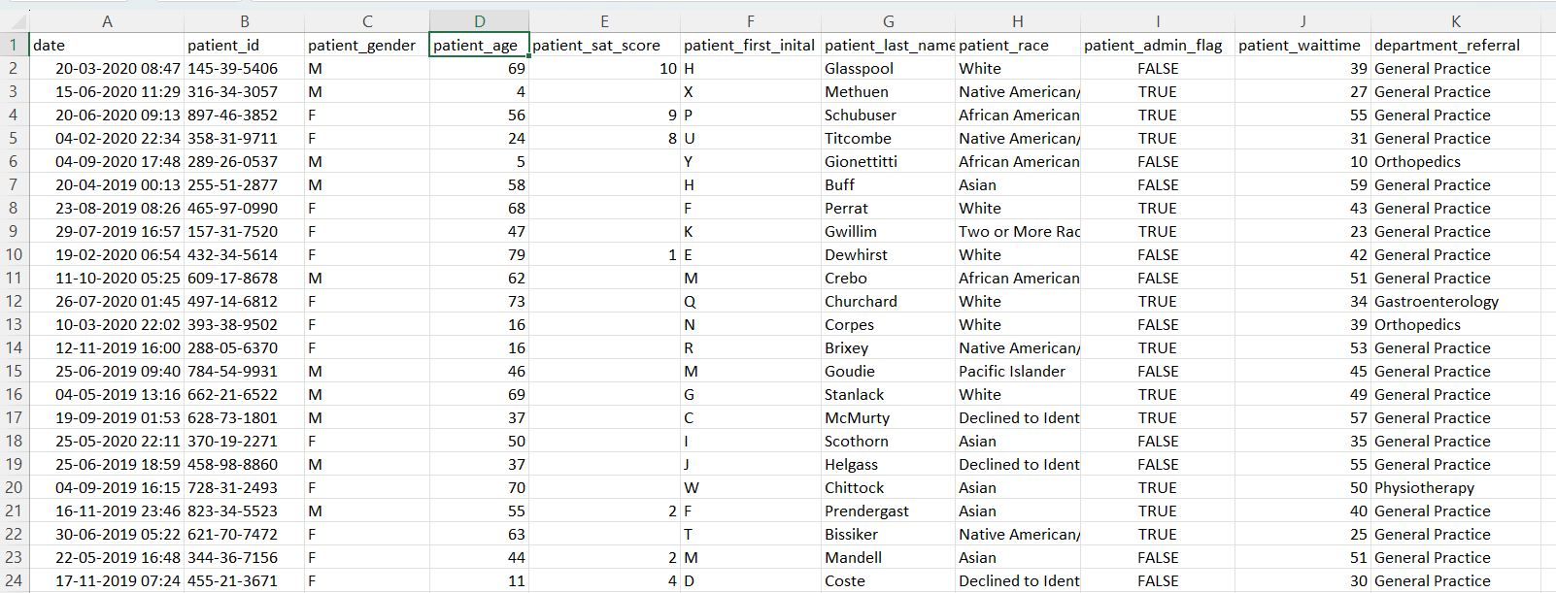
Problem
SCENARIO
You have been hired as a consultant data analyst by Columbia Asia Hospital. The Hospital is looking for the key insights for the following objectives:
Assess the hospital's revenue generation
Insights about suitable departments for new hires
Strategies and suggestions for patient discounts

Slide 5
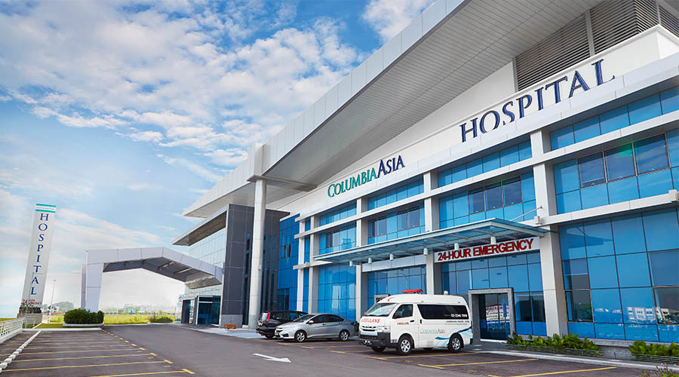
Content Overview
Data Source:
The dataset includes comprehensive records of patient visits, doctor referrals, and billing information from Columbia Asia Hospital. Key tables, such as doctor_patients_data and hospital_er, capture details on patient demographics, appointment fees, satisfaction scores, and wait times, offering a full view of hospital operations and patient experience.
Tools Used:
SQL for data querying and extraction.
Power BI for data visualization and insights generation.

Slide 6
Data Cleaning & Extraction Process
Data Extraction & Cleaning
Data Transform & Analysis
Insights
Visual Creation & Dashboard
Data Extraction & Cleaning
Data was loaded into Power BI and cleaned in Power Query by fixing errors, filling gaps, checking the data types and ensuring accuracy for reliable analysis
Data was loaded into SQL and loaded into MySQL Workbench by creating a database to find the ranks, perform aggregation metrics
Data Transform & Analysis
Custom columns & measures were built using measures, DAX with calculated columns, filters, aggregations (e.g., SUMX, AVERAGEX), and extracting the time using time intelligence to enable trend and comparison analysis.
Visual Creation & Dashboard
Visual Design Bar charts, Slicers, Filters, Bookmarks,
Column-Bar Charts, KPI cards, donut charts and pie charts—were created to present key metrics and trends clearly
Insights
Slicers, drill-throughs, and custom interactions were added to make the dashboard dynamic and interactive, allowing users to filter data and gain deeper insights easily by looking into the dashboard.

Slide 7
KPI Analysis
Average Patient Spent
$55.6 k
Discount Eligibility
High Discount = $35 k
High Discount = $15 k
Total Patients
9216
Total Doctors
22
Average Wait Time
35.26 mins
Average Patient Score
4.99
Total Revenue
$509.31 M
Appointment Fee
Cardiology: $1,200
Gastroenterology: $700
General Practice: $500
Neurology: $1,500
Orthopedics: $700
Physiotherapy: $1,000
Renal: $500

Slide 8
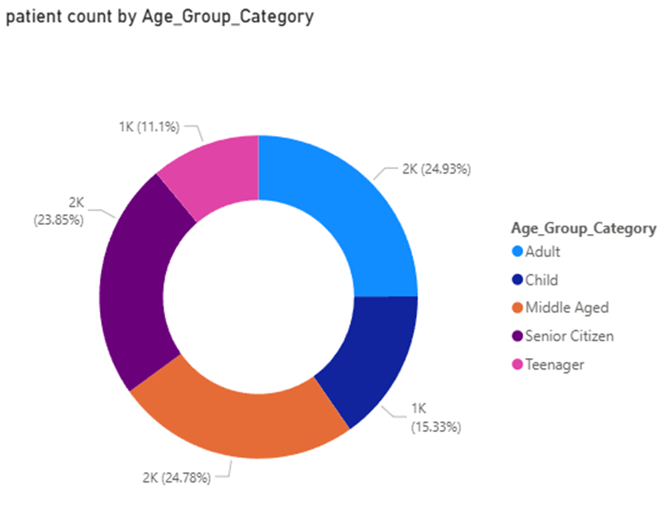
Data Analysis & Findings
Patient Age Group analysis
To better understand who our patients are and how they use our services, categorized them into five distinct age groups.
This demographic segmentation helps us tailor our care and services more effectively
Child = less than or equal to 12 years
Teenager = between 12 and 21 years
Adult = between 21 and 40 years
Middle Aged = between 40 and 60 years
Senior Citizen = 60+ years
Hence divided the overall patients into five age categories to distinguish between the age group categories & departments
INSIGHTs
Helps to conduct/plan age-specific programs & services considering the above age groups

Slide 9
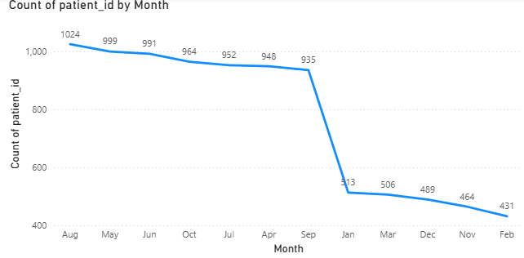
Data Analysis & Findings
Monthly patient visits
Total Patients Visited: 9,216
Seasonal Patient Flow: Monthly visit trends highlight clear seasonal patterns, helping optimize staffing and resource allocation.
Peak in August: Patient visits reach their highest in August, likely influenced by school holidays, weather conditions, or external factors.
Low in February: February shows the lowest patient traffic, making it an ideal period for facility maintenance or staff training with minimal operational impact.
Yearly Patterns: Patient visits remain strong from April to October, drop sharply in November, and stay relatively low during January–March and November–December, signaling periods of reduced demand.

Slide 10
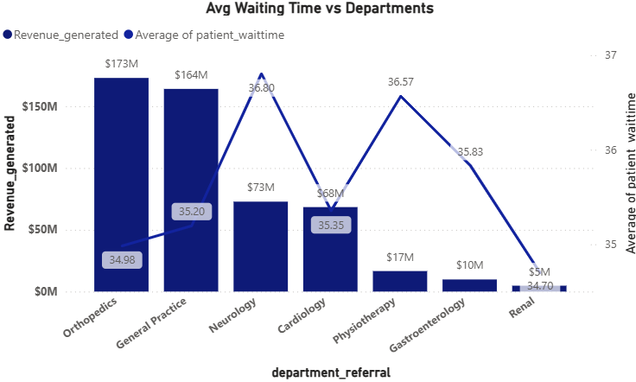
Data Analysis & Findings
Patient Wait Time analysis
Average Wait Time For Patients: 35.26 mins across hospital
Wait times range: 34.70 – 36.80 mins across the departments
Neurology has highest avg wait (36.8 mins), though difference is minimal
No critical delays — indicates efficient and balanced resource allocation
Orthopedics & General Department has generated greater revenue compared to other departments indicating the key areas of hospital
INSIGHTs
High-revenue departments present strong opportunities for targeted investments. By expanding their services and resources, the hospital can drive further growth and attract more patients.

Slide 11
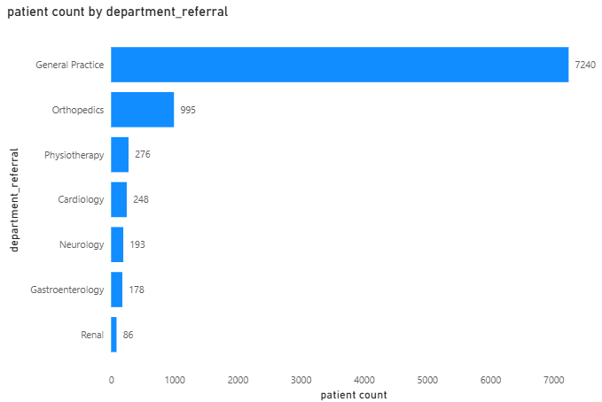
Data Analysis & Findings
Department wise Patient count
General Practice and Orthopedics had the highest patient volume, indicating these departments are essential for patient care and could benefit from increased staffing.
Renal has recorded least number of patients in overall which can help the hospital to understand the department importance while increasing the staff
INSIGHTs
The departments which recorded by greater number of patients present strong opportunities for targeted investments.
Prioritizing these departments for staffing and resource allocation could help manage demand and improve patient flow.

Slide 12
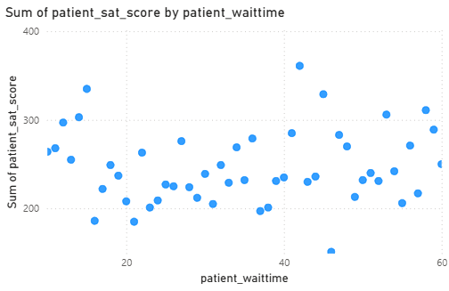
Data Analysis & Findings
Wait time Impact on Satisfaction Score
The chart shows the relationship between patient wait time and the sum of patient satisfaction scores which is having negative correlation. As wait times increase, satisfaction scores generally trend downward, though there are fluctuations. This suggests that longer wait times negatively impact patient satisfaction, highlighting the need for better scheduling and resource management to improve patient experience.
The Interpretation of Correlation = 0.51
INSIGHTs
Efforts to reduce wait times, especially in high-demand departments, could significantly improve patient satisfaction. Additionally, implementing efficient scheduling or queue management systems could help reduce congestion during peak hours.

Slide 13
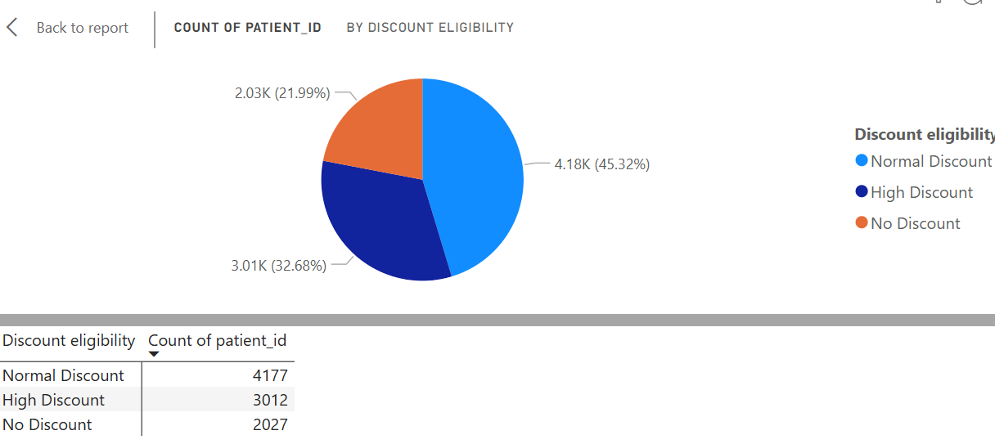
Data Analysis & Findings
Discount Eligibility for the patients based on their spend
Analyze the relationship between discount levels and patient satisfaction to assess the effectiveness of discounts on patient experience.
Normal Discount: Set at 20% of the average spend (~15K). This creates a reasonable entry point for patients to qualify.
High Discount: Set at 90% of the average spend (~50K). This ensures only significantly high spenders qualify
INSIGHTs
Around 22% of patients qualify for the High Discount, as their total bill exceeds 35K.
About 45% of patients fall into the Normal Discount category, with total bills between 15K and 35K.

Slide 14
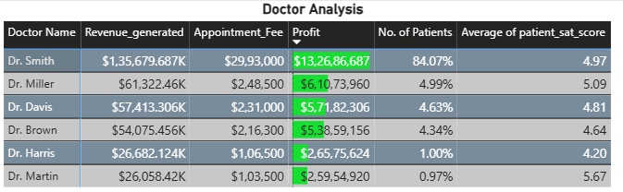
Data Analysis & Findings
Wait time Impact on Satisfaction Score
With 5,986 patients, Dr. Smith handles one of the highest patient loads in the hospital. This reflects both strong demand for his services and a potentially heavy workload, suggesting the need for additional support or recognition.
INSIGHTs
Top Revenue-Generating Doctors:
Analysis identified the top 5 doctors who generated the highest revenue despite treating fewer patients. This highlights efficient, high-value practices, likely involving specialized procedures, and emphasizes their critical role in driving the hospital’s financial performance.

Slide 15
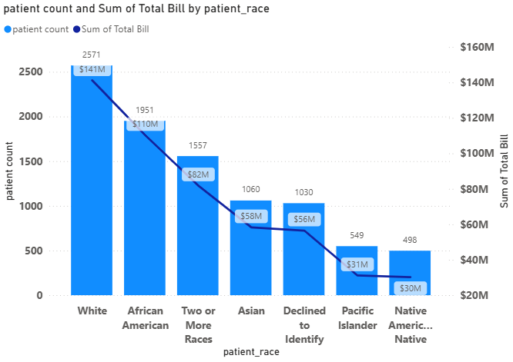
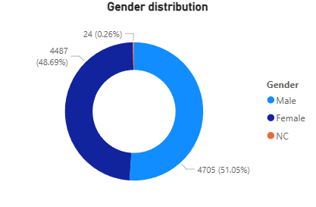
Data Analysis & Findings
Demographic Analysis
gender analysis
INSIGHTs
There is no much difference in gender as Male & Female have generated around ~99% where as ~51% Male and ~48 Female Patients were recorded
In Demographic Analysis we can notice that White race have generated revenue around ~27% overall and greater than other races as well. This can be used while hospital is planning to start a new branches.

Slide 16
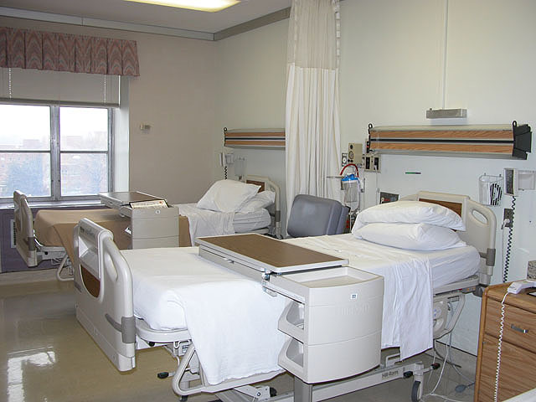
Patient Satisfaction Growth
Analysis
Patient Satisfaction Rate
Patient satisfaction scores vary significantly across different age groups and racial demographics, with some groups consistently reporting lower satisfaction.
Recommendations:
Develop targeted patient engagement strategies for age groups and racial demographics showing lower satisfaction scores.
Customize services and communication based on demographic needs to provide a more personalized patient experience.

Slide 17

Staff Hire Strategy
Analysis
Staffing & Growth
Strategic Doctor Hiring: General Practice Department: With over 7,200 patient visits and only 3 doctors currently managing the load, it is highly recommended to recruit 2–3 additional general practitioners.
This expansion will reduce strain on the existing team, enhance service quality, and significantly improve patient access and wait times.
Hospital Profitability Overview: Columbia Asia Hospital displays strong and stable financial performance, with consistently high profitability. This solid financial footing provides the flexibility to invest confidently in staff expansion and patient-centered initiatives, ensuring continued growth and operational excellence.

Slide 18
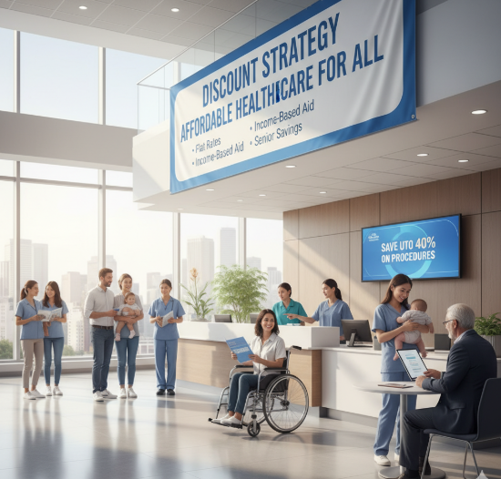
Discount Strategy
Analysis
Discount Eligibility
Patients receiving medium to high-level discounts based on their total bill
Recommendations:
Introduce loyalty discounts or follow-up visit discounts to encourage repeat visits and build long-term patient relationships. Provide special discounts for senior citizens and long-term patients to enhance trust and goodwill.
Introduce seasonal wellness packages (e.g., winter immunity or summer hydration checkups) with bundled discounts to attract patients during off-peak periods.

Slide 19
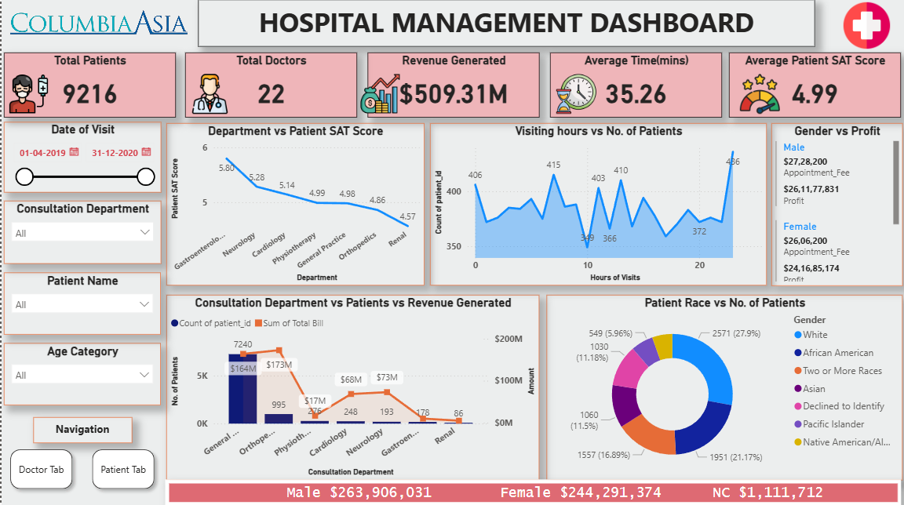
Hospital Management Dashboard

Slide 20
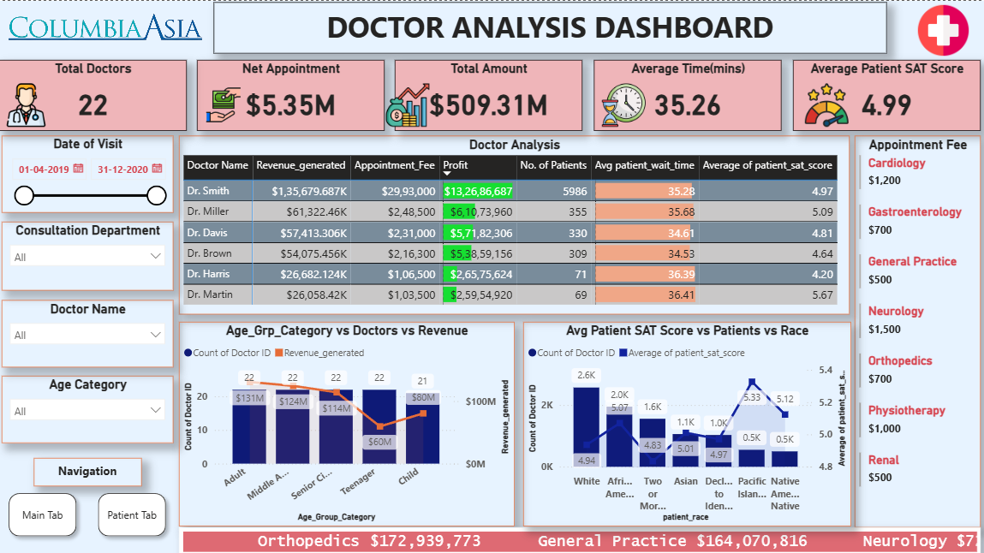
Doctor Analysis Dashboard

Slide 21
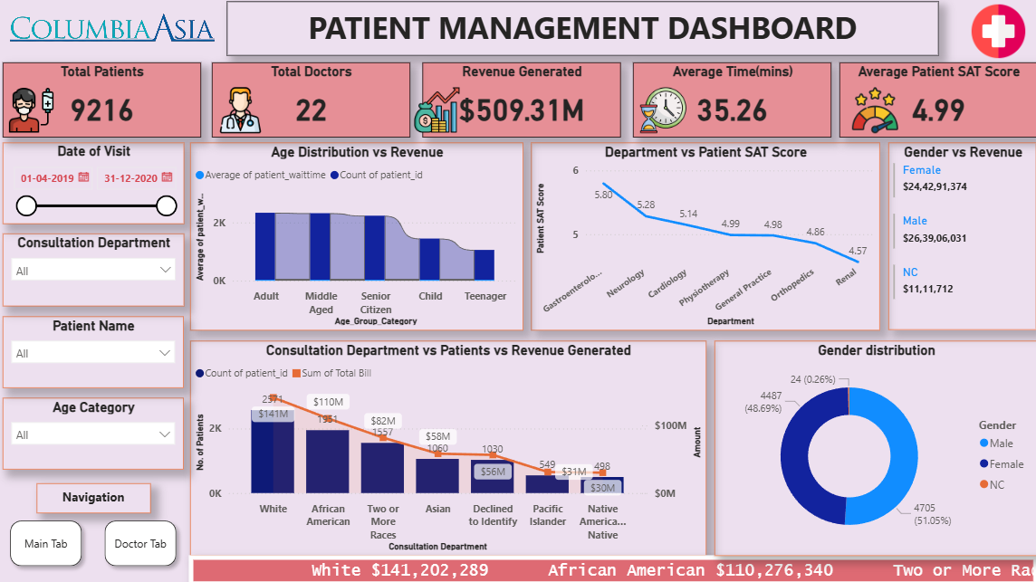
Patient Analysis Dashboard

Slide 22

Conclusion
Columbia Asia Hospital displays strong and stable financial performance, with consistently high profitability. This solid financial footing provides the flexibility to invest confidently in staff expansion and patient-centered initiatives, ensuring continued growth and operational excellence. It focusses on improving he patient satisfaction score by offering quality treatment with high qualified staff

