Slide 1
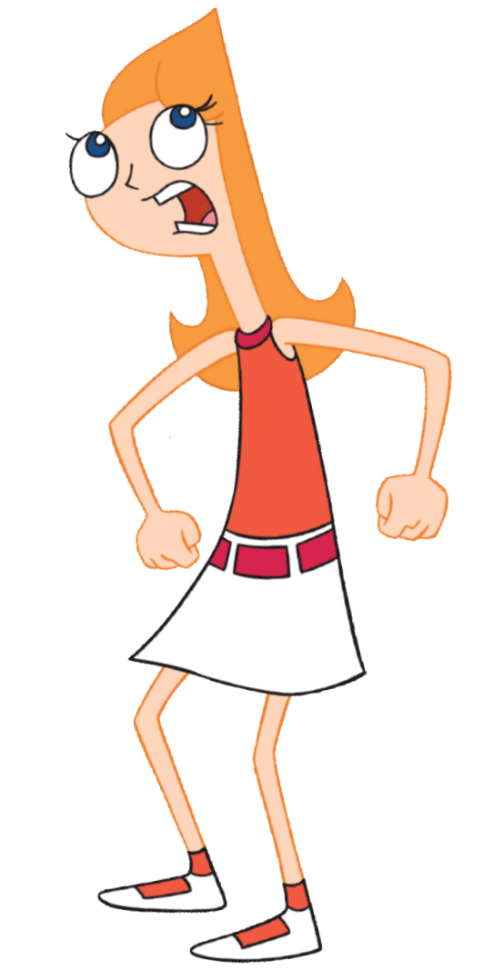
MOM! Phineas and Ferb are ...
Aims: To understand the use of random numbers in Scratch.
Objectives:
ALL: Copy a script that uses random numbers.
MOST: Use random numbers in a simple game.
SOME: Design a new game that uses a random
numbers.

Slide 2

Computers use a mathematical formula to generate pseudo-random numbers.
These are good enough for most purposes, but if you REALLY need random numbers, you can get them from:
http://www.random.org/
Here's a really simple script that simulates the roll of a die:
Have a play with the “pick random” command.

Slide 3
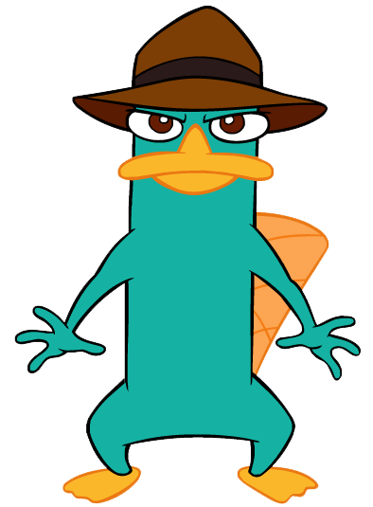
Task:
Imagine someone asked you to write a program to help them choose national lottery numbers.
You could use the “pick random” command to choose the numbers:
How many numbers do you need?
What are the upper and lower limits of the numbers?
Are duplicates allowed?
If you get stuck, a possible solution is on the next slide.

Slide 4
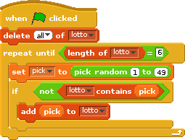
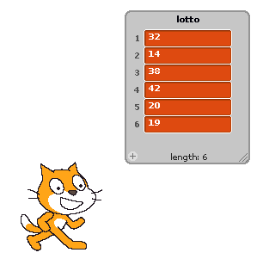
You need to make a list called “lotto”.
We need to empty it before running the script.
The loop runs until we have 6 numbers.
We set “pick” to a random number between 1 and 49.
If “lotto” does not contain “pick”, we add it to the list.

Slide 5
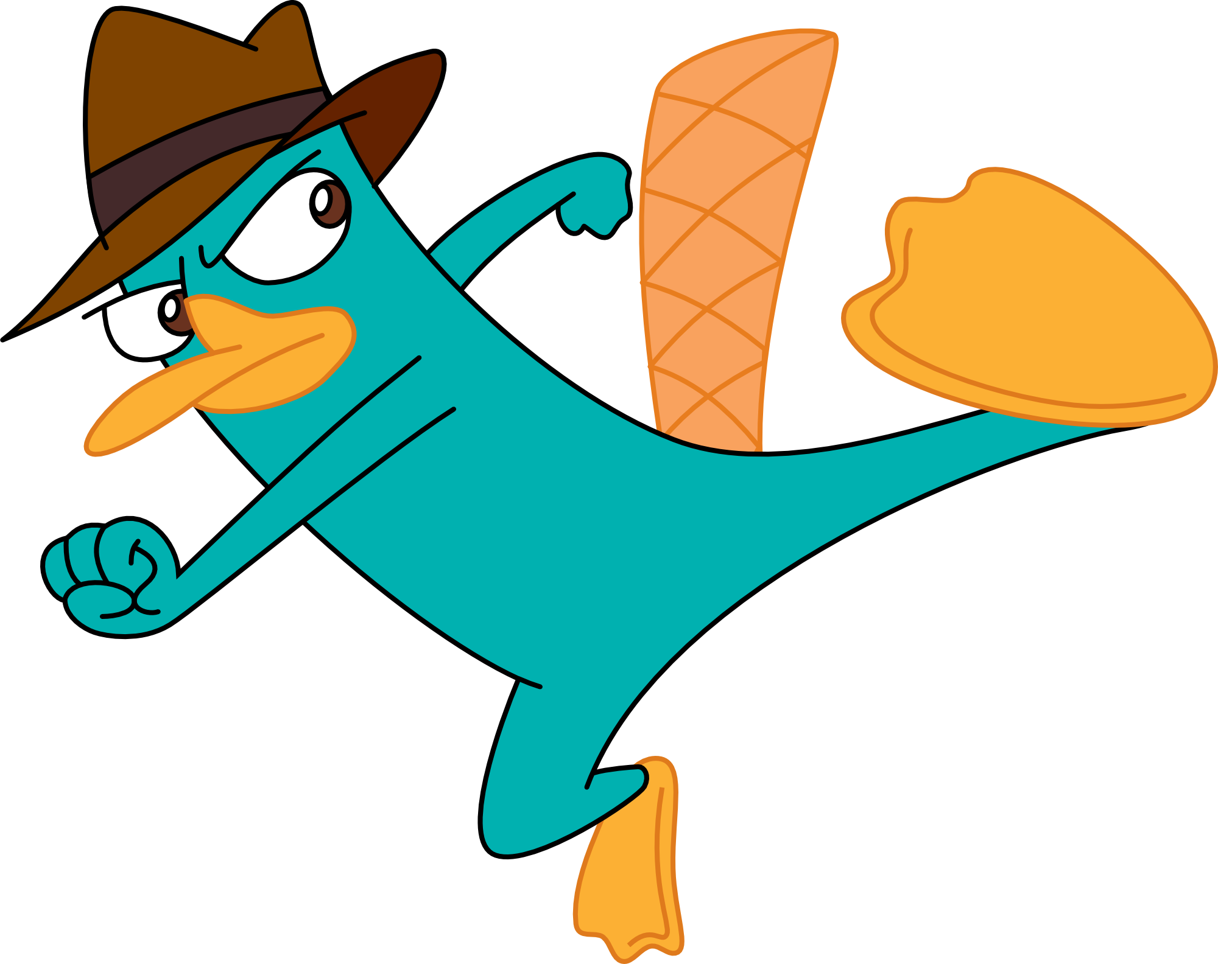
Next we are going to make a script which performs a very simple test of how random the “pick random” numbers are.
Here's the instructions:
Make a list with 10 items.
Use a loop to pick a random number from 1 to 10 one thousand times.
If a number comes up, add one to the element in the list at that index.
At the end, all the cells should be somewhere around 100.
Have a go, a possible solution is on the next slide (but you don't need to look at that!)

Slide 6
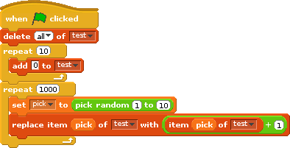
Here we simply replace the item at index “pick” in the list with itself plus one.
Mini-Task:
Run this script and see what the results are like.

Slide 7
Drop Dead
Our main task today is to write a script tha simulates the game “Drop Dead.”
In this game, a player starts with 5 dice. You roll them all together.
If any come up as “2” or “5”, you score zero for the round and lose those dice.
If you do not get any “2”s or “5”s, then you add the sum of all your dice onto your total.
When all your dice have “dropped dead”, it's game over.
See the next slide for a sample game ....

Slide 8
Drop Dead
4, 4, 5, 1, 1 score 0, lose 1 die.
3, 1, 1, 5 score 0, lose 1 die.
1, 2, 3 score 0, lose 1 die.
1, 1 score 2.
6, 4 score 10, total = 12.
4, 3 score 7, total = 19.
3, 6 score 9, total = 28.
3, 3 score 6, total = 34.
5, 2 score 0, lose 2 dice.
GAME OVER
Score = 34.
Have a go at making a script to play this game.
If you get stuck, there's a solution on the next slides.

Slide 9
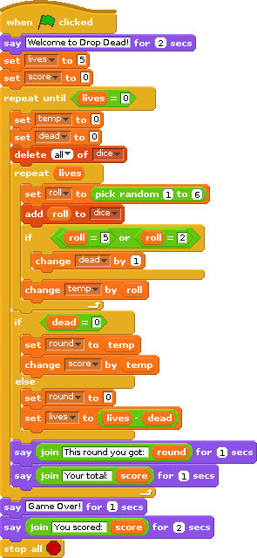
Here's one way to do this in Scratch.
On the next couple of slides you can see the loop and the “if” block a bit more clearly.

Slide 10
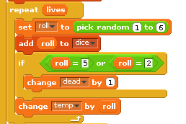
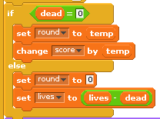
The “lives” variable tells us how many dice we have left. We use this in a loop to build up a new set of dice-throws.
If any of the throws are a 2 or a 5, we add one to the “dead” variable so that we know how many dice we lost in that round.
We also keep a running total in “temp”.
If we didn't roll a 2 or a 5, we can add the contents of temp onto our total and set the “round” variable to the same number.
Otherwise, we set round to zero and reduce lives by the amount of lives we lost.

Slide 11
Task
Here's another simple game idea: Guess the Number.
Use “pick random” in a script where the computer picks a number at random between 1 and 100.
It then gives you a certain number of chances to guess the number.
If you get it wrong the computer should tell you whether your next guess should be higher or lower.
Try writing a similar program in which you pick the number and the computer has to try to guess it! Use random numbers to make the computer's choices seem more like “guesses”.

