Slide 1
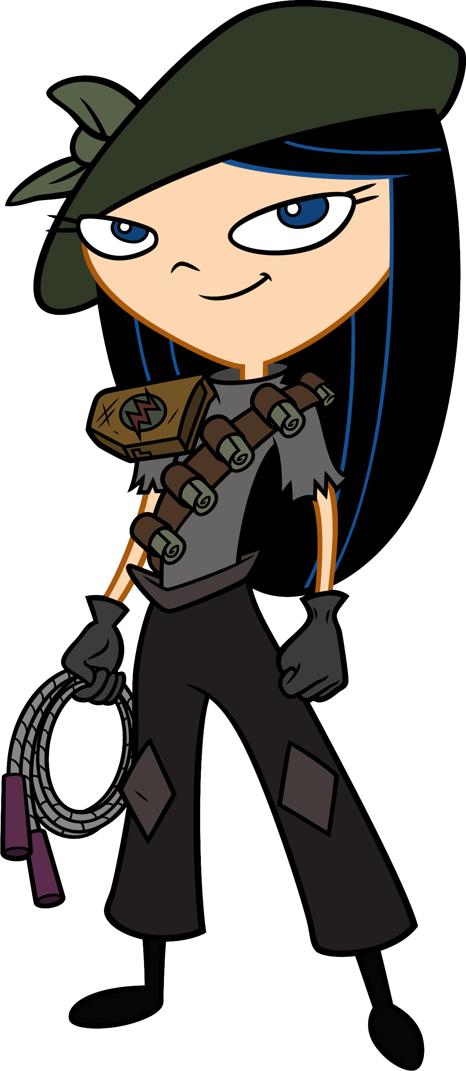
Whatcha doin'?
Aims:
To learn about the Playfair Cipher.
Objectives
ALL: Learn more about using lists.
MOST: Reproduce the code that implements the playfair cipher.
SOME: Feel confident in using 2-d lists.

Slide 2
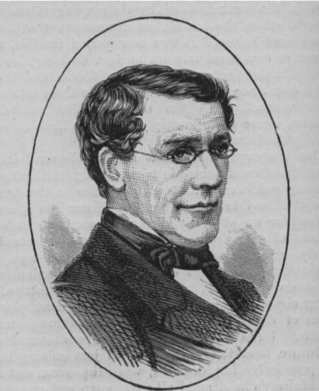
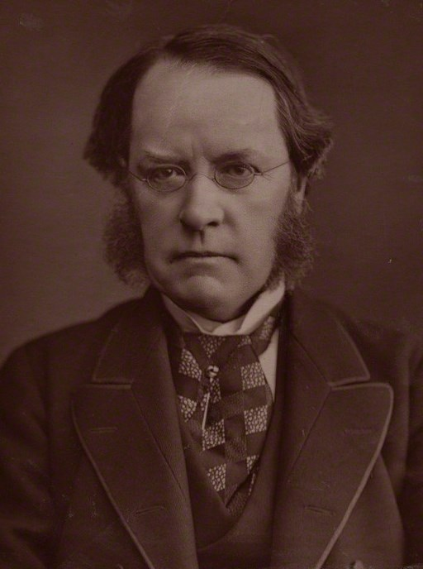
The Playfair Cipher uses a different approach to encrypting a message, compared to the methods we have looked at so far.
Instead of working on individual letters, this method focuses on pairs of letters (digraphs).
Charles Wheatstone (inventor of this cipher).
Lord Playfair
(who encouraged the British Government to use it).

Slide 3
The first thing we need to do is to arrange the letters of the alphabet into a 5x5 grid ('J' is usually not included in simple Playfair systems, so we will use 'I' if we need a 'J').
To add to the security of the cipher, we will use a keyword and then fill the rest of the grid in alphabetical order. For instance, if the keyword is "ENCRYPTION":
ENCRY
PTIOA
BDFGH
KLMQS
UVWXZ
As you can see, the final 'n' of “encryption” is ignored, as we already have an 'n'. From that point onwards we add each letter of the alphabet (excluding 'J') that was not present in the keyword.
In some versions of the cipher, the whole grid might be randomised, but this would require both sender and recipient to have a copy of the grid, rather than simply to know an easily remembered keyword

Slide 4
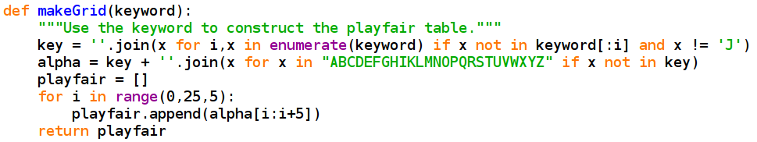
So, let's look at a bit of Python that will make this 5x5 grid of letters.
First, we use ''.join() to set “key” to the keyword without any duplicated letters or 'J's. Then we make a new string consisting of the key plus the letters of the alphabet that have not already appeared in the key. Finally, we build the table by taking slices from this string and making each one an item in a list – a row in the table in effect.

Slide 5
Now we have a grid, we can encipher a message. In the Playfair system, pairs of letters are enciphered together. If the two letters happen to be the same, a 'Q' is added as padding. If both letters are on the same row of the table, we encipher them to the letters one position to the right on the grid (if this shift would take us off the right of the grid, we use the letter in the first column). For instance, if our first digraph was "TO" and we were using the grid we looked at earlier, the first two cipher characters would be "IA".
ENCRY
PTIOA
BDFGH
KLMQS
UVWXZ

Slide 6
If the two characters are in the same column, we take the characters below them (using the top row if we go off the bottom). For instance, if we were enciphering "ZA", the cipher-text would be "YH".
ENCRY
PTIOA
BDFGH
KLMQS
UVWXZ
If the two letters do not share a column or a row, the process is different. A letter is enciphered with the letter from the same row as itself, but the column occupied by its paired letter. In our grid above, if we were enciphering "TS" we would get "AL".
Finally, if the last letter is on its own, we add another 'Q' to form a digraph.

Slide 7
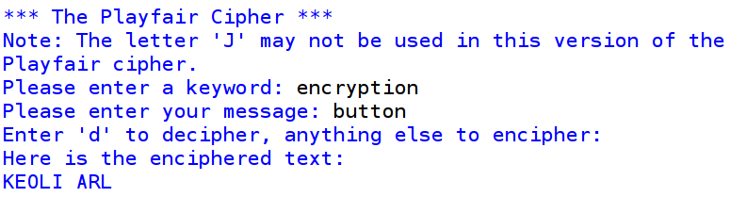
When deciphering, we reverse the shifts if letters share a column or row, but apply the same rule in the third situation above. Of course, double letters in the plain-text may cause some 'Q's to be added which we will need to remove ourselves.
Here's a quick example.

Slide 8
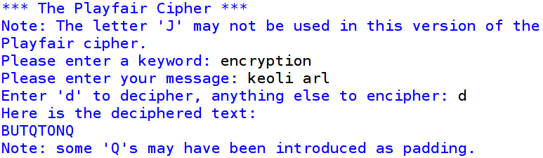
Because the message had a double letter in it, a 'Q' has been introduced as padding.
This made the message have an odd number of letters so another 'Q' has been added at the end.

