Slide 1
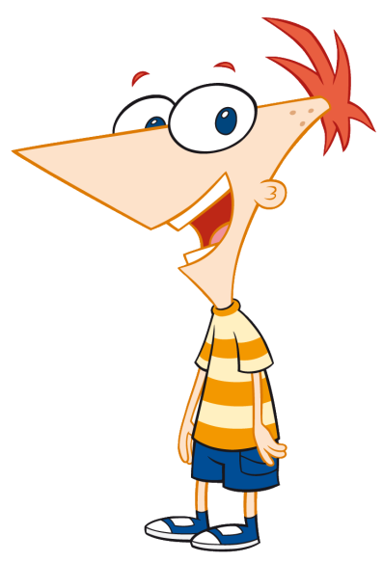
Hey, Ferb, I know what
we’re gonna do today!
Aims:
To introduce (or re-introduce) Scratch.
Objectives:
ALL: Open Scratch and copy simple scripts.
MOST: Experiment, making changes to scripts.
SOME: Create scripts independently.

Slide 2
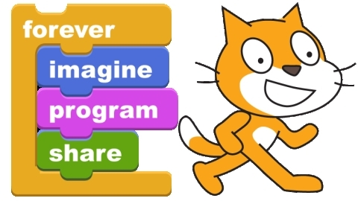
Scratch is a programming language developed at M.I.T.
(the Massachusetts Institute of Technology).
The “drag-and-drop” interface makes it easy to use.
Today we are going to write our first scripts and learn about loops.

Slide 3
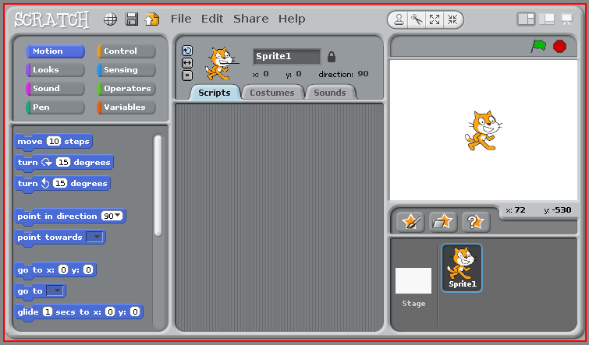
To start Scratch, click Start > All Programs > Scratch.
The “stage”.
Where you see the results of scripts.
Choose which type of block you want.
This is where you drag blocks from.
Build scripts here.

Slide 4
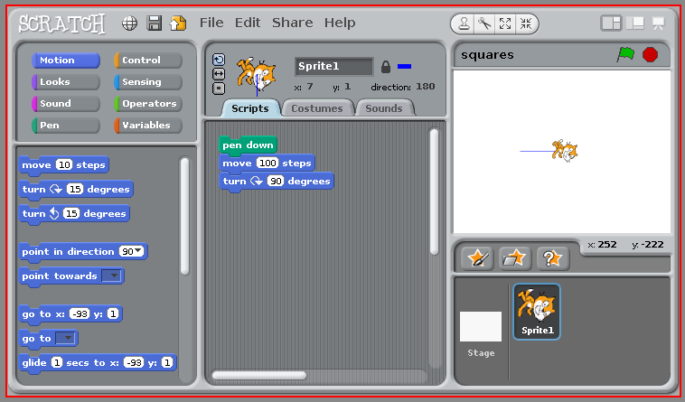
Click
here
for
pen
blocks.
Here's the first script we are going to try.
It just puts the pen down, draws a line and then turns.

Slide 5


Drag and drop the blocks into the center area.
Change the numbers to “100” and “90”.
Click your script to see the cat draw a line!
This part is a comment.
Comments do not affect how your script runs.
Comments help you (and other people) understand your scripts.
To add a comment, right click in the script area.
Drop this block into your scripts area.
It will clear the stage when you click it.

Slide 6
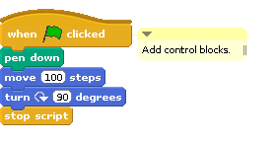
Add these control blocks and you can run the script
by clicking on the green flag.

Slide 7
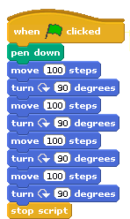
Make this script.
What will it draw?
Why is it bad?

Slide 8
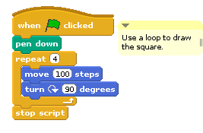
Making four copies of the draw and turn blocks
is too much like hard work!
Good programmers are lazy (in a way).
They want a fast, easy, way to do things.
They certainly don't want chunks of their programs to be repeated.
They use loops instead.

Slide 9
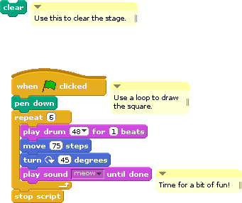
Have a bit of fun!
Change the numbers in your script.
Add some drum beats and sounds.
Can you work out how to make a script that draws:
a triangle
a pentagon?
a circle?

