Slide 1

MOM!
Phineas and Ferb are …
Aims:
To begin to understand algorithms.
Objectives:
ALL:
MOST:
SOME:

Slide 2
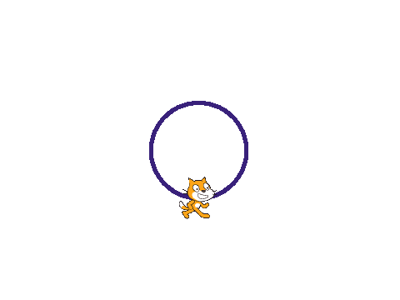
How to draw a circle.
Imagine you are the cat. You need to walk in a circle.
How do you do it?
If you are stuck, try getting up and doing it.

Slide 3

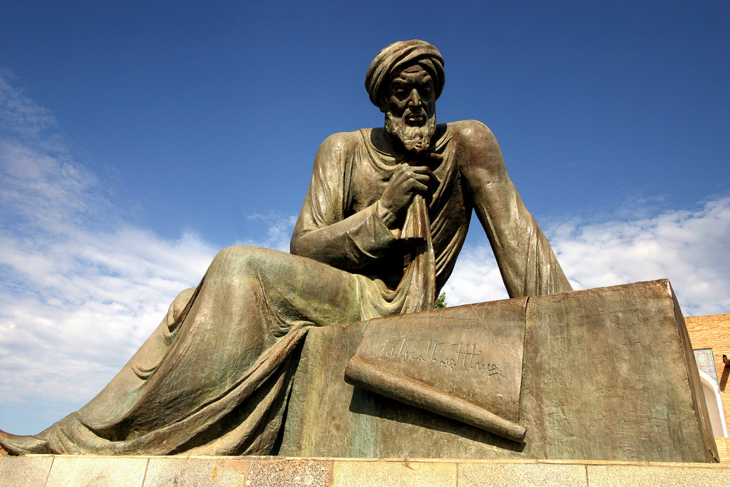
I hope you worked out that you can walk in a circle by this process:
Go forwards a bit.
Turn a bit (same way every time!).
Repeat.
This is an ALGORITHM.
In computer science, we use “algorithm” to mean a process you follow to get a certain outcome.
It's like a recipe, a set of instructions or directions.
We need to make the algorithm more precise
so that the cat can understand it.
How many steps should he/she walk?
How many degrees should he/she turn?
Muḥammad ibn Mūsā al-Khwārizmī

Slide 4
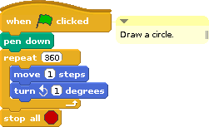

Is this really a circle?
If not, what is it?
How can it help us with our other problem
(drawing triangles, pentagons etc.)?

Slide 5
Observation One
At the end of drawing any of these shapes, we need to be back where we started.
We will have gone around 360 degrees.
Observation Two
Our circle was actually a shape with 360 sides.
To draw it we turned 1 degree each time.
That is 360 divided by 360.
Observation Three
To draw a square, we turned 90 degrees each time.
That's 360 divided by 4.
Something to try out.
If this is right, to draw a triangle, we would need to turn 360 divided by 3 degrees each time.
Try this out. Create a script that uses this method to draw a triangle.

Slide 6
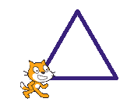
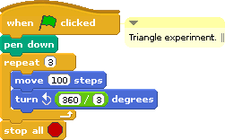
So, how can we use what we know now to make
a script that will draw lots of different polygons?
You can find blocks for doing maths by pressing the “operators” button.
In programming, we use “*” for times and “/” for divided by.

Slide 7
