Slide 1
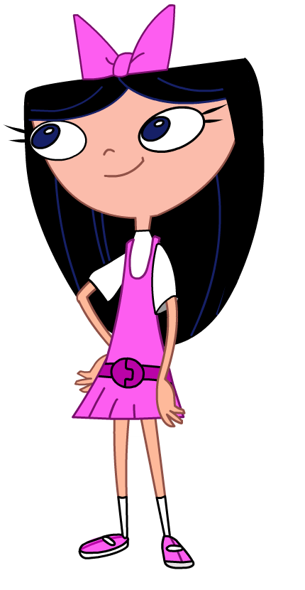
Whatcha doin'?
Aims:
To explore how to use Scratch to calculate square roots.
To develop our understanding of algorithms
Objectives:
ALL: Reproduce the square root script.
MOST: Understand the algorithm fully.
SOME: Create a script to calculate cube roots.

Slide 2
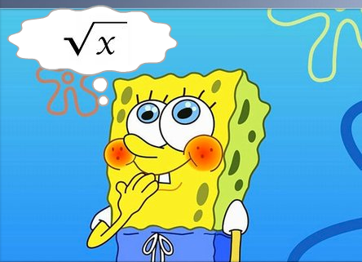
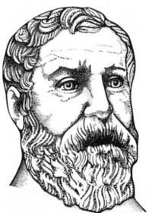
Square Roots
One of the oldest algorithms we know about helps us to find the square root of a number.
This method is attributed to Heron of Alexandria, a Greek mathematician.
Here's the algorithm:
Let's say we are looking for the square root of x.
Start with a guess.
If the guess is good enough, you can stop.
Otherwise, make the new guess half of the guess
  plus x divided by the guess.

Slide 3
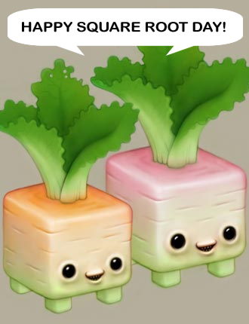
Example
We are trying to find the square root of 16.
We guess 1 (I'm only going to use 2 decimal places).
1 is not right!
Half of 1 + 16/1 is 8.5
Half of 8.5 + 16/8.5 is 5.19
Half of 5.19 + 16/5.19 is 4.14
Half of 4.14 + 16/4.14 is 4.00
To make this script, we are going to need some new techniques.

Slide 4
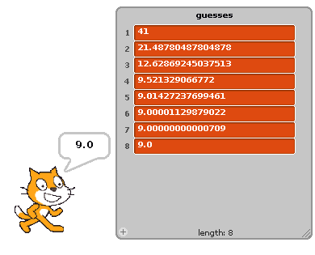
One new thing we are going to use is a list.
We are going to use a list to store all the guesses we make before finding the answer.

Slide 5
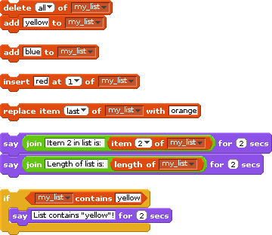
Have a play around with lists in Scratch so that you get an idea of how they work.

Slide 6
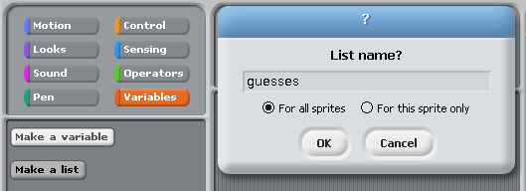
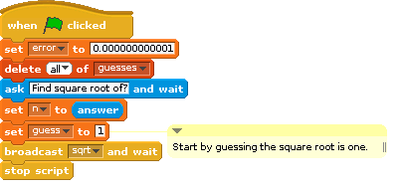
First we make a list and call it “guesses”.
In the script, we delete all of guesses so that we start each run with an empty list.
We set error to a small number and get the number from the user. We set the guess to 1 and then we broadcast “sqrt”.

Slide 7
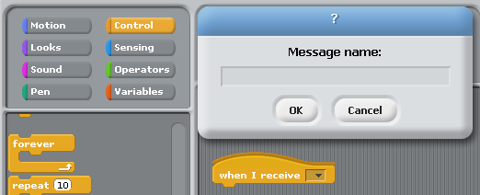
We are going to create the script that runs when we broadcast “sqrt”.
Click on the control button in the upper left region and then drag the “when I receive” block into the script area.
When you click the little arrow on the block, you'll be given the chance to choose the message you want to use.

Slide 8


Another thing you may not have done before is to build up a more complicated mathematical operation.
We are going to gather these pieces into an expression that will tell us if we have found the square root.
If the absolute value of n minus the guess squared is less than “error”, then the guess is close enough.
abs is a function that ignores the sign of a number.
So:
abs of -2 = 2
abs of 5 = 5
abs of 0 = 0

Slide 9
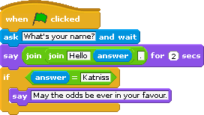
If
If is a very important part of Scratch, it allows the script to make decisions about what to do while the program is running.
Try having a go with a simple script like this to try out the “if” block.
In the square-root program we use an if statement to stop when we have the answer.

Slide 10
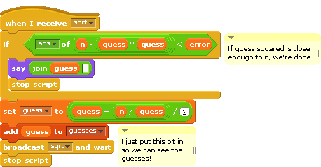
The first part checks to see if we have the answer.
If not, then we set guess to the new value and call “sqrt” again.
Because this definition refers to itself, it is known as a recursive function.

Slide 11
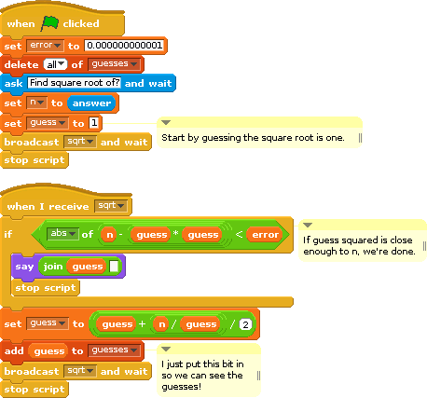
Make the square root script and try it out.
Do you understand how it works?
Does it give the correct answers?

Slide 12
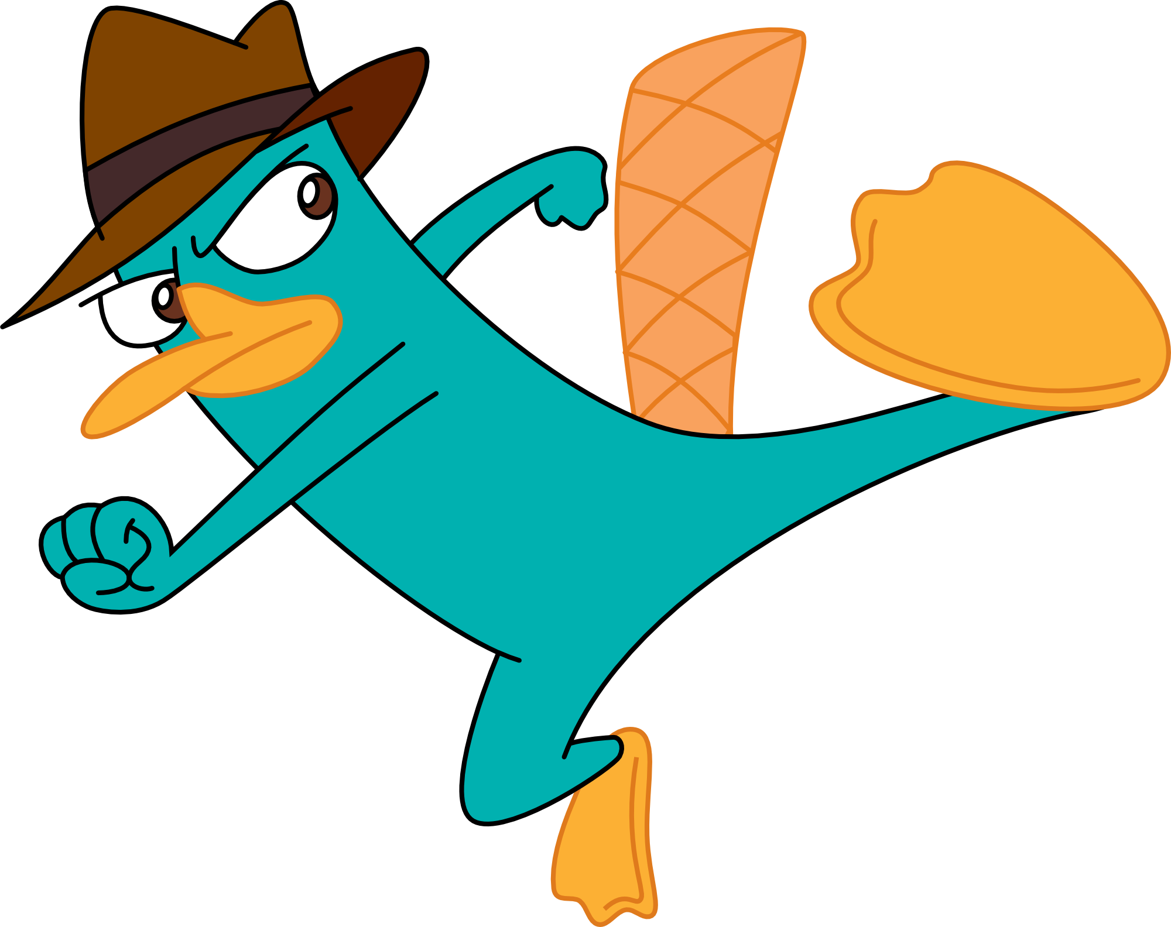
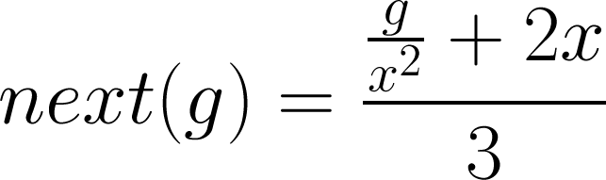
Task
Write a script that find the cube root of the number the user supplies.
To do so, you will need to change the way that the next guess is calculated.
If x is the user's number and g is the guess:
Sir Isaac Newton invented this method for Cube Roots.

