Slide 1

Whatcha doin'?
Aims:
To understand a simple sorting algorithm –
Bubblesort.
Objectives:
ALL:
Understand why sorting algorithms are important.
Understand what we mean by an efficient algorithm.
MOST:
Understand how the Bubblesort algorithm works.
SOME:
Create a script to implement Bubblesort independently.

Slide 2
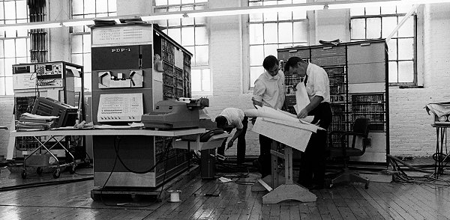
Sorting Algorithms
Computers spend a lot of time sorting data.
Naturally, we want to be able to sort our data as efficiently as possible.
When we talk about the efficiency of an algorithm, we basically mean the method should:
be correct
be fast
use the smallest possible amount of memory
a pdp-1
(famous old computer)!

Slide 3
Bubblesort
This algorithm is not very efficient, but it's a good place to start when thinking about sorting algorithms.
Let's say we have a list of numbers.
The algorithm works by looking at each number and its neighbour.
If they are in the wrong order, they are swapped.
If you do this repeatedly, the list will be sorted.
For example:
If the original list was: 7, 4, 5, 2, 8, 1.
4, 7, 5, 2, 8, 1. swap 7 & 4
4, 5, 7, 2, 8, 1. swap 5 & 7
4, 5, 2, 7, 8, 1. swap 2 & 7
4, 5, 2, 7, 8, 1. no swap
4, 5, 2, 7, 1, 8. swap 8 & 1
Clearly, we need to repeat this several times to sort the whole list.

Slide 4

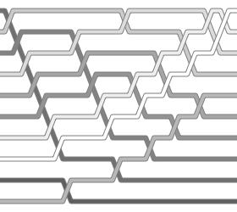
Let's have a go at writing a program that will use Bubblesort to put a list of numbers into ascending order.
A nice picture of Bubblesort.

Slide 5
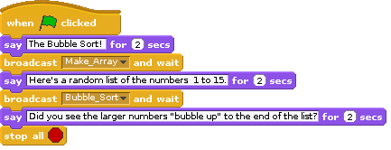
This part of the program tells the user what is going to happen and then calls the two scripts:
  “Make_Array”
  “Bubble_Sort”

Slide 6
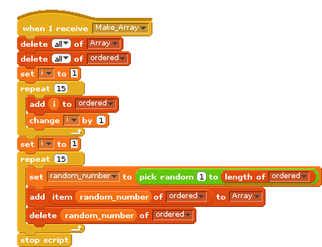
This script makes an array of 15 random numbers, without any duplicates.
Make sure you can see how it works!

Slide 7

Task:
Write a script that will sort the numbers in the list created by “Make_Array”.
You'll need a nested loop – a loopwithin a loop.
Each time through you'll need to check an item in the array against its neighbour.
If the element is greater than an element to its right in the list, swap them over.
If you get stuck, a possible solution follows ...

Slide 8
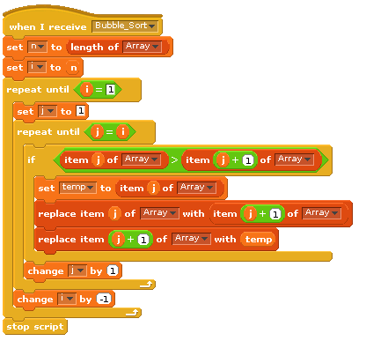
This sorts the numbers.
We use nested loops to keep working on the array until it is sorted.
Here's where the swaps happen.
We can reduce i by one each time because we know the next-biggest number will have moved to its correct position after each pass.

Slide 9
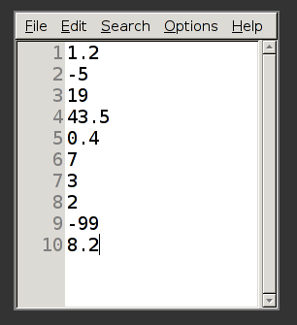
Import and export data
Here's something to try.
Right-click on your list and select “export”.
Now scratch will let you save your data as a text file.
Navigate to your scratch folder and save the file there.
Now let's import some data.
First open a text editor (notepad is best for this)
and enter a list of numbers. Put each number on
a line on its own like this.
Then you can save it and import it into scratch by
right-clicking on your array and selecting “import”.

Slide 10
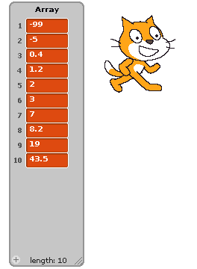
Rather than clicking on the green flag, you'll need to click on the “hat” of the “Bubble_Sort” script to sort these numbers.
Extra Credit:
Use the internet to learn about “Insertion Sort” and write a Scratch program that implements this algorithm.

