Slide 1
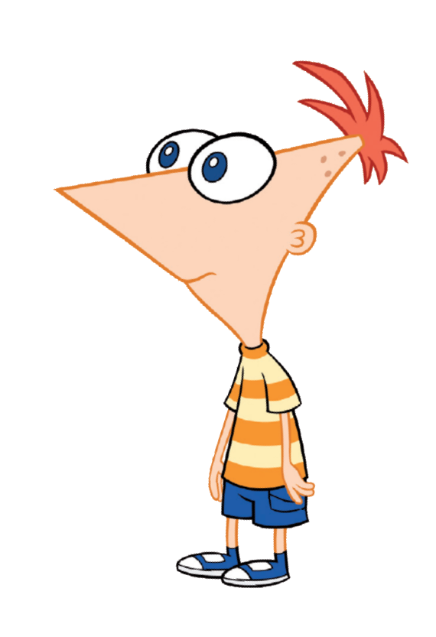
Hey Ferb, I know what we're gonna do today!
Aims:
Build on our knowledge of Python.
Design a program to test the user's knowledge of multiplication tests.
Objectives:
All: Save copy of a template Python program.
Most: Use the template in the exercises.
Some: Successfully complete all the tasks..

Slide 2
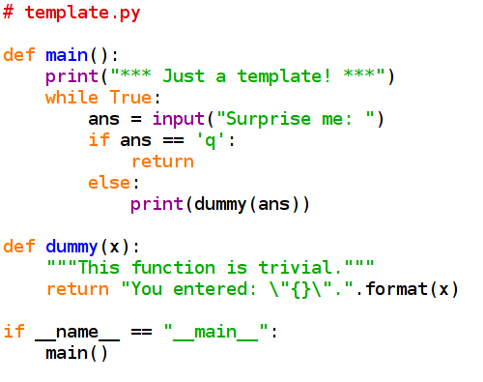
A template file
Quite a few programs we write will take some input and apply a function to it, all within a loop that lets the user quit when he or she is ready.
It's a good idea to make the main part of your program a function called main().
Type this in and save it as “template.py”.
This makes sure the main() function runs when the program is started.

Slide 3
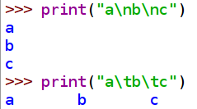
I've used something called “escape sequences” in this dummy function.
Basically, putting a '\' in front of a character is a way of printing characters that would otherwise mess up the syntax of our print statement (like quotation marks) as well as certain “special characters”.
The main ones to know are: \n for a newline and \t for a tab space.

Slide 4
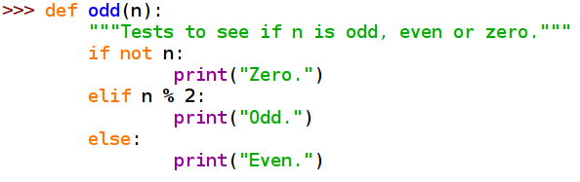
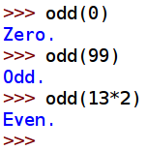
If
We have already used “if” a couple of times and you probably have a good idea of how it works.
In our template program, we test to see if the user has entered a 'q' and if so, we make the main() function “return” (which ends the program).
Enter this function in the interpreter and test it for yourself.
It's good style (but not always necessary) to pair each “if” with an “else”.
You can also add other conditions using “elif”.

Slide 5
The modulus operator '%' gives you the remainder following a division. If we divide an even number by 2, there will be no remainder.
If we divide an odd number by 2, it will give remainder 1.
>>> 8%2
0
>>> 9%2
1
So I could have written:
elif n%2 == 1:
As far as the “if” or “elif” clauses are concerned, 0 is “False” and any other number is “True” (just like “while”).
If the remainder is '1', the expression as a whole is “True” and “Odd.” is returned.
Otherwise, if the remainder was '0', that counts as “False” and the function continues to the next test.

Slide 6
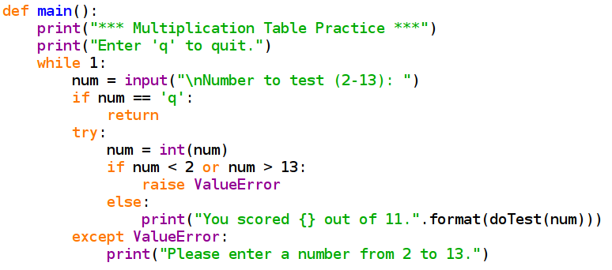
Now we are going to write a more complex program.
This will allow the user to test his/her knowledge of the multiplication tables.
The first thing to do is adapt our template to what we want to do.
We only accept numbers
between 2 & 13.
If you want to check this part before you have written doTest(), just rename the template's dummy(x) to doTest(x). This will let you check that main() is okay.
We need a function doTest() that will return a score.

Slide 7
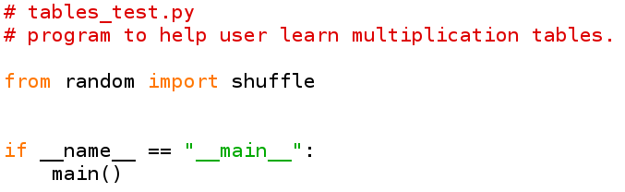
main() and doTest()
go in here.
Before we write the doTest() function, make sure you have the line that imports random. The call to the main() goes right at the end of the program.

Slide 8
Simple Version of doTest()
Using what you know now, you should be able to make a function that tests the user on his or her times tables.
set a “score” variable to zero.
loop over the numbers 2 to 13:
  print the sum we need the answer to;
  get the user's input;
  check the input against the right answer;
  add one to the score if the user was correct.
return the score.
Task:
Write and test the function.

Slide 9
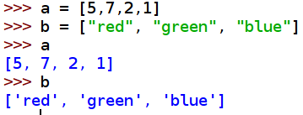
Let's use “shuffle”
It's not a very good test if we always ask for the numbers in the same order. We are going to use Python's “random” module to shuffle the numbers.
Lists
To shuffle the numbers, we need them all to be in a new data type: a list.
So far we have used variables that could just contain one item.
Lists can contain several items (or none).
They are incredibly useful and we will need them in many programs we write.
Here's one way to make a list.

Slide 10

Lists
We can also use the range() command that we use in “for” loops
to create a list.
The second example here is called a list comprehension.
These are very useful and we will be using them often.

Slide 11
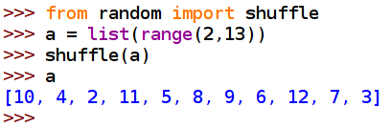

Here's how to shuffle the list.
Put the import command early in your program – before defining any functions.

Slide 12
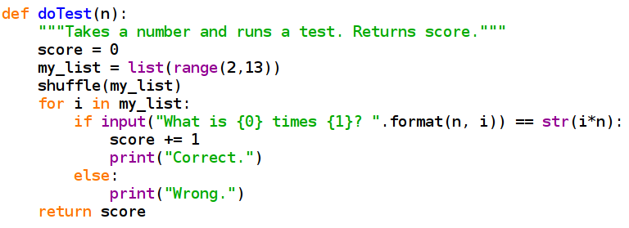
So, now we know how to make a list.
Once we have the numbers in a list, we can shuffle the list.
Then we can use the “for” loop to iterate over all the numbers in our shuffled list.
My version looks like this.
We need the string version of i*n so that we can compare it with what the user entered (a string).

Slide 13
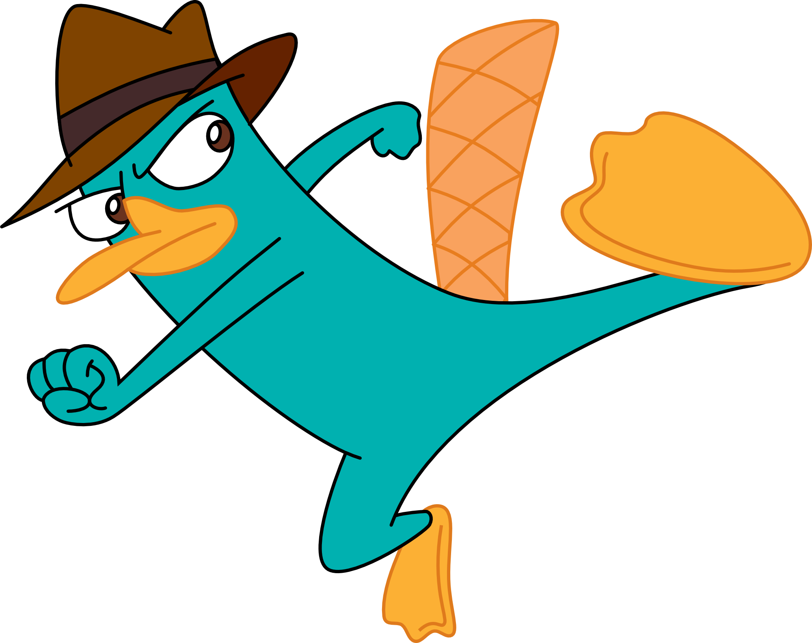
Task:
When you have entered this program and tested it, make the following modifications:
Change the doTest() function so that, if the user enters the wrong answer, the correct answer is displayed.
Ask for the user's name at the start of the program.
Store it in a variable.
After each test, tell the user, by name, how well he/she did.
11 = excellent
5 - 10 = good
0 - 5 = poor

