Slide 1

Hey, Ferb, I know what we’re gonna do today!
We are learning to:
Write recursive functions to calculate factorials and
  Fibonacci numbers.
Write a program to compute square roots.
What I am looking for:
All: Consolidate function-writing skills.
Most: Know the difference between iterative and recursive functions.
Some: Write a cube root program based on “square_root.py”.

Slide 2
Factorial (or n!)
Today's lesson involves a fair bit of maths, which is a good thing, right?
The factorial function, often written n!, means the result of multiplying some postive integer n by every integer from n down to 1.
5! = 5 x 4 x 3 x 2 x 1 = 120
Note:
For some reason that your maths teacher will explain:
0! = 1
Factorials get big very quickly ... I'd much rather use a computer than do them by hand.

Slide 3
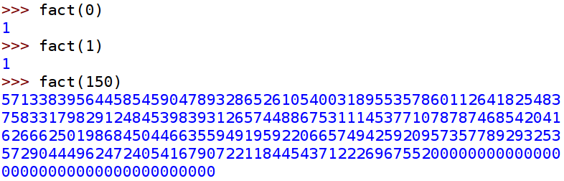
I'm sure you could write a function to calculate factorials.
So, have a go ...
Output should be something like this:
Hmm, 150! is pretty big ...

Slide 4
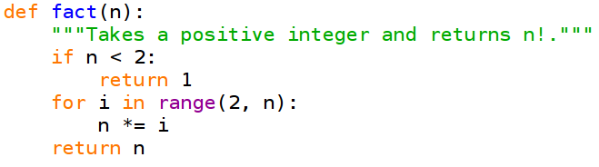
Here's my version, but as long as yours produces the correct results, it's fine!
Hopefully, that all makes sense to you.

Slide 5
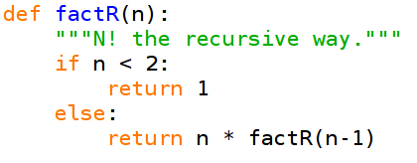
Recursion
Here's another way to compute n!.
This algorithm is different from those that we have looked at before.
It's a recursive algorithm, which means that it calls itself in order to solve the problem.
Recursive functions need a “base case” which let them know when to stop.
Instead of a loop, we have a series of recursive function calls:
  5! = 5 * 4!
  = 5 * 4 * 3!
  = 5 * 4 * 3 * 2!
  = 5 * 4 * 3 * 2 * 1!
The “if” clause tells us that 1! = 1, so now the function can return 120.

Slide 6
Reasons not to use Recursion
All those intermediate steps in the process have to be stored in a part of memory called “the stack”.
The iterative version probably uses less memory.
All those function calls can be time-consuming.
The iterative version may be faster.
Python has a built-in recursion-depth limit.
A long recursion may crash your program!
Times to use Recursion
Sometimes recursion really is the best way to solve a problem.
For instance, some of the fastest known sorting algorithms are recursive.
Recursion sometimes lets you write functions in a way that is closer to the mathematical definition of what you are doing.

Slide 7
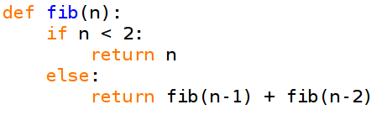
Fibonacci Numbers
The Fibonacci Numbers are really interesting, but for now we are just going to look at how to calculate them.
Fibonacci Numbers are defined as follows.
They begin with 0 and 1.
After that, you get the next term by adding together the previous two terms.
0, 1, 1, 2, 3, 5, 8, 13, 21, 34, 55, 89, 144, 233, 377 ...
This translates neatly into a recursive function.
Base Case: If n is less than 2, return n.
Otherwise: return fib(n-1) plus fib(n-2).

Slide 8
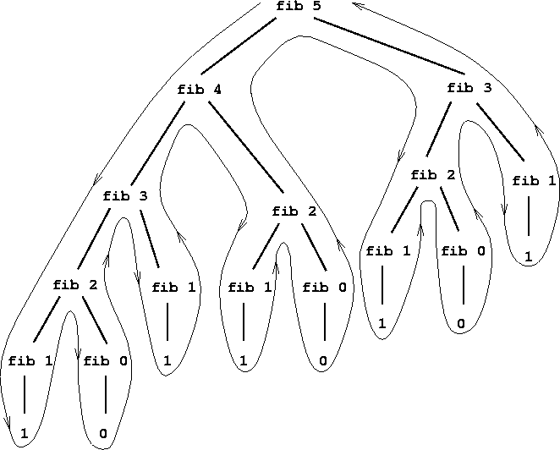
Here's a diagram of how the recursive algorithm calculates fib(5).
As you can see, there's a lot of duplication. (Bad).
The section that calculates fib(3) appears twice and there's another calculation of the fib(2) section in the middle.
This means that my recursive function is a really bad way to calculate Fibonacci numbers!

Slide 9

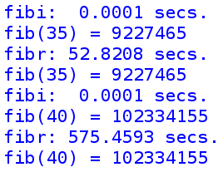
Test Machine:
Toshiba Tecra 8200.
Pentium III with 256 MB RAM.
Fibr() is slow.
Here you see the results of calculating fib(35) and fib(40).
-> “fibr” is the recursive function.
-> “fibi” uses an iterative method (basically just a “for” loop).
Task
Write an iterative function to compute Fibonacci numbers.
Test it out for correctness and speed!

Slide 10
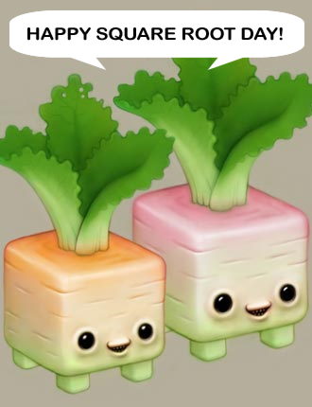
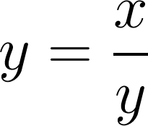
I'm sure all of you know what a Square Root is and how to find one.
Quick reminder, square root of 529:
>>> 529 ** 0.5
23.0
But that is totally cheating.
We are going to explore how to calculate square roots.
This method is attributed to:
Heron (also known as Hero) of Alexandria.
Let's say that y is the square root of x.
In that case:

Slide 11
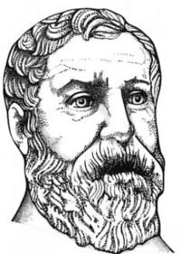
Heron's algorithm
Start by making a guess for the square root.
Loop:
If it is correct, stop.
Otherwise, take the average of the guess and x divided by the
guess as your new estimate.
Repeat
Example
We are trying to find the square root of 16.
We guess 1 (I'm only going to use 2 decimal places).
1 is not right!
The average of 1 + 16/1 is 8.5
The average of 8.5 + 16/8.5 is 5.19
The average of 5.19 + 16/5.19 is 4.14
The average of 4.14 + 16/4.14 is 4.00
What a Heron!

Slide 12
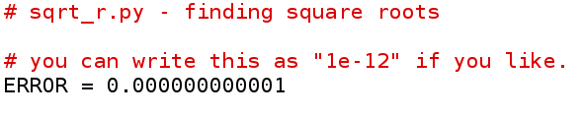
Our Square Root Function
We define ERROR as a constant.
Its value will not change during the running of the program.
It's a convention to use all capitals for the names of constants in Python.
NB. You CAN change the value of ERROR during the program, if you want.
But all the other coders will snigger.
“ERROR” is also a global value because it is defined before any of the functions. Normally we avoid this, but it saves us from having a “magic number”.
A “magic number” is what we call a number in a program that serves some mysterious purpose!
If we call our constant “ERROR” we know it means the margin of error – how close we want to get to the square root.

Slide 13
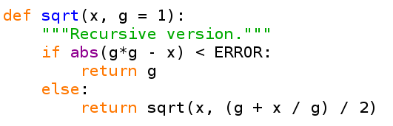
First we need a “base case” so that the function knows when to stop.
Here, I am using the abs() function (absolute value).
It takes a number and returns the positive version of that number.
>>> abs(5)
5
>>> abs(-5)
5
If the absolute value of the guess squared minus the user's number is less than the margin of error, then we have a good enough answer.
“g = 1” means: if you don't get passed a value for g, use 1.
Here's the recursive call. We pass x on.
The new guess is the average of the guess plus x divided by the guess.

Slide 14
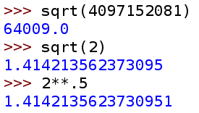
Our function works well.
It can do a (reasonably) large number.
When we give it a tough one like the square root of 2, it gives (almost) the same answer as the built-in version!
To Do
1. Get this function typed in and tested.
2. Write an iterative version of the function.
Hint: Use a “while” loop.

Slide 15

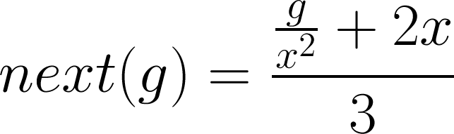
Task
Write a function that find the cube root of the number the user supplies.
To do so, you will need to change the way that the next guess is calculated.
If x is the user's number and g is the guess:
Sir Isaac Newton invented this method for Cube Roots.

