Slide 1
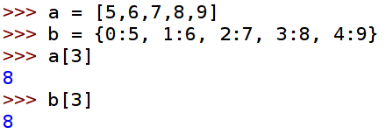
Dictionaries
So far, when we wanted to oup several pieces of information together we have used lists.
Dictionaries are another data structure that are very useful to us.
We can make a dictionary that behaves very much like a list:
This is a lot more work than just using a list, so we wouldn't bother.
The good thing about dictionaries is that we can use almost anything as the key (not just integers).

Slide 2
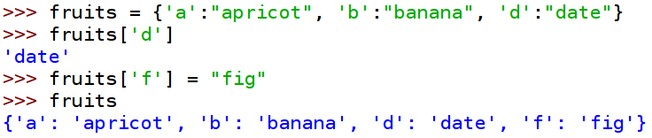
Here I have made a little dictionary of fruits, using letters a keys.
As you can see it is easy to add a pair (called a key, value pair) to the dictionary.
We are going to use dictionaries to do some encryption ...

Slide 3


Let's say we want to do the Caesar cipher.
We are going to use a shift of 3.
First, let's make an alphabet.
Now we want a dictionary that maps each letter onto one three letters ahead in the alphabet.
That is a dictionary comprehension! It works just like a list comprehension.
Now we have the mapping we require.

