Slide 1

Whatcha doin'?
Aims:
To learn how to use Scratch to perform more complex
mathematical operations.
Objectives:
ALL: Re-create a script to calulate Pi.
MOST: Work on a script to generate Prime numbers.
SOME: Adapt the prime number program to explore primality further.

Slide 2
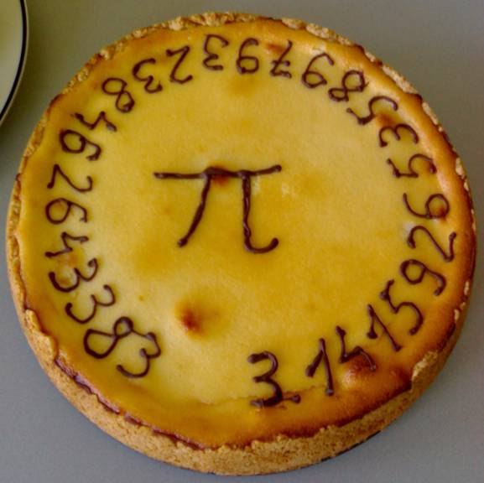
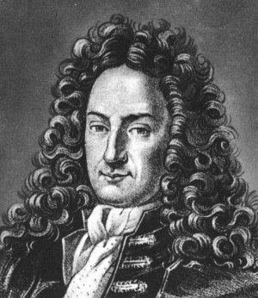
Pi
In this lesson, we are going to look at how to use Scratch to calculate Pi.
The method we are going to use was invented by Gottfried Wilhelm Leibnitz (1646-1716).

Slide 3
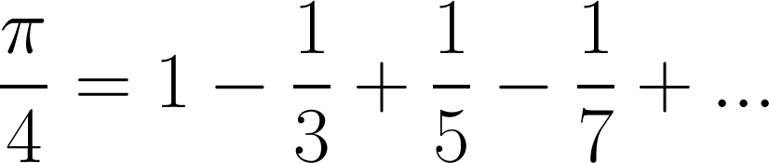
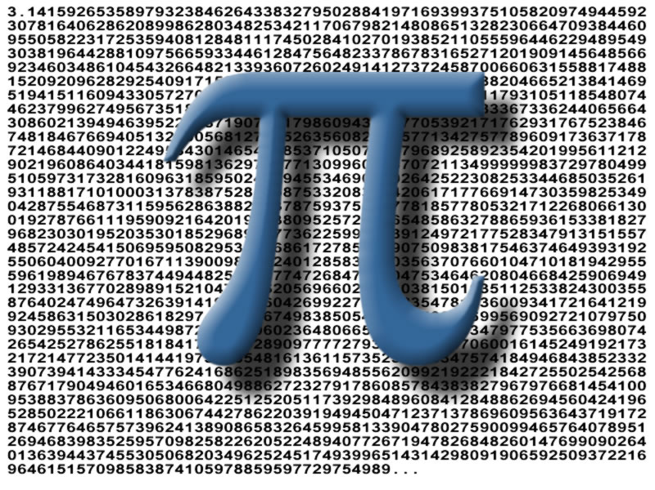
So, let's see how we can make a script to use this formula to calculate pi.

Slide 4
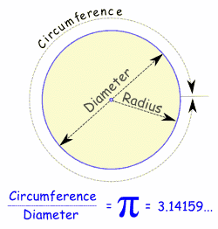
The first thing to note is that all the fractions have one on the top.
The numbers below are the consecutive odd numbers.
We have to alternate between adding and taking away the fractions.
The longer the series of fractions we use, the more accurate our estimation of Pi will be.

Slide 5
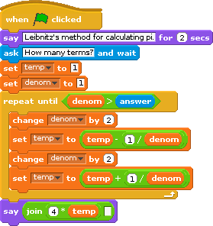
We let the user choose how many terms in the series to use.
We set “denom” (for denominator) and the temporary variable “temp” both to 1.
This means we have done the first term in the series before we enter the loop.
Then we loop until the denominator is bigger than the number the user gave us.
We do a subtraction and an addition adding 2 before each operation in order to reproduce the calculation we wanted.
This is a little trick – if you don't join the answer on to a space, Scratch will round the answer down to 2 decimal places.

Slide 6
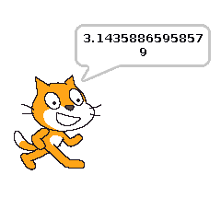

I ran my program for 1000 terms and this was the result I got.
As you can see, only the first two decimal places are correct!
This is quite a poor way to calculate pi.
The series “converges” (or gets closer to) pi very slowly.
Task:
Try experimenting with the program. See if you can use a larger number of terms to get pi accurate to 4 decimal places.

Slide 7
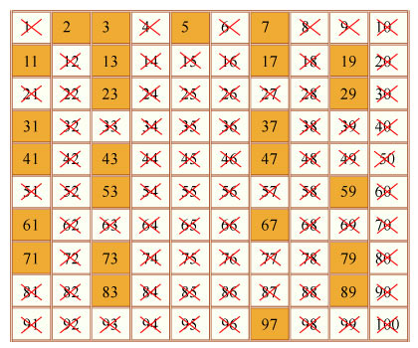
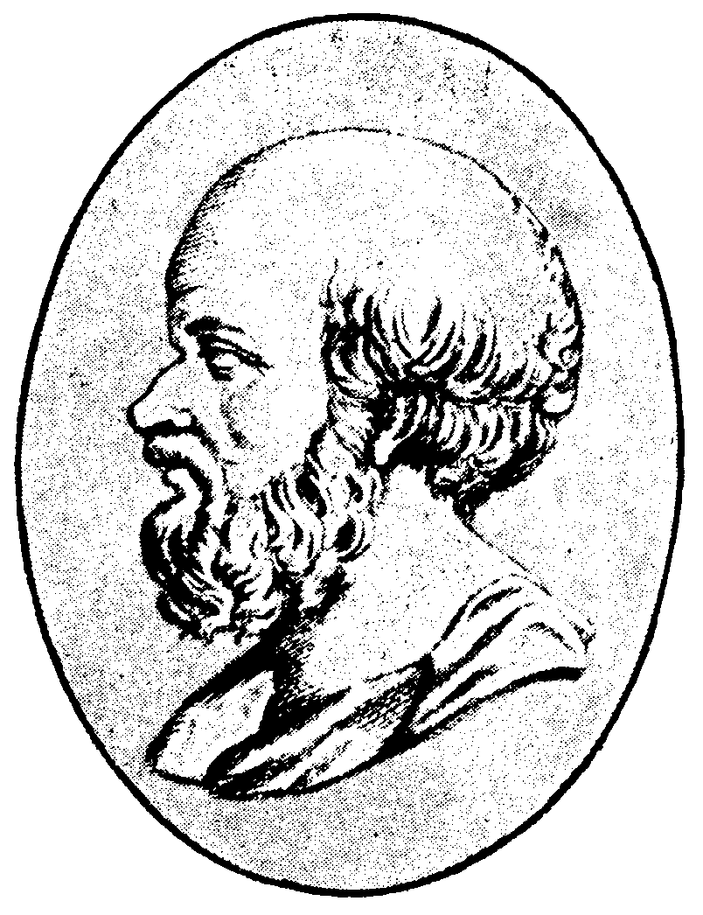
Prime Numbers
When you learned about prime numbers, you may have looked at “The Sieve of Eratosthenes”.
This is a very ancient algorithm for finding prime numbers.
First, write out all the numbers from which you want to find primes.
Cross off 1 as it is not prime.

Slide 8
The next number to the right that is not crossed out is prime.
Cross out all the numbers that are divisible by that number.
Repeat until you have run out of numbers!

Slide 9


So, now we have a method, let's see how we can write a script that will use this method to find prime numbers.
Let's make the program find the nth prime, in other words, the user gives us a number and we find the prime in that position in the series of primes.
For instance the first prime number is 2.
The 100th prime is 541.
Let's use a list!

