Slide 1

AI-ENHNACED SUSTAINABLE FARMING
FA20-BSSE-215: Muhammad Usman
FA20-BSSE-220: Muhammad Farhan Rana
Supervisor: Mam Sadia Zafar

Slide 2
Agenda
Agenda: AI-Enhanced Sustainable Farming
1.Introduction - Importance of sustainable farming - Role of AI in agriculture
2. AI Technologies in Farming -Precision agriculture - Predictive analytics - Robotics and automation
3. Case Studies - Real-world examples - Success stories
4. Challenges and Solutions - Adoption barriers - Ethical considerations
5. Future Trends - Innovations in AI - Long-term impacts
6. Q&A Session - Open discussion

Slide 3
Introduction
Project Overview
Development of the "AI Enhanced Sustainable Farming" system
Aim: Integrate artificial intelligence with sustainable agricultural practices
Incorporates AI, IoT devices, and data analytics to assist farmers
Provides actionable insights to improve farming efficiency
Project Goals
Enhance Farming Efficiency
Optimize resource utilization (water, fertilizers, pesticides)
Improve crop management and monitoring
Promote Environmental Sustainability
Reduce environmental impact through precise farming techniques
Support eco-friendly farming practices
Maximize Crop Yields
Predict crop yields with high accuracy
Provide recommendations for optimal farming practices

Slide 4
Problem Statement
Challenges in Modern Agriculture
Resource Optimization
Inefficient use of water, fertilizers, and pesticides leads to waste and increased costs
Environmental Impact
Conventional farming practices contribute to soil degradation, water pollution, and greenhouse gas emissions
Crop Productivity
Inconsistent crop yields due to varying environmental conditions, pest infestations, and diseases
Need for Advanced Solutions
Data-Driven Decision Making
Lack of real-time data and predictive insights to support informed decision making
Integration of Technology
Underutilization of AI, IBM cloud Sensor Simulator, and data analytics in agriculture
Sustainability Goals
Growing need for sustainable farming practices to ensure long-term food security

Slide 5

Related woRK
Cloud Tern Solution (2024)
Title: AI Revolutionizing Sustainable Agriculture: Enhancing Crop Monitoring and Management
Focus: Using AI for real-time crop monitoring and management, enhancing crop yield, and reducing resource wastage.
Outcome: Demonstrated significant improvements in crop yield prediction accuracy and resource optimization.
Drawback: 1. High Initial cost 2. Not Scalable at varying farm size
Montrealethics.ai (2024)
Title: AI Applications in Agriculture: Sustainable Farming
Focus: Application of AI technologies to promote sustainable farming practices.
Outcome: Highlighted the potential of AI to improve sustainability by optimizing the use of fertilizers and pesticides, thus minimizing environmental impact.
Drawback: 1. Difficulty in integrating AI systems with environment 2. Technical Complexity
Ahmed et al. (2022)
Title: Enhancing Smart Farming through the Applications of Agriculture 4.0 Technologies
Journal: Internet of Things, 18, 100334
Focus: Comprehensive review of Agriculture 4.0 technologies, including IoT, AI, and big data.
Outcome: Identified key technologies and their applications in enhancing farm productivity and sustainability.
Drawback: 1. Interoperability Issues 2. Dependence on External Factors

Slide 6
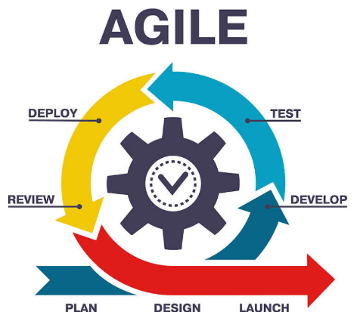
Methodology
1. Development Approach
Agile Software Development: Iterative development with continuous feedback integration.
Combination of Methodologies: Incorporation of both Waterfall and Agile elements.
2. Tools and Techniques
Programming Languages: Python for data analysis and machine learning.
Development Environments: VS-Code and Jupyter Notebook for coding and debugging.
Version Control: Git and GitHub for collaboration and version tracking.
3. Data Management and Analysis
Libraries: Pandas and NumPy for data manipulation; TensorFlow and Scikit-learn for machine learning.
Testing:
Unit Testing: Using pytest to ensure component functionality.
Integration Testing: Validating module interactions.
4. Continuous Integration/Continuous Deployment (CI/CD)
Automation: GitHub CI/CD pipelines for automated build, test, and deployment processes.

Slide 7
Methodology
Requirement Gathering
Design
Implementation
Testing
Verification
Validation
5. Development Stages
Requirements Gathering: Domain analysis to identify needs and constraints.
Design: Developing high-level architecture and system design for modularity and scalability.
Implementation: Coding is based on design specifications, followed by best practices.
Testing: Writing and executing unit and integration tests to validate functionality.
Validation: Ensuring the system meets original specifications and requirements.
Verification: Code walkthroughs and peer reviews to identify potential issues.
6. Core Functionalities
Data Collection: Gathering data from IBM Cloud and Kaggle.
Data Processing: Cleaning and normalizing data for analysis.
AI Analysis: Using machine learning to predict crop yields, pest infestations, and disease outbreaks.
Decision Support: Generating recommendations for Crop.
Actuation/Implementation: Implementing actions through IoT devices, drones, and automated machinery.
Development
Stages

Slide 8


Tools & technologies
1. Programming Languages
Python: Chosen for its extensive libraries in data analysis and machine learning.
2. Development Environments
VS-Code: Used for coding and debugging.
Jupyter Notebook: Ideal for data exploration and interactive coding.
3. Version Control
Git & GitHub: Essential for collaboration, version tracking, and maintaining a history of changes.
4. Data Management and Analysis
Pandas & NumPy: Libraries for data manipulation and analysis.
TensorFlow & Scikit-learn: Libraries used for machine learning tasks.
5. Testing Frameworks
Integration Testing: Validating the interaction between different modules.
6. Continuous Integration/Continuous Deployment (CI/CD)
GitHub: Used to automate the build, test, and deployment processes.

Slide 9
Results
Category | Description | Key Metrics
Functionality | Accurate Data Collection: Successful data gathering from IBM Simulator and Kaggle. Effective Data Processing: Efficient cleaning, preprocessing, and normalizing of data. AI Analysis: Accurate predictions for crop yields, pest infestations, and disease outbreaks. Decision Support: Actionable recommendations for optimized farming practices. | High accuracy in predictions. Effective decision-making insights. Comprehensive data analysis.
Performance | High Computational Efficiency: Fast response times even with large data volumes. Low Latency: Quick processing and analysis. Resource Utilization: Maintained optimal performance under varying loads. | Fast response times. Low latency. Efficient resource utilization.
Reliability | Robust System: High reliability with minimal downtime. Error Handling: Effective error handling mechanisms. | High uptime percentage. Robust error handling and recovery processes.
Scalability | Seamless Scaling: Efficient handling of increasing data volumes and user loads. Future Growth: Ready to scale further as more data and users are added. | Ability to handle large datasets. Scalable architecture supporting future growth and expansion.

Slide 10
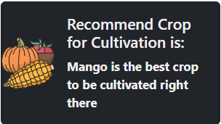
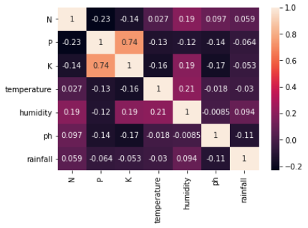
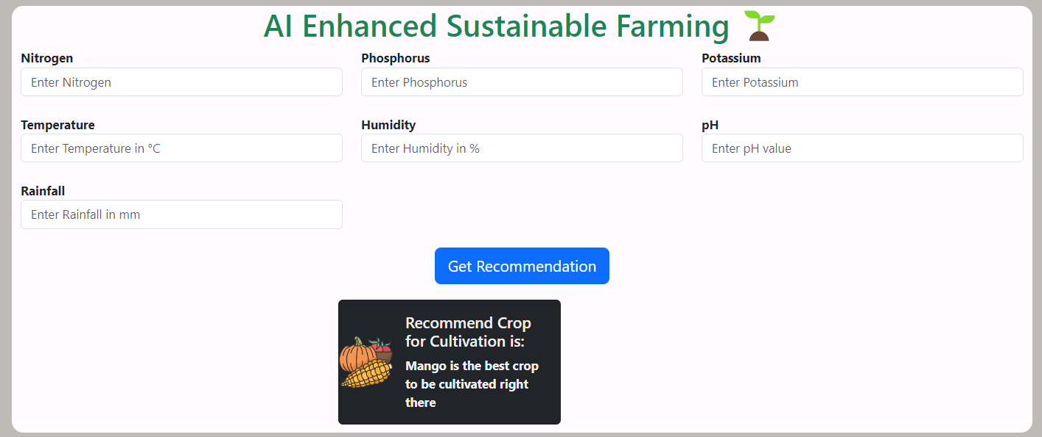
INTERFACE
User-Friendly Design:
Dashboard:
Data Collection:
Decision Support:
Web Accessibility:

Slide 11
Conclusion AND Future work
Conclusion
Significant Advancements:
Effective Solution:
Impact:
Future Work
Enhanced Data Integration:
Advanced AI Models:
Emerging Technologies:
Leveraged AI, IoT, and data analytics to enhance sustainable farming
Provided actionable insights and decision-support tools to farmers.
Accurate data collection, processing, and analysis.
Robust performance and high reliability under real-world conditions.
Optimized resource utilization and increased crop yields.
Minimized environmental impact.
Further integration with external data sources and farm management systems.
Seamless data exchange and interoperability.
Development of more sophisticated machine learning algorithms.
Improved accuracy and predictive capabilities.
Explore integration with blockchain and edge computing.
Enhance data security, traceability, andrealtime decision-making.

Slide 12
references
A comprehensive list of references is cited using a standard format.
[1] Cloud Tern Solution, "AI Revolutionizing Sustainable Agriculture: Enhancing Crop Monitoring and Management," Version 1.0, April 3, 2024. [Online]. Available: https://www.linkedin.com/pulse/ai-revolutionizing-sustainable-agriculture-enhancing-crop-monitoring-u0o8c/
[2] Montrealethics.ai, "AI Applications in Agriculture: Sustainable Farming," Version 1.0, January 24, 2024. [Online]. Available: https://montrealethics.ai/ai-applications-in-agriculture-sustainable-farming/
[3] Yu, X., Chen, Q., & Wang, X. (2020). Research on the application of deep learning in intelligent transportation systems. Journal of Physics: Conference Series, 1693(1), 012058. https://doi.org/10.1088/1742-6596/1693/1/012058 [Research paper]

Slide 13
Demonstration

