Slide 1
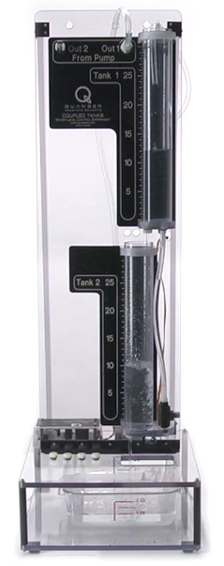
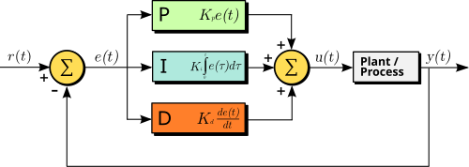
The PID Workshop
CSSC at UT Dallas
Juned Shaikh, Reillan Sawyer and
Muhammad Usama Zubair
Notes:
Welcome to the PID workshop. The goal of this session is to build intuition first and formulas second. We will start with the structure of a PID controller, then move into practical tuning, common implementation issues, and a few techniques that make the controller more usable in real systems. By the end, the audience should understand what each gain does, how to get a reasonable first set of gains, and why real hardware usually needs more than the ideal textbook equation. [Sources] MathWorks Simulink PID Controller documentation: derivative filtering, output saturation, anti-windup, and controller structure. Caltech FBS Wiki PID Control chapter: PID roles, integrator windup, and tuning overview. Engineering LibreTexts PID tuning via classical methods: Ziegler-Nichols experimental tuning concepts. Wikipedia: PID controller and Ziegler-Nichols method for standard definitions and classic formulas.

Slide 2
The PID Workshop
Intro to PID
Manual tuning
Problems with the D
Integral Anti-windup
Ziegler-Nichols (ZN) tuning
Gain Scheduling
Link: https://github.com/m-usama-z/cssc-pid-workshop
Notes:
This is the roadmap for the workshop. We begin with the meaning of proportional, integral, and derivative action. Then we look at manual tuning because it is still one of the most useful engineering skills when a model is incomplete. After that, we focus on two practical problems: derivative sensitivity to noise and integral windup under actuator limits. We then cover Ziegler-Nichols as a systematic starting rule, and we close with gain scheduling for systems whose dynamics change across operating conditions. [Sources] MathWorks Simulink PID Controller documentation: derivative filtering, output saturation, anti-windup, and controller structure. Caltech FBS Wiki PID Control chapter: PID roles, integrator windup, and tuning overview. Engineering LibreTexts PID tuning via classical methods: Ziegler-Nichols experimental tuning concepts. Wikipedia: PID controller and Ziegler-Nichols method for standard definitions and classic formulas.

Slide 3

Intro to PID
Notes:
A PID controller compares the reference with the measured output and acts on the error. The proportional term gives an immediate correction that scales with how far we are from the setpoint. The integral term accumulates past error, so it is the term that removes persistent offset. The derivative term looks at how fast the error is changing, which can add damping and reduce overshoot. A useful way to explain the tuning roles is this: proportional sets aggressiveness, integral corrects bias over time, and derivative adds prediction. In practice, many loops run as PI because the derivative term is not always worth the added sensitivity to noise. [Sources] MathWorks Simulink PID Controller documentation: derivative filtering, output saturation, anti-windup, and controller structure. Caltech FBS Wiki PID Control chapter: PID roles, integrator windup, and tuning overview. Engineering LibreTexts PID tuning via classical methods: Ziegler-Nichols experimental tuning concepts. Wikipedia: PID controller and Ziegler-Nichols method for standard definitions and classic formulas.

Slide 4
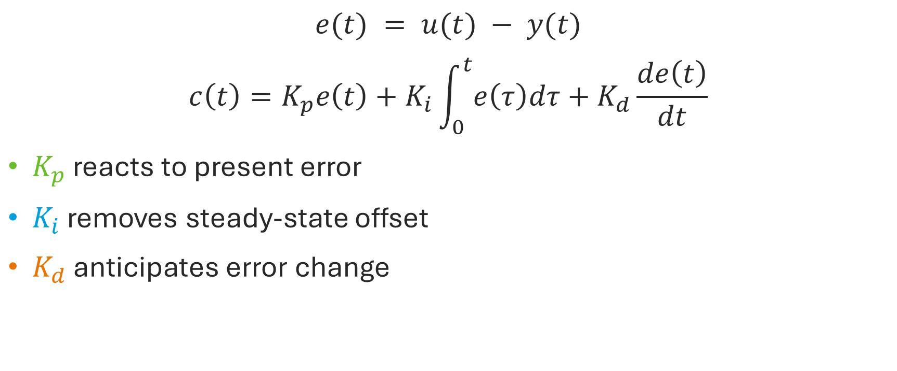
Intro to PID
$$e(t) = u(t) − y(t)$$
$$c\left(t\right)=K_{p}e\left(t\right)+K_{i}\int_{0}^{t}{e\left(τ\right)dτ}+K_{d}\frac{de\left(t\right)}{dt}$$
$K_{p}$ reacts to present error
$K_{i}$ removes steady-state offset
$K_{d}$ anticipates error change
Notes:
A PID controller compares the reference with the measured output and acts on the error. The proportional term gives an immediate correction that scales with how far we are from the setpoint. The integral term accumulates past error, so it is the term that removes persistent offset. The derivative term looks at how fast the error is changing, which can add damping and reduce overshoot. A useful way to explain the tuning roles is this: proportional sets aggressiveness, integral corrects bias over time, and derivative adds prediction. In practice, many loops run as PI because the derivative term is not always worth the added sensitivity to noise. [Sources] MathWorks Simulink PID Controller documentation: derivative filtering, output saturation, anti-windup, and controller structure. Caltech FBS Wiki PID Control chapter: PID roles, integrator windup, and tuning overview. Engineering LibreTexts PID tuning via classical methods: Ziegler-Nichols experimental tuning concepts. Wikipedia: PID controller and Ziegler-Nichols method for standard definitions and classic formulas.

Slide 5
Car Acceleration Analogy
P - Proportional (The Current Error)
Action: You notice your speed (e.g., 60 mph) is lower than your desired speed (e.g., 80 mph).
Intuition: The larger the speed difference (error), the harder you press the gas pedal.
Result: You quickly accelerate to reduce that gap.

Slide 6
Car Acceleration Analogy
I - Integral (The Past Error)
Action: You are driving up a long hill. Even though you are pressing the pedal, the speed stays slightly below 80 mph for a sustained time.
Intuition: Because the car has been below the speed for a while, you gradually press the pedal further down to compensate for the incline.
Result: The accumulation of time spent driving too slowly makes you add more gas to eliminate that steady-state error.

Slide 7
Car Acceleration Analogy
D - Derivative (The Future Error/Change)
Action: You notice your speed is approaching 80 mph very quickly.
Intuition: You lift off the accelerator slightly before you reach 80 mph to prevent overshooting the speed.
Result: You are acting on the rate of change (acceleration) to stabilize the speed smoothly, rather than waiting for the speed to already be too high.

Slide 8
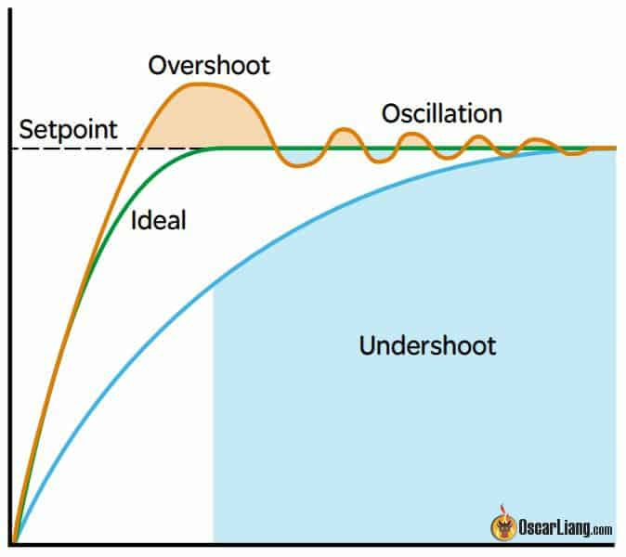
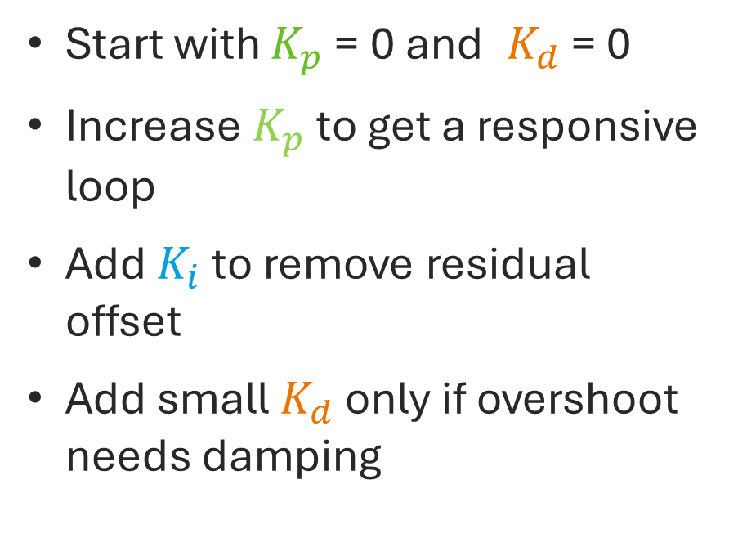
Manual Tuning
Start with $K_{p}$ = 0 and $K_{d}$ = 0
Increase $K_{p}$ to get a responsive loop
Add $K_{i}$ to remove residual offset
Add small $K_{d}$ only if overshoot needs damping
Notes:
A practical manual tuning workflow is to start with proportional control only. Increase Kp until the loop becomes responsive but not obviously oscillatory. Once the response is fast enough, introduce integral action gradually to remove steady-state error. If the system overshoots too much or rings, a small amount of derivative action may help, but it should be added cautiously. While tuning, watch a few simple metrics: rise time tells you how fast the response is, overshoot tells you how aggressive it is, settling time tells you when the system calms down, and steady-state error tells you whether the final value is correct. This procedure is not optimal, but it is transparent and effective for first-pass tuning. [Sources] MathWorks Simulink PID Controller documentation: derivative filtering, output saturation, anti-windup, and controller structure. Caltech FBS Wiki PID Control chapter: PID roles, integrator windup, and tuning overview. Engineering LibreTexts PID tuning via classical methods: Ziegler-Nichols experimental tuning concepts. Wikipedia: PID controller and Ziegler-Nichols method for standard definitions and classic formulas.

Slide 9
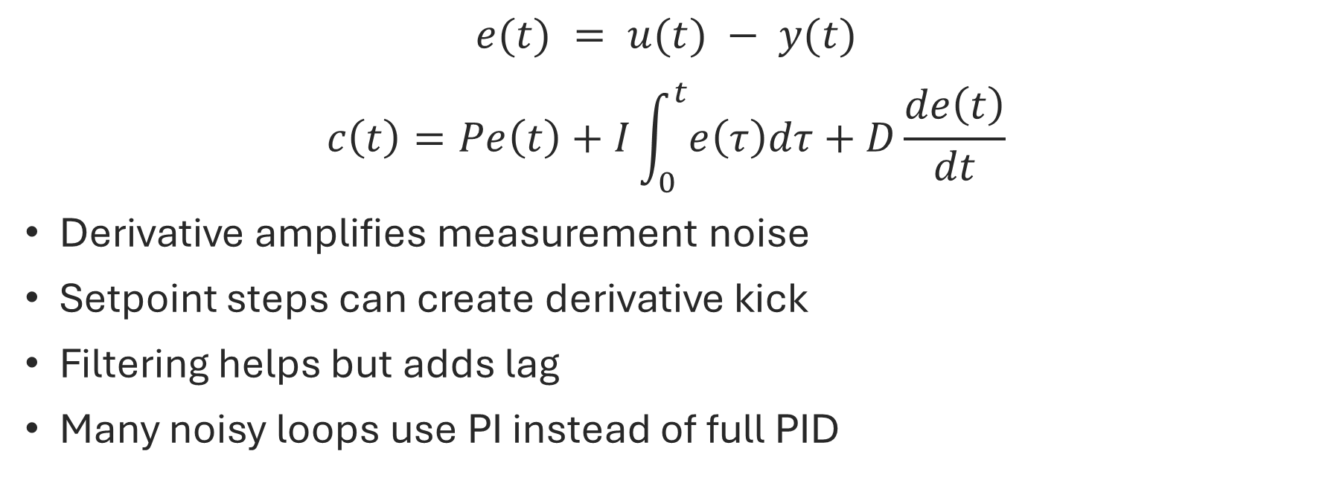
Problems with D
$$e(t) = u(t) − y(t)$$
$$c\left(t\right)=Pe\left(t\right)+I\int_{0}^{t}{e\left(τ\right)dτ}+D\frac{de\left(t\right)}{dt}$$
Derivative amplifies measurement noise
Setpoint steps can create derivative kick
Filtering helps but adds lag
Many noisy loops use PI instead of full PID
Notes:
The derivative term is attractive in theory because it predicts the trend of the error, but it also reacts strongly to high-frequency measurement noise. That means a noisy sensor can make the control signal chatter when derivative gain is too large. Another issue is derivative kick: if the derivative is taken directly on the error, a sudden setpoint change can create a large spike in control effort. Two common mitigations are to filter the derivative term and to take derivative action on the measurement rather than on the full error. Even with those fixes, derivative action is often omitted in noisy industrial loops, which is why PI control is extremely common. [Sources] MathWorks Simulink PID Controller documentation: derivative filtering, output saturation, anti-windup, and controller structure. Caltech FBS Wiki PID Control chapter: PID roles, integrator windup, and tuning overview. Engineering LibreTexts PID tuning via classical methods: Ziegler-Nichols experimental tuning concepts. Wikipedia: PID controller and Ziegler-Nichols method for standard definitions and classic formulas.

Slide 10
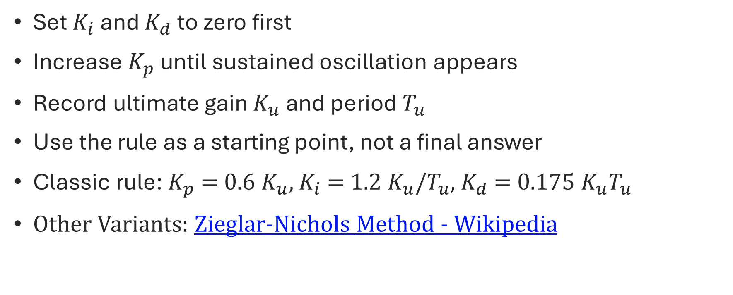
Ziegler-Nichols Tuning
Set $K_{i}$ and $K_{d}$ to zero first
Increase $K_{p}$ until sustained oscillation appears
Record ultimate gain $K_{u}$ and period $T_{u}$
Use the rule as a starting point, not a final answer
Classic rule: $K_{p}$ = 0.6 $K_{u}$, $K_{i}$ = 1.2 $K_{u}$/$T_{u}$, $K_{d}$ = 0.175 $K_{u}T_{u}$
Other Variants: Zieglar-Nichols Method - Wikipedia
Notes:
The Ziegler-Nichols closed-loop method is a classic heuristic for getting initial PID gains. You disable integral and derivative action, then increase proportional gain until the loop reaches sustained oscillation. That gain is the ultimate gain, Ku, and the oscillation period is Pu. The Ziegler-Nichols formulas convert those two measured quantities into initial controller settings. The benefit is that the method is simple and does not require a detailed process model. The downside is that it tends to produce aggressive tuning with noticeable overshoot, so it should be treated as a starting point that is refined afterward based on the real design goals. [Sources] MathWorks Simulink PID Controller documentation: derivative filtering, output saturation, anti-windup, and controller structure. Caltech FBS Wiki PID Control chapter: PID roles, integrator windup, and tuning overview. Engineering LibreTexts PID tuning via classical methods: Ziegler-Nichols experimental tuning concepts. Wikipedia: PID controller and Ziegler-Nichols method for standard definitions and classic formulas.

Slide 11
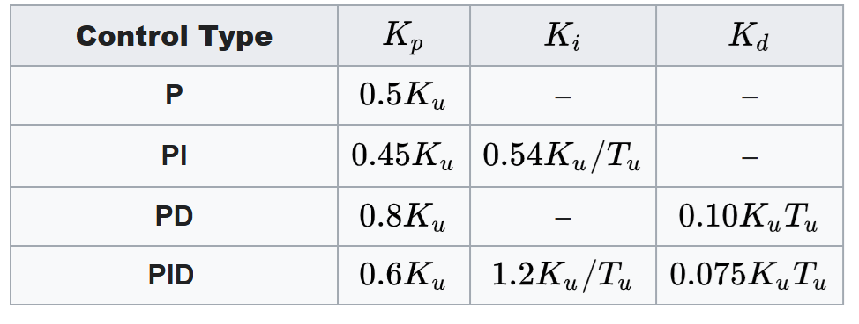
Ziegler-Nichols Tuning
Notes:
The Ziegler-Nichols closed-loop method is a classic heuristic for getting initial PID gains. You disable integral and derivative action, then increase proportional gain until the loop reaches sustained oscillation. That gain is the ultimate gain, Ku, and the oscillation period is Pu. The Ziegler-Nichols formulas convert those two measured quantities into initial controller settings. The benefit is that the method is simple and does not require a detailed process model. The downside is that it tends to produce aggressive tuning with noticeable overshoot, so it should be treated as a starting point that is refined afterward based on the real design goals. [Sources] MathWorks Simulink PID Controller documentation: derivative filtering, output saturation, anti-windup, and controller structure. Caltech FBS Wiki PID Control chapter: PID roles, integrator windup, and tuning overview. Engineering LibreTexts PID tuning via classical methods: Ziegler-Nichols experimental tuning concepts. Wikipedia: PID controller and Ziegler-Nichols method for standard definitions and classic formulas.

Slide 12
Integral Anti-Windup
Windup happens when the actuator saturates
The integrator keeps accumulating error
Recovery becomes slow and overshoot grows
Clamp or back-calculate the integrator state
Notes:
Integral windup appears when the actuator hits a limit, such as maximum voltage, valve position, or duty cycle. The controller output cannot increase further, but the integrator may keep accumulating error as if more authority were available. When the loop finally leaves saturation, that stored integral action causes sluggish recovery or large overshoot. Anti-windup methods try to stop that buildup. The simplest approach is clamping, where the integrator is paused or limited when the output is saturated in the wrong direction. A more systematic method is back-calculation, which feeds the difference between the unsaturated and saturated outputs back into the integrator state. [Sources] MathWorks Simulink PID Controller documentation: derivative filtering, output saturation, anti-windup, and controller structure. Caltech FBS Wiki PID Control chapter: PID roles, integrator windup, and tuning overview. Engineering LibreTexts PID tuning via classical methods: Ziegler-Nichols experimental tuning concepts. Wikipedia: PID controller and Ziegler-Nichols method for standard definitions and classic formulas.

Slide 13
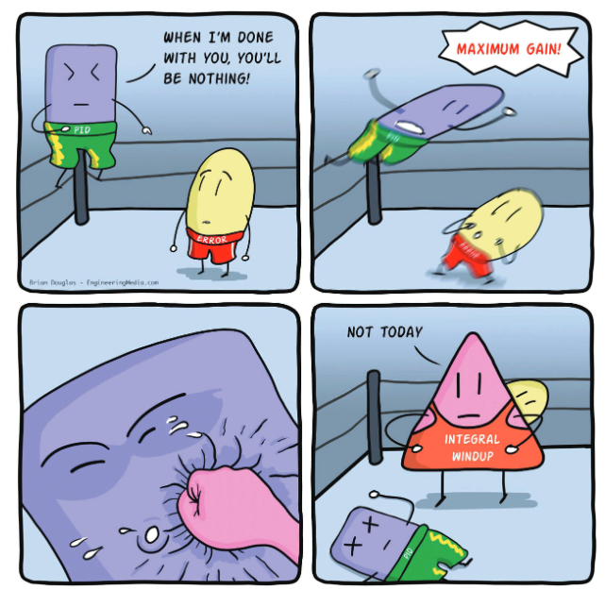
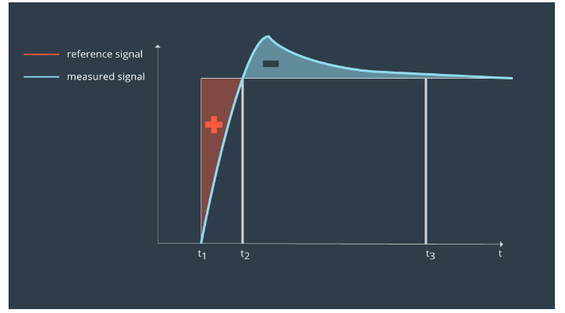
Integral Anti-Windup
Notes:
Integral windup appears when the actuator hits a limit, such as maximum voltage, valve position, or duty cycle. The controller output cannot increase further, but the integrator may keep accumulating error as if more authority were available. When the loop finally leaves saturation, that stored integral action causes sluggish recovery or large overshoot. Anti-windup methods try to stop that buildup. The simplest approach is clamping, where the integrator is paused or limited when the output is saturated in the wrong direction. A more systematic method is back-calculation, which feeds the difference between the unsaturated and saturated outputs back into the integrator state. [Sources] MathWorks Simulink PID Controller documentation: derivative filtering, output saturation, anti-windup, and controller structure. Caltech FBS Wiki PID Control chapter: PID roles, integrator windup, and tuning overview. Engineering LibreTexts PID tuning via classical methods: Ziegler-Nichols experimental tuning concepts. Wikipedia: PID controller and Ziegler-Nichols method for standard definitions and classic formulas.

Slide 14
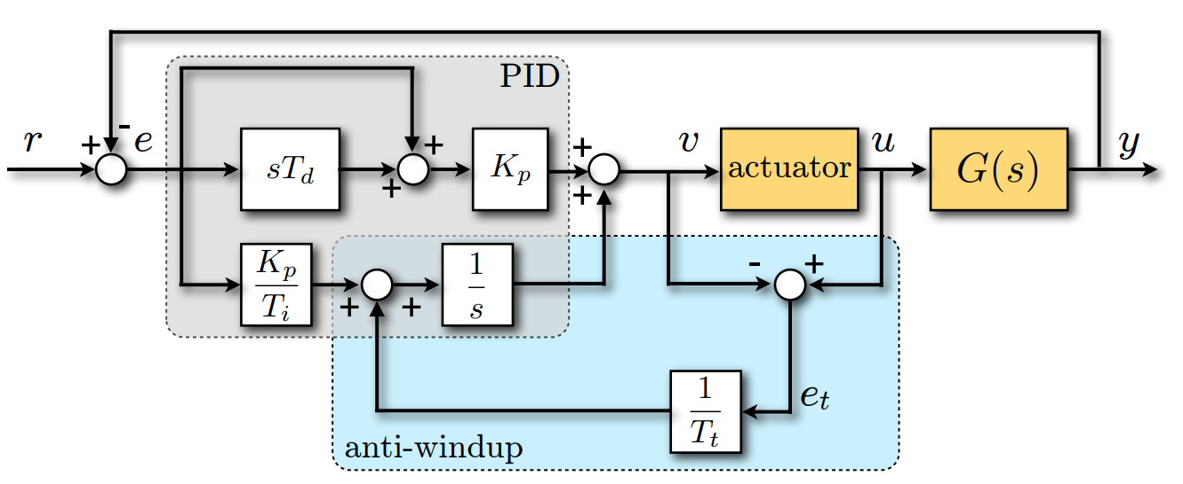
Back-calculation
Notes:
A more systematic method is back-calculation, which feeds the difference between the unsaturated and saturated outputs back into the integrator state. [Sources] MathWorks Simulink PID Controller documentation: derivative filtering, output saturation, anti-windup, and controller structure. Caltech FBS Wiki PID Control chapter: PID roles, integrator windup, and tuning overview. Engineering LibreTexts PID tuning via classical methods: Ziegler-Nichols experimental tuning concepts. Wikipedia: PID controller and Ziegler-Nichols method for standard definitions and classic formulas.

Slide 15
Gain Scheduling
One gain set may not fit all operating points
Schedule gains using various sensor measurements
Interpolate smoothly between local tunings
Validate transitions as carefully as steady operation
Notes:
Gain scheduling is useful when the plant behaves differently in different regions, for example at low versus high speed, light versus heavy load, or small versus large angle. Instead of forcing one fixed controller to handle the whole range, we tune several local controllers and switch or interpolate between them based on a scheduling variable. The key idea is simple, but implementation needs care. The scheduling variable should be measurable and physically meaningful, the gains should vary smoothly to avoid abrupt control changes, and transitions must be tested because a controller that looks good at each operating point can still behave poorly while moving between them. [Sources] MathWorks Simulink PID Controller documentation: derivative filtering, output saturation, anti-windup, and controller structure. Caltech FBS Wiki PID Control chapter: PID roles, integrator windup, and tuning overview. Engineering LibreTexts PID tuning via classical methods: Ziegler-Nichols experimental tuning concepts. Wikipedia: PID controller and Ziegler-Nichols method for standard definitions and classic formulas.

Slide 16
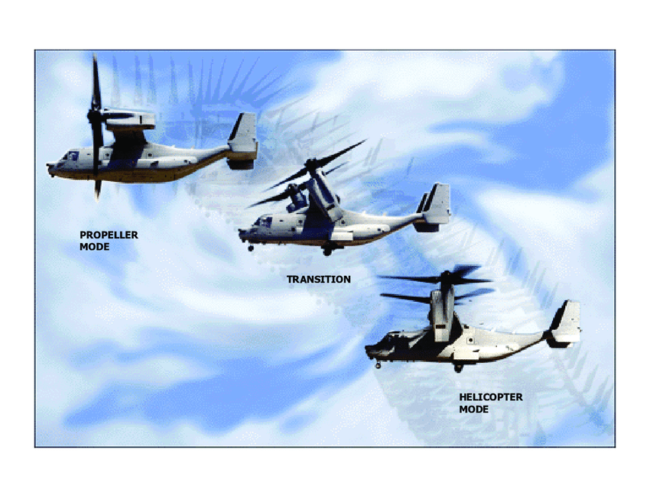
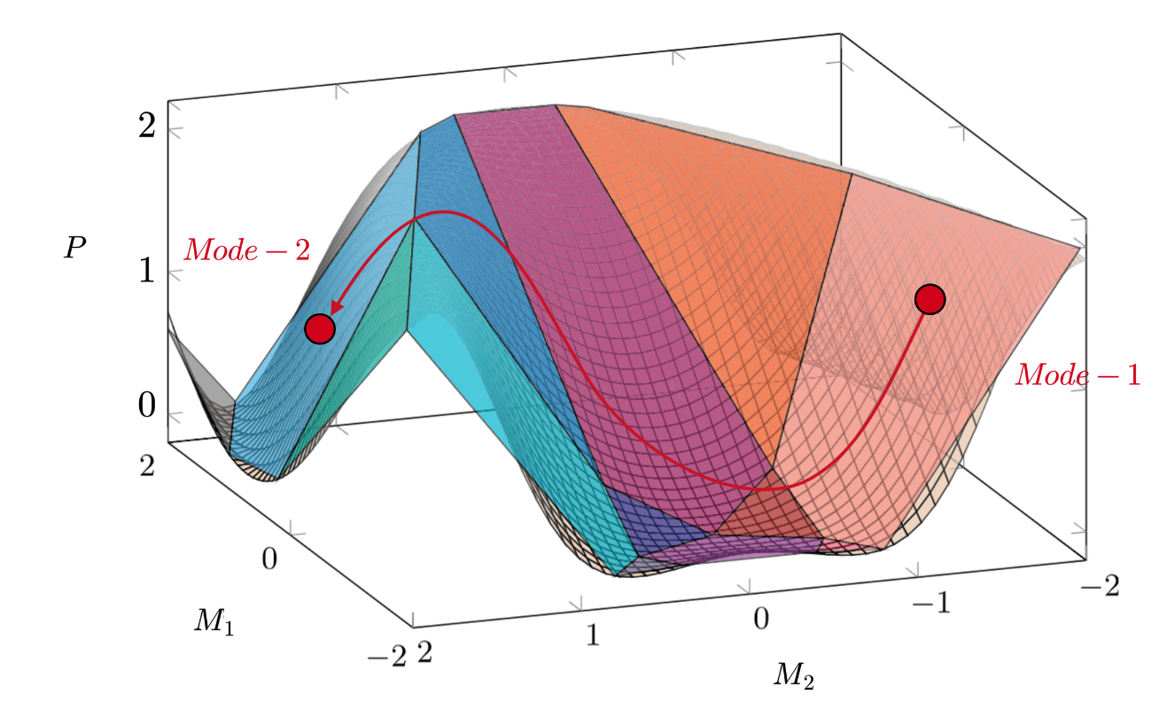
Gain Scheduling
Notes:
Gain scheduling is useful when the plant behaves differently in different regions, for example at low versus high speed, light versus heavy load, or small versus large angle. Instead of forcing one fixed controller to handle the whole range, we tune several local controllers and switch or interpolate between them based on a scheduling variable. The key idea is simple, but implementation needs care. The scheduling variable should be measurable and physically meaningful, the gains should vary smoothly to avoid abrupt control changes, and transitions must be tested because a controller that looks good at each operating point can still behave poorly while moving between them. [Sources] MathWorks Simulink PID Controller documentation: derivative filtering, output saturation, anti-windup, and controller structure. Caltech FBS Wiki PID Control chapter: PID roles, integrator windup, and tuning overview. Engineering LibreTexts PID tuning via classical methods: Ziegler-Nichols experimental tuning concepts. Wikipedia: PID controller and Ziegler-Nichols method for standard definitions and classic formulas.

Slide 17
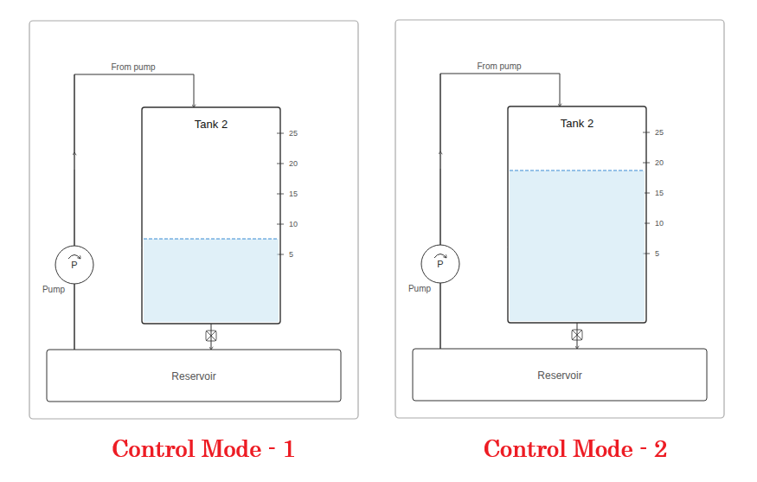
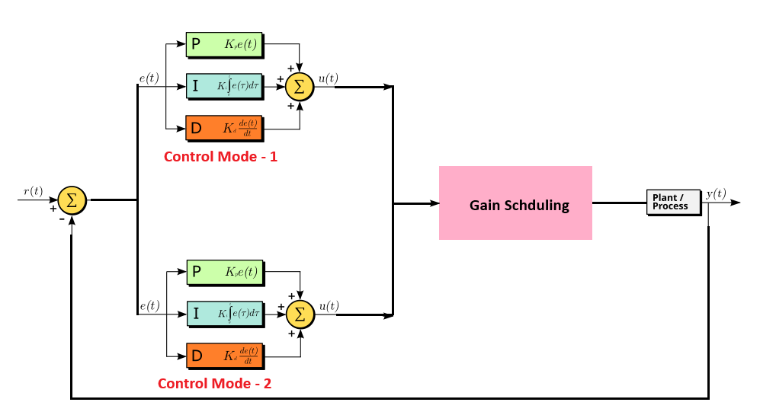
Gain Scheduling
Notes:
Gain scheduling is useful when the plant behaves differently in different regions, for example at low versus high speed, light versus heavy load, or small versus large angle. Instead of forcing one fixed controller to handle the whole range, we tune several local controllers and switch or interpolate between them based on a scheduling variable. The key idea is simple, but implementation needs care. The scheduling variable should be measurable and physically meaningful, the gains should vary smoothly to avoid abrupt control changes, and transitions must be tested because a controller that looks good at each operating point can still behave poorly while moving between them. [Sources] MathWorks Simulink PID Controller documentation: derivative filtering, output saturation, anti-windup, and controller structure. Caltech FBS Wiki PID Control chapter: PID roles, integrator windup, and tuning overview. Engineering LibreTexts PID tuning via classical methods: Ziegler-Nichols experimental tuning concepts. Wikipedia: PID controller and Ziegler-Nichols method for standard definitions and classic formulas.

Slide 18
References
Markaroglu, Hayk, et al. "Tracking time adjustment in back calculation anti-windup scheme." ECMS 2006 Proceedings edited by: W. Borutzky, A. Orsoni, R. Zobel (2006).
FPV Drone PID Explained – Mastering Flight Performance through PID Tuning. URL: oscarliang.com/pid

Slide 19
Experiment Design
Dataset must capture the dynamics of interest, consider:
Standard operating region
Safety and system constraints
What inputs and outputs can be measured?
What sampling rates are needed in measurement?
Some common test signals
Step response
Impulse response
Sinusoidal and chirp responses
Pseudo-random binary sequences

Slide 20

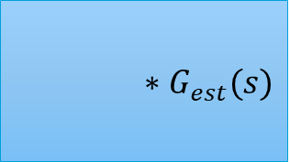
Modeling the Real World
Not generally feasible to measure full system state
Measurement noise
Process noise
Delays in the system
Two options:
Explicitly model disturbances
Structured and reproducible noise
Consistent lag/ delay
Filter or trim data
Startup transients
White measurement noise
Saturated sensor or anomalies
Process Noise
Measurement Noise
u
System
x
Measurement
Delay
y
Constant delays are generally easy to estimate from the data
$$∗G_{est}(s)$$
u
$$e^{−τs}$$
x

