Slide 1
Results: Machine-Learned Snow-Liquid-Ratio Forecasts
Michael Wessler
Steenburgh Research Group
University of Utah Department of Atmospheric Science
April 2021

Slide 2
Support Vector Regression
Trained on ERA5 0.25°
Temperature, Relative Humidity, Wind Speed, observed SWE
Lesser of 1979-2019 or length of observation record at each station
Applied to GFS 0.25°
Temperature, Relative Humidity, Wind Speed, forecast SWE (QPF)
Verified on lesser of 2015-2019 or length of observation record at each station
Can be easily applied to higher resolution GFS or other models
Model state frozen and saved for future applications
Z-score normalization means and stdev saved for future applications

Slide 3
Alternate Methods Tested
Simple Multiple Linear Regression
Non-stepwise
Elastic Multiple Linear Regression
L₁/L₂ regularization, minimizes overfitting, reduces number of predictors
Fixed SLR
10:1, 11:1 etc
NWS Lookup Table
Antiquated surface T or max T aloft methods
Climatological SLR
Baxter (2008) with time interpolation via Weather Prediction Center (WPC)
Existing weather.utah.edu SLR
Simplified surface-500mb layer-temperature based curve fit
Alcott and Steenburgh (2010)
All event and ‘high SWE’ stepwise multiple linear regression equations
Kuchera
Max T (>500mb) method commonly used in web products (esp. WeatherBell)
HRRRv3
Near-surface temperature curve fit

Slide 4
Northern Utah Group

Slide 5
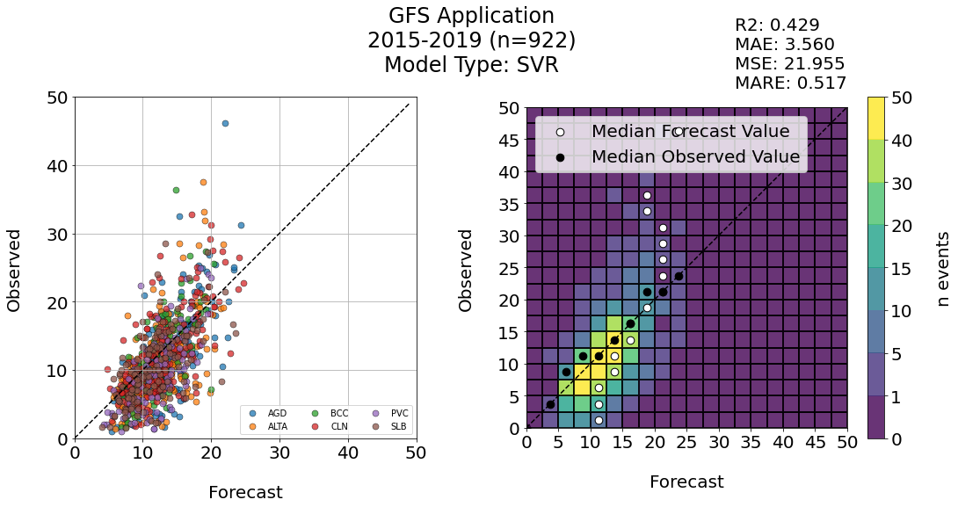
Northern Utah Group

Slide 6
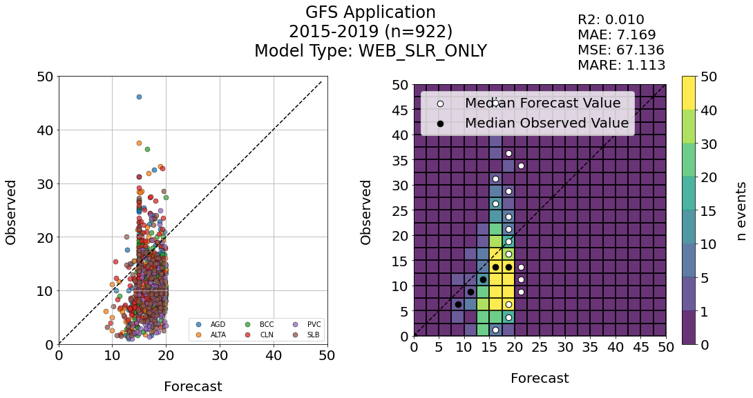
Northern Utah Group

Slide 7
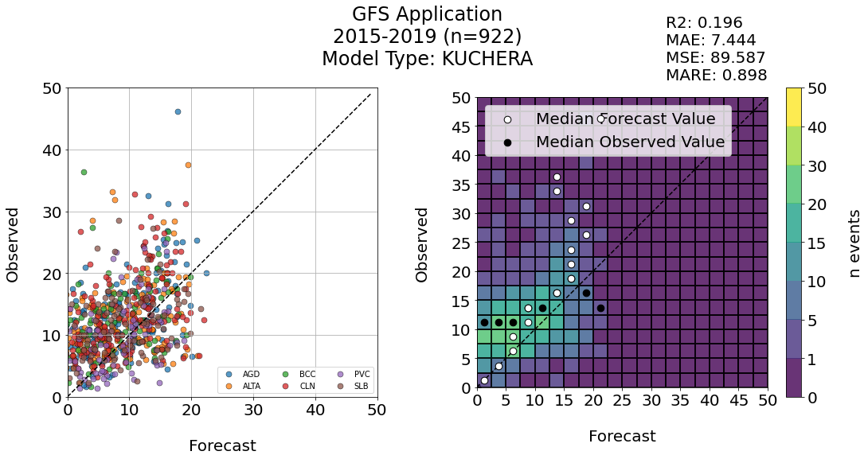
Northern Utah Group

Slide 8
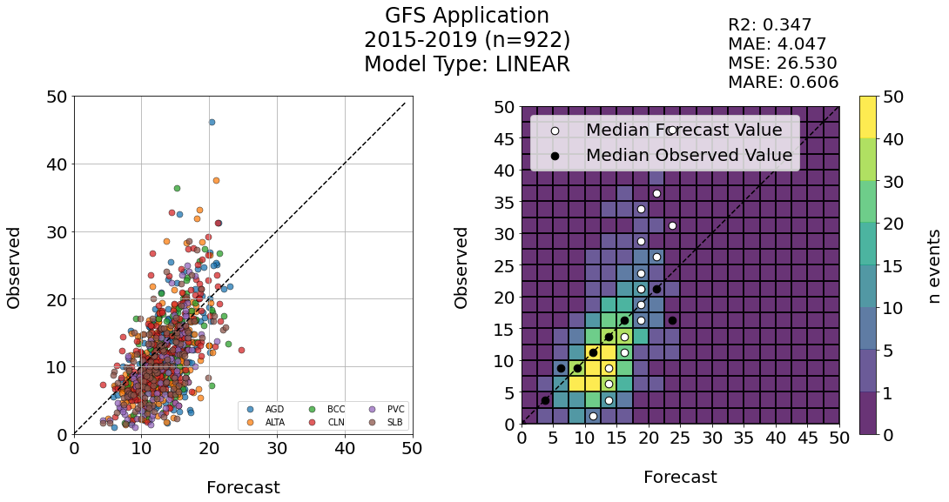

Northern Utah Group

Slide 9
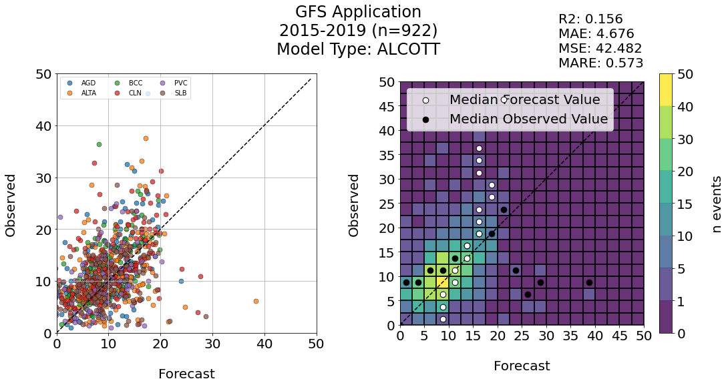
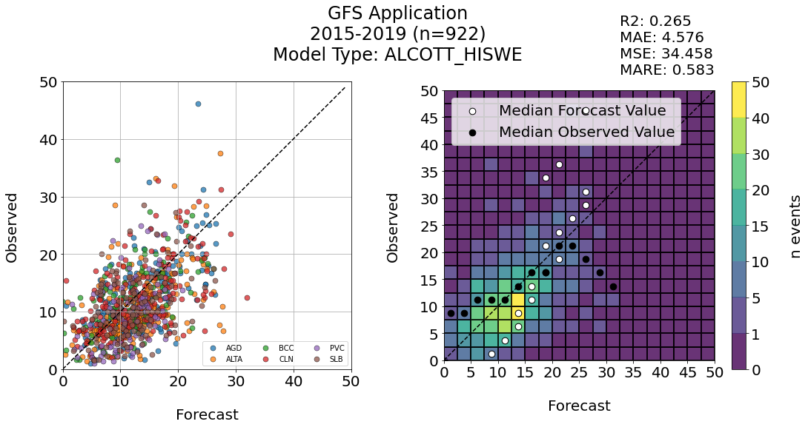
Northern Utah Group

Slide 10
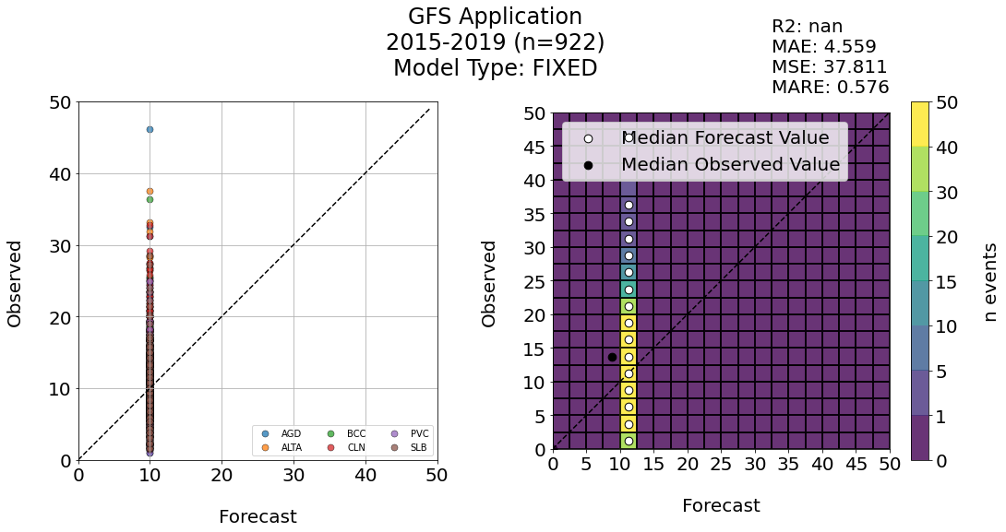
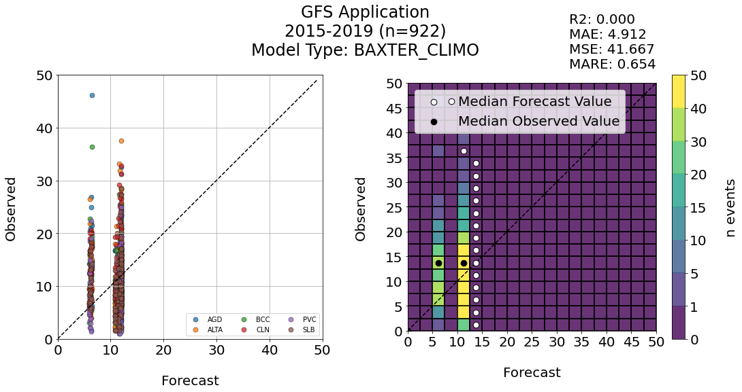
Northern Utah Group

Slide 11
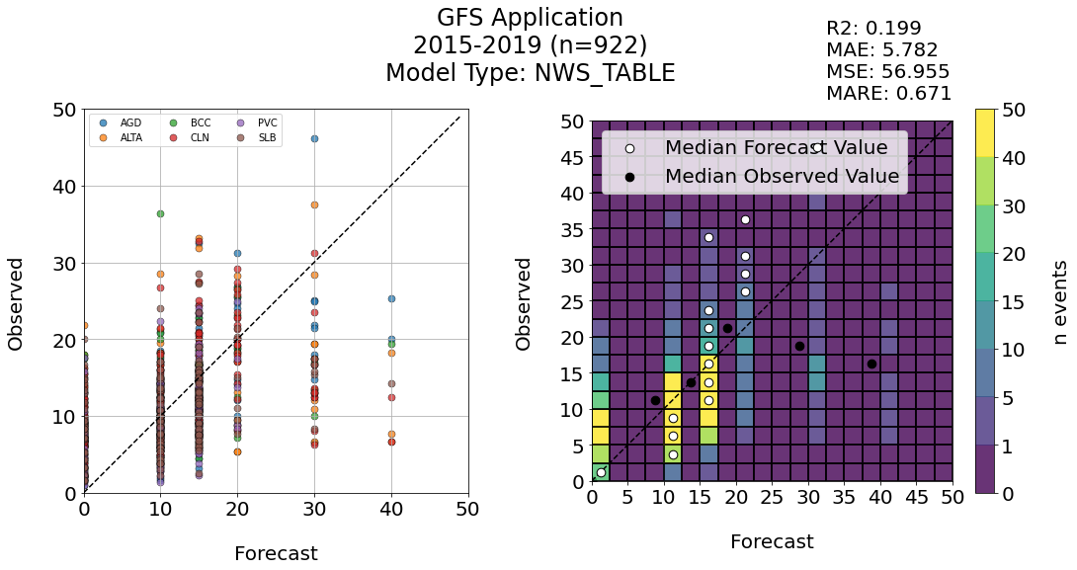
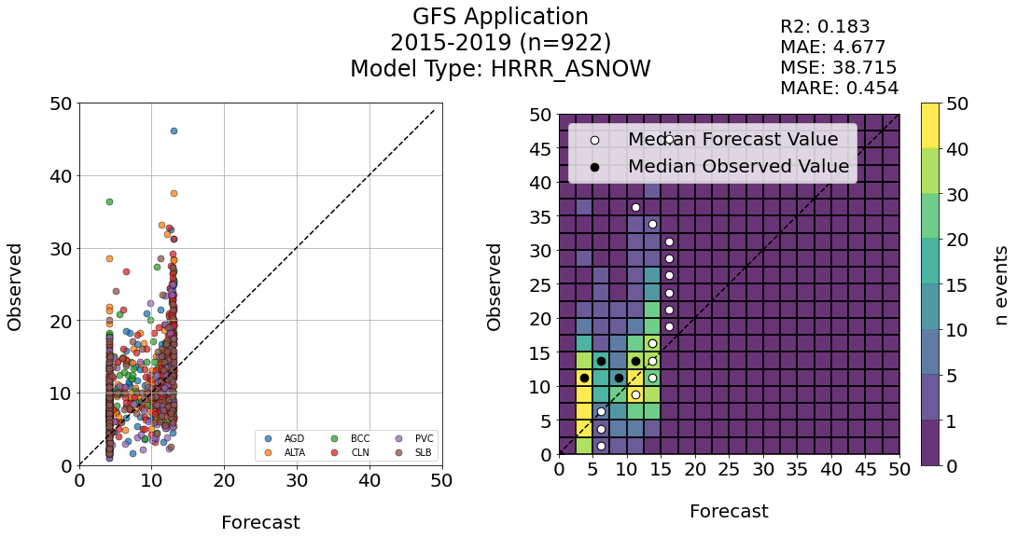
Northern Utah Group

Slide 12
Montana (Flatheads) + CSSL

Slide 13
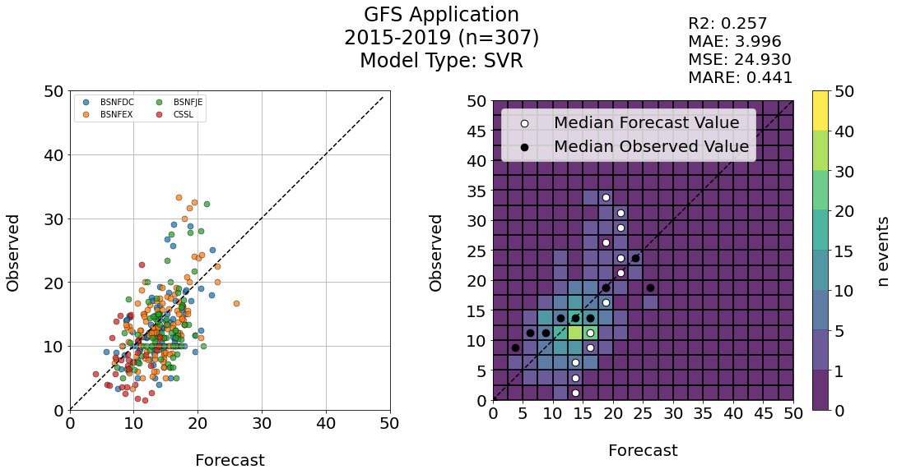
Montana (Flatheads) + CSSL

Slide 14
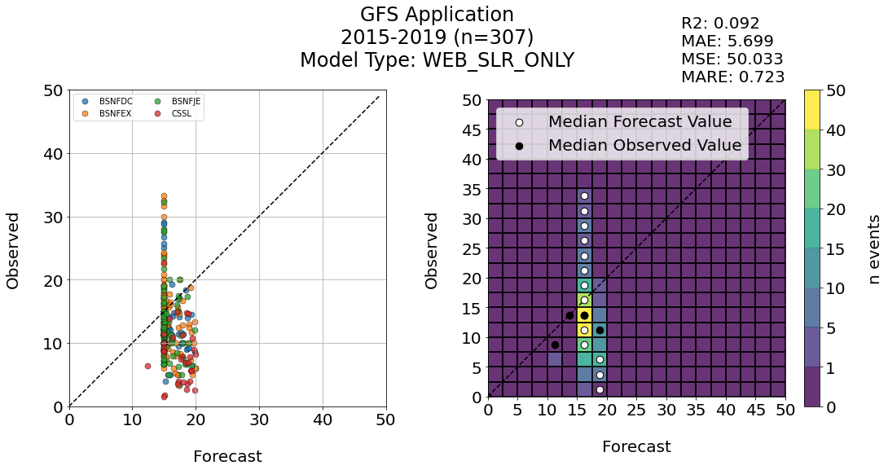
Montana (Flatheads) + CSSL

Slide 15
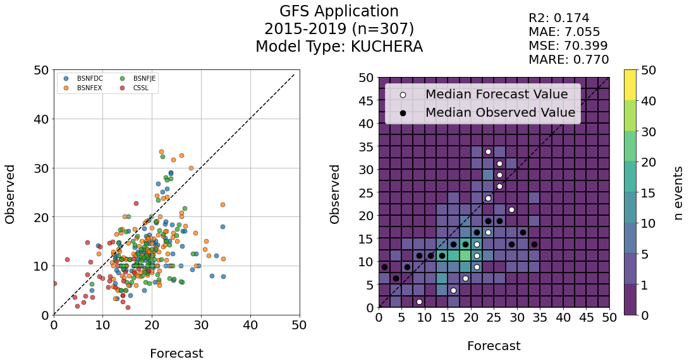
Montana (Flatheads) + CSSL

Slide 16
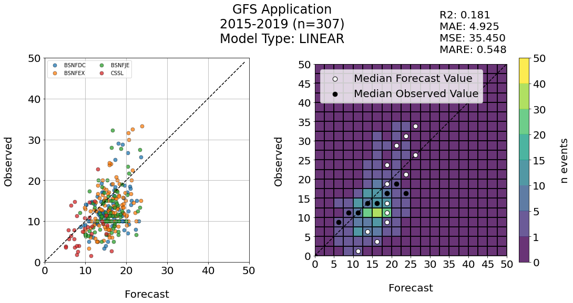

Montana (Flatheads) + CSSL

Slide 17
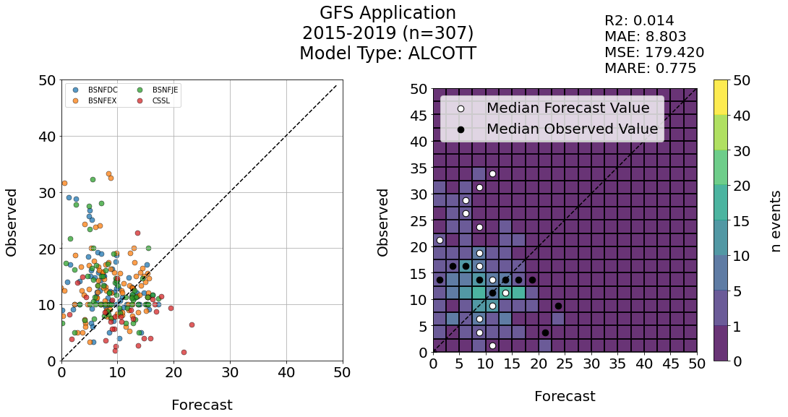
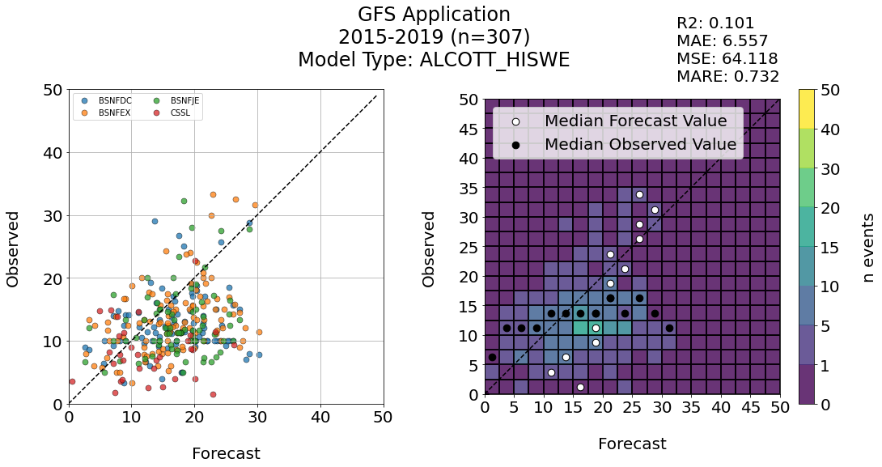
Montana (Flatheads) + CSSL

Slide 18
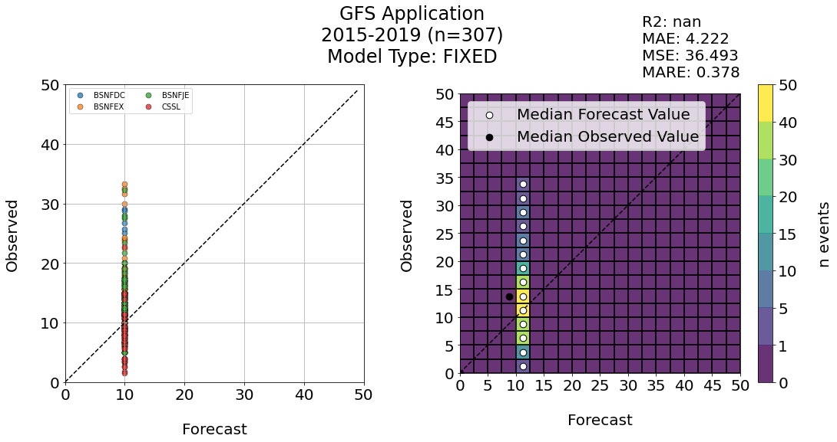
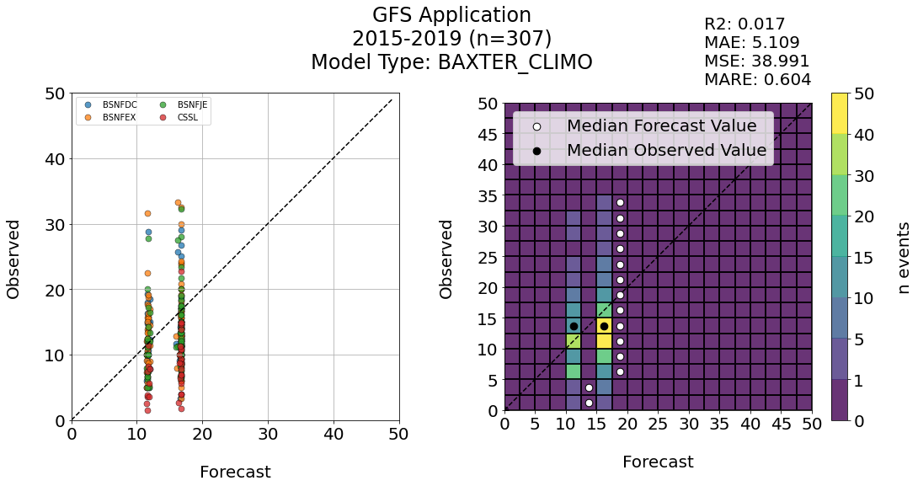
Montana (Flatheads) + CSSL

Slide 19
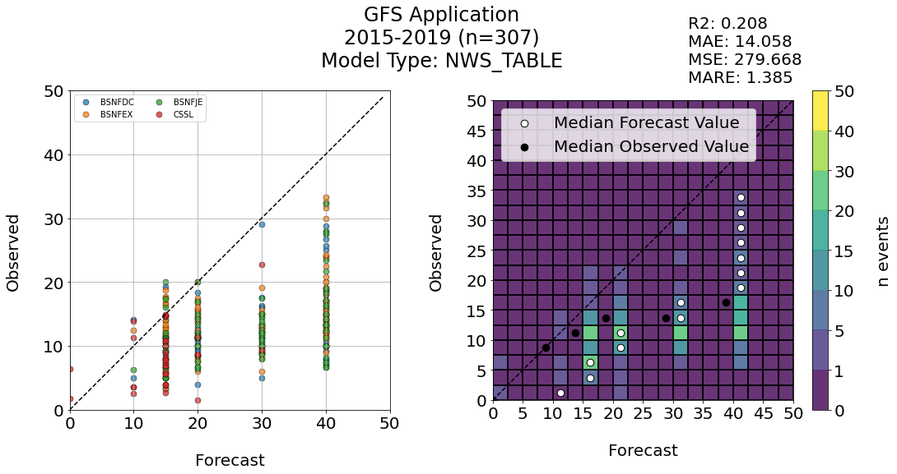
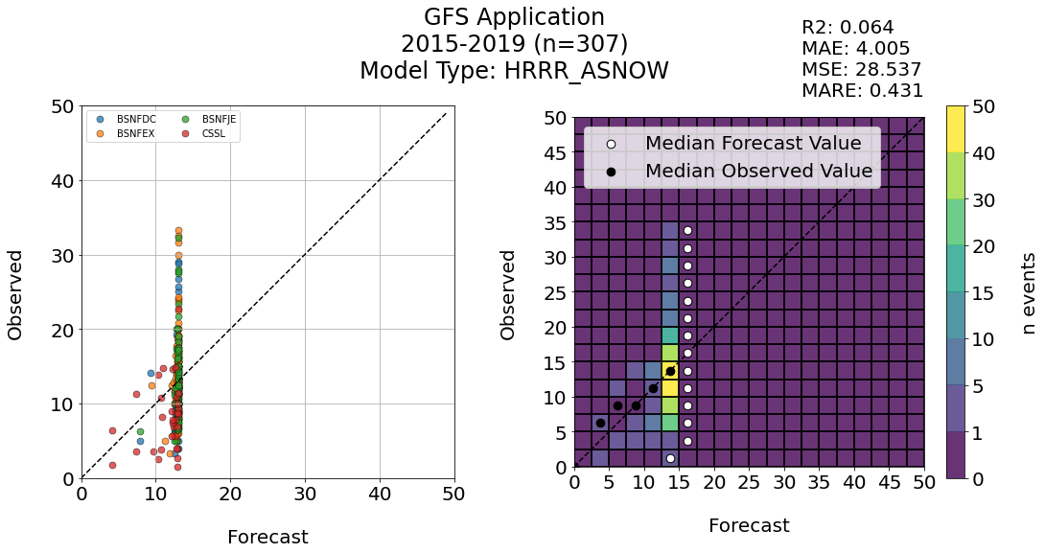
Montana (Flatheads) + CSSL

Slide 20
Alta Collins

Slide 21
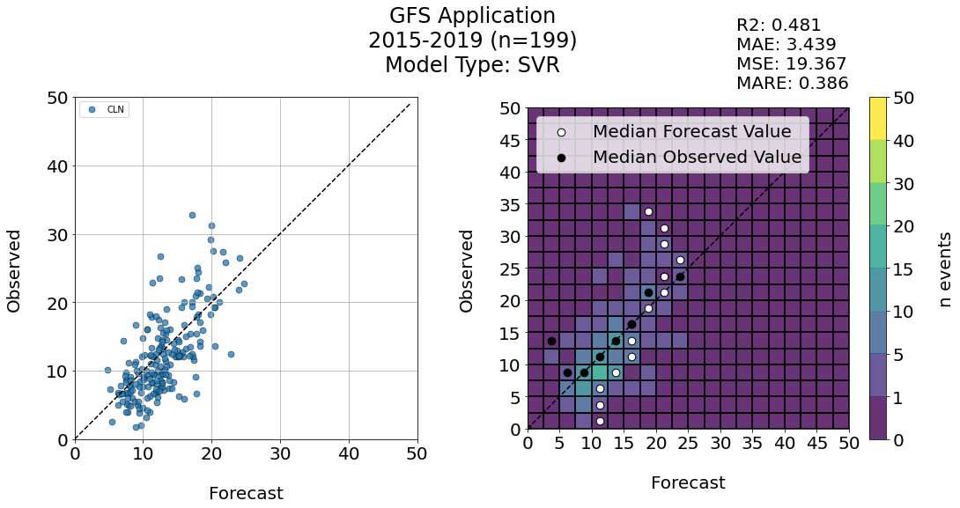
Alta Collins

Slide 22
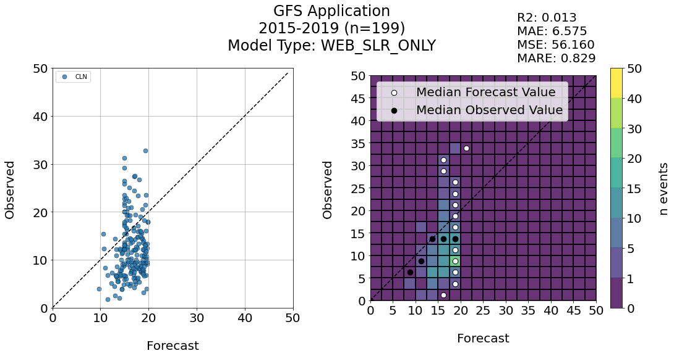
Alta Collins

Slide 23
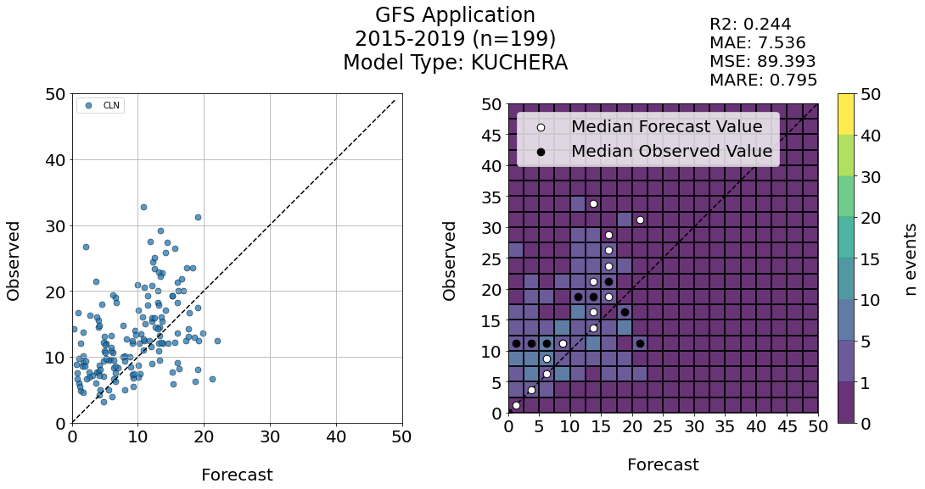
Alta Collins

Slide 24
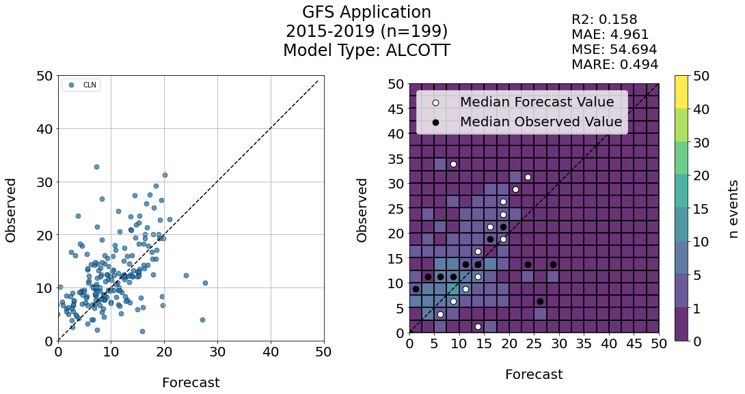
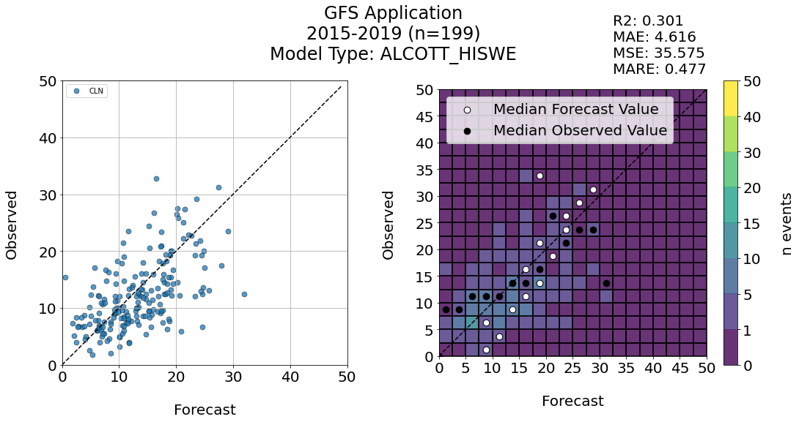
Alta Collins

