Slide 1




Deep Learning Bootcamp 2024

Slide 2
Deep Learning Bootcamp 2024

Slide 3
Schedule
Event No. | Details
Event 1 26nd Jan 2024 | Deep Learning Essentials Covers the basics of Python and necessary packages required for Deep Learning such as numpy, scipy, pandas etc.
Event 2 06th Feb 2024 | PyTorch for Deep Learning Covers the basics of PyTorch, as well as how to use PyTorch for performing classification and regression tasks.
Event 3 23rd Feb 2024 | Deep Learning for Images In this event, we will extend the classification using deep learning, specifically focusing on datasets involving images.
Event 4 15th Mar 2024 | Deep Learning for Sequence Data (text and time series) In this event, we will focus on using Deep Learning models for datasets involving sequences or temporal relations. We plan to cover examples from both text and time-series datasets.
Event 5 28th Mar 2024 | Hackathon The purpose of this final event is to apply the skills acquired in previous sessions to solve a real-world problem within a specified time frame.

Slide 4
Session 2 Deep Learning using PyTorch
Sriram Ranga
Arpita Nema

Slide 5
Agenda
Quick refresher/intro to Deep Learning and introduction to PyTorch (15 mins)
Work Session 1 – Working with Tensors (30 mins)
Discussion on the flow of PyTorch (20 mins)
Work Session 2 – Components of PyTorch (30 mins)
Break (15 mins)
Work Session 3 – Solving a Classification Problem (30 mins)
Challenges – Create your own Neural Network for Regression (30 mins)

Slide 6
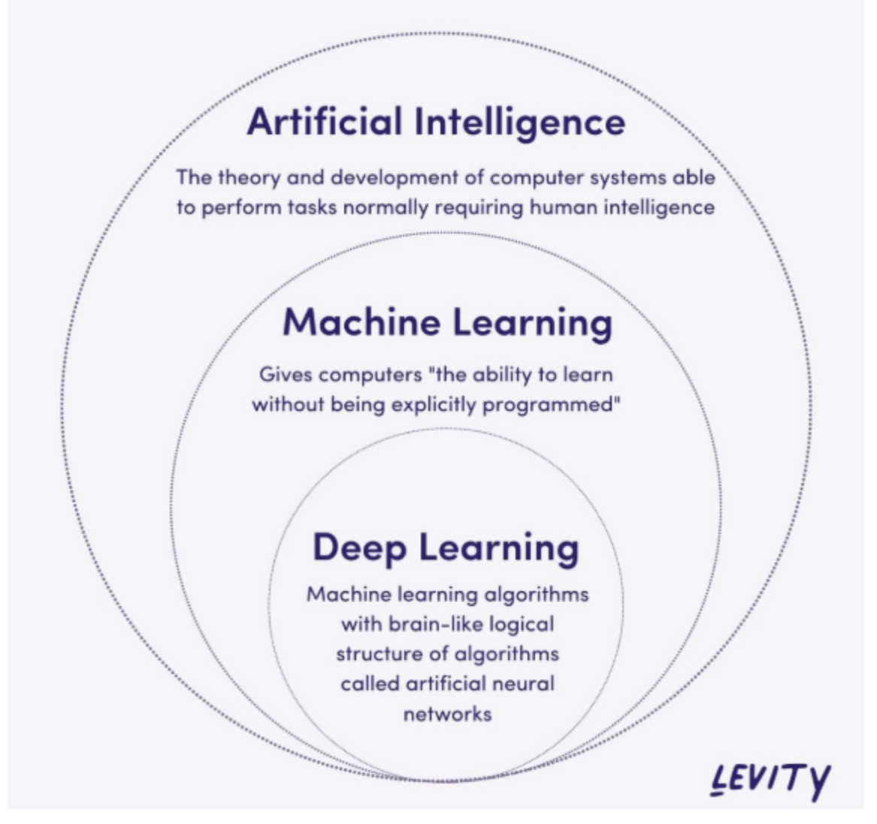
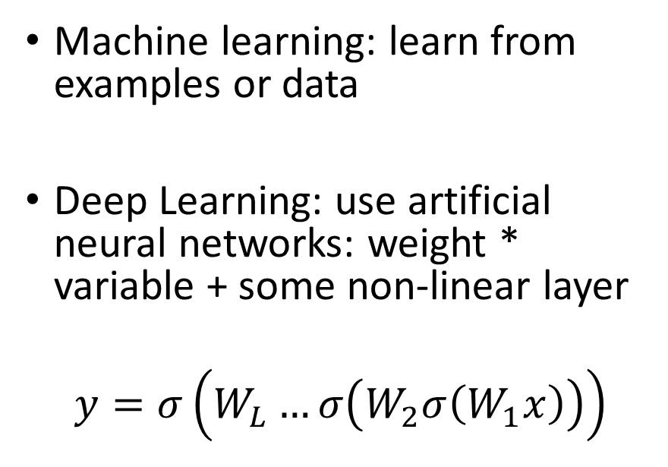
Revisiting Deep Learning
Machine learning: learn from examples or data
Deep Learning: use artificial neural networks: weight * variable + some non-linear layer
$$y=σ\left(W_{L}…σ\left(W_{2}σ\left(W_{1}x\right)\right)\right)$$

Slide 7
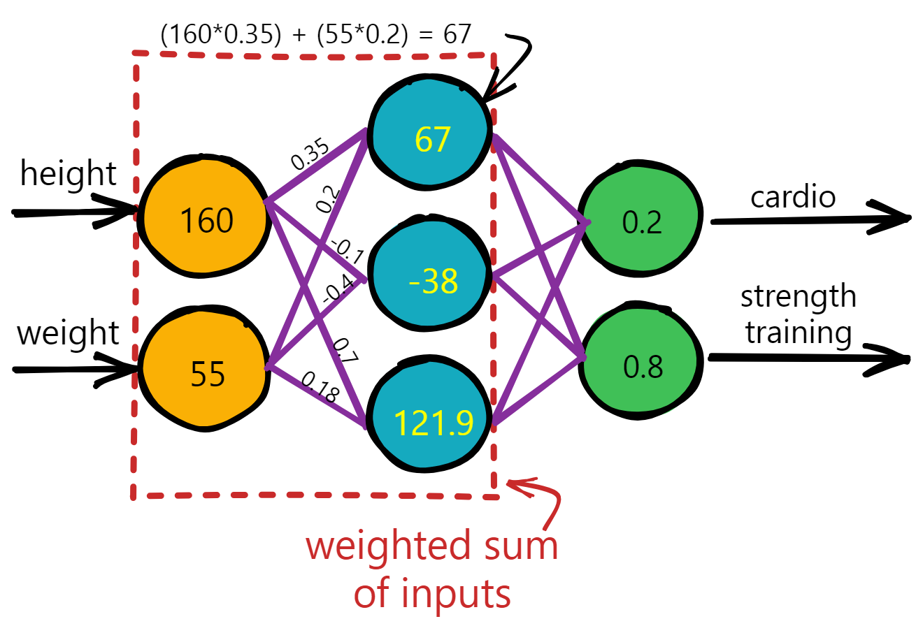
A Neural Networks is basically a mathematical function

Slide 8
ML workflow
Training Data
Feature Extraction
ML model
ML algorithm
Quality metric
Feature Extraction
ML model
Score
Test Data
Quality metric

Slide 9
DL workflow
Training Data
NeuralNetwork
Optimization Algorithm
Loss Function
Trained Neural Network
Score
Test Data
Loss Function

Slide 10
Implementing Deep Learning
Using NumPy, that we used in the previous session
Deep Learning with Numpy Notebook
Using PyTorch
Deep Learning with PyTorch Notebook

Slide 11

Lets us build the network in a modular format – easy to create, easy to maintain
Provides support for GPU acceleration through the use of Tensors
Makes the task of optimization very easy by providing us with an automatic differentiation engine called Autograd

Slide 12
GPUs and Tensors
GPUs are specialized computers, which are composed of a large number of cores which can run things for us in parallel.
Tensors are objects provided by PyTorch that let us make use of this performance acceleration provided by GPUs

Slide 13
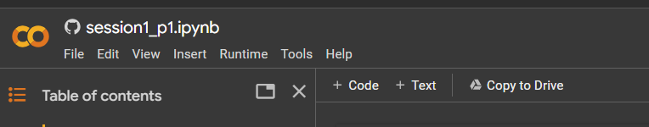

Google Colab Notebook
Let’s get started!

Slide 14

Feedback form for Session 2

Slide 15
For any questions, feel free to drop an e-mail to us! ☺ ntu-dl-bootcamp@e.ntu.edu.sg Bootcamp Website: ntu-dl-bootcamp.github.io//deep-learning-2024/
Thank You!

