Slide 1


Image Processing with Deep Learning
Michael Yuhas and Subrat Panda

Slide 2
Agenda
Time | Item
2:00-2:15 | Introduction to Convolution
2:15-2:45 | Convolutional Neural Networks (CNNs)
2:45-3:15 | Classification with CNNs
3:15-3:30 | Break
3:30-4:00 | Transfer Learning
4:00-4:30 | Semantic Segmentation with CNNs
4:30-5:00 | Other Techniques

Slide 3
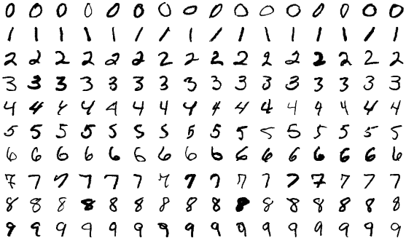
A Real-World Problem…
Imagine you run a post office
You receive millions of letters and packages a day and need to decide where to send them
Human labor is costly and time consuming
How can you automate this task?
[1] S. Janprasai, MNIST Examples Modified

Slide 4
A Real-World Problem…
This was the problem facing USPS in 1989
How would you solve this problem?
[1] S. Janprasai, MNIST Examples Modified

Slide 5
Introduction to Convolution

Slide 6
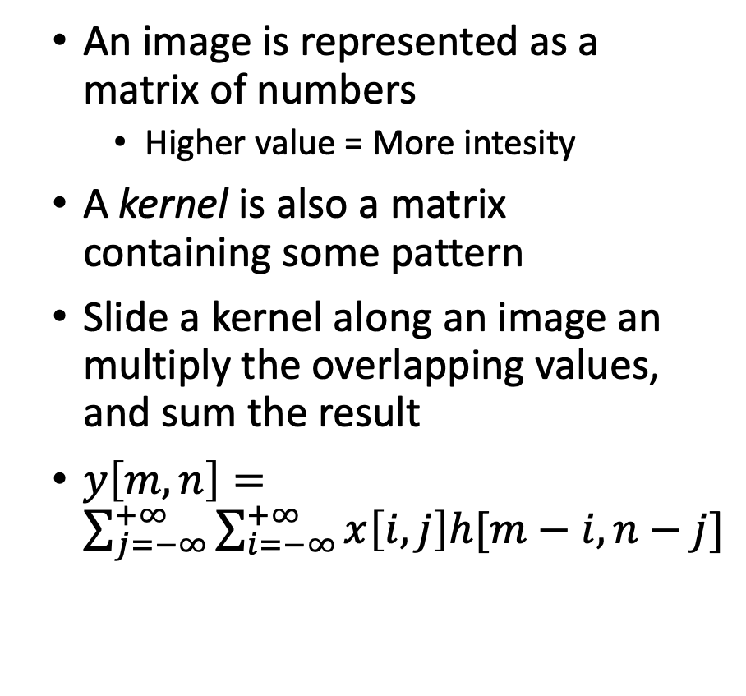
Convolution
An image is represented as a matrix of numbers
Higher value = More intesity
A kernel is also a matrix containing some pattern
Slide a kernel along an image an multiply the overlapping values, and sum the result
$y\left[m,n\right]=\sum_{j=−∞}^{+∞}{\sum_{i=−∞}^{+∞}{x\left[i,j\right]h[m−i,n−j]}}$
[2] Intuitively Understanding Deep Convolution, Towards Data Science (2018)

Slide 7
Edge Detection
Sobel kernel – a special kernel used for edge detection
Yield a high value when a gradient is present in one direction

Slide 8
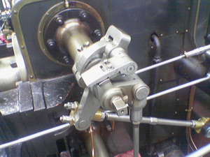
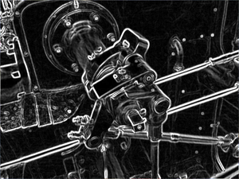
Exercise 1
Write your own edge detector…
[3] Simpsons Contributor, Valve Original
[3] Simpsons Contributor, Valve Sobel

Slide 9
Image Classification with CNNs

Slide 10
Learnable Filters
What if we were able to learn kernel weights instead of crafting them ourselves
This pattern, summing the multiplication of weights is the same thing that happens in a neural network!
Not just limited to three color channels: can go from any arbitrary sized tensor to another
[4] Intuitively Understanding Deep Convolution, Towards Data Science (2018)

Slide 11
Padding
https://ezyang.github.io/convolution-visualizer/
Reasons to pad:
Information loss at edges of image
Need to match output dimensions
Types of padding:
0’s
1’s
Reflective

Slide 12
Stride
Skip pixels while dragging the kernel
A higher stride let’s us…
Process data faster
Reduce dimensionality
At the expense of…
Ignoring information in the input
[4] Intuitively Understanding Deep Convolution, Towards Data Science (2018)

Slide 13
Dilation
https://ezyang.github.io/convolution-visualizer/
Increase the receptive field of a neuron without increasing number of computations

Slide 14
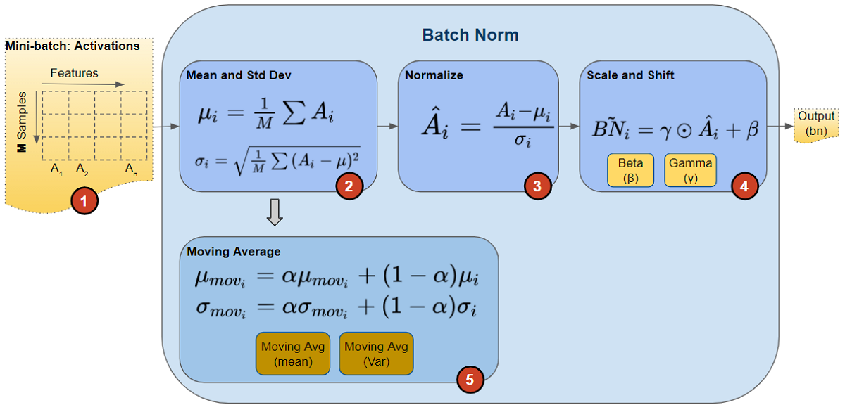
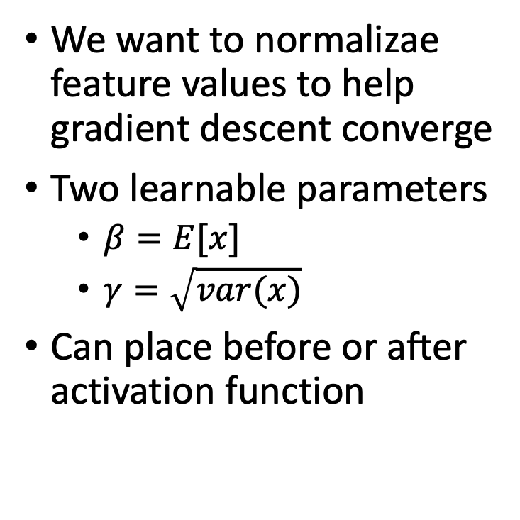
Normalization
We want to normalizae feature values to help gradient descent converge
Two learnable parameters
$β=E[x]$
$γ=\sqrt{var(x)}$
Can place before or after activation function
[5] K. Doshi, Batch Norm Explained Visually, Towards Data Science (2021)

Slide 15
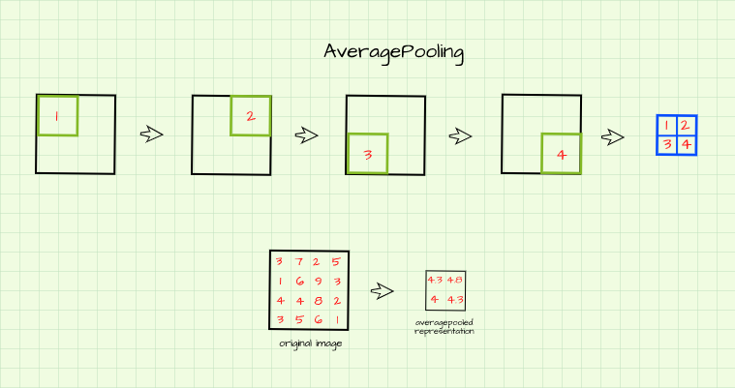
Pooling
Sometimes we want to reduce dimensionality without learning any new parameters
Speed up computation cost
Types:
Average
Max
Min
[6] O. Olu-Ipinlaye, Pooling in Convolutional Neural Networks, PaperSpace (2023)

Slide 16
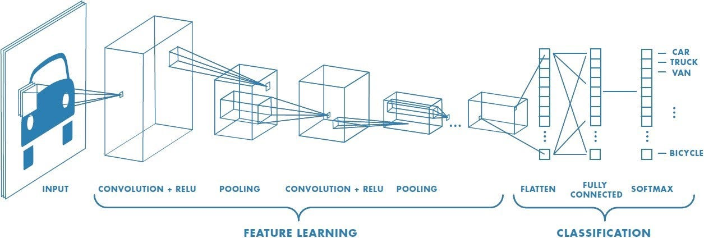
Adding Depth
In shallow networks we learn a function that maps a feature space to an output
In deep learning, we don’t know the features, so we use one conv layer to learn them
Repeat ad infinitum
[7] S. N. Gupta, Deep Convolutional Neural Networks Explained in Layman’s Terms, Medium (2022).

Slide 17
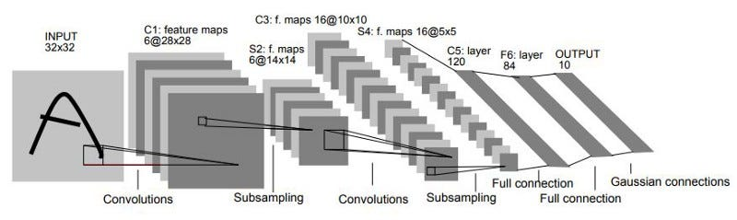
LeNet
Invented by Yann LeCun in 1989 to classify postcode digits
2 convolutional layers followed by 2 fully connected layers
28x28 black and white input image
Surprisingly powerful (can use this to make a car follow lanes)
[8] S. Bangar, LeNet5 Architecture Explained, Medium (2022)

Slide 18
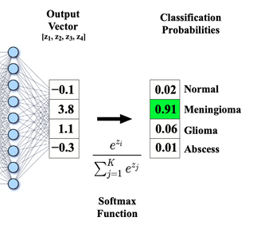
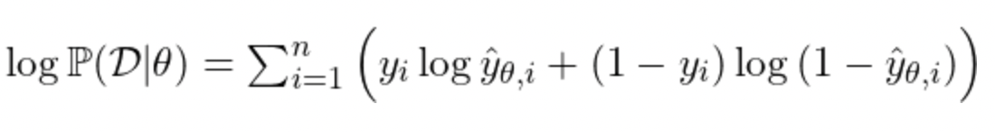
NLLLoss and Softmax
[9] Questions and Answers in MRI
Sometimes we want to know not just which class is most likely, but what is its probability
With this probability value, Softmax let’s us create a loss function based on probability
We take the log of the probability to make this play nicely with optimizers (like Adam)

Slide 19
Exercise 2: Image Classification
Now let’s put everything we learned into practice…
Can you solve the character recognition problem?
[1] S. Janprasai, MNIST Examples Modified

Slide 20
Break Time

Slide 21
Using Pretrained Models

Slide 22
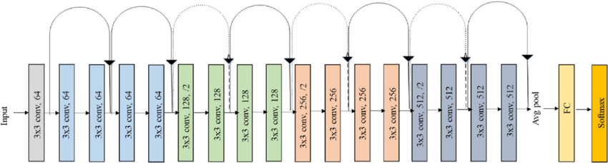
Resnet
[10] S. Igbal, Original Resnet-18 Architecture
We can go deeper, but we suffer the vanishing gradient problem
Resnet solves this with skip connections
Comes in variants from 18 layers to over 100
However, this comes at a cost of training time

Slide 23
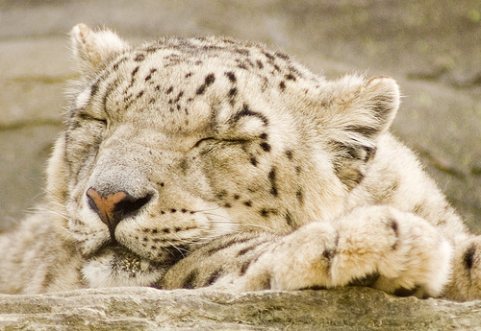
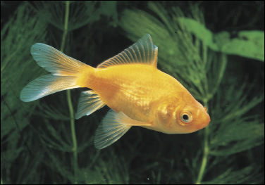
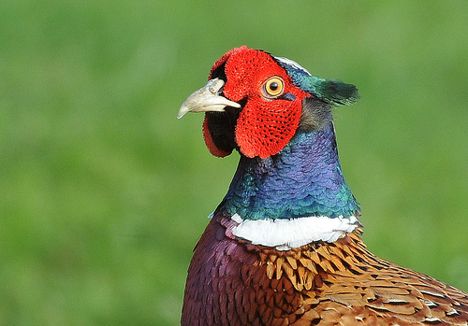
ImageNet
Benchmark dataset for color image classification
Over 1000 classes
1,281,167 training images
50,000 validation images
100,000 test images
[11] ImageNet

Slide 24
Exercise 4: Load a Pretrained Model from TorchHub
Let’s use a more complex classification model…

Slide 25
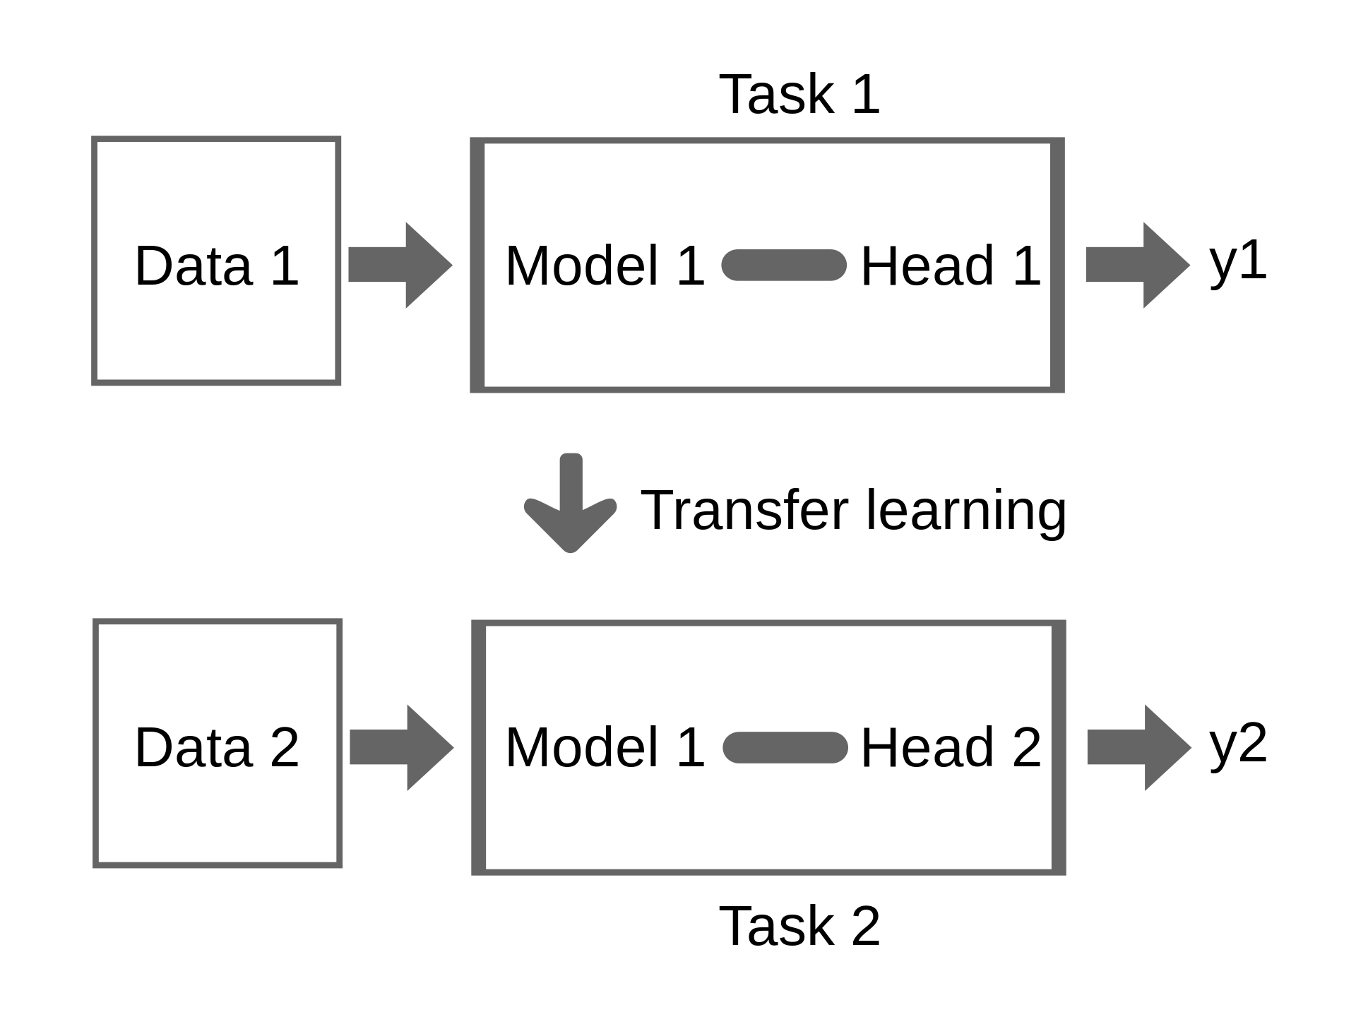
Transfer Learning
Use a model trained on one dataset to make predictions on another dataset
We need to fine tune on some data from the second dataset
Can greatly reduce training time
[12] Biggerj1, Illustration of Transfer Learning

Slide 26
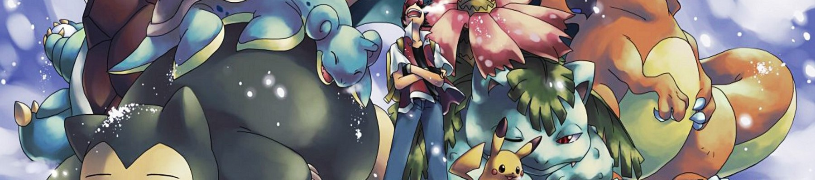
Exercise 5: Transfer Learning
Can you fine-tune Resnet to classify images of Pokemon?
[13] R. Banik, The Complete Pokemon Dataset, Kaggle (2018)

Slide 27
Semantic Segmentation with CNNs

Slide 28
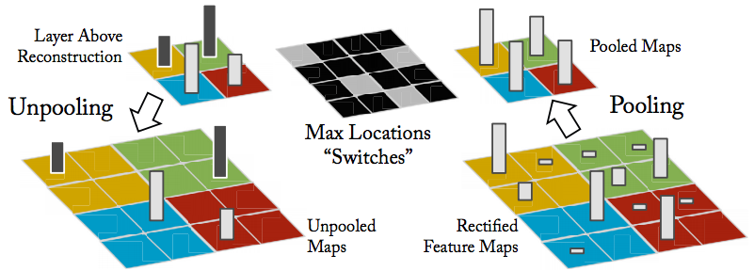
Unpooling
[14] Visualizing and Understanding Convolutional Neural Networks, CMU (2016)
If we can reduce dimensions, we can also increase them
Usefull for image generation, augmentation, and segmentation

Slide 29
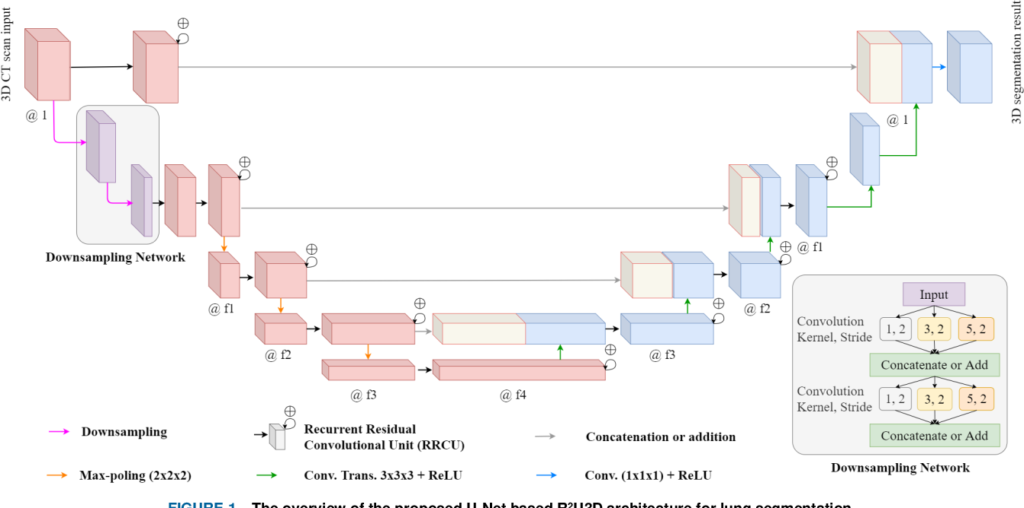
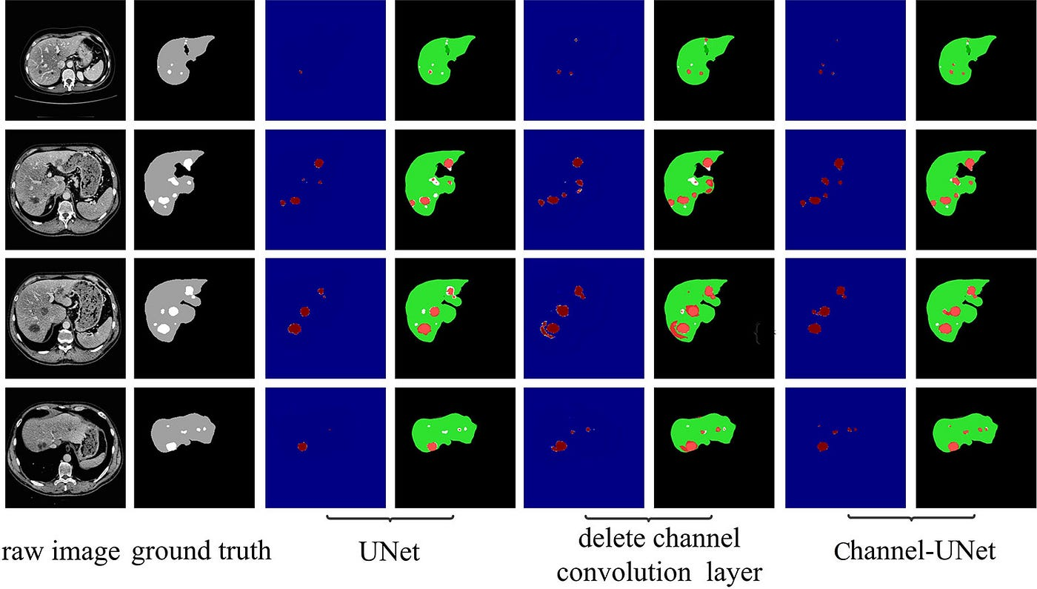
UNET
An Image Segmentation Architecture
Classify each pixel in an input image
Useful for lane detection, medical imaging, etc.
[15] A. Quesada, U-Net: A Versatile Deep Learning Architecture for Image Segmentation, Medium (2023)

Slide 30
Image Generation with Diffusion Models

