Slide 1





Slide 2

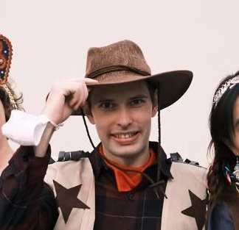

Slide 3

Time | Item
2:00-2:05 | Challenge Description and Dataset
2:05-2:10 | Contest Rules
2:10-2:30 | Reference Implementation
2:30-5:00 | Q + A

Slide 4


Slide 5

Training Set Stats
6175 Samples
19 Primary Types
19 Secondary Types
136 Pokémon
Average Image Size: 723x723
Average Description Length: 20 words
Guess a Pokémon’s primary type and secondary type based on an image and a textual description
Only Gen I Pokémon
The training set does not contain all 151 Pokémon; your algorithm needs to work even on unseen data
This is a multimodal classification problem
Test set is blind: you do not get to see it

Slide 6


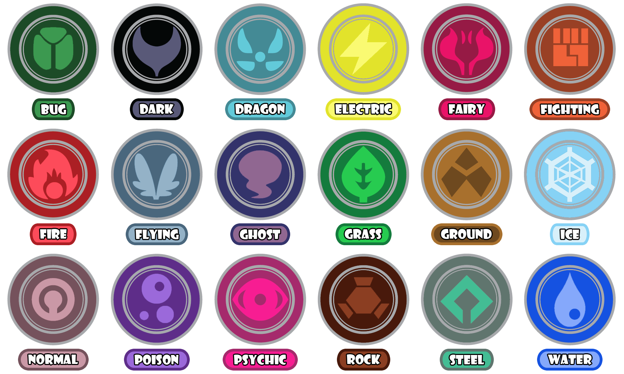
Image:
Primary Type:
NA
Secondary Type:
Description:
“It swims facing backward by opening and closing its
two-piece shell. It is surprisingly fast.”
None
Model Input (x)
Targets (y)

Slide 7


https://github.com/ntu-dl-bootcamp/deep-learning-2024/blob/main/hackathon/hackathon.ipynb

Slide 8

You can only use the dataset provided to you. Hardcoding a table of Pokémon names and their corresponding types is forbidden.
You have until the 23:59 on Saturday (30-Mar-2024) to complete the challenge
You are allowed to use the Internet, ChatGPT, or any other resources to help you write your code, but you must train your model yourself
You are allowed to start with a pretrained model, including transformers.
You must submit both your iPython notebook (*.ipynb) and the weights (*.pt) file by email
The winner will be the team with the best accuracy on primary type classification, ties will be broken by performance on secondary type accuracy
You cannot get help from other teams enrolled in the competition
You cannot get help from student studying computer science or a related field if they are not involved in the competition and enrolled on your team

Slide 9

BERT
Primary Type
“It swims facing backward by opening and closing its two-piece shell. It is surprisingly fast.”
ResNet
Secondary Type
Fully Connected Layers
At a minimum you need:
Feature extraction
Mode combination
2 classification heads
Feel free to go off the beaten path:
How early do you combine features?
How deep are your heads?
How much processing on the combined feature space?

Slide 10


