Slide 1
Lecture 14
Introduction to C++ and Object-Oriented Programming
Fundamentals of Computer and Programming
Instructor: Morteza Zakeri, Ph.D. (m-zakeri@live.com)
Spring 2024
Modified Slides from Dr. Brian Gregor
Computer Engineering Department, Amirkabir University of Technology
Notes:
1

Slide 2
Outline
Very brief history of C++
Definition of object-oriented programming (OOP)
When C++ is a good choice
First program!
Some C++ syntax
Function calls
Create a C++ class
References and Pointers
More on object-oriented programming

Slide 3
Outline
Very brief history of C++
Definition of object-oriented programming
When C++ is a good choice
First program!
Some C++ syntax
Function calls
Create a C++ class
References and Pointers
More on object-oriented programming

Slide 4

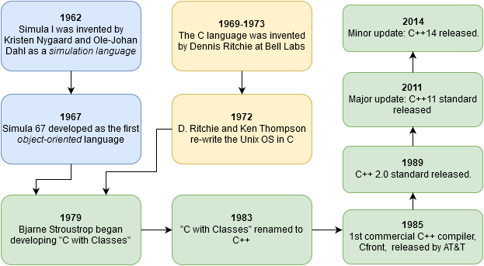


Very brief history of C++
Simula 67
C
For details more check out A History of C++: 1979−1991
C++
Quote: “C++ was designed to provide Simula’s facilities for program organization together with C’s efficiency and flexibility for systems programming. It was intended to deliver that to real projects within half a year of the idea. It succeeded.”

Slide 5
Outline
Very brief history of C++
Definition of object-oriented programming
When C++ is a good choice
First program!
Some C++ syntax
Function calls
Create a C++ class
References and Pointers
More on object-oriented programming

Slide 6
Object-oriented programming (OOP)
Seeks to define a program in terms of the things (objects) in the problem
files, molecules, buildings, cars, people, etc.,
what they need, and what they can do.
Data beside operations
Modeling real-world phenomena's
class GasMolecule
Objects
(instances of a class)
Data:
molecular weight, structure, common names, etc.
Methods:
IR(wavenumStart, wavenumEnd) : return IR emission spectrum in range
GasMolecule ch4
GasMolecule co2
spectrum = ch4.IR(1000,3500)
Name = co2.common_name
“pseudo-code”

Slide 7


Object-oriented programming
“Class Car”
OOP defines classes to represent these things.
Classes can contain data and methods (internal/in-class functions).
Classes control access to internal data and methods.
A public interface is used by external code when using the class.
This is a highly effective way of modeling real-world problems inside of a computer program.
public interface
private data and methods

Slide 8
Characteristics of C++
C++ is object oriented
With support for many programming styles (procedural, functional, etc.)
C++ is compiled.
A separate program, the compiler, is used to turn C++ source code into a form directly executed by the CPU.
C++ is strongly typed and unsafe
Conversions between variable types must be made by the programmer (strong typing) but can be circumvented when needed (unsafe)
C++ is C compatible
call C libraries directly and C code is nearly 100% valid C++ code.
C++ is capable of very high performance
The programmer has a very large amount of control over the program execution
C++ has no automatic memory management
The programmer is in control of memory usage

Slide 9
Outline
Very brief history of C++
Definition of object-oriented programming
When C++ is a good choice
First program!
Some C++ syntax
Function calls
Create a C++ class
References and Pointers
More on object-oriented programming

Slide 10
Why C++?
Despite its many competitors C++ has remained popular for ~30 years and will continue to be so in the foreseeable future.
Why?
Complex problems and programs can be effectively implemented
OOP works in the real world!
No other language quite matches C++’s combination of performance, expressiveness, and ability to handle complex programs.

Slide 11
When to choose C++
Choose C++ when:
Program performance matters
Dealing with large amounts of data, multiple CPUs, complex algorithms, etc.
Programmer productivity is less important
It is faster to produce working code in Python, R, Matlab or other scripting languages!
The programming language itself can help organize your code
Ex. In C++ your objects can closely model elements of your problem.
Access to libraries
Ex. Nvidia’s CUDA Thrust library for GPUs
Your group uses it already!

Slide 12
Outline
Very brief history of C++
Definition of object-oriented programming
When C++ is a good choice
First C++ program!
Some C++ syntax
Function calls
Create a C++ class
References and Pointers
More on object-oriented programming

Slide 13
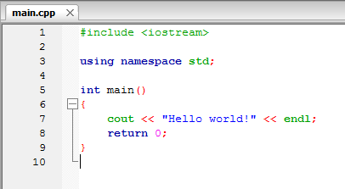
Hello, World! explained
The main routine – the start of every C++ program!
It returns an integer value to the operating system and (in this case) takes no arguments: main()
The return statement returns an integer value to the operating system after completion.
0 means “no error”.
C++ programs must return an integer value.

Slide 14
Hello, World! explained
loads a header file containing function and class definitions
Loads a namespace called std.
Namespaces are used to separate sections of code for programmer convenience.
To save typing we’ll always use this line in this tutorial.
cout is the object that writes to the stdout device, i.e., the console window.
It is part of the C++ standard library.
Without the “using namespace std;” line this would have been called as std::cout. It is defined in the iostream header file.
<< is the C++ insertion operator. It is used to pass characters from the right to the object on the left.
endl is the C++ newline character.

Slide 15
C++ Reserved Keywords
alignas alignof and and_eq asm auto bitand bitor bool break case catch char char8_t
char16_t char32_t class co_await co_return co_yield compl concept const consteval
constexpr constinit const_cast continue decltype default delete
do double
dynamic_cast else
enum explicit export extern false float for friend goto
if inline int long
mutable namespace new noexcept not not_eq nullptr operator or
or_eq private protected public register
reinterpret_cast requires
return short signed sizeof static
static_assert static_cast struct
switch template this thread_local throw
true try typedef typeid
typename union unsigned using virtual void volatile wchar_t while xor xor_eq final* import* module* override*
∗ Note: context sensitive

Slide 16
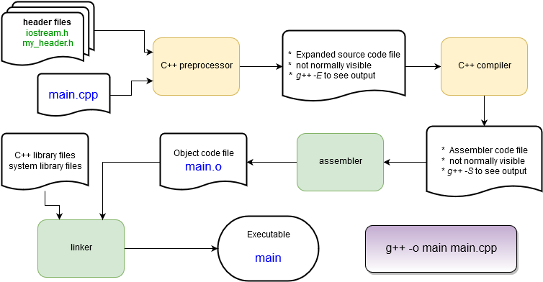
Behind the Scenes: The Compilation Process

Slide 17
Header Files
C++ (along with C) uses header files as to hold definitions for the compiler to use while compiling.
A source file (file.cpp) contains the code that is compiled into an object file (file.o).
The header (file.h) is used to tell the compiler what to expect when it assembles the program in the linking stage from the object files.
Source files and header files can refer to any number of other header files.
C++ language headers aren’t referred to with the .h suffix. <iostream> provides definitions for I/O functions, including the cout function.
#include <iostream>
using namespace std;
int main(){
string hello = "Hello";
string world = "world!";
string msg = hello + " " + world;
cout << msg << endl;
msg[0] = 'h';
cout << msg << endl;
return 0;
}

Slide 18

Slight change
Let’s put the message into some variables of type string and print some numbers.
Things to note:
Strings can be concatenated with a + operator.
No messing with null terminators or strcat() as in C
Some string notes:
Access a string character by brackets or function:
msg[0] → “H” or msg.at(0) → “H”
C++ strings are mutable – they can be changed in place.
#include <iostream>
using namespace std;
int main(){
string hello = "Hello";
string world = "world!";
string msg = hello + " " + world;
cout << msg << endl;
msg[0] = 'h';
cout << msg << endl;
return 0;
}

Slide 19
A first C++ class: string
string is not a basic type (more on those later), it is a class.
string hello creates an instance of a string called “hello”.
hello is an object.
Remember that a class defines some data and a set of functions (methods) that operate on that data.
#include <iostream>
using namespace std;
int main(){
string hello = "Hello";
string world = "world!";
string msg = hello + " " + world;
cout << msg << endl;
msg[0] = 'h';
cout << msg << endl;
return 0;
}

Slide 20
A first C++ class: string
Update the code as you see here.
After the last character is entered, IDE will display some info about the string class.
If you click or type something else just delete and re-type the last character.
Ctrl-space will force the list to appear.
#include <iostream>
using namespace std;
int main()
{
string hello = "Hello";
string world = "world!";
string msg = hello + " " + world ;
cout << msg << endl;
msg[0] = 'h';
cout << msg << endl;
msg
return 0;
}

Slide 21
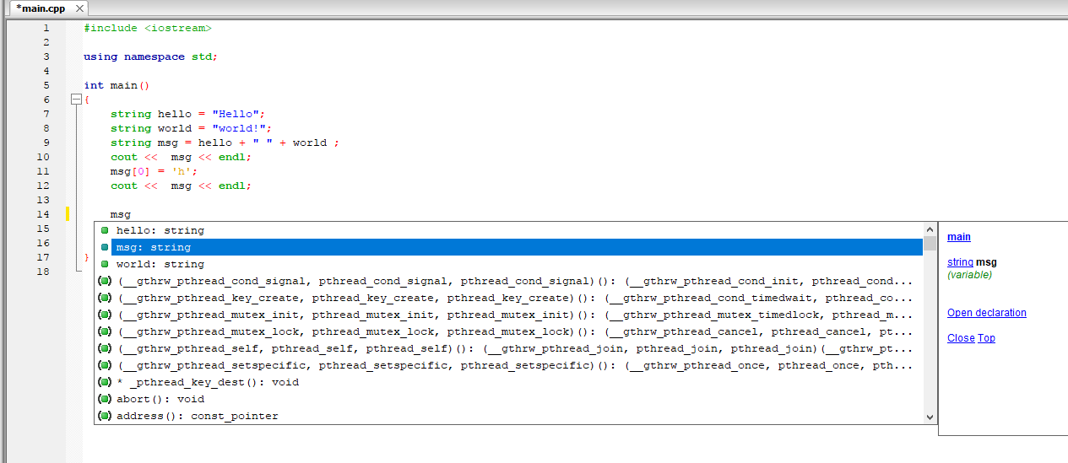
A first C++ class: string
Shows this function (main) and the type of msg (string)
List of string methods
List of other string objects
Next: let’s find the size() method without scrolling for it.

Slide 22
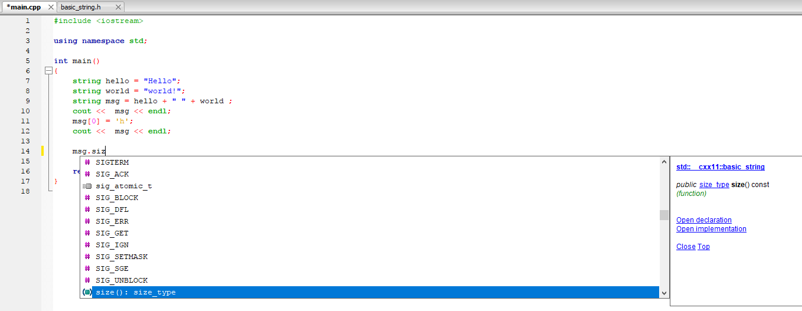
A first C++ class: string
Start typing “msg.size()” until it appears in the list.
Once it’s highlighted (or you scroll to it) press the Tab key to auto-enter it.
On the right you can click “Open declaration” to see how the C++ compiler defines size(). This will open basic_string.h, a built-in file.

Slide 23
A first C++ class: string
Tweak the code to print the number of characters in the string, build, and run it.
From the point of view of main(), the msg object has hidden away its means of tracking and retrieving the number of characters stored.
Note: while the string class has a huge number of methods your typical C++ class has far fewer!
#include <iostream>
using namespace std;
int main()
{
string hello = "Hello" ;
string world = "world!" ;
string msg = hello + " " + world ;
cout << msg << endl ;
msg[0] = 'h';
cout << msg << endl ;
cout << msg.size() << endl ;
return 0;
}
Note that cout prints integers without any modification!

Slide 24
Outline
Very brief history of C++
Definition of object-oriented programming
When C++ is a good choice
First C++ program!
Some C++ syntax
Function calls
Create a C++ class
References and Pointers
More on object-oriented programming

Slide 25
Basic Syntax
C++ syntax is very similar to C, Java, or C#. Here’s a few things up front and we’ll cover more as we go along.
Curly braces are used to denote a code block (like the main() function):
{ … some code … }
Statements end with a semicolon:
Comments are marked for a single line with a // or for multilines with a pair of /* and */ :
Variables can be declared at any time in a code block:
int a ;
a = 1 + 3 ;
void my_function() {
int a ;
a=1 ;
int b;
}
// this is a comment.
/* everything in here
is a comment */

Slide 26
Basic Syntax
Functions are sections of code that are called from other code.
Functions always have a return argument type, a function name, and then a list of arguments separated by commas:
A void type means the function does not return a value.
Variables are declared with a type and a name:
// No arguments? Still need ():
void my_function() {
/* do something...
but a void value means the
return statement can be skipped.*/
}
int add(int x, int y) {
int z = x + y ;
return z ;
}
// Specify the type
int x = 100;
float y;
vector<string> vec ;
// Sometimes types can be inferred
auto z = x;

Slide 27
Basic Syntax
A sampling of arithmetic operators:
Arithmetic: + - * / % ++ --
Logical: && (AND) || (OR) ! (NOT)
Comparison: == > < >= <= !=
Sometimes these can have special meanings beyond arithmetic, for example the “+” is used to concatenate strings.
What happens when a syntax error is made?
The compiler will complain and refuse to compile the file.
The error message usually directs you to the error but sometimes the error occurs before the compiler discovers syntax errors so you hunt a little bit.

Slide 28
Built-in (aka primitive or intrinsic) Types
“primitive” or “intrinsic” means these types are not objects
Here are the most commonly used types.
Note: The exact bit ranges here are platform and compiler dependent!
Typical usage with PCs, Macs, Linux, etc. use these values
Variations from this table are found in specialized applications like embedded system processors.
Name | Name | Value
char | unsigned char | 8-bit integer
short | unsigned short | 16-bit integer
int | unsigned int | 32-bit integer
long | unsigned long | 64-bit integer
bool |  | true or false
Name | Value
float | 32-bit floating point
double | 64-bit floating point
long long | 128-bit integer
long double | 128-bit floating point
http://www.cplusplus.com/doc/tutorial/variables

Slide 29
Need to be sure of integer sizes?
In the same spirit as using integer(kind=8) type notation in Fortran, there are type definitions that exactly specify exactly the bits used. These were added in C++11.
These can be useful if you are planning to port code across CPU architectures (ex. Intel 64-bit CPUs to a 32-bit ARM on an embedded board) or when doing particular types of integer math.
For a full list and description see:
http://www.cplusplus.com/reference/cstdint/
#include <cstdint>
Name | Name | Value
int8_t | uint8_t | 8-bit integer
int16_t | uint16_t | 16-bit integer
int32_t | uint32_t | 32-bit integer
int64_t | uint64_t | 64-bit integer

Slide 30
Reference and Pointer Variables
The object hello occupies some computer memory.
string hello = "Hello";
string *hello_ptr = &hello;
string &hello_ref = hello;
The asterisk indicates that hello_ptr is a pointer to a string. hello_ptr variable is assigned the memory address of object hello which is accessed with the “&” syntax.
The & here indicates that hello_ref is a reference to a string. The hello_ref variable is assigned the memory address of object hello automatically.
Variable and object values are stored in particular locations in the computer’s memory.
Reference and pointer variables store the memory location of other variables.
Pointers are found in C. References are a C++ variation that makes pointers easier and safer to use.

Slide 31
Type Casting
C++ is strongly typed. It will auto-convert a variable of one type to another in a limited fashion: if it will not change the value.
Conversions that don’t change value:
increasing precision (float → double) or
integer → floating point of at least the same precision.
C++ allows for C-style type casting with the syntax:
(new type) expression
But since we’re doing C++ we’ll look at the 4 ways of doing this in C++ next...
short x = 1 ;
int y = x ; // OK
short z = y ; // NO!
double x = 1.0 ;
int y = (int) x ;
float z = (float) (x / y) ;

Slide 32
Type Casting
static_cast<new type>( expression )
This is exactly equivalent to the C style cast.
This identifies a cast at compile time.
This will allow casts that reduce precision (ex. double → float)
~99% of all your casts in C++ will be of this type.
double d = 1234.56 ;
float f = static_cast<float>(d) ;
// same as
float g = (float) d ;

Slide 33
Type Casting
dynamic_cast<new type>( expression)
Special version where type casting is performed at runtime, only works on reference or pointer type variables.
Usually handled automatically by the compiler where needed, rarely done by the programmer.

Slide 34

Type Casting cont’d
Danger!
const_cast<new type>( expression )
Variables labeled as const can’t have their value changed.
const_cast lets the programmer remove or add const to reference or pointer type variables.
If you need to do this, you probably want to re-think your code.
“unsafe”: the compiler will not protect you here!
The programmer must make sure everything is correct!

Slide 35
Type Casting cont’d
reinterpret_cast<new type>( expression )
Takes the bits in the expression and re-uses them unconverted as a new type.
Also only works on reference or pointer type variables.
Sometimes useful when reading in binary files and extracting parameters.

Slide 36
Outline
Very brief history of C++
Definition of object-oriented programming
When C++ is a good choice
First C++ program!
Some C++ syntax
Function calls
Create a C++ class
References and Pointers
More on object-oriented programming

Slide 37

Functions
4 function calls are listed.
The 1st and 2nd functions are identical in their behavior.
The values of L and W are sent to the function, multiplied, and the product is returned.
RectangleArea2 uses const arguments
The compiler will not let you modify their values in the function.
Try it! Uncomment the line and see what happens when you recompile.
The 3rd and 4th versions pass the arguments by reference with an added &
The function arguments L and W are sent as type float.
The return type is float.
float RectangleArea1(float L, float W) {
return L*W ;
}
float RectangleArea2(const float L, const float W) {
// L=2.0 ;
return L*W ;
}
float RectangleArea3(const float& L, const float& W) {
return L*W ;
}
void RectangleArea4(const float& L, const float& W, float& area) {
area= L*W ;
}
Product is computed

Slide 38
Pass by Value
main()
RectangleArea1(float L, float W)
float L
copy
float L
float W
copy
float W
C++ defaults to pass by value behavior when calling a function.
The function arguments are copied when used in the function.
Changing the value of L or W in the RectangleArea1 function does not effect their original values in the main() function
When passing objects as function arguments it is important to be aware that potentially large data structures are automatically copied!

Slide 39
Pass by Reference
main()
reference
RectangleArea3(const float& L, const float& W)
float L
float L
float W
reference
float W
Pass by reference behavior is triggered when the & character is used to modify the type of the argument.
This is the type of behavior you see in Fortran, Matlab, Python, and others.
Pass by reference function arguments are NOT copied. Instead the compiler sends a pointer to the function that references the memory location of the original variable. The syntax of using the argument in the function does not change.
Pass by reference arguments almost always act just like a pass by value argument when writing code EXCEPT that changing their value changes the value of the original variable!!
The const modifier can be used to prevent changes to the original variable in main().

Slide 40
Pass by Reference
void does not return a value.
void RectangleArea4(const float& L, const float& W, float& area) {
area = L*W ;
}
In RectangleArea4 the pass by reference behavior is used as a way to return the result without the function returning a value.
The value of the area argument is modified in the main() routine by the function.
This can be a useful way for a function to return multiple values in the calling routine.

Slide 41
Passing objects to Functions
In C++ arguments to functions can be objects …
which can contain any quantity of data you’ve defined!
Example: Consider a string variable containing 1 million characters (approx. 1 MB of RAM).
Pass by value requires a copy – 1 MB.
Pass by reference requires 8 bytes!

Slide 42
Passing objects to Functions
Pass by value could potentially mean the accidental copying of large amounts of memory which can greatly impact program memory usage and performance.
When passing by reference, use the const modifier whenever appropriate to protect yourself from coding errors.
Generally speaking – use const anytime you don’t want to modify function arguments in a function.

Slide 43

Function overloading
Briefly: The same function can be implemented multiple times with different arguments.
This allows for special cases to be handled, or specialized behavior for different types.
Multiple constructors in a class are an example of function overloading.
float sum(float a, float b) {
return a + b;
}
int sum(int a, int b) {
return a + b;
}

Slide 44
Outline
Very brief history of C++
Definition of object-oriented programming
When C++ is a good choice
First C++ program!
Some C++ syntax
Function calls
Create a C++ class
References and Pointers
More on object-oriented programming

Slide 45
A first C++ class
Start a new project. Call it BasicRectangle.
In the main.cpp, we’ll define a class called BasicRectangle
First, just the basics fields:
length and width.
Enter the code on the right before the main() function in the main.cpp file (copy and paste is fine) and create a BasicRectangle object in main.cpp:
#include <iostream>
using namespace std;
class BasicRectangle
{
public:
// width
float W ;
// length
float L ;
};
int main()
{
cout << "Hello world!" << endl;
BasicRectangle rectangle ;
rectangle.W = 1.0 ;
rectangle.L = 2.0 ;
return 0;
}

Slide 46
Basic C++ Class Syntax
class keyword
Name of class
Curly braces at the beginning and end followed by a semi-colon
class BasicRectangle
{
public:
// width ;
float W ;
// length
float L ;
};
Internal variables are called members
public keyword indicates everything following the keyword is accessible by any other code outside of this class.
The class can now be used to declare an object named rectangle.
The width and length of the rectangle can be set.
BasicRectangle rectangle ;
rectangle.W = 1.0 ;
rectangle.L = 2.0 ;

Slide 47
Accessing data in the class
Public members in an object can be accessed (for reading or writing) with the syntax:
object.member
Next let’s add a function inside the object (called a method) to calculate the area.
int main()
{
cout << "Hello world!" << endl;
BasicRectangle rectangle ;
rectangle.W = 1.0 ;
rectangle.L = 2.0 ;
return 0;
}

Slide 48
Accessing methods in the class
class BasicRectangle
{
public:
// width ;
float W ;
// length
float L ;
float Area() {
return W * L ;
}
};
int main()
{
cout << "Hello world!" << endl;
BasicRectangle rectangle ;
rectangle.W = 21.0 ;
rectangle.L = 2.0 ;
cout << rectangle.Area() << endl ;
return 0;
}
method Area does not take any arguments, it just returns the calculation based on the object members.
Methods are accessed just like members:
object.method(arguments)

Slide 49
Basic C++ Class Summary
C++ classes are defined with the keyword class and must be enclosed in a pair of curly braces plus a semi-colon:
class ClassName { …. } ;
The public keyword is used to mark members (variables) and methods (functions) as accessible to code outside the class.
The combination of data and the functions that operate on it is the OOP concept of encapsulation.

Slide 50
Encapsulation in Action
In C – calculate the area of a few shapes…
In C++ with Circle and Rectangle classes…not possible to miscalculate.
/* assume radius and width_square are assigned
already ; */
float a1 = AreaOfCircle(radius) ; // ok
float a2 = AreaOfSquare(width_square) ; // ok
float a3 = AreaOfCircle(width_square) ; // !! OOPS
Circle c1 ;
Rectangle r1 ;
// ... assign radius and width ...
float a1 = c1.Area() ;
float a2 = r1.Area() ;

Slide 51
Now for a “real” class
Defining a class in the main.cpp file is not typical.
Two parts to a C++ class:
Header file (my_class.h)
Contains the interface (definition) of the class – members, methods, etc.
The interface is used by the compiler for type checking, enforcing access to private or protected data, and so on.
Also useful for programmers when using a class – no need to read the source code, just rely on the interface.
Source file (my_class.cc)
Compiled by the compiler.
Contains implementation of methods, initialization of members.
In some circumstances there is no source file to go with a header file.

Slide 52
Now for a “real” class
rectangle.h
rectangle.cpp
#ifndef RECTANGLE_H
#define RECTANGLE_H
class Rectangle
{
public:
Rectangle();
virtual ~Rectangle();
protected:
private:
};
#endif // RECTANGLE_H
#include “rectangle.h"
Rectangle::Rectangle()
{
//ctor
}
Rectangle::~Rectangle()
{
//dtor
}

Slide 53
Modify rectangle.h
As in the sample BasicRectangle, add storage for the length and width to the header file.
Add a declaration for the Area method.
The protected keyword will be discussed later.
The private keyword declares anything following it (members, methods) to be visible only to code in this class.
#ifndef RECTANGLE_H
#define RECTANGLE_H
class Rectangle
{
public:
Rectangle();
virtual ~Rectangle();
float m_length ;
float m_width ;
float Area() ;
protected:
private:
};
#endif // RECTANGLE_H

Slide 54
rectangle.cpp
The syntax:
class::method
tells the compiler that this is the code for the Area() method declared in rectangle.h
Now take a few minutes to fill in the code for Area().
Hint – look at the code used in BasicRectangle...
#include "rectangle.h"
Rectangle::Rectangle()
{
//ctor
}
Rectangle::~Rectangle()
{
//dtor
}
float Rectangle::Area()
{
}

Slide 55
Last Step
Go to the main.cpp file
Add an include statement for “rectangle.h”
Create a Rectangle object in main()
Add a length and width
Print out the area using cout.
Hint: just like the BasicRectangle example…

Slide 56
Solution
You should have come up with something like this:
#include <iostream>
using namespace std;
#include "rectangle.h"
int main()
{
Rectangle rT ;
rT.m_width = 1.0 ;
rT.m_length = 2.0 ;
cout << rT.Area() << endl ;
return 0;
}

Slide 57
Outline
Very brief history of C++
Definition of object-oriented programming
When C++ is a good choice
First C++ program!
Some C++ syntax
Function calls
Create a C++ class
References and Pointers
More on object-oriented programming

Slide 58
References and Pointers
Part 1 introduced the concept of passing by reference when calling functions.
Selected by using the & character in function argument types:
int add (int &a, int b)
References hold a memory address of a value.
int add (int &a, int b)→ a has the value of a memory address, b has an integer value.
Used like regular variables and C++ automatically fills in the value of the reference when needed:
int c = a + b ; → “retrieve the value of a and add it to the value of b”

Slide 59
References and Pointers
From C there is another way to deal with the memory address of a variable: via pointer types.
Similar syntax in functions except that the & is replaced with a *:
int add (int *a, int b)
To get a value from a pointer requires a manual dereferencing by the programmer:
int c = *a + b ; → “retrieve the value of a and add it to the value of b”

Slide 60
References and Pointers
Item | Reference | Pointer
Declaration | int &ref ; | int *ptr ;
Set memory address to something in memory | int a = 0 ; int &ref = a ; | int a = 0 ; int *ptr = &a ;
Fetch value of thing in memory | cout << ref ; | cout << *ptr ;
Can refer/point to nothing (null value)? | No | Yes
Can change address that it refers to/points at? | No. int a = 0 ; int b = 1 ; int &ref = a ; ref = b ; // value of a is now 1! | Yes int a = 0 ; int b = 1 ; int *ptr = &a ; ptr = &b ; // ptr now points at b
Object member/method syntax | MyClass obj ; MyClass &ref = obj ; ref.member ; ref.method(); | MyClass obj ; MyClass *ptr = obj ; ptr->member ; ptr->method(); // OR (*ptr).member ; (*ptr).method() ;

Slide 61
References and Pointers
Item | Reference | Pointer
Declaration | int &ref ; | int *ptr ;
Set memory address to something in memory | int a = 0 ; int &ref = a ; | int a = 0 ; int *ptr = &a ;
Fetch value of thing in memory | cout << ref ; | cout << *ptr ;
Can refer/point to nothing (null value)? | No | Yes
Can change address that it refers to/points at? | No. int a = 0 ; int b = 1 ; int &ref = a ; ref = b ; // value of a is now 1! | Yes int a = 0 ; int b = 1 ; int *ptr = &a ; ptr = &b ; // ptr now points at b
Object member/method syntax | MyClass obj ; MyClass &ref = obj ; ref.member ; ref.method(); | MyClass obj ; MyClass *ptr = obj ; ptr->member ; ptr->method(); // OR (*ptr).member ; (*ptr).method() ;
int a = 0 ;
int &ref = a ;
int *ptr = &a ;
int a: 4 bytes in memory at address 0xAABBFF with a value of 0.
Value stored in ref: 0xAABBFF
Value stored in ptr: 0xAABBFF

Slide 62
When to use a reference or a pointer
Both references and pointers can be used to refer to objects in memory in methods, functions, loops, etc.
Avoids copying due to default call-by-value C++ behavior
Could lead to memory/performance problems.
Or cause issues with open files, databases, etc.
If you need to:
Hold a null value (i.e., point at nothing), use a pointer.
Re-assign the memory address stored, use a pointer.
Otherwise, use a reference.
References are much easier to use!
No need to check if a reference has a null value … since they can’t hold one.

Slide 63
When to use a reference or a pointer
Both references and pointers can be used to refer to objects in memory in methods, functions, loops, etc.
Avoids copying due to default call-by-value C++ behavior
Could lead to memory/performance problems.
Or cause issues with open files, databases, etc.
// Pointer to a null value
int *a = NULL ; // C-style
int *b = nullptr ; // C++11 style.
// Reference to a null value
// won't compile.
int &c = nullptr ;
Read more: https://www.geeksforgeeks.org/pointers-vs-references-cpp/

Slide 64
Null Value Checking
// Pointer version
void add(const int *a, const int b, int *c)
{
if (a && c) { // check for null pointer
*c = *a + b ;
}
}
// a && c → this means if a AND c are not // null
// Reference version
void add(const int &a, const int b, int &c)
{
c = a + b ;
}
A null value means the pointer is not currently pointing at anything.
It’s a good idea to check before accessing the value they point at.
References cannot be null, so the code on the right does not need checking.

Slide 65
Outline
Very brief history of C++
Definition of object-oriented programming
When C++ is a good choice
First C++ program!
Some C++ syntax
Function calls
Create a C++ class
References and Pointers
More on object-oriented programming

Slide 66
The formal concepts in OOP
Object-oriented programming (OOP):
Defines classes to represent data and logic in a program. Classes can contain members (data) and methods (internal functions).
Creates instances of classes, aka objects, and builds the programs out of their interactions.
The core concepts in addition to classes and objects are:
Encapsulation
Inheritance
Polymorphism
Abstraction
Encapsulation
Inheritance
Abstraction
Polymorphism
OOP

Slide 67
OOP Core Concepts
Encapsulation
As mentioned while building the C++ class in the last session.
Bundles related data and functions into a class
Inheritance
Builds a relationship between classes to share class members and methods
Abstraction
The hiding of members, methods, and implementation details inside of a class.
Polymorphism
The application of the same code to multiple data types
There are 3 kinds, all of which are supported in C++.
However only 1 is actually called polymorphism in C++ jargon (!)

Slide 68
C++ Classes
In the Rectangle class, IDE generated two methods automatically.
Rectangle() is a constructor. This is a method that is called when an object is instantiated for this class.
Multiple constructors per class are allowed
~Rectangle() is a destructor. This is called when an object is removed from memory.
Only one destructor per class is allowed!
(ignore the virtual keyword for now)
#ifndef RECTANGLE_H
#define RECTANGLE_H
class Rectangle
{
public:
Rectangle();
virtual ~Rectangle();
float m_length ;
float m_width ;
float Area() ;
protected:
private:
};
#endif // RECTANGLE_H

Slide 69
Encapsulation
Bundling the data and area calculation for a rectangle into a single class is and example of the concept of encapsulation.
#ifndef RECTANGLE_H
#define RECTANGLE_H
class Rectangle
{
public:
Rectangle();
virtual ~Rectangle();
float m_length ;
float m_width ;
float Area() ;
protected:
private:
};
#endif // RECTANGLE_H

Slide 70
Construction and Destruction
The constructor is called when an object is created.
This is used to initialize an object:
Load values into member variables
Open files
Connect to hardware, databases, networks, etc.

Slide 71
Construction and Destruction
The constructor is called when an object is created.
This is used to initialize an object:
Load values into member variables
Open files
Connect to hardware, databases, networks, etc.
The destructor is called when an object goes out of scope.
Example:
Object c1 is created when the program reaches the first line of the function, and destroyed when the program leaves the function.
void function() {
ClassOne c1 ;
}

Slide 72
When an object is instantiated…
The rT object is created in memory.
When it is created its constructor is called to do any necessary initialization.
Here the constructor is empty so nothing is done.
The constructor can take any number of arguments like any other function but it cannot return any values.
Essentially the return value is the object itself!
What if there are multiple constructors?
The compiler chooses the correct one based on the arguments given.
#include "rectangle.h"
int main()
{
Rectangle rT ;
rT.m_width = 1.0 ;
}
#include "rectangle.h"
Rectangle::Rectangle()
{
//ctor
}
Note the constructor has no return type!

Slide 73
A second constructor
Two styles of constructor. The right code is the C++11 member initialization list style. At the left is the old way. C++11 is preferred.
With the old way the empty constructor is called automatically even though it does nothing – it still adds a function call.
Same rectangle.h for both styles.
rectangle.cpp
rectangle.cpp
#include "rectangle.h"
/* OK to do this */
Rectangle::Rectangle(float width, float length){
m_width = width ;
m_length = length ;
}
#include "rectangle.h“
/* Better to do this */
Rectangle::Rectangle(float width, float length):
m_width(width),m_length(length) {
}
OR
rectangle.h
class Rectangle
{
public:
Rectangle();
Rectangle(float width, float length) ;
/* etc */
};

Slide 74
Member Initialization Lists
Syntax:
Colon goes here
Members assigned and separated with commas. Note: order doesn’t matter.
MyClass(int A, OtherClass &B, float C):
m_A(A),
m_B(B),
m_C(C) {
/* other code can go here */
}
Additional code can be added in the code block.

Slide 75
and now use both constructors
Both constructors are now used.
The new constructor initializes the values when the object is created.
Constructors are used to:
Initialize members
Open files
Connect to databases
Etc.
#include <iostream>
using namespace std;
#include "rectangle.h"
int main(){
Rectangle rT ;
rT.m_width = 1.0 ;
rT.m_length = 2.0 ;
cout << rT.Area() << endl ;
Rectangle rT_2(2.0,2.0) ;
cout << rT_2.Area() << endl ;
return 0;
}

Slide 76
Default values
C++11 added the ability to define default values in headers in an intuitive way.
Pre-C++11 default values would have been coded into constructors.
If members with default values get their value set in constructor than the default value is ignored.
i.e., no “double setting” of the value.
#ifndef RECTANGLE_H
#define RECTANGLE_H
class Rectangle
{
public:
Rectangle();
virtual ~Rectangle();
// could do:
float m_length = 0.0 ;
float m_width = 0.0 ;
float Area() ;
protected:
private:
};
#endif // RECTANGLE_H

Slide 77
Default constructors and destructors
The two methods created by IDE automatically are explicit versions of the default C++ constructors and destructors.
Every class has them – if you don’t define them then empty ones that do nothing will be created for you by the compiler.
If you really don’t want the default constructor you can delete it with the delete keyword.
Also in the header file you can use the default keyword if you like to be clear that you are using the default.
class Foo {
public:
Foo() = delete ;
// Another constructor
// must be defined!
Foo(int x) ;
};
class Bar {
public:
Bar() = default ;
};

Slide 78
Custom constructors and destructors
You must define your own constructor when you want to initialize an object with arguments.
A custom destructor is always needed when internal members in the class need special handling.
Examples: manually allocated memory, open files, hardware drivers, database or network connections, custom data structures, etc.

Slide 79

Destructors
Destructors are called when an object is destroyed.
Destructors have no return type.
There is only one destructor allowed per class.
Objects are destroyed when they go out of scope.
Destructors are never called explicitly by the programmer. Calls to destructors are inserted automatically by the compiler.
This class just has 2 floats as members which are automatically removed from memory by the compiler.
Rectangle::~Rectangle()
{
//dtor
}
~House() destructor
House object

Slide 80
Destructors
Example:
class Example {
public:
Example() = delete ;
Example(int count) ;
virtual ~Example() ;
// A pointer to some memory
// that will be allocated.
float *values = nullptr ;
};
Example::Example(int count) {
// Allocate memory to store "count"
// floats.
values = new float[count];
}
Example::~Example() {
// The destructor must free this
// memory. Only do so if values is not
// null.
if (values) {
delete[] values ;
}
}

Slide 81
Scope
Scope is the region where a variable is valid.
Constructors are called when an object is created.
Destructors are only ever called implicitly.
int main() { // Start of a code block
// in main function scope
float x ; // No constructors for built-in types
ClassOne c1 ; // c1 constructor ClassOne() is called.
if (1){ // Start of an inner code block
// scope of c2 is this inner code block
ClassOne c2 ; //c2 constructor ClassOne() is called.
} // c2 destructor ~ClassOne() is called.
ClassOne c3 ; // c3 constructor ClassOne() is called.
} // leaving program, call destructors for c3 and c1 ~ClassOne()
// variable x: no destructor for built-in type

Slide 82
Reference
Reading Assignment: Chapters 1 and 2 of “C++ How to Program”
See also:
https://cplusplus.com/
https://www.w3schools.com/cpp/
82

