Slide 1
Lecture 4 Calculations
Fundamentals of Computer and Programming
Instructor: Morteza Zakeri, Ph.D.
(zakeri@aut.ac.ir)
Modified Slides from Dr. Hossein Zeinali and Dr. Bahador Bakhshi
School of Computer Engineering,
Amirkabir University of Technology
Spring 2025
Notes:
1

Slide 2
What We Will Learn
Basic mathematic operations in C
Effect of type and type conversion
Precedence
Advanced mathematical operations
Mathematic library
Random numbers
2
Notes:
2

Slide 3
Basic operations
مفهوم محاسباتي | عملگر (operator)
جمع | +
تفريق | -
تقسيم | /
ضرب | *
باقيمانده | %
3
Notes:
3

Slide 4
Example
1 + 2 → 3
1 + 2 + 3 + 4 → 3 + 3 + 4
→ 6 + 4
→ 10
10 * 20 → 200
100 / 20 → 5
4
Notes:
4

Slide 5
Modulo
%
Only can be used by int operands
5 % 4 → 1
7 % 88 → 7
-20 % 7 → -6
20 % -7 → 6
-20 % -7 → -6
5
Notes:
5

Slide 6
Parenthesis
(2 + 5) * (7 – 1) → (7) * (6) → 42
1 * (2 + (3 * (4 + 5))) → 1 * (2 + (3 * (9)))
→ 1 * (2 + (27))
→ 1 * (29)
→ 29
(((1 * 2) + 3) * 4) + 5 → (((2) + 3) * 4) + 5
→ ((5) * 4) + 5
→ (20) + 5
→ 25
6
Notes:
6

Slide 7
برنامه چاپ ميانگين سه عدد
#include <stdio.h>
int main(void){
float num1, num2, num3, sum, average;
printf("Enter 3 number: \n");
scanf("%f",&num1);
scanf("%f",&num2);
scanf("%f",&num3);
sum = num1 + num2 + num3;
average = sum / 3;
printf("Miangin = ");
printf("%f\n", average);
return 0;
}
7
Notes:
7

Slide 8
What We Will Learn
Basic mathematic operations in C
Effect of type and type conversion
Precedence
Advanced mathematical operations
Mathematic library
Random numbers
8
Notes:
8

Slide 9
General rules of type conversion
If either operand is long double, convert the other to long double.
Otherwise, if either operand is double, convert the other to double.
Otherwise, if either operand is float, convert the other to float.
Otherwise, convert char and short to int.
Then, if either operand is long, convert the other to long.
9
Notes:
9

Slide 10
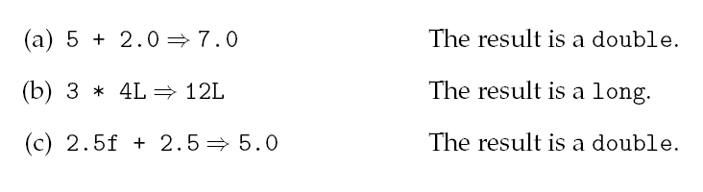
Effect of types
Type of operands determines the type of the result
The type of output is the type of operands (after conversion)
int <op> int → int
int <op> long → long
float <op> float → float
float <op> int → float
double <op> float → double
10
Notes:
10

Slide 11
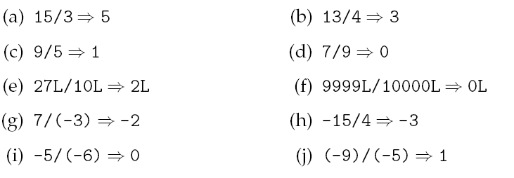
Effect of types
If both operand of division (/) is int
→ data lost
11
Notes:
11

Slide 12
Effect of types & Explicit casts
Expression Type of result
(double) 1 + 2.0f → 3.0 double
(int) 2.69 + 4 → 6 int
(double) 1 / 2 → 0.5 double
1 / (int) 2.0 → 0 int
(double) (1 / 2) → 0.0 double
(int)((double) 1 / 2) → 0 int
12
Notes:
12

Slide 13
What We Will Learn
Basic mathematic operations in C
Effect of type and type conversion
Precedence
Advanced mathematical operations
Mathematic library
Random numbers
13
Notes:
13

Slide 14
Precedence (اولويت)
1) Parenthesis
2) Unary + - (for sign): +4, -8
3) Explicit casting
4) / * %
5) Binary + -: 4+8
6) If multiple + - or / * %: from left to right
-5 + 2 / 4.0 * (-7 / 8) → -5 + 2 / 4.0 * (0)
→ -5 + 0.5 * 0
→ -5 + 0.0
→ -5.0
14
Notes:
14

Slide 15
Precedence
(7 + (float) (2 + (int) 1.005)) / (int) 20 →
(7 + (float) (2 + 1)) / (int) 20 →
(7 + (float) (3)) / (int) 20 →
(7 + 3.0f) / (int) 20 →
10.0f / (int) 20 → 0.5 // Result is float
5 + (double)(7 / (int) 8.5 / 7.0 * 6) →
5 + (double)(7 / 8 / 7.0 * 6) →
5 + (double)(0 / 7.0 * 6) →
5 + (double)(0.0 * 6) → 5 + 0.0 → 5.0 // Result is double
15
Notes:
15

Slide 16
برنامه چاپ جمع قسمت صحيح دو عدد اعشاري
#include <stdio.h>
int main(void){
float num1, num2; // ورودي‌ها
int sum; // حاصل‌ جمع
printf("Enter 2 number: \n");
scanf("%f",&num1);
scanf("%f",&num2);
sum = (int)num1 + (int)num2;
printf("%d\n", sum);
return 0;
}
16
Notes:
16

Slide 17
برنامه چاپ جمع قسمت اعشاري دو عدد اعشاري
#include <stdio.h>
int main(void){
float num1, num2, fpart1, fpart2, sum;
printf("Enter 2 number: \n");
scanf("%f",&num1);
scanf("%f",&num2);
fpart1 = num1 - (int)num1;
fpart2 = num2 - (int)num2;
sum = fpart1 + fpart2;
printf("%f\n", sum);
return 0;
}
17
Notes:
17

Slide 18
What We Will Learn
Basic mathematic operations in C
Effect of type and type conversion
Precedence
Advanced mathematical operations
Mathematic library
Random numbers
18
Notes:
18

Slide 19
Increment and Decrement of Variables
Unary operators only for variables
++ : increase by one
-- : decrease by one
int i = 10;
i = i + 1; // i = 11
i++; // i = 12
++i; // i = 13
i--; // i = 12
--i; // i = 11
i = i - 1; // i = 10
19
Notes:
19

Slide 20
Increment and Decrement (Cont’d.)
Postfix: Use the value then apply the operator
Prefix: Apply the operator then use the value
int i = 10, j;
j = i + 1; // i = 10, j = 11
j = i++; // i = 11, j = 10
j = ++i; // i = 12, j = 12
j = i--; // i = 11, j = 12
j = --i; // i = 10, j = 10
j = i - 1; // i = 10, j = 9
20
Notes:
20

Slide 21
Assignment Combined with Operation
These are equal
<variable> <op>= <expression>
<variable> = <variable> <op> (<expression>)
int i = 9, j = 20;
i += 1; // i = i + 1; // i = 10
j /= i; // j = j / i; // j = 2
i *= i + j - 6 + i / j;
/* i = i * (i + j - 6 + (i / j)); i = 110 */
21
Notes:
21

Slide 22
Multiple assignment
More than one assignment in a statement
From right to left
int i, j, k, l;
i = j = k = l = 1;
i += j *= --k -= 3 / l;
/* → i += j *= --k -= 3
→ i += j *= --(k -= 3) [k = -2]
→ i += j *= --k [k = -3]
→ i += j *= -3 [j = -3]
→ i += -3 [i = -2]
i = -2, j = -3, k = -3, l = 1
*/
22
Notes:
22

Slide 23
Precedence
Operator | Direction
( )
- + ++ -- (type)
* / % | Left to right
+ - add. sub. | Left to right
= += -= *= /= %= | Right to left
23
Notes:
23

Slide 24
Arithmetic on characters
char can be used as 8-bit integer
All arithmetic operations can be used with characters
/* A: 65, B: 66, C: 67, … */
char c = 'A', ch;
int i;
c++; // c = 66, c = 'B'
ch = c;
ch += 3; // ch = 69, ch = 'E'
i = c - ch + 'X' - 'Z'; // i = -5
24
Notes:
24

Slide 25
sizeof operator
sizeof is a unary operator
Return the size of operand
Operand can be
Variable, value or type
int size, i = 10;
size = sizeof i;
size = sizeof(i);
size = sizeof(2000);
size = sizeof(char)
25
Notes:
25
According to C99 Standards, the sizeof() operator only takes into account the type of the operand, which may be an expression or the name of a type (i.e int, double, float etc.), and not the value obtained on evaluating the expression. Hence, the operand inside the sizeof() operator is not evaluated. It is evaluated only if the type of the operand is a variable length array because in that case, the size can be determined only after the expression is evaluated.

Slide 26
sizeof operator
According to C99 Standards, the sizeof() operator only considers the operand type.
may be an expression or the name of a type (i.e., int, double, float, etc.) and not the value obtained on evaluating the expression.
The operand inside the sizeof()operator is not evaluated.
It is evaluated only if the type of the operand is a variable length array.
in that case, the size can be determined only after the expression is evaluated.

Slide 27
Precedence
Operator | Direction
( )
- + ++ -- (type) sizeof
* / % | Left to right
+ - add. sub. | Left to right
= += -= *= /= %= | Right to left
27
Notes:
27

Slide 28
Complicated examples
int i, j, k, n;
i = j = k = n = 1;
i = sizeof(int) + sizeof(char) + sizeof 10;
//i:9
i = j = k = n = 1;
i += j * k++ + sizeof n;
//i:6 j:1 k:2 n:1
i = j = k = n = 2;
i = j + (k = ++n); //i:5 j:2 k:3 n:3
28
Notes:
28

Slide 29
Undefined Statements
When the standard does not tell what will happen
Linux GCC and Code::Blocks outputs are different
Examples
int i, j, k;
k = i = 10;
j = i++ + k + --i; //j = 29 or 30?
i = j = 10;
i = j + i++; //i = 11 or 20?
29
Notes:
29
Linux GCC & Code::Blocks outputs are different

Slide 30
Recap: Overflow and Underflow
Computer’s precision is limited
The number of bits in each type is limited
double [-1e308, 1e308]
Overflow
When result is larger than specified ranges
1e300 * 1e200
Underflow
When the result is too smaller than precision
1e-300 * 1e-200
30
Notes:
30

Slide 31
برنامه محاسبه مقدار چند جمله‌ای درجه 2
#include <stdio.h>
int main(void){
float a, b, c, x, result;
printf("Enter a, b, c, x: ");
scanf("%f", &a);
scanf("%f", &b);
scanf("%f", &c);
scanf("%f", &x);
result = a * x * x + b * x + c;
printf("%f\n", result);
return 0;
}
31
Notes:
31

Slide 32
What We Will Learn
Basic mathematic operations in C
Effect of type and type conversion
Precedence
Advanced mathematical operations
Mathematic library
Random numbers
32
Notes:
32

Slide 33
Math Library
#include <math.h>
double f = 36;
fabs(-f) 36.000000
sqrt(f) 6.00000
pow(f, 0.5) 6.000000
ceil(-10.2) -10.000000
ceil(10.2) 11.000000
floor(-10.2) -11.000000
floor(10.2) 10.000000
fmax(10.1, 20.2) 20.2
fmin(10.1, 20.2) 10.1
rint(10.2) 10.0 rint(-10.2) -10.0
rint(20.6) 21 rint(-20.6) -21
33
Notes:
33

Slide 34
Math Library
const double PI = 3.141592653589793;
const double E = 2.7182818284590451;
sin(PI) 0.000000
cos(PI/2) 0.000000
acos(1) 0.000000
log(E) 1.000000
log(10) 2.30258
exp(1) 2.718282
34
Notes:
34

Slide 35
برنامه محاسبه محيط و مساحت دايره
#include <stdio.h>
#include <math.h>
#define PI 3.141592653589793
int main(void){
float r;
printf("Enter shoa");
scanf("%f", &r);
double masahat = PI * pow(r, 2);
double mohit = 2 * PI * r;
printf("masahat = %f\n", masahat);
printf("mohit = %f\n", mohit);
return 0;
}
35
Notes:
35

Slide 36
برنامه حل معادله درجه دو (با فرض وجود ريشه)
#include <stdio.h>
#include <math.h>
int main(void){
float a, b, c, delta, root1, root2;
printf("Enter a, b, c: ");
scanf("%f", &a);
scanf("%f", &b);
scanf("%f", &c);
36
Notes:
36

Slide 37
برنامه حل معادله درجه دو (با فرض وجود ريشه)
delta = sqrt((b * b) - (4 * a * c));
root1 = (-b + delta) / (2 * a);
root2 = (-b - delta) / (2 * a);
printf("root1 = ");
printf("%f\n", root1);
printf("root2 = ");
printf("%f\n", root2);
return 0;
}
37
Notes:
37

Slide 38
Random Numbers
#include <stdlib.h>
rand();
A random number in [0, RAND_MAX]
How does it work
Start from a seed number
X0 ← F(seed number)
Xn+1 = F(Xn)
Same seed
Same random number sequence
38
Notes:
38

Slide 39
Random Numbers
We usually want different random number
Run 1: 10, 20, 17, 1000, 23, 345, 30
Run 2: 23, 904, 23, 346, 85, 234, 63
We should use different seed in each run
How?
Initialize seed by system time
#include <time.h>
time_t t = time(NULL);
srand(t);
39
Notes:
39

Slide 40
Random Numbers
#include <stdio.h>
#include <stdlib.h>
#include <time.h>
int main(void){
int r1, r2;
srand(0);
r1 = rand();
printf("r1 = %d\n", r1);
time_t t = time(NULL);
srand(t);
r2 = rand();
printf("r2 = %d\n", r2);
return 0;
}
First Run
r1 = 38
r2 = 1873
Second Run
r1 = 38
r2 = 1866
Third Run
r1 = 38
r2 = 1860
40
Notes:
40

Slide 41
برنامه‌ چاپ يك عدد اعشاري تصادفي در بازه (0, 1)
#include <stdio.h>
#include <stdlib.h>
#include <time.h>
int main(void){
time_t t = time(NULL);
srand(t);
int ir = rand();
double fr = (ir + 1) / (RAND_MAX + 2.0);
printf("%f\n", fr);
return 0;
}
41
Notes:
41

Slide 42
Print 3 random numbers between 0 and 49
#include <stdio.h>
#include <stdlib.h>
#include <time.h>
int main (){
int i, n;
time_t t;
/* Initializes random number generator */ srand((unsigned) time(&t));
/* Print 3 random numbers from 0 to 49 */ printf("%d\n", rand() % 50); printf("%d\n", rand() % 50); printf("%d\n", rand() % 50);
return(0);
}

Slide 43
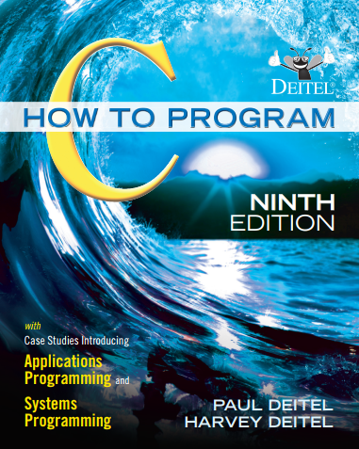
Reference
Reading Assignment: Sections 2.3 to 2.6 of Chapter 2 of “C How to Program” and Section and Sections 3.11 to 3.12 of Chapter 3.
43

Slide 44
Questions
Given the following code snippet, what will be printed?
int main() {
int a = 5, b = 2, c = 4;
int result = a + b * c - b % c;
printf("Result: %d\n", result); 15
return 0;
}
A) 12 B)11 C)14 D)13
Answer: A
44

Slide 45
Questions
What is the final value of a and b in the code?
int main() {
int a = 5, b = 10;
a = b--;
b = ++a;
printf("a = %d, b = %d\n", a, b);
return 0;
}
A) a=5, b=9 B) a=11, b=11
C) a=9, b=10 D) a=10, b=10
Answer: B
45

Slide 46
Questions
What is the result of the following code if c is assigned the value INT_MAX + 1?
int main() {
int c = INT_MAX + 1;
printf("c = %d\n", c);
return 0;
}
A) c = INT_MAX B) c = INT_MIN
C) Undefined behavior D) c = 0
Answer: B
46

