Slide 1

Version Control System using Git
نام درس: کارگاه کامپیوتر
ارائه‌دهنده: مَهراد حنافروش

Slide 2
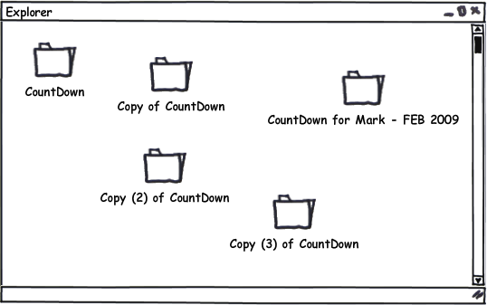
The Problem
Maintaining group Projects
Patches are mostly sent via email
Difficult to roll back
Almost impossible to maintain if the number of people working in the project is large
Testing new unstable features

Slide 3

Version Controlling System
A method for recalling versions of a codebase
Keeping a record of changes
Who did what and when in the system
Save yourself when things inevitably go wrong
two type:
Centralized VCS
Distributed VCS

Slide 4
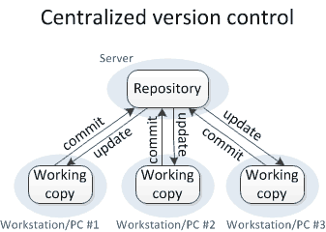
Centralized VCS

Slide 5
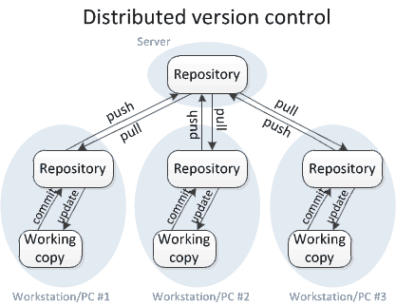
Distributed VCS

Slide 6

Git
Free, open source
Fully distributed
Handle small files very effectively
Tracks contents, not files
No network
Three stages
Created by Linus Torvalds in less than 2 weeks

Slide 7
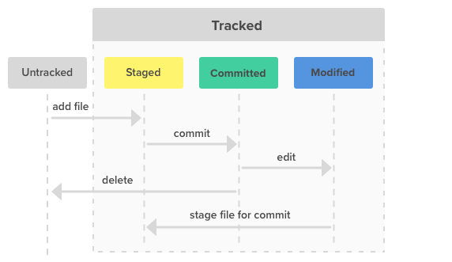
The States of git files

Slide 8

Scenario
Sync (Clone, Pull)
Add, Remove or modify files
Stage files (add)
Commit changes (commit)
Push to remote repo (push)
Local
Remote Repo
README.md
README.md
README.md
README.md
README.md
README.md
main.c
main.c
main.c
main.c

Slide 9
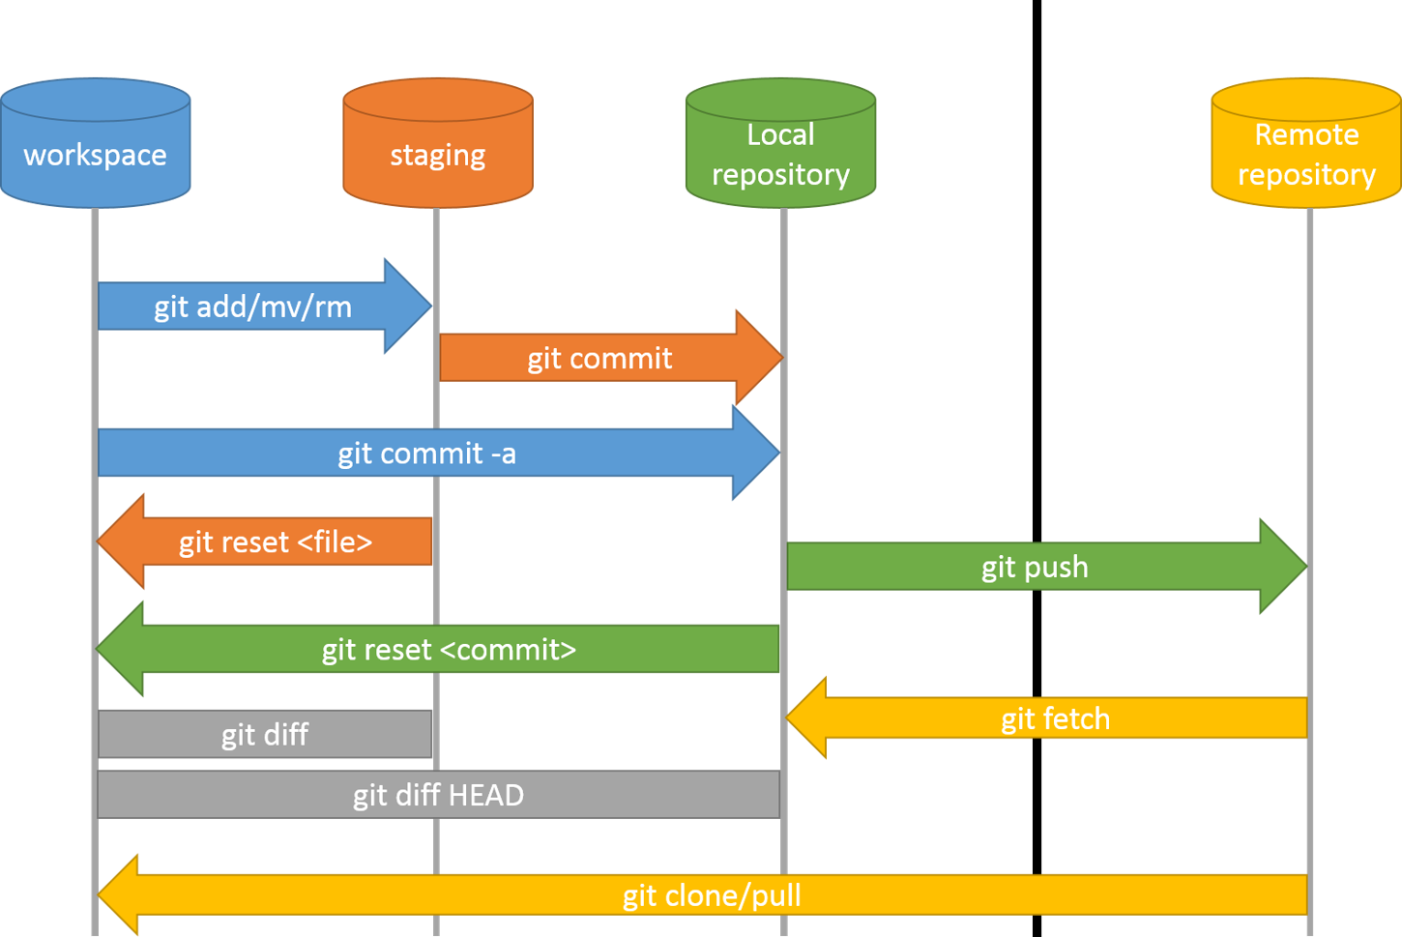
Workflow

Slide 10
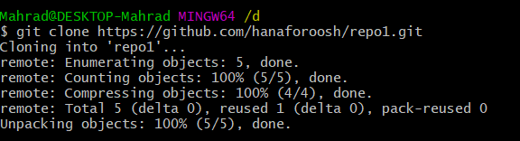
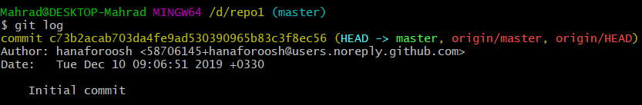
Commands
git clone https://github.com/hanaforoosh/repo1.git
git log

Slide 11
Commands (cont’d)
HEAD
Master
C73b2
29725
40661
Origin/Master
Origin/HEAD
Git push
Modify firstFile
Git add firstFile
Git commit -m "testFile has been modifed“
Git push
Make a file and name it firstFile
Git add firstFile
git commit -m "testFile has been added to the Repo"

Slide 12
Commands (cont’d)
HEAD
Master
C73b2
29725
40661
Origin/Master
Origin/HEAD
Git checkout 29725
Check the contents of firstFile
Git checkout Master
Git Reset --hard 29725
Git push --force

Slide 13
Commands (cont’d)
Git log --graph
Git push
Git pull
Git branch newBranch
Git checkout –b newBranch
Git push origin newBranch
Git commit --am “message”
Git status
Git show
Git diff 29725 firstFile
Git merge newBranch
HEAD^
Master~3

Slide 14
سوالات
علت استفاده از سیستم‌های کنترل نسخه چیست؟
انواع سیستم‌های کنترل نسخه را نام ببرید.
برای دریافت اطلاعات از Remote Repository از چه دستوراتی استفاده می‌شود؟
مراحل کار با گیت را به همراه دستورات متناظر آن‌ها توضیح دهید.
دو دستور پر کاربرد در ارتباط با Remote Repository را نام ببرید.

