Slide 1
Lecture 9
Arrays and Strings
Fundamentals of Computer and Programming
Instructor: Morteza Zakeri, Ph.D. (m-zakeri@live.com)
Spring 2024
Modified Slides from Dr. Hossein Zeinali and Dr. Bahador Bakhshi
Computer Engineering Department, Amirkabir University of Technology
Notes:
1

Slide 2
What We Will Learn
Introduction
Arrays in functions
Multidimensional arrays
String
String functions
Array of Strings
2
Notes:
2

Slide 3
What We Will Learn
Introduction
Arrays in functions
Multidimensional arrays
String
String functions
Array of Strings
3
Notes:
3

Slide 4
Introduction
Algorithms usually work on large data sets
Sort a set of numbers
Search a specific number in a set of numbers
How to read and store a set of data?
To read
Repeat the scanf statement
Use the loop statements
To store the data
Save each data in a single variable??
3000 int variables! ! ! !
4
Notes:
4

Slide 5

Array
A collection of same type variables
A nx1 vector of
Integers, chars, floats, …
Example
An array of 8 integer
An array of 5 chars
5
Notes:
5
Indices are start from 0,
Element of arrays are saved in successive address, starting from the address of first element

Slide 6
Arrays in C
Array declaration in C
<Elements’ Type> <identifier> [ <size> ]
<Elements’ Type>: int, char, float, …
<size>
Old compilers (standard): it should be constant
New compilers (standard): it can be variable
Elements in array
From 0 to (size – 1)
6
Notes:
6

Slide 7
Example
int num[20];
num is array of 20 integers
num[0] is the first integer variable
num[19] is the last integer
Indices are always integer while the elements’ type can be any type
float farr[100];
farr is array of 100 floats
farr[0] is the first float
farr[49] is the 50th float
farr[99] is the last float
7
Notes:
7
Indices are always integer while the elements’ type can be any type

Slide 8
What We Will Learn
Introduction
Arrays in functions
Multidimensional arrays
String
String functions
Array of Strings
8
Notes:
8

Slide 9
Arrays in Functions
int number[20];
number[i] is an integer variable
Array element can be used for call by value input
Array element can be use for output
int f(int x);
void h(void){
int arr[50];
//Array element in call by value
arr[30] = f(arr[5]);
}
9
Notes:
9

Slide 10
Arrays in Functions (cont’d)
Array cannot be used as output type of function
int [] f(int x, int y); // Compile error
Arrays can be used in input list of functions
Arrays are not passed by Call By Value
Arrays are passed by Call By Reference
If we change array elements in a function
The element is changed in the caller function
10
Notes:
10

Slide 11
Arrays in Functions (version 1)
Function arr_func takes an array of integers
int arr_func(int num[90]){
}
// or
int arr_func(int num[]){
}
Array a is passed to function arr_func
int a[90];
i = arr_func(a);
11
Notes:
11

Slide 12
Arrays in Functions (version 1)
#include <stdio.h>
void init_array(int arr[10]){
int i;
for(i = 0; i < 10; i++)
arr[i] = i;
}
void main(void){
int a[10];
init_array(a);
int j;
for(j = 0; j < 10; j++)
printf("a[%d] = %d\n", j, a[j]);
}
تابعي كه يك آرايه به طول 10را مي‌گيرد و اعضاي آن را با اعداد 0 تا 9 مقداردهي مي‌كند.
12
Notes:
12

Slide 13
Array Size in Functions
If array is an input parameter of a function
It cannot find out the size of the array
Array size should be passed from caller function to called function
Using definitions
#define SIZE 20
void func(int a[]){ for(int i = 0; i < SIZE; i++)…}
Using input variable
void read(int a[], int size){ for(int i = 0; i < size; i++)
// or
void read(int size, int a[size]){
for(int i = 0; i < size; i++) … }
13
Notes:
13
warning: ‘sizeof’ on array function parameter ‘a’ will return size of ‘int *’ [-Wsizeof-array-argument]
#include <stdio.h>
int f1(int n, int a[10]){
for(int i = 0; i < sizeof(a)/sizeof(a[0]); i++)
printf("%d\n", a[i]);
return 0;}
int main(void){ int a[5] = {10, 20, 30, 40, 50};
printf("\nf run = %d\n", f1(5, a));
return 0;}

Slide 14
Array Size in Functions (cont’d)
If array is declared in a function
It knows the size of the array
It can find out the size of the array using sizeof
void func(void){
int i, a[200];
for(i = 0; i < 200; i++)
a[i] = 0;
// or
for(i = 0; i < sizeof(a)/sizeof(a[0]); i++) a[i] = 0;
}
14
Notes:
14

Slide 15
Out-of-range access
C compiler does not check the range you access
int x[10]; x[20] = 30; y = x[100];
No compiler error!
What happen
Read: Logical error
y = x[100];
Write: May or may not logical or runtime error
x[20] = 30;
15
Notes:
15

Slide 16
Out-of-range Example
#include <stdio.h>
void init_array(int size, int arr[]){
int i;
for(i = 0; i < size; i++)
arr[i] = i;
}
void print_array(int size, int arr[]){
int i;
for(i = 0; i < size; i++)
printf("arr[%d] = %d\n", i, arr[i]);
}
16
Notes:
16

Slide 17
Out-of-range Example (Cont’d)
void main(void){
int x = 1;
int y = 2;
int a[10] = {0}; // all elements set to Zero
init_array(10, a); // OK
print_array(10, a); // OK
print_array(30, a); // Wrong output
init_array(1000, a); // May be Run-time error!!!
init_array(20, a); // May changes X, Y!!!
// Logical error
printf("x = %d, y = %d\n" , x, y);
}
17
Notes:
17

Slide 18
Find Array Max index
#include <stdio.h>
int max_index(int a[], int size){
int i;
int index = 0;
for(i = 1; i < size; i++)
if(a[i] > a[index])
index = i;
return index;
}
void main(void){
int arr[] = {1, 4, 12, 93, 23};
printf("max index = %d\n", max_index(arr, 5));
}
تابعي كه يك آرايه را بگيرد و محل بزرگترين عضو آن‌را برگرداند.
18
Notes:
18

Slide 19
Array elements swap
#include <stdio.h>
void array_swap(int a[], int i, int j){
int tmp;
tmp = a[i];
a[i] = a[j];
a[j] = tmp;
}
void main(void){
int num[10] = {1, 2, 5, 6};
int x = 2, y = 6;
printf("num[%d] = %d, num[%d] = %d\n", x, num[x], y, num[y]);
array_swap(num, x, y);
printf("num[%d] = %d, num[%d] = %d\n", x, num[x], y, num[y]);
}
تابعي كه يك آرايه و دو محل آن‌را بگيرد و آنها را باهم جابجا كند.
19
Notes:
19
What happen

Slide 20
Sorting Problem
Example:
Input: 8 2 4 9 3 6
Output: 2 3 4 6 8 9

Slide 21
Selection Sort
Algorithm:
Find the smallest element in the array
Exchange it with the element in the first position
Find the second smallest element and exchange it with the element in the second position
Continue until the array is sorted.

Slide 22
الگوريتمي كه يك رشته عدد را كه محل عضو اول آن با start و محل عضو آخر آن با end مشخص شده است را به صورت صعودي مرتب كند.
Algorithm: sort (x, start, end)
while (start != end)
j ← find index of minimum element from start to end
swap x[j] and x[start]
start ← start + 1
==================
Algorithm find_min(x, start, end)
y ← start
i ← start + 1
while (i <= end)
if(x[i] < x[y])
y ← i
i ← i + 1
return y
Verify the Algorithm
Notes:
نکات:
تفكر تقسيم و حل: براي حل يك مساله الگوريتمي داريم كه همه جزييات آن را به صورت همزمان بيان نميكنيم.
به این الگوریتمی که در این اسلاید هست مرتب سازی انخابی (selection sort) گفته می‌شود.

Slide 23
Selection Sort: Example
8
4
6
9
2
3
1
1
2
3
4
9
6
8
1
4
6
9
2
3
8
1
2
3
4
6
9
8
1
2
6
9
4
3
8
1
2
3
4
6
8
9
1
2
3
9
4
6
8
1
2
3
4
6
8
9

Slide 24
Selection Sort
void selection_sort(int arr[], int n) {
int i, j, min_idx;
// One by one move boundary of unsorted subarray
for (i = 0; i < n - 1; i++) {
// Find the minimum element in unsorted array
min_idx = i;
for (j = i + 1; j < n; j++) {
if (arr[j] < arr[min_idx])
min_idx = j;
}
// Swap the found minimum element with the first element
if (min_idx != i)
swap(arr[min_idx], arr[i]);
}
}

Slide 25
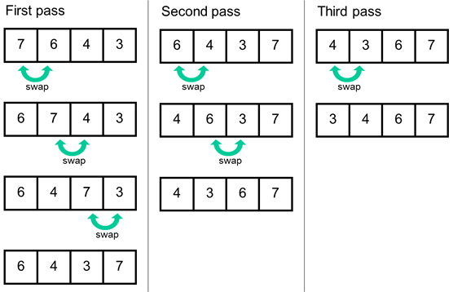
Bubble sort

Slide 26
Sorting an array: Bubble sort
#include <stdio.h>
void array_swap(int a[], int i, int j){
int tmp;
tmp = a[i];
a[i] = a[j];
a[j] = tmp;
}
void bubble_sort(int a[], int size){
int i, j;
for(i = 0; i < size - 1; i++)
for(j = i + 1; j < size; j++)
if(a[i] < a[j])
array_swap(a, i, j);
}
تابع مرتب‌سازي مجموعه اعداد صحيح
26
Notes:
26
What happen

Slide 27
Sorting an array: Bubble sort (Cont’d)
void print(int a[], int size){
int i;
for(i = 0; i < size; i++)
printf("%d ", a[i]);
printf("\n");
}
int main(void){
int arr[] = {1, 7, 3, 7, 11, 0};
int size = sizeof(arr) / sizeof(arr[0]);
printf("Before sort: ");
print(arr, size);
bubble_sort(arr, size);
printf("After sort: ");
print(arr, size);
return 0;
}
// Call print in bubble_sort to show //progress
27
Notes:
27
What happen

Slide 28
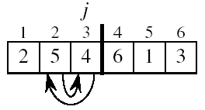
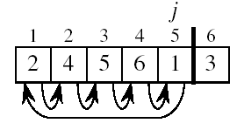
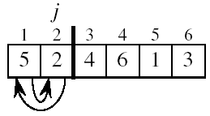
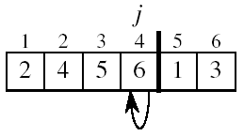
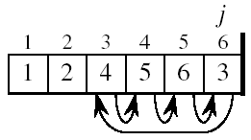
Exercise: Insertion Sort

Slide 29
Quiz: Insertion Sort
Write the code of insertion sort as a C function.

Slide 30
Quiz: Insertion Sort (Answer)
void insertion_sort(int arr[], int n)
{
int i, key, j;
for (i = 1; i < n; i++)
{
key = arr[i];
j = i - 1;
/* Move elements of arr[0..i-1], that are greater than key, to one position ahead of their current position */
while (j >= 0 && arr[j] > key)
{
arr[j + 1] = arr[j];
j = j - 1;
}
arr[j + 1] = key;
}
}

Slide 31
Binary Search
int bsearch(int start, int end, int a[], int value){
int mid = (start + end) / 2;
if(a[mid] == value)
return mid;
else if(start >= end)
return -1;
else if(value > a[mid])
return bsearch(mid + 1, end, a, value);
else
return bsearch(start, mid - 1 , a, value);
}
31

Slide 32
What We Will Learn
Introduction
Initializing arrays
Arrays in functions
Multidimensional arrays
String
String functions
Array of Strings
32
Notes:
32

Slide 33
Multidimensional Arrays
If element of an array is array itself, it will be Multidimensional array
nxn matrix, mxnxnxm matrix
int t[10][20];
10x20 matrix of integers
t[1][1]; // t[1,1] → compile error
Integer variable in location (1,1)
33
Notes:
33
Such definitions are incorrect: int t[10,10]

Slide 34
Initializing Multidimensional Arrays
int num[2][3] = {1, 2, 0, 3, 4 , 7};
int num[2][3] = {{1, 2, 0},{3, 4, 7}};
num[0][2] is 0, num[1][0] is 3
int num[5][3] = {{1, 2, 0},{3, 4, 7}};
num[2][2] is 0, num[1][2] is 7
int num[2][3][2] = {{{1,2},{3,4},{5,6}}, {{1},{2},{3}}};
num[0][2][1] is 6, num[1][0][1] is 0
int num[][2] = {{1,1},{2,2},{3,3}};
num[1][1] is 2, num[2][0] is 3
34
Notes:
34

Slide 35
Multidimensional Arrays in Functions
Can be used as input of functions
All dimensions except the first one must be given
void func(int a[10][20][5]);
Input is a 10x20x5 integer matrix
void func(int a[][20][30], int size);
void func(int size1, int size2, int a[size1][size2]);
Input is a matrix of integers that both rows and columns are variable
35
Notes:
35

Slide 36
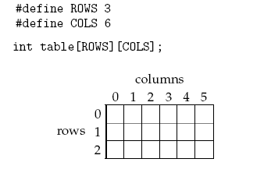
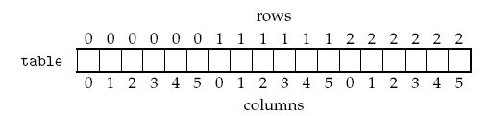
Multidimensional arrays memory layout
36

Slide 37
Print a matrix
تابعي براي چاپ يك ماتريس كه ابعاد آن ثابت است.
#include <stdio.h>
void displayMatrix (int nRows, int nCols, int matrix[nRows][nCols]){
int row, column;
for ( row = 0; row < nRows; ++row) {
for ( column = 0; column < nCols; ++column )
printf ("%5i", matrix[row][column]);
printf ("\n");
}
}
int main (void){
int sampleMatrix[3][5] = {{ 7, 16, 55, 13, 12 }, { 12, 10, 52, 0, 7 }, { -2, 1, 2, 4, 9 }};
printf ("Original matrix:\n");
displayMatrix (3, 5, sampleMatrix);
}
37
Notes:
37

Slide 38
Transpose matrix (A^{T})
محاسبه ترانهاده ماتريس
#define SIZE 5
void swap(int a[SIZE][SIZE], int i, int j){
int tmp;
tmp = a[i][j];
a[i][j] = a[j][i];
a[j][i] = tmp;
}
void transpose(int a[][SIZE]){
int i, j;
for(i = 0; i < SIZE; i++)
for(j = i; j < SIZE; j++)
swap(a, i, j);
}
38
Notes:
38

Slide 39
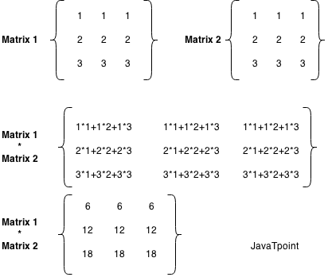
Matrix multiplication
ضرب ماتریس‌ها
Math recap:

Slide 40
Matrix multiplication
ضرب ماتریس‌ها
#include <stdio.h>
#include <stdlib.h>
// matrix dimensions so that we dont have to pass them as
// parametersmat1[R1][C1] and mat2[R2][C2]
#define R1 2 // number of rows in Matrix-1
#define C1 2 // number of columns in Matrix-1
#define R2 2 // number of rows in Matrix-2
#define C2 3 // number of columns in Matrix-2
void multiplyMatrix(int m1[][C1], int m2[][C2]){
int result[R1][C2];
printf("Resultant Matrix is:\n");
for (int i = 0; i < R1; i++) {
for (int j = 0; j < C2; j++) {
result[i][j] = 0;
for (int k = 0; k < R2; k++) {
result[i][j] += m1[i][k] * m2[k][j];
}
printf("%d\t", result[i][j]);
}
printf("\n"); }
}

Slide 41
Exercise: Matrix calculation
Write programs for other operations on matrix:
Add,
Sub,
Determinant,
Eigenvalues,
etc.

Slide 42
What We Will Learn
Introduction
Initializing arrays
Arrays in functions
Multidimensional arrays
String
String functions
Bugs and avoiding them
42
Notes:
42

Slide 43
Introduction
Until now
We have seen strings in printf()
Our old definition: string is a set of chars between “ ”
printf("This is a string\n");
printf("This is %s\n", "a string\n");
Strings:
An array of chars
Terminated by the null char '\0'
43
Notes:
43

Slide 44
Strings in C
Since strings are array
char str3[] = {'p', 'r', 'o', 'g', 'r', 'a', 'm', '\0'};
char str1[8] = "program";
char str2[] = "program";
char *str3 = "program"; //we will see later
44
Notes:
44

Slide 45
Reading and Writing Strings
printf can be used to print strings
printf("program");
printf("%s", "program");
scanf can be used to read strings
char str[200];
scanf("%s", str);
Initial white spaces are ignored
Read until space or '\n' (which is replaced by \0)
We must allocate sufficient size.
45
Notes:
45
Provide example for each of them

Slide 46
Reading and Writing Strings (cont’d)
puts(str)is very simple version of printf()
Can only be used to print strings
Adds ‘\n’ to end of string
gets(char str[]) can be used to read strings
gets does not ignore the white spaces
Read until \n
String should be large enough
46
Notes:
46

Slide 47
What We Will Learn
Introduction
Initializing arrays
Arrays in functions
Multidimensional arrays
String
String functions
Bugs and avoiding them
47
Notes:
47

Slide 48
String Library
Access to string library by
#include <string.h>
Many functions to work with strings
Find the length of string
Compare strings
Copy strings
Search in strings
…
48
Notes:
48

Slide 49
Length of String
strlen(str): Length of string
From start to first occurrence of the null char
char str[] = "This is test";
char str1[10]={'a', 'b', '\0', 'c', '\0'};
strlen(str) → 12
strlen(str1) → 2
49
Notes:
49

Slide 50
Compare Strings
str1 and str2 are compared as follows
Compare char by char from left to right until str1 and str2 has same chars.
In the first different char
If(char of str1 < char of str2) → str1 < str2
If (both string finish) → str1 = str2
strcmp(str1, str2):compare str1 and str2
If(str1 == str2) → return 0
If(str1 < str2) → return -1
If(str1 > str2) → return 1
50
Notes:
50

Slide 51
Compare Strings: Examples
char s1[] = "abc";
char s2[] = "abc";
i = strcmp(s1, s2); //i = 0
char s3[] = "abc";
char s4[] = "abx";
i = strcmp(s3, s4); //i = -1
char s5[] = "axc";
char s6[] = "abc";
i = strcmp(s5, s6); //i = 1
char s7[] = "ab";
char s8[] = "abc";
i = strcmp(s7, s8); //i = -1
char s9[] = "abc";
char s10[] = "aBc";
i = strcmp(s9, s10); //i = 1
51
Notes:
51

Slide 52
Compare Strings
strcmpi(str1, str2)
Compares str1 and str2 similar to strcmp
But ignores uppercase/lowercase difference
char str1[]="ABC", str2[]="abC";
strcmpi(str1, str2) → 0
52
Notes:
52

Slide 53
Copy Strings
Strings should be copied char by char
strcpy(dst_str, src_str): copy the src_str to the dst_str
src_str is a constant string
dst_str should have sufficient size
53
Notes:
53

Slide 54
Copy Strings: Example
char str1[] = "Test String";
char str2[20];
strcpy(str2, str1);
printf("%s\n", str2);
printf("%s\n", str1);
Test String
Test String
54
Notes:
54

Slide 55
Concatenate Strings
strcat(dst, src): Append the src string to the end of dst
src is constant string
dst should have sufficient space
55
Notes:
55

Slide 56
Concatenate Strings: Example
char str1[] = "String";
char str2[20]= "Test ";
strcat(str2, str1);
printf("%s\n", str2);
// Test String
56
Notes:
56

Slide 57
Sized Version of the Functions
strncpy(dst, src, n):
copys n chars from src to dst
If(strlen(src) > n)
Copies n chars to dst
Does not add ‘\0’ to end of dst
If(strlen(src) < n)
Copy src to dst
Add n – strlen(src) – 1 ‘\0’ to end of dst
dst must be large enough
n < size of dst
57
Notes:
57

Slide 58
Sized Version of Functions
strncmp(str1, str2, n):
Compares the first x chars
x = min{n, strlen(str1)+1, strlen(str2)+1 }
strncat(dst, src, n):
Appends the x chars from src to dst
x = min{n, strlen(src)}
Adds ‘\0’ to end of dst
dst must be large enough
58
Notes:
58

Slide 59
Numbers and Strings: number → string
To convert a number to string
char str1[100];
int i = 100;
sprintf(str1, "%d", i);
float f = 10.11;
sprintf(str1, "%0.2f", f);
String str1 should have sufficient size
// str1 = “100”
// str1 = “10.11”
59
Notes:
59

Slide 60
Numbers and Strings: string → number
To convert from strings to numbers
#include <stdlib.h>
char str1[] = "10";
int i;
i = atoi(str1); // i = 10
sscanf(str1, "%d", &i); // i = 10
char str2[] = "20.44";
double f;
f = atof(str2); // f = 20.44
sscanf(str2, "%lf", &f); // f = 20.44
60
Notes:
60

Slide 61
String as Array
Strings are array of chars
We work on arrays element by element
We can work on strings char by char
char str1[] = "100000";
str1[2] = '2';
We can pass strings to functions
61
Notes:
61

Slide 62
String as Array: Example
#include <stdio.h>
#include <string.h>
void str_n_m_cat(char s1[], char s2[], int n, int m, char res[]){
strncpy(res, s1, n);
res[n] = '\0';
strncat(res, s2, m);
res[n+m] = '\0’;
}
void main(void){
char s1[] = "abcdefgh", s2[] = "abcdefgh";
char result[50];
str_n_m_cat(s1, s2, 6, 6, result);
str_n_m_cat(s1, s2, 600, 6, result);//Runtime error
}
تابعي كه دو رشته s1 و s2 و دو عدد n و m را بگيرد و يك رشته توليد كند كه شامل n عضو اول s1 و m عضو s2 است.
62
Notes:
62

Slide 63
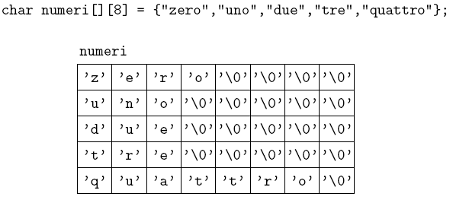
Array of Strings
2 dimensional array, each row is a string
63
Notes:
63

Slide 64
Array of Strings: Example
#include <stdio.h>
#include <string.h>
#define MAX_NAME_SIZE 100
void read_data(char names[][MAX_NAME_SIZE], double grades[], int size){
int i;
for(i = 0; i < size; i++){
printf("Enter name: ");
scanf("%s", names[i]);
printf("Enter grade: ");
scanf("%lf", &(grades[i]));
}
}
double get_average(double grades[], int size){
int i;
double res = 0;
for(i = 0; i < size; i++)
res += grades[i];
return (res / size);
}
برنامه‌اي كه تعداد دانشجويان را بگيرد، سپس اسم هر دانشجو و نمره را بگيرد.
اسم دانشجوياني كه نمره آنها بيشتر از ميانگين است، را چاپ كند.
64
Notes:
64

Slide 65
Array of Strings: Example (Cont’d)
void print_names(char names[][MAX_NAME_SIZE], double grades[], int size, double average){
int i;
printf("Average = %lf \n", average);
printf("List of students whose grade is above the average: \n");
for(i = 0; i < size; i++)
if(grades[i] > average)
printf("%s\n", names[i]);
}
65
Notes:
65

Slide 66
Array of Strings: Example (Cont’d)
int main(void){
int num;
printf("Enter number of students: ");
scanf("%d", &num);
double grades[num];
char names[num][MAX_NAME_SIZE];
read_data(names, grades, num);
double average = get_average(grades, num);
print_names(names, grades, num, average);
return 0;
}

Slide 67
ctype.h
Many function to work on chars
Check digit
Check alphabetic
Check lower or upper case
Convert from/to upper/lower case
67
Notes:
67

Slide 68
ctype.h
int isdigit(ch)
Check ch is digital char or not
int isalpha(ch)
Check ch is alphabetic or not
int islower(ch)
Check ch is lowercase alphabetic or not
int isupper(ch)
Check ch is uppercase alphabetic or not
char tolower(ch)
Convert ch to lowercase and return it
char toupper(ch)
Convert ch to upper case and return it
68
Notes:
68

Slide 69
What We Will Learn
Introduction
Initializing arrays
Arrays in functions
Multidimensional arrays
String
String functions
Bugs and avoiding them
69
Notes:
69

Slide 70
Common Bugs and Avoiding them
Strings which are used as destination
scanf, sprintf, strcpy, ….
Must be large enough
Take care about the ‘\0’
You should never destroy it, some library functions do!
Out of range array index!!! (read/write, wrong size in function, multidimensional array memory)
You cannot assign a value to array
int a[4], b[4]; a = b; // Error
To debug
Print the array index and corresponding value
70
Notes:
70

Slide 71
Reference
Reading Assignment: Chapters 6 and 8 of “C How to Program”
71

