Slide 1
Lecture 10
Pointers and Dynamic Memory
Fundamentals of Computer and Programming
Instructor: Morteza Zakeri, Ph.D. (m-zakeri@live.com)
Spring 2024
Modified Slides from Dr. Hossein Zeinali and Dr. Bahador Bakhshi
Computer Engineering Department, Amirkabir University of Technology
Notes:
1

Slide 2
What We Will Learn
Introduction
Pointers and Functions
Pointers and Arrays
Pointers and Strings
Pointer to Pointer & Pointer to Function
Dynamic memory allocation
2
Notes:
2
2
How does scanf changes our variables while functions are called by value?!

Slide 3
What We Will Learn
Introduction
Pointers and Functions
Pointers and Arrays
Pointers and Strings
Pointer to Pointer & Pointer to Function
Dynamic memory allocation
3
Notes:
3
3

Slide 4
Pointer: Reference to Memory
Pointer is a variable that
Contains the address of another variable
Pointer refers to an address
Examples
int i;
int *pi;
i = 20;
pi = &i;
4
Notes:
4
4

Slide 5
Pointer: Declaration and Initialization
<type> * <identifier>;
Examples
int i, *pi;
pi = &i;
float f;
float *pf = &f;
char c, *pc = &c;
int &ref = i; // Only C++
5
Notes:
5
Syntactically, C does not have references as C++ does.
5

Slide 6
Value of referred memory by a pointer
int *pi, *pj, i, j;
pi variable contains the memory address
If you assign a value to it: pi = &i;
The address is saved in pi
If you read it: pj = pi;
The address is copied from pi to pj
*pi is the value of referred memory
If you read it: j = *pi;
The value in the referred address is read from pi
If you assign a value to it: *pj = i;
The value is saved in the referred address
6
Notes:
6
6

Slide 7
Using Pointers: Example
int i = 10, j;
/* address of i is 100, value of i is 10 */
/* address of j is 200, value of j is ?? */
int *pi;
/* address of pi is 300, value of pi is ?? */
pi = &i;
/* address of pi is 300, value of pi is 100 */
j = *pi;
/* address of j is 200, value of j is 10 */
*pi = 20;
/* address of pi is 300, value of pi is 100 */
/* address of i is 100, value of i is 20 */
7
Notes:
7
7

Slide 8
Using Pointers: Example
double d1, d2, *pda, *pdb;
d1 = 10;
d2 = 20;
pda = &d1;
pdb = &d1;
*pda = 15;
d2 = d2 + *pdb;
printf("d2 = %f\n", d2);
// d2 = 35.0
8
Notes:
8
8

Slide 9
Using Pointers: Example
In C, you can cast between a pointer and an int
A pointer is just a 32-bit or 64-bit number (depending on machine architecture) referring to the aforementioned chunk of memory.
#include <stdio.h>
int main () {
int x = 5;
int *ref = &x; // now ref points to x
printf ("%d\n", x); // print the value of x // 5
printf ("%p\n", &x); // print the address of x // 0x7ffe4b79fb1c
printf ("%p\n", &ref); // print the address of the pointer variable // 0x7ffe4b79fb20
printf ("%d\n", *ref); // print the value of the int that ref is pointing to // 5
return 0;
}
Notes:
If this is what you are asking, %p and %Fp print out a pointer, specifically the address to which the pointer refers, and since it is printing out a part of your computer's architecture, it does so in Hexadecimal.
In C, you can cast between a pointer and an int, since a pointer is just a 32-bit or 64-bit number (depending on machine architecture) referring to the aforementioned chunk of memory.

Slide 10
Pointer: Reference to Memory
Pointer variable contains an address
There is a special address
NULL
We can NOT
Read any value from NULL
Write any value to NULL
If you try to read/write → Run time error
NULL is usually used
For pointer initialization
Check some conditions
10
Notes:
10
10

Slide 11
What We Will Learn
Introduction
Pointers and Functions
Pointers and Arrays
Pointers and Strings
Pointer to Pointer & Pointer to Function
Dynamic memory allocation
11
Notes:
11
11

Slide 12
Call by value
void func(int y){
y = 0;
}
void main(void){
int x = 100;
func(x);
printf("%d", x); // 100 not 0
}
Call by value
The value of the x is copied to y
By changing y, x is not changed
12
Notes:
12
12

Slide 13
Call by reference
Call by reference
The value of variable is not copied to function
If function changes the input parameter → the variable passed to the input is changed
Is implemented by pointers in C
void func(int *y){
*y = 0;
}
void main(void){
int x = 100;
func(&x);
printf("%d", x); // 0 ☺
}
13
Notes:
13
13

Slide 14
Pointers in Functions
void add(double a, double b, double *res){
*res = a + b;
return;
}
int main(void){
double d1 = 10.1, d2 = 20.2;
double result = 0;
add(d1, d2, &result);
printf("%f\n", result); // 30.3
return 0;
}
14
Notes:
14
14

Slide 15
What happen?
double result = 0;
The address of result is 100, value of result is 0
add(d1, d2, &result);
Value of d1, Value of d2 and the address of result is copied to add
add(double a, double b, double *res)
Value of a is the value of d1, value of b is the value of d2 and value of res is 100 and the value of *res is 0
*res = a + b;
Value of a is added to b and output is saved in the referred address by res (100)
But the 100 is the address of result. Therefore the value is saved in memory location result
15
Notes:
15
15

Slide 16
Swap function (the wrong version)
void swap(double a, double b){
double temp;
temp = a;
a = b;
b = temp;
return;
}
int main(void){
double d1 = 10.1, d2 = 20.2;
printf("d1 = %f, d2 = %f\n",d1,d2 );
swap(d1, d2);
printf("d1 = %f, d2 = %f\n",d1, d2);
return 0;
}
// d1 = 10.1, d2 = 20.2
// d1 = 10.1, d2 = 20.2
16
Notes:
16
16

Slide 17
swap function (the correct version)
void swap(double *a, double *b){
double temp;
temp = *a;
*a = *b;
*b = temp;
return;
}
void main(void){
double d1 = 10.1, d2 = 20.2;
printf("d1 = %f, d2 = %f\n", d1, d2);
swap(&d1, &d2);
printf("d1 = %f, d2 = %f\n", d1, d2);
}
// d1 = 10.1, d2 = 20.2
// d1 = 20.2, d2 = 10.1
17
Notes:
17
17

Slide 18
Pointer as the function output
Functions can return a pointer as output
But, the address pointed by the pointer must be valid after the function finishes
The pointed variable must be exist
It must not be automatic local variable of the function
It can be static local variable, global variable, or the input parameter
18
Notes:
18
18

Slide 19
Pointer as the function output
int gi;
int * func_a(void){
return &gi;
}
float * func_b(void){
static float x;
return &x;
}
19
Notes:
19
19

Slide 20
Pointer to constant: const <type> *
If the input parameter
Is a pointer
But should not be changed
Why?
We do not want to copy the value of variable
Value can be very large (array or struct)
We do not allow the function to change the variable
void func(const double *a){
*a = 10.0; //compile error
}
20
Notes:
20
20

Slide 21
Constant pointer: <type> * const
If a variable is a constant pointer
We cannot assign a new address to it
void func(int * const a){
int x, y;
int * const b = &y;
a = &x; //compile error
b = &x; //compile error
*a = 100; // no error
}
21
Notes:
21
21

Slide 22
What We Will Learn
Introduction
Pointers and Functions
Pointers and Arrays
Pointer and Strings
Pointer to Pointer & Pointer to Function
Dynamic memory allocation
22
Notes:
22
22

Slide 23
Operations on Pointers
Arithmetic
☑ <pointer> - or + <integer> (or <pointer> -= or += <integer>)
☑ <pointer>++ or <pointer>--
☑ <pointer> - <pointer> (they must be the same type)
 <pointer> + <pointer> NOT ALLOWED
Comparison between pointers
int arr[20];
int *pi, *pj, i;
pi = &arr[10];
pj = &arr[15];
i = pj - pi; // i = 5
i = pi - pj; // i = -5
if(pi < pj) // if is True
if(pi == pj) // if is False
23
Notes:
23
23

Slide 24
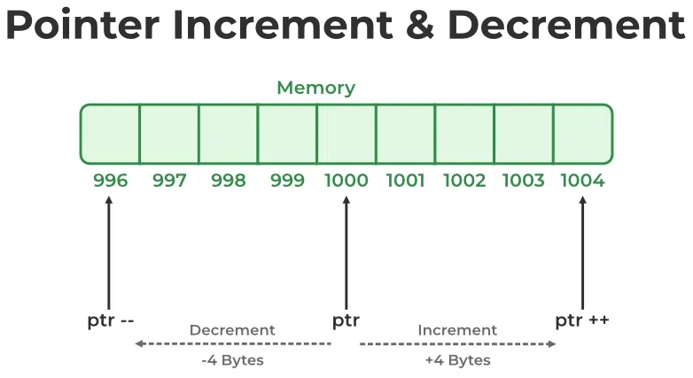
Operations on Pointers
If an integer pointer that stores address 1000 is decremented, then it will decrement by 4 (size of an int), and the new address will point to 996.

Slide 25
Operations on Pointers Examples
int a = 22;
int *p = &a;
printf("p = %u\n", p); //p = 6422288
p++; printf("p++ = %u\n", p); //p++ = 6422292 +4 // 4 bytes
p--;
printf("p-- = %u\n", p); //p-- = 6422288 -4 // restored to original value
float b = 22.22;
float *q = &b;
printf("q = %u\n", q); //q = 6422284
q++; printf("q++ = %u\n", q); //q++ = 6422288 +4 // 4 bytes
q--;
printf("q-- = %u\n", q); //q-- = 6422284 -4 // restored to original value
char c = 'a’;
char *r = &c;
printf("r = %u\n", r); //r = 6422283
r++; printf("r++ = %u\n", r); //r++ = 6422284 +1 // 1 byte
r--;
printf("r-- = %u\n", r); //r-- = 6422283 -1 // restored to original value

Slide 26
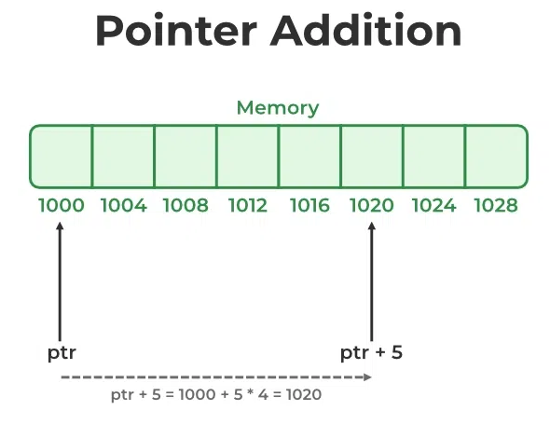
Operations on Pointers
The ptr is an integer pointer that stores 1000 as an address.
add integer 5 to it using the expression, ptr = ptr + 5, then,
the final address stored in the ptr will be ptr = 1000 + sizeof(int) * 5 = 1020.

Slide 27
Operations on Pointers
int a = 22;
int *p = &a;
int *q = p + 2;
int *r = q + 2;
int *z1, z2;
printf ("p = %u\n", p); // p = 3131704112
printf ("q = %u\n", q); // q = 3131704120
printf (“r = %u\n", r); // r = 3131704128
z1 = r - p;
printf ("z1 = r - p = %u\n", z1); // z1 = r - p = 4
z2 = r - p;
printf ("z2 = r - p = %u\n", z2); // z2 = r - p = 4
z1 = r + p; // Compiler-time error
invalid operands to binary + (have ‘int *’ and ‘int *’)

Slide 28
Operations on Pointers Examples
int *pi, *pj, *pk, i, j, k;
char *pa, *pb, *pc, a, b, c;
pi = &i;
pj = pi + 2;
pk = pj + 2;
pa = &a;
pb = pa + 2;
i = pj - pi;
j = pb - pa;
k = pk - pi;
pi = pj + pk; // compile error: No + operation for 2 pointers
pc = pi; // compile error: Different types
i = pa – pi; // compile error: Different ptr types
// i = 2
// j = 2
// k = 4
28
Notes:
28
28

Slide 29
Array and Pointers
Pointer can refer to each element in an array
int a[20];
int *pa;
pa = &a[10]; // pa refers to element 10
a[11] = *pa; // value of pa is saved in element 11
The name of array is the pointer to the first element
pa = &a[0]; //pa refers to element 0
pa = a; //pa refers to element 0
29
Notes:
29
29

Slide 30
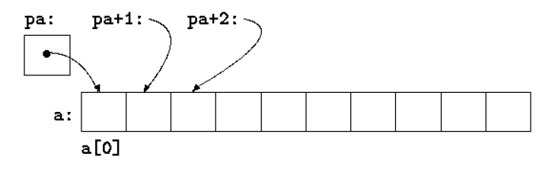
Arrays and Pointers
int a[50];
int *pa;
pa = a;
If address a = 100
pa = 100
pa+1 points to a[1]
pa + 1 = 104
pa + 2 points to a[2]
pa + 2 = 108
Example
30
Notes:
30
30

Slide 31
Arrays and Pointers: Similarity
int arr[20], *pi, j;
pi = &arr[0]; //pi refers to array
pi = pi + 2; //pi refers to element 2
pi--; //pi refers to element 1
j = *(pi+2); //value of element 3
pi = arr + 2; //pi refers to element 2
/* arr is used as a pointer */
j = pi[8]; //value of element 10
/* pi is used as array */
31
Notes:
31
31

Slide 32
Arrays and Pointers: Difference
We can change pointers
Assign new value, arithmetic and …
We cannot change the array variable
int arr[20], arr2[20], *pi;
pi = arr;
pi++;
arr2 = pi; //Compile error
arr2 = arr; //Compile error
arr++; //Compile error
32
Notes:
32
32

Slide 33
Arrays in Functions (version 2)
int func1(int num[90]){
}
int func2(int num[], int size){
}
int func3(int *num, int size){
}
func1 knows size from [90], func2 and func3 know size from int size
33
Notes:
33
33

Slide 34
Copying Arrays
void array_copy_wrong1(int a[], int b[]){
a = b; //Compile error
}
void array_copy_wrong2(int *a, int *b){
a = b; //logical error
}
void array_copy1(int dst[], int src[], int size){
for(int i = 0; i < size; i++)
dst[i] = src[i];
}
void array_copy2(int *dst, int *src, int size){
for(int i = 0; i < size; i++)
dst[i] = src[i];
}
void array_copy3(int *dst, int *src, int size){
for(int i = 0; i < size; i++)
*(dst + i) = *(src + i);
}
void array_copy4(int *dst, int *src, int size){
for(int i = 0; i < size; i++, src++, dst++)
*dst = *src;
}
تابعي كه يك آرايه را در آرايه ديگر كپي كند.
34
Notes:
34
34

Slide 35
Copying Arrays (running example)
int t1[10]={0}, t2[10]={0}, t3[10]={0}, t4[10]={0}, x[]={1,2,3,4,5,6,7,8,9,10};
array_copy1(t1, x, 10);
→ t1 = {1 2 3 4 5 6 7 8 9 10}
array_copy2(t2, x + 2, 8);
→ t2 = {3 4 5 6 7 8 9 10 0 0}
array_copy3(&(t3[5]), x, 5);
→ t3 = {0 0 0 0 0 1 2 3 4 5}
array_copy4(t4 + 6, &x[8], 2);
→ t4 = {0 0 0 0 0 0 9 10 0 0}
35
Notes:
35
35

Slide 36
Computing arr1 – arr2
#include <stdio.h>
int search(int *arr, int size, int num){
int i;
for(i = 0; i < size; i++)
if(arr[i] == num)
return 1;
return 0;
}
int sub_set(int *arr1, int size_arr1, int *arr2, int size_arr2, int *res){
int i;
int result_index = 0;
for(i = 0; i < size_arr1; i++)
if(search(arr2, size_arr2, arr1[i]) == 0){
res[result_index] = arr1[i];
result_index++;
}
return result_index;
}
برنامه‌اي كه تفاضل دو مجموعه را حساب كند.
36
Notes:
36

Slide 37
Computing arr1 – arr2 (Cont’d)
void print_arr(int *arr, int size){
for(int i = 0; i < size; i++)
printf("%d ", arr[i]);
printf("\n");
}
int main(void){
int a1[] = {1, 2, 3, 4, 5, 6};
int a2[] = {4, 8, 6, 11};
int res[100];
int result_size;
result_size = sub_set(a1, sizeof(a1) / sizeof(int), a2, sizeof(a2) / sizeof(int), res);
if(result_size > 0)
print_arr(res, result_size);
else
printf("a1 - a2 = {}\n");
return 0;
}
برنامه‌اي كه تفاضل دو مجموعه را حساب كند.
37
Notes:
37

Slide 38
Array of pointers
Pointer is a type in C
We can define pointer variable
We can define array of pointer
int i = 10, j = 20, k = 30;
int *arr_of_pointers[10];
arr_of_pointers[0] = &i;
arr_of_pointers[1] = &j;
arr_of_pointers[2] = &k;
*arr_of_pointers[1] = *arr_of_pointers[2];
→ i = 10, j = 30, k = 30
38
Notes:
38
38

Slide 39
Call by reference in depth
Note: The value of a pointer variable is actually passed using call by value
void array_copy(int *dst, int *src, int size){
for(int i = 0; i < size; i++, src++, dst++)
*dst = *src;
printf("%p\n%p\n", dst, src);
}
int main() {
int a[] = {1,2,3,4,5}, b[5], *pa, *pb;
pa = a;
pb = b;
printf("%p\n", pa);
printf("%p\n", pb);
array_copy(pb, pa, 5);
printf("%p\n", pa);
printf("%p\n", pb);
}
Outputs:
0xffffcc10
0xffffcbf0
0xffffcc04
0xffffcc24
0xffffcc10
0xffffcbf0
39
Notes:
39
39

Slide 40
What We Will Learn
Introduction
Pointers and Functions
Pointers and Arrays
Pointer and Strings
Pointer to Pointer & Pointer to Function
Dynamic memory allocation
40
Notes:
40
40

Slide 41
Strings and Pointers
Since strings are array
char str1[8] = "program";
char str2[] = "program";
char str3[] = {'p', 'r', 'o', 'g', 'r', 'a', 'm', '\0'};
Because arrays are similar to pointers
char *str4 = "program";
41
Notes:
41
41
The “program” is a constant value in C, We define a pointer to char and set the start address of the constant value in variable str4

Slide 42
Strings in C (Cont’d)
str1, str2, and str3 are array
str4 is a pointer
We cannot assign a new value to str1, str2, str3
Array is a fix location in memory
We can change the elements of array
We can assign a new value for str4
Pointer is not fix location, pointer contains address of memory
Content of str4 is constant, you can not change elements
42
Notes:
42
42
Provide an example

Slide 43
char Array vs. char *: Example
char str1[8] = "program";
//this is array initialization
char *str4 = "program";
//this is a constant string
str1[6] = 'z';
str4 = "new string";
str1 = "new array"; //Compile Error
str4[1] = 'z'; //Runtime Error
*(str4 + 3) = 'a'; //Runtime Error
43
Notes:
43
43

Slide 44
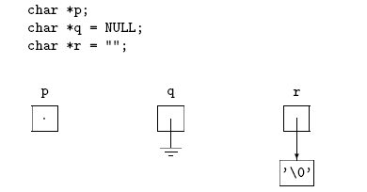
Empty vs. Null
Empty string ""
Is not null pointer
Is not uninitialized pointer
44
Notes:
44
44
What is that the NULL dangling pointers

Slide 45
More String Functions
char * strchr(const char *s, char c)
Return the pointer to the first occurrence of c in s or NULL
char *s="ABZDEZFZ";
char *pc = strchr(s, 'Z');
printf("First index of Z = %d", (pc - s));
First index of Z = 2
char * strstr(const char *s1, cost char *s2)
Return pointer to the first occurrence of s2 in s1 or NULL
char *s="ABCDxyEFxyGH";
char *pc = strstr(s, "xy");
printf("First index of xy = %d", (pc - s));
First index of xy = 4
45
Notes:
45

Slide 46
برنامه‌اي كه دو عدد double را تا n رقم بعد از اعشار باهم مقايسه كند.
#include <stdio.h>
#include <string.h>
int check_equal(double d1, double d2, int n){
int dot_index1, dot_index2;
int search_size;
char s1[50], s2[50];
sprintf(s1, "%0.*lf", n, d1);
sprintf(s2, "%0.*lf", n, d2);
dot_index1 = strchr(s1, '.') - s1;
dot_index2 = strchr(s2, '.') - s2;
if(dot_index1 != dot_index2)
return 0;
search_size = dot_index1 + n + 1;
if(strncmp(s1, s2, search_size) == 0)
return 1;
else
return 0;
}
46
Notes:
46

Slide 47
برنامه‌اي كه دو عدد double را تا n رقم بعد از اعشار باهم مقايسه كند.
int main(void){
int n;
double d1, d2;
printf("Enter numbers d1 and d2: ");
scanf("%lf %lf", &d1, &d2);
printf("Enter n: ");
scanf("%d", &n);
if(check_equal(d1, d2, n))
printf("Are equal\n");
else
printf("Are Not equal\n");
return 0;
}
47
Notes:
47

Slide 48
String Tokenizer
#include <stdio.h>
#include <string.h>
int tokenizer(char *s, char *sep, char result[][100]){
int res_index = 0;
char *index;
while((index = strstr(s, sep)) != NULL){
int len = index - s;
if(len > 0){
strncpy(result[res_index], s, len);
result[res_index][len] = '\0';
res_index++;
}
s = index + strlen(sep);
}
if(strlen(s) > 0){
strcpy(result[res_index], s); res_index++;
}
return res_index;
}
48
Notes:
48

Slide 49
String Tokenizer (Cont’d)
int main(void){
char *s = "a123bb123ccc123dddd123eeeee123fffffffffff123";
char *sep = "123";
char res[10][100];
int num = tokenizer(s, sep, res);
int i;
for(i = 0; i < num; i++)
printf("Token %d = %s\n", i + 1, res[i]);
return 0;
}
Token 1 = a
Token 2 = bb
Token 3 = ccc
Token 4 = dddd
Token 5 = eeeee
Token 6 = fffffffffff
49
Notes:
49

Slide 50
برنامه‌اي كه تعداد دانشجويان را بگيرد، سپس اسم هر دانشجو و نمره را بگيرد. اسم دانشجوياني كه نمره آنها بيشتر از ميانگين است را چاپ كند.
#include <stdio.h>
#include <string.h>
/* char * names[] does not work */
void read_data(char names[][100], double grades[], int size){
int i;
for(i = 0; i < size; i++){
printf("Enter name: ");
scanf("%s", names[i]);
printf("Enter grade: ");
scanf("%lf", &(grades[i]));
}
}
double get_average(double grades[], int size){
int i;
double res = 0;
for(i = 0; i < size; i++)
res += grades[i];
return (res / size);
}
50
Notes:
50
50

Slide 51
برنامه‌اي كه تعداد دانشجويان را بگيرد، سپس اسم هر دانشجو و نمره را بگيرد. اسم دانشجوياني كه نمره آنها بيشتر از ميانگين است را چاپ كند.
void print_names(char names[][100], double grades[], int size, double average){
int i;
printf("Average = %lf \n", average);
printf("List of students whose grade is above the average: \n");
for(i = 0; i < size; i++)
if(grades[i] > average)
printf("%s\n", names[i]);
}
int main(void){
int num;
printf("Enter number of students: ");
scanf("%d", &num);
double grades[num];
char names[num][100];
read_data(names, grades, num);
double average = get_average(grades, num);
print_names(names, grades, num, average);
return 0;
}
51
Notes:
51
51

Slide 52
What We Will Learn
Introduction
Pointers and Functions
Pointers and Arrays
Pointer and Strings
Pointer to Pointer and Pointer to Function
Dynamic memory allocation
52
Notes:
52
52

Slide 53
Pointer to Pointer
Pointer is a variable
Has a value: address of other value
Has an address
Pointer to pointer
Saving the address of a pointer in another pointer
int i, j, *pi, *pj;
int **ppi;
pi = &i;
ppi = &pi;
j = **ppi; pj = *ppi;
53
Notes:
53
53

Slide 54
Pointer to Pointer: Example
int i = 10, j = 20, k = 30;
int *pi, *pj, **ppi;
pi = &i;
pj = &j;
ppi = &pi;
printf("%d\n", *pi);
printf("%d\n", **ppi);
ppi = &pj;
**ppi = 100;
printf("%d\n", j);
*ppi = &k;
printf("%d\n", *pj);
We will see the applications later
10
10
100
30
54
Notes:
54
54

Slide 55
Pointer to functions
Functions are stored in memory
Each function has its own address
We can have pointer to function
A pointer that store the address of a function
type (*<identifier>)(<type1>, <type2>, …)
int (*pf)(char, float)
pf is a pointer to a function that the function return int and its inputs are char and float
55
Notes:
55

Slide 56
Pointer to functions: Example
int f1(int x, char c){
printf("This is f1: x = %d, c = %c\n", x, c); return 0;
}
int f2(int n, char m){
printf("This is f2: n = %d, m = %c\n", n, m); return 0;
}
int main(void){
int (*f)(int, char); // parentheses are required here
f = f1; // or f = &f1;
(*f)(10, 'a'); // parentheses are optional here
f = f2; // or f = &f2
(*f)(100, 'z');
return 0;
}
This is f1: x = 10, c = a
This is f2: n = 100, m = z
56
Notes:
56

Slide 57
Pointer to function: Application 1
Why?
To develop general functions
To change function operation in run-time
Example: atexit
#include <stdlib.h>
int atexit(void (*function)(void));
To do a function, when the program is terminated
Normal termination
57
Notes:
57

Slide 58
Pointer to function: Application 1
#include <stdio.h>
#include <stdlib.h>
void good_bye(void){ printf("Goooodddd Byeee :-)\n"); }
int main(void){
int i;
atexit(good_bye);
printf("Enter an int: ");
scanf("%d", &i);
if(i < 0){
printf("No negative\n");
return 0;
}
if(i > 7){
printf("No more than 7\n");
return 0;
}
if(i % 2 == 0)
printf("Go to class \n");
else
printf("Do the homework \n");
return 0;
}
Notes:
58

Slide 59
Pointer to function: Application 2
Why?
To develop general functions
To change function operation in run-time
Example: qsort function in <stdlib.h>
void qsort(void *arr, int num, int element_size, int (*compare)(void *, void *))
To sort array arr with num elements of size element_size.
The order between elements is specified by the “compare” function
59
Notes:
59
دو مورد براي اينكار لازم است
1- بتوان آرايه اي از هر نوع را گرفت كه اينكار توسط void * انجام ميشود. اشاره گري كه ميتوان هر نوع اشاره گر ديگر را به آن اختصاص داد ولي چون type ندارد نميتوان از آن خواند، قبل از آن بايد cast شود
2- انجام مقايسه را در زمان اجرا تغيير داد، اينكار توسط اشاره گر به تابع انجام ميشود

Slide 60
Pointer to function: Application 2
#include <stdio.h>
#include <stdlib.h>
int int_cmp_asc(const void *i1, const void *i2){
int a = *((int *)i1);
int b = *((int *)i2);
return (a > b) ? 1 : (a == b) ? 0 : -1;
}
int int_cmp_dsc(const void *i1, const void *i2){
int a = *((int *)i1);
int b = *((int *)i2);
return (a > b) ? -1 : (a == b) ? 0 : 1;
}
Notes:
60

Slide 61
Pointer to function: Application 2
int main(void){
int i;
int arr[] = {1, 7, 3, 11, 9};
qsort(arr, 5, sizeof(int), int_cmp_asc);
for(i = 0; i < 5; i++)
printf("%d \n", arr[i]);
qsort(arr, 5, sizeof(int), int_cmp_dsc);
for(i = 0; i < 5; i++)
printf("%d \n", arr[i]);
return 0;
}
Notes:
61

Slide 62
What We Will Learn
Introduction
Pointers and Functions
Pointers and Arrays
Pointer and Strings
Pointer to Pointer & Pointer to Function
Dynamic memory allocation
62
Notes:
62
62

Slide 63
Dynamic Memory Allocation
Until now we define variables:
int i; int a[200]; int x[n]
Memory is allocated for the variables when the scope starts
Allocated memory is released when the scope finishes
We cannot change the size of the allocated memories
We cannot change the size of array
These variables are in stack
We want to see how to allocate memory in heap
63
Notes:
63
63

Slide 64
Heap
Memory is compose of a few logical sections
Stack is one of the logical sections that is used for function calls
All automatic variables are allocated in stack
Stack is managed by operating system
Created by function call and destroyed when function ends
Another logical section is “Heap”
Heap is used for dynamic memory allocation
Heap is managed by programmer (at least in C)
Memory allocation functions and the free function
64
Notes:
64

Slide 65
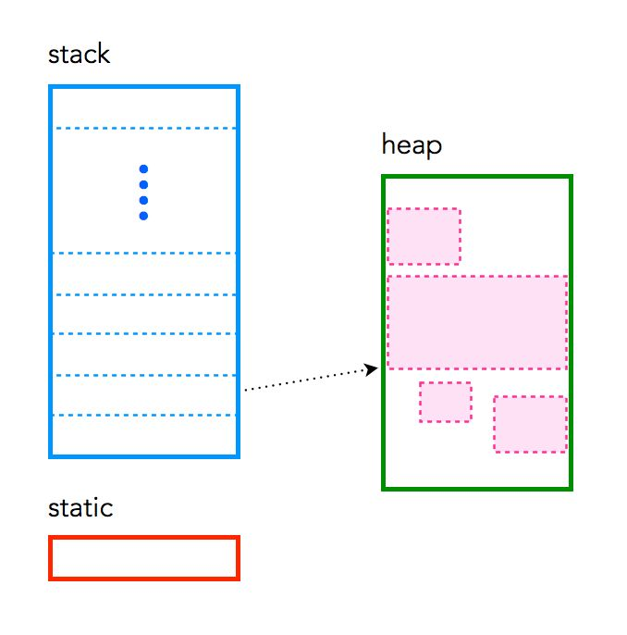
Stack, Heap, and Static Memories
C has three different pools of memory:
Static: global variable storage, permanent for the entire run of the program.
Stack: local variable storage (automatic, continuous memory).
Heap: dynamic storage (large pool of memory, not allocated in contiguous order).
65
Notes:
65

Slide 66
Dynamic Memory Allocation (cont’d)
Memory allocation by calloc
#include <stdlib.h>
void * calloc(int num, int size);
void * is generic pointer, it can be converted to every pointer type
Allocates a block of memory for an array of num elements, each of them size bytes long, and initializes all its bits to zero.
If memory is not available calloc returns NULL
66
Notes:
66
66
Allocates a block of memory for an array of num elements, each of them size bytes long, and initializes all its bits to zero.

Slide 67
Dynamic Memory Allocation (cont’d)
Memory allocation by malloc
#include <stdlib.h>
void * malloc(int size);
void * is generic pointer, it can be converted to every pointer type.
Allocates a block of size bytes of memory, returning a pointer to the beginning of the block. Allocated memory is not Initialized.
If memory is not available malloc returns NULL
67
Notes:
67
67
Allocates a block of size bytes of memory, returning a pointer to the beginning of the block.

Slide 68
Dynamic Memory Allocation: Example
int *pi;
/* allocate memory, convert it to int * */
pi = (int *) malloc(sizeof(int));
if(pi == NULL){
printf("cannot allocate\n");
return -1;
}
double *pd;
pd = (double *) calloc(1,sizeof(double));
68
Notes:
68
68

Slide 69
Free
In static memory allocation, memory is freed when block/scope is finished
In dynamic memory allocation, we must free the allocated memory
int *pi;
pi = (int *) malloc(sizeof(int));
if(pi != NULL)
free(pi);
69
Notes:
69
69

Slide 70
برنامه‌اي كه n را مي‌گيرد، آرايه با اندازه n را توليد و بعد حافظه را آزاد مي‌كند.
#include <stdio.h>
#include <stdlib.h>
int main(void){
int i, n;
int *arr;
printf("Enter n: ");
scanf("%d", &n);
arr = (int *)calloc(n, sizeof(int));
if(arr == NULL){
printf("cannot allocate memory\n");
exit(-1);
}
for(i = 0; i < n; i++) /* do you work here */
arr[i] = i;
for(i = 0; i < n; i++)
printf("%d\n", arr[i]);
free(arr);
return 0;
}
70
Notes:
70
70

Slide 71
برنامه‌اي كه n و m را مي‌گيرد، ماتريس nxm را توليد و بعد حافظه را آزاد مي‌كند.
#include <stdio.h>
#include <stdlib.h>
int main(void){
int i, j, n, m;
int **arr;
printf("Enter n, m: ");
scanf("%d%d", &n, &m);
arr = (int **)malloc(n * sizeof(int *));
for(i = 0; i < n; i++)
arr[i] = (int *)malloc(m * sizeof(int));
for(i = 0; i < n; i++)
for(j = 0; j < m; j++)
arr[i][j] = i * j;
for(i = 0; i < n; i++)
free(arr[i]);
free(arr);
return 0;
}
71
Notes:
71
71

Slide 72
Reallocation
If we need to change the size of allocated memory: Expand or Shrink it
void * realloc(void *p, int newsize);
Allocate newsize bytes for pointer p
Previous data of p does not change
If the new size is larger, the value of the newly allocated portion is indeterminate.
72
Notes:
72
72
Changes the size of the memory block pointed to by ptr.
The function may move the memory block to a new location (whose address is returned by the function).
The content of the memory block is preserved up to the lesser of the new and old sizes, even if the block is moved to a new location. If the new size is larger, the value of the newly allocated portion is indeterminate.

Slide 73
Reallocation
int *p;
p = (int *)calloc(2, sizeof(int));
printf("%d\n", *p);
*p = 500;
printf("%d\n", *(p+1));
*(p + 1) = 100;
p = (int *)realloc(p, sizeof(int) * 4);
printf("%d\n", *p);
p++;
printf("%d\n", *p);
p++;
printf("%d\n", *p);
p++;
printf("%d\n", *p);
// 0
// 0
// 500
// 100
// ???
// ???
73
Notes:
73
73

Slide 74
برنامه‌اي که تعدادي عدد (تعداد آن را نمي‌دانيم) كه با -1 تمام مي‌شود را بگيرد و اعداد كوچكتر از ميانگين را چاپ كند.
#include <stdio.h>
#include <stdlib.h>
void find_small(double *arr, int size){
int i;
double sum = 0, average;
for(i = 0; i < size; i++)
sum += arr[i];
average = sum / size;
for(i = 0; i < size; i++)
if(arr[i] < average)
printf("%f ", arr[i]);
}
74
Notes:
74
74

Slide 75
برنامه‌اي که تعدادي عدد (تعداد آن را نمي‌دانيم) كه با -1 تمام مي‌شود را بگيرد و اعداد كوچكتر از ميانگين را چاپ كند.
int main(void){
double *arr = NULL; int index = 0;
while(1){
double num;
printf("Enter number (-1 to finish): ");
scanf("%lf", &num);
if(num == -1)
break;
if(arr == NULL)
arr = (double *)malloc(sizeof(double));
else
arr = (double *)realloc(arr, (index + 1) * sizeof(double));
arr[index] = num;
index++;
}
find_small(arr, index);
if(arr != NULL)
free(arr);
return 0;
}
75
Notes:
75
75

Slide 76
An example of multifunction application (menu-based app)
برنامه‌اي بنويسيد كه منوي زير را به كاربر نشان دهد:
1: New Data
2: Show Data
3: Exit
اگر كاربر 1 وارد كند، برنامه عدد n را مي‌گيرد، آرايه‌اي به طول n ايجاد مي‌كند. سپس، n عدد را از كاربر مي‌گيرد و آنها را در آرايه نگه مي‌دارد.
اگر كاربر 2 وارد كند اطلاعات وارد شده نشان داده مي‌شود.
اگر كار بر 3 وارد كند از برنامه خارج مي‌شويم.
76
Notes:
76
76

Slide 77
An example of multifunction application (menu-based app)
#include <stdio.h>
#include <stdlib.h>
void show(){
printf("1: New Data\n");
printf("2: Show Data\n");
printf("3: Exit\n");
}
int main(void){
int n;
int *arr = NULL;
while(1){
int code;
show();
scanf("%d", &code);
if(code == 1){
printf("Enter size: ");
scanf("%d", &n);
printf("Enter data: \n");
if(arr == NULL)
arr = (int *)malloc(n * sizeof(int));
else
arr = (int *)realloc(arr, n * sizeof(int));
int i;
for(i = 0; i < n; i++)
scanf("%d", &(arr[i]));
}
77
Notes:
77
77

Slide 78
An example of multifunction application (menu-based app)
else if(code == 2){
printf("Your data: ");
int i;
for(i = 0; i < n; i++)
printf("%d ", arr[i]);
printf("\n");
}
else if(code == 3){
if(arr != NULL)
free(arr);
exit(0);
}
else{
printf("Unknown input ...\n");
}
}
}
78
Notes:
78
78

Slide 79
What We Will Learn
Introduction
Pointers and Functions
Pointers and Arrays
Pointer and Strings
Pointer to Pointer & Pointer to Function
Dynamic memory allocation
Common Bugs
79
Notes:
79
79

Slide 80
Common Bugs
Be very very careful about pointers
Invalid type of value assigned to pointer
int i, *pi = &i;
*pi = 29.090; // No warning in some compilers!!!
Invalid usage of pointers
int *pi, i;
pi = i;
i = pi;
We cannot change constant string
char *s = "abc";
*(s + 1) = 'z'; // Run Time Error
80
Notes:
80
80

Slide 81
Reference
Reading Assignment: Chapter 7 of “C How to Program”
81

