Slide 1
Lecture 3 C Programming Basics
Fundamentals of Computer and Programming
Instructor: Morteza Zakeri, Ph.D.
(zakeri@aut.ac.ir)
Modified Slides from Dr. Hossein Zeinali and Dr. Bahador Bakhshi
School of Computer Engineering,
Amirkabir University of Technology
Spring 2025
Notes:
1

Slide 2
What We Will Learn
What is the C
Variables
Types
Values
Casting
Constants & Definition
2
Notes:
2

Slide 3
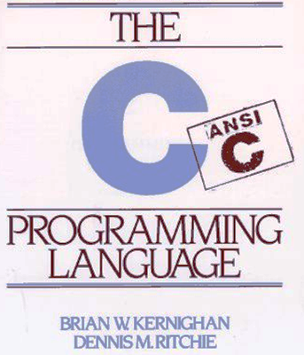
3
Notes:
3
زبان C در سال ۱۹۷۲ توسط دنیس ریچی از روی زبان B و BCPL در آزمایشگاه بل ساخته شد
چاپ کتاب "The C Programming Language" در سال ۱۹۷۸ توسط برایان کرنیگان و ریچی باعث رشد روزافزون این زبان در جهان شد. (1988 (2nd Edition)) در سال ۱۹۹۰، استاندارد ANSI C ( با تغییرات قالب بندی) توسط سازمان بین‌المللی استانداردسازی (ISO) به عنوان ISO / IEC 9899: 1990 تصویب شد، که گاهی اوقات C90 نیز نامیده می‌شود؛ بنابراین، اصطلاحات "C89" و "C90" به همان زبان برنامه‌نویسی اشاره دارند.
استاندارد C در اواخر دهه ۱۹۹۰ بازنگری شد و منجر به انتشار ISO / IEC 9899: 1999 در ۱۹۹۹ شد، که معمولاً به آن "C99" گفته می‌شود.
C11
در سال ۲۰۰۷، کار بر روی تجدید نظر در مورد استاندارد C، به‌طور غیررسمی به نام "C1X" تا انتشار رسمی آن در تاریخ ۲۰۱۱-۱۲-۰۸ آغاز شد.
C18 که در ژوئن سال ۲۰۱۸ منتشر شده استاندارد فعلی زبان برنامه‌نویسی C است.

Slide 4
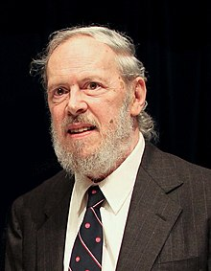
The C Language
C is a general-purpose programming language
C is developed by Dennis Ritchie at Bell Laboratories (1972) – Now C18
C is one of the widely used languages
Application development
System programs, most operating systems are developed in C: Unix, Linux
Many other languages are based on it
4
Notes:
4
Why C
Textbooks

Slide 5
Programming in C Language
C programming language
A set of notations for representing programs
C standard libraries
A set of developed programs (functions)
C programming environment
A set of tools to aid program development
5
Notes:
5

Slide 6
The First Example
Write a program that prints
“Hello the CE juniors :-)”
6
Notes:
6

Slide 7
The First C Program
#include <stdio.h>
int main(void){
printf("Hello the CE juniors :-) \n");
return 0;
}
7
Notes:
7
1- include, 2- function output/name/input, 3- function call, 4- return value

Slide 8
General Rules
C is case sensitive: main is not MaIn
A “;” is required after each statement
Each program should have a main function
int main(void){…
void main(void){…
main(){…
int main(int argc, char ** argv){…
Program starts running from the main
You should follow coding styles (beautiful code)
8
Notes:
8

Slide 9
General Rules: Spaces
Equal Statements
int main(void){ | int main ( void) {
printf("abc"); return 0; | printf ( "abc" ); return 0;
return 0; | return 0;
9
Notes:
9

Slide 10
General Rules: Spaces
Not Equal Statements
int main(void){ | intmain(void) {
printf("abc def"); | printf("abcdef");
10
Notes:
10

Slide 11
Comments
/* Our first
C program */
#include <stdio.h>
int main(void){
//This program prints a simple message
printf("Hello the CE juniors :-) \n");
return 0;
}
11
Notes:
11
Different version of this program
1-Multiple printf
2-Using \n

Slide 12
The First C Program
You should
Develop the source code of program
Compile
Run
Debug
All of them can be done in IDE
Code::Blocks, Dev-C++
CLion
VS Code, Eclipse,
12
Notes:
12

Slide 13
What We Will Learn
What is the C
Variables
Types
Values
Casting
Constants & Definition
13
Notes:
13

Slide 14
Variables
“write a program to calculate the sum of two numbers given by user”
Solving problems
Input data → Algorithm → Output date
What we need
Implementing the algorithm
Named Functions
We will discuss later
Storing the input/output data
Variables
14
Notes:
14

Slide 15
Variables (cont’d)
Data is stored in the main memory
Variables
Are the name of locations in the main memory
We use names instead of physical addresses
Specify the coding of the location
What do the “01”s means?
What is the type of data?
15
Notes:
15

Slide 16
Variables
Variables in the C
<Qualifier> <Type> <Identifier>;
<Qualifier>
Is optional
We will discuss later
<Type>
Specifies the coding
<Identifier>
Is the name
16
Notes:
16

Slide 17
Types: Integers
Integer numbers
Different types, different sizes, different ranges
Type | Size | Unsigned | Signed
short | 16Bits
int | 32Bits
long or long int | 32/64 Bits
long long or long long int | 64 Bits
17
Notes:
17
https://en.wikipedia.org/wiki/C_data_types
The actual size of the integer types varies by implementation. The standard requires only size relations between the data types and minimum sizes for each data type:
The relation requirements are that the long long is not smaller than long, which is not smaller than int, which is not smaller than short. As char's size is always the minimum supported data type, no other data types (except bit-fields) can be smaller.
The minimum size for char is 8 bits, the minimum size for short and int is 16 bits, for long it is 32 bits and long long must contain at least 64 bits.

Slide 18
Types: Float and Double
Floating point number
float 32 bits
double 64 bits
long double 96 bits
Limited precision
float: 8 digits precision
1.0 == 1.00000001
double: 16 digits precision
1.0 == 1.0000000000000001
18
Notes:
18

Slide 19
Types: Char
Character
Type: char
Single letters of the alphabet, punctuation symbols
Should be single quotation
‘a’, ‘^’, ‘z’, ‘0’, ‘1’, ‘\n’, ‘\’’, ‘\0’
19
Notes:
19

Slide 20
Types: Booleans
#include <stdbool.h>
Logics (Boolean): bool
Only two values: false , true
20
Notes:
20
#define bool _Bool
#define true 1
#define false 0

Slide 21
Signed and Unsigned Types
Integers in C and C++ are either signed or unsigned.
For each signed type there is an equivalent unsigned type.

Slide 22
Signed Integers
Signed integers are used to represent positive and negative values.
On a computer using two’s complement arithmetic, a signed integer ranges from -2^{n-1} through 2^{n-1}-1.

Slide 23
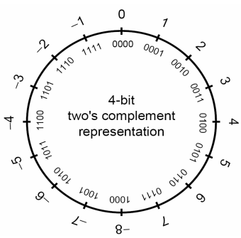
Signed Integer Representation
Tow’s Complement (ranges from -2^{n-1} through 2^{n-1}-1).
Notes:
(Two's complement)
Three-bit integers Bits Unsigned value Signed value
000 0 0
001 1 1
010 2 2
011 3 3
100 4 −4
101 5 −3
110 6 −2
111 7 −1

Slide 24
Unsigned Integers
Unsigned integer values range from zero to a maximum that depends on the size of the type
This maximum value can be calculated as 2^{n}-1, where n is the number of bits used to represent the unsigned type.

Slide 25
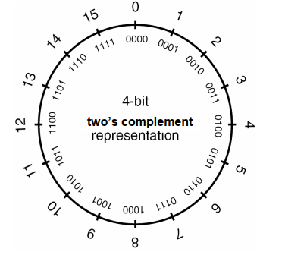
Unsigned Integer Representation
Tow’s complement (ranges from 0 through 2^{n} -1)

Slide 26
Integer Ranges
Minimum and maximum values for an integer type depend on
The type’s representation
Signedness
The number of allocated bits
The C99 standard sets minimum requirements for these ranges.

Slide 27
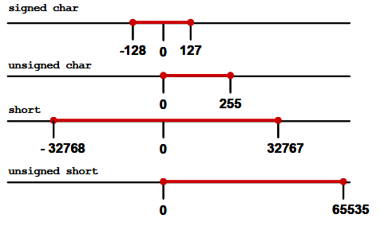
Example Integer Ranges
Char in C is a 1-byte integer.

Slide 28
Signed / Unsigned Characters
The type char can be signed or unsigned.
When a signed char with its high bit set is saved in an integer, the result is a negative number.
Use unsigned char for buffers, pointers, and casts when dealing with character data that may have values greater than 127 (0x7f).

Slide 29
Overflow and Underflow
All types have limited number of bits
Limited range of number are supported
Limited precision
Overflow
Assign a very big number to a variable that is larger than the limit of the variable.
Underflow
Assign a very small number to a variable that is smaller than the limit of the variable.
Example
29
Notes:
#include <stdio.h>
int main(void){
int x, y, z;
x = 1111111111;
y = 222222222;
z = x * y;
printf("%d %d %d\n", x, y, z);
float f1, f2, f3;
f1 = 3e-30;
f2 = 5e-35;
f3 = f1 * f2;
printf("%e %e %e\n", f1, f2, f3);
return 0;
}
1111111111 222222222 -1062865566
3.000000e-30 5.000000e-35 0.000000e+00

Slide 30
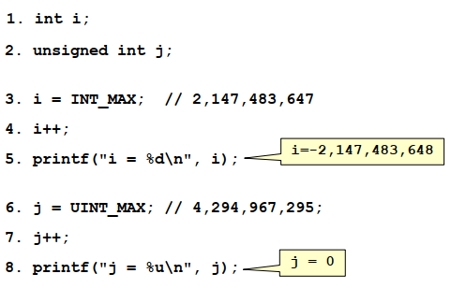
Overflow Examples
Example of signed and unsigned integer overflows:
#include <limits.h>

Slide 31
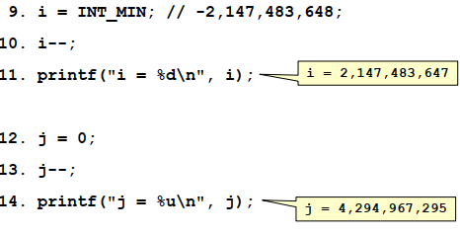
Underflow Examples
Example of signed and unsigned integer underflows:

Slide 32
Variables: Identifier
The name of variables: identifier
Identifier is a string (single word) of
Alphabet
Numbers
“_”
But
Cannot start with digits
Cannot be the key-words (reserved words)
Cannot be duplicated
Should not be library function names: printf
32
Notes:
32

Slide 33
Variables: Identifier
Use readable identifiers:
Do not use memorystartaddress
Use memory_start_address
Do not use xyz, abc, z, x, t
Use counter, sum, average, result, parameter, …
Do not be lazy
Use meaningful and readable names
33
Notes:
33

Slide 34
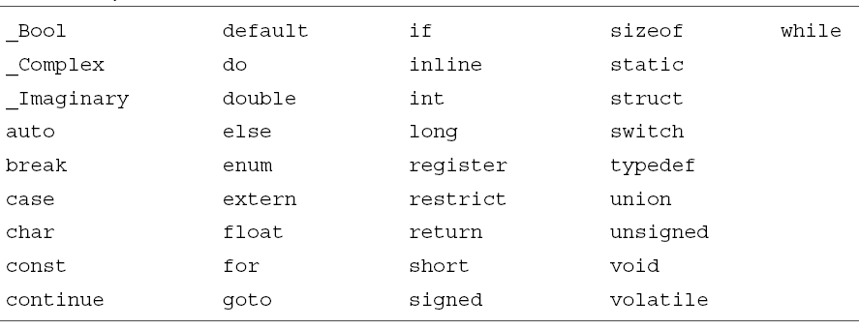
C reserved words
Cannot be used for identifiers
34
Notes:
34

Slide 35
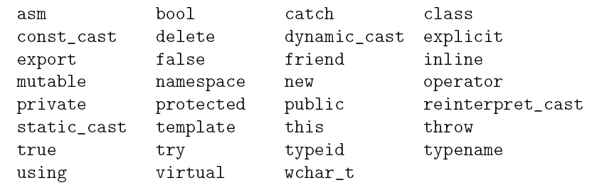
C++ reserved words
Cannot use for identifiers
35
Notes:
35

Slide 36
Variable Identifiers
Example of valid identifiers
student
Grade
sum
all_students
average_grade_1
36
Notes:
36

Slide 37
Variable Identifiers
Example of valid identifiers
student
Grade
sum
all_students
average_grade_1
Example of invalid identifiers
if
32_test
wrong*
$sds$
37
Notes:
37

Slide 38
Variables: Declaration (اعلان)
Reserve memory for variable: declaration
<type> <identifier>;
A variable must be declared before use
char test_char;
int sample_int;
long my_long;
double sum, average, total;
int id, counter, value;
38
Notes:
38

Slide 39
Variable Type Effect (in complied langs.)
Important note: the type of variable is NOT stored in the main memory
After compiling the program → NO type is associated to memory locations!!!
So, what does do the type?!
It determines the “operations” that work with the memory location
E.g.:
int x, y, z; z = x + y;
float a, b, c; c = a + b;
Integer + and =
Performed by ALU
Integer + and =
Performed by ALU

Slide 40
Variable Type Effect (in complied langs.)
Important note: the type of variable is NOT stored in the main memory
After compiling the program → NO type is associated to memory locations!!!
So, what does do the type?!
It determines the “operations” that work with the memory location
E.g.:
int x, y, z; z = x + y;
float a, b, c; c = a + b;
Integer + and =
Performed by ALU
Integer + and =
Performed by ALU
Float + and =
Performed by FPU
Float + and =
Performed by FPU

Slide 41
Variables: Initial Values
What is the initial value of a variable?
In C: we do not know.
In C: it is not 0.
We need to assign a value to each variable before use it.
41
Notes:
41

Slide 42
What We Will Learn
What is the C
Variables
Types
Values
Casting
Constants & Definition
42
Notes:
42

Slide 43
Constants in C
Values
Numeric
Integer numbers
Float numbers
Char
Strings
Symbolic constant
Constant variables
43
Notes:
43

Slide 44
Values
Variables
Save/restore data (value) to/from memory
Declaration specifies the type and name (identifier) of variable
Assigning value to the variable: assignment
<identifier> = <value>;
Compute the <value> and save result in memory location specified by <identifier>
44
Notes:
44
The = in C is not the = in mathematics

Slide 45
Values: Examples
int i, j;
long l;
float f;
double d;
i = 10;
j = 20;
f = 20.0;
l = 218;
d = 19.9;
45
Notes:
45

Slide 46
Value Types
Where are the values stored?!
int x = 20;
x = 30 + 40;
In main memory
There is a logical section for these constant values
So, we need to specify the type of the value
The coding of 01s of the value
The type of value is determined from the value itself
46
Notes:
46

Slide 47
Values (literals): Integers
Valid integer values
10, -20, +400; //Decimal (base 10) integer literal
0x12A, 0X12A; //Hexadecimal (base 16) integer literal
017; //Octal (base 8) integer literal
5000L; // long int integer literal
Invalid integer values
10.0, -+20, -40 0, 600,000, 5000 L, 019;
47
Notes:
47
Decimal constants
It contains digits between 0 and 9, but should not begin with a zero.
Octal constants
It contains digits between 0 and 7, and must begin with a zero.
Hexadecimal constants
It contains digits from 0 to 9, and letters from a-f (either in uppercase or lowercase), and must always start with 0x or 0X.
You can also explicitly specify the type of an integer constant as long int by appending l or L:

Slide 48
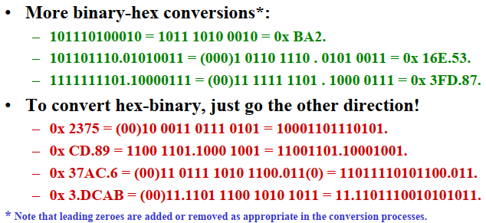
Binary-Hex and Hex-Binary: Examples
HEX: base 16
The letters that stand for hexadecimal numbers above 9 can be upper or lower case – both are used.

Slide 49
Values (literals): Float and Double
Valid numbers:
0.2; .5; -.67; 20.0; 60e10; 7e-2
12.5f; // float literal
12.5L; // long double literal
Invalid numbers:
0. 2; 20. 0; 20 .0; 7 e; 6e; e12
49
Notes:
49
By default, floating constants are of type double. We can explicitly mention the type of a floating-point constant as a float by appending f or F at the end of the constant.
Similarly, We can explicitly mention the type of a floating-point constant as long double by appending l or L at the end.

Slide 50
Values (literals): Chars
Char values
Should be enclosed in single quotation
‘a’, ‘^’, ‘z’, ‘0’, ‘1’, ‘\n’, ‘\’’, ‘\0’
Each character has a code: ASCII code
‘A’: 65; ‘a’: 97; ‘1’: 49; ‘2’: 50; ‘\0’ : 0
Character vs. Integer
‘1’ != 1 ; ‘2’ != 2
‘1’ == 49 But 1 == 1
50
Notes:
50

Slide 51
Values (literals): Strings
String is a set of characters
Starts and ends with double quotation: "
Examples:
"This is a simple string"
"This is a cryptic string #$56*(#"
51
Notes:
51

Slide 52
Effect of Value Types
The type of values have the same effect of the type of variables
It determines the “operations” that work on the values
E.g.:
int z; z = 10 + 20;
float c; c = 1.1 + 2.2;
Integer + and =
Performed by ALU
Integer + and =
Performed by ALU
Float + and =
Performed by FPU
Float + and =
Performed by FPU

Slide 53
Values: Initialization
int i = 20;
int j = 0x20FE, k = 90;
int i, j = 40;
char c1 = 'a', c2 = '0';
bool b1 = true;
float f1 = 50e4;
double d = 50e-8;
53
Notes:
53

Slide 54
Values: From memory to memory
int i, j = 20;
i = j; // i = 20
double d = 65536; // d = 65536.0
double b = d; // b = 65536.0
d = b = i = j = 0;
// j = 0, i = 0, b = 0.0, d = 0.0
54
Notes:
54

Slide 55
Basic Input Output
To read something: scanf
Integer: scanf("%d", &int_variable);
Float: scanf("%f", &float_variable);
Double: scanf("%lf", &double_variable);
To print (show) something: printf
Integer: printf("%d", int_variable);
Float: printf("%f", float_variable);
Message (string literal): printf("message");
55
Notes:
55
Some of the most commonly used placeholders follow:
%a : Scan a floating-point number in its hexadecimal notation.
%d : Scan an integer as a signed decimal number.
%ld: for long
%i : Scan an integer as a signed number. Similar to %d, but interprets the number as hexadecimal when preceded by 0x and octal when preceded by 0. For example, the string 031 would be read as 31 using %d, and 25 using %i. The flag h in %hi indicates conversion to a short and hh conversion to a char.
%u : Scan for decimal unsigned int (Note that in the C99 standard the input value minus sign is optional, so if a minus sign is read, no errors will arise and the result will be the two's complement of a negative number, likely a very large value. See strtoul().[failed verification]) Correspondingly, %hu scans for an unsigned short and %hhu for an unsigned char.
%f : Scan a floating-point number in normal (fixed-point) notation.
%g, %G : Scan a floating-point number in either normal or exponential notation. %g uses lower-case letters and %G uses upper-case.
%x, %X : Scan an integer as an unsigned hexadecimal number.
%o : Scan an integer as an octal number.
%s : Scan a character string. The scan terminates at whitespace. A null character is stored at the end of the string, which means that the buffer supplied must be at least one character longer than the specified input length.
%c : Scan a character (char). No null character is added.
whitespace: Any whitespace characters trigger a scan for zero or more whitespace characters. The number and type of whitespace characters do not need to match in either direction.
%lf : Scan as a double floating-point number. "Float" format with the "long" specifier.
%Lf : Scan as a long double floating-point number. "Float" format the "long long" specifier.
%n : Nothing is expected. The number of characters consumed thus far from the input is stored through the next pointer, which must be a pointer to int. This is not a conversion and does not increase the count returned by the function.

Slide 56
What We Will Learn
What is the C
Variables
Types
Values
Casting
Constants & Definition
56
Notes:
56

Slide 57
Casting
What is the casting?
When the type of variable and value are not the same
Example: Assigning double value to integer variable
It is not a syntax error in C (only warning)
But can cause runtime errors
It is useful (in special situations)
But we should be very very careful
57
Notes:
57

Slide 58
Implicit casting
Implicit (ضمني)
We don’t say it
But we do it
char f2 = 50e6; /* cast from double to char */
int i = 98.01; /* cast from double to int */
58
Notes:
58

Slide 59
Explicit casting
Explicit (صريح)
We say it
And we do it
int i = (int) 98.1; /* Cast from double to int */
char c = (char) 90; /* Cast from int to char */
59
Notes:
59

Slide 60
Casting effects
Casting from small types to large types
There is not any problem
No loss of data
int i;
short s;
float f;
double d;
s = 'A'; // s = 65
i = 'B'; // i = 66
f = 4566; // f = 4566.0
d = 5666; // d = 5666.0
60
Notes:
60

Slide 61
Casting effects (cont’d)
Casting from large types to small types
Data loss is possible
Depends on the values
float f = 65536; // 65536.0
double d = 65536; // 65536.0
short s = 720; // 720
char c = (char) 65536; // c = 0
short s = (short) 65536; // s = 0
int i = 1.22; // i = 1
int j = 1e23; // j = ???
61
Notes:
61

Slide 62
Casting effects (cont’d)
Casting to Boolean
If value is zero → false
If values is not zero → true
bool b2 = 'a', b3 = -9, b4 = 4.5; // true
bool b5 = 0, b6 = false; b7 = '\0'; // false
62
Notes:
62

Slide 63
Truncation Errors
Truncation errors occur when
an integer is converted to a smaller integer.
type and the value of the original integer is outside the range of the smaller type.
Low-order bits of the original value are preserved and the high-order bits are lost.

Slide 64
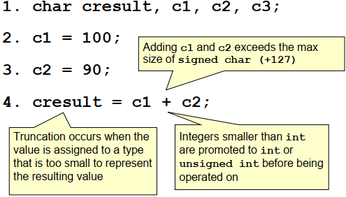
Truncation Error Example

Slide 65
Sign Errors
Can occur when
converting an unsigned integer to a signed integer.
converting a signed integer to an unsigned integer.

Slide 66
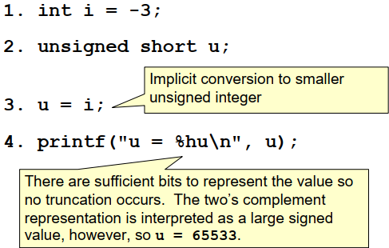
Sign Error Example

Slide 67
What We Will Learn
What is the C
Variables
Types
Values
Casting
Constants & Definition
67
Notes:
67

Slide 68
Constant Variables!!!
Constants
Do not want to change the value
Example: pi = 3.14
We can only initialize a constant variable
We MUST initialize the constant variables (why?!)
const is a qualifier
const int STUDENTS = 38;
const long int MAX_GRADE = 20;
int i;
i = MAX_GRADE;
STUDENTS = 39; //ERROR
68
Notes:
68

Slide 69
Definitions
Another tool to define constants
Definition is not variable
We define definition, don’t declare them
Pre-processor replaces them by their values before compiling
#define STUDENTS 38
int main(void){
int i;
i = STUDENTS;
STUDENTS = 90; //ERROR! What compiler sees: 38 = 90
69
Notes:
69

Slide 70
Definitions
#define NAME “Test”
#define AGE (20 / 2)
#define MIN(a, b) (((a)<(b))?(a):(b))
#define MAX(a, b) (((a)>(b))?(a):(b))
#define MYLIB
70
Notes:
70

Slide 71
Summary
Simple programs in C
Two basics
Variables
Types
Values
Types
Casting
The type mismatch
Constant variables & definitions
71
Notes:
71

Slide 72
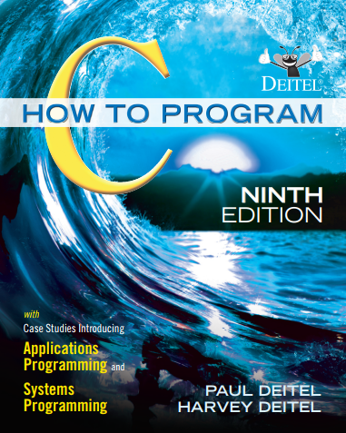
Reference
Reading Assignment: Chapter 2 of “C How to Program”
72

Slide 73
Questions
Which of the following statements about C is FALSE?
A) C is case-sensitive.
B) The main function is optional in every program.
C) Statements must end with a semicolon.
D) Program execution starts with the main function
Answer: B
73

Slide 74
Questions
What is the size of an int data type in C on most systems?
A) 16 bits B) 32 bits
C) 64 bits D) Depends on the system
Answer: D
What is the correct format specifier for reading an integer value using scanf?
A) %i B) %d C) %f D) %c
Answer: B
74

Slide 75
Questions
Which of the following scenarios would likely result in data loss during casting?
A) Casting a double to float
B) Casting a float to int
C) Casting an int to char
D) All of the above
Answer: D
75

