Slide 1
Fundamentals of Computer and Programming
Lecture 5
Interaction
Instructor: Morteza Zakeri, Ph.D. (m-zakeri@live.com)
Modified Slides from Dr. Hossein Zeinali and Dr. Bahador Bakhshi
Computer Engineering Department, Amirkabir University of Technology
Spring 2025
Notes:
1

Slide 2
Interaction
Produce output
Get input values
Notes:
Different kinds of interactions
Input: Directly from keyboard, Mouse in GUI, Microphone, Joystick, …
Output: Directly message on screen, Windows in GUI, Sound card, …
In this course we use the simple method (directly read from keyboard and write to screen) → which is called “console”
In Graphical OS (like Windows), the console is simulated by OS in a window

Slide 3
Different kinds of interactions
Input: Directly from keyboard, Mouse in GUI, Microphone, Joystick, …
Output: Directly message on screen, Windows in GUI, Sound card, …
In this course we use the simple method
directly read from the keyboard and write to the screen
called “Console” or “ Terminal”
In Graphical OS (like Windows), the console is simulated by OS in a window

Slide 4
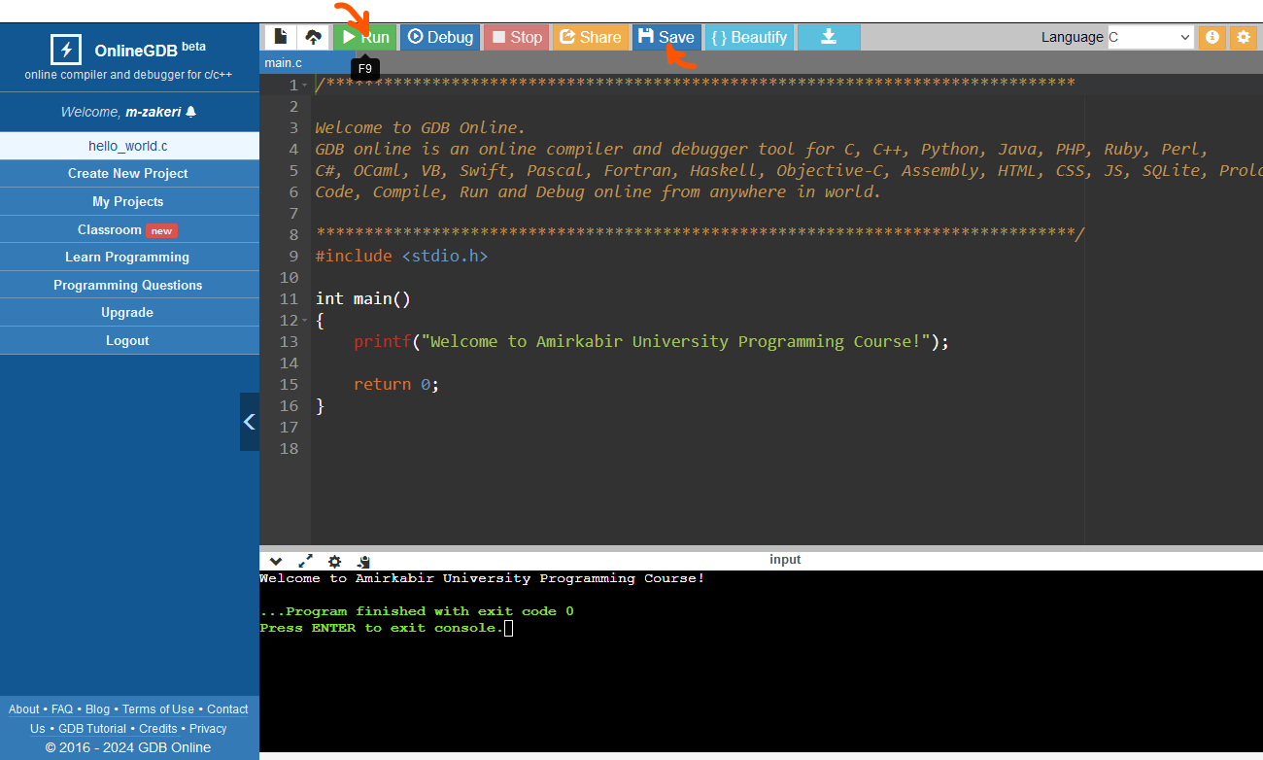
C Online Compilers
https://www.onlinegdb.com/online_c_compiler

Slide 5
Interaction
Produce output
Get input values

Slide 6
Printing
Printing messages
printf("This is message \n");
//‘\n’ prints a new line
Printing variables
printf("format specifier", parameters);
format specifier = %[flags][width][.precision]specifier
int i = 20;
char c = 'a';
printf("%d, %c", i, c);
printf("i is %d and char is %c", i, '6');

Slide 7
Printing Integers
%d, %i, %ld
%i is the same as %d in printf
printf("%d", 100);
// 100
printf("%d, %d", +1000, -100);
// 1000, -100
printf("%i", 100);
// 100
printf("%ld, %i", +1000, -100);
// 1000, -100
Notes:
Q: What is the difference between %d and %i when used as format specifiers in printf?
A: They are the same when used for output, e.g. with printf, but different when used as input specifier e.g. with scanf, where %d scans an integer as a signed decimal number, but %i defaults to decimal but also allows hexadecimal (if preceded by "0x") and octal if preceded by "0".
(One difference between %i and %d is that when used with scanf(), then %d always expects a decimal integer, whereas %i recognizes the 0 and 0x prefixes as octal and hexadecimal, but no sane programmer uses scanf() anyway so this should not be a concern
So "033" would be 27 with %i but 33 with %d.)

Slide 8
Printing Unsigned Integers
%u (base 10), %o (base 8), %x (base 16) and %X (Base 16)
unsigned int i = 26;
printf("%u\n", i); //26
printf("%o\n", i); //32
printf("%x\n", i); //1a
printf("%X\n", i); //1A
Notes:
We have also h before d for indicating short numbers.

Slide 9
Printing Floats
%f, %e, %E, %lf
printf("%f", 100.5f);
// 100.500000
float f = -2;
double d = 100;
printf("%f, %lf", f, d);
// -2.000000, 100.000000
printf("%f, %e", 1e3, 1e3);
// 1000.000000, 1.000000e+003
Notes:
e/E for exponential notation.

Slide 10
Printing Chars
%c
printf("%c", 'a’); // a
printf("%c, %c", 'a','b’); // a, b
char c1 = 'a';
printf("%c, %c, %c", c1, 'b', 65); // a, b, A

Slide 11
Special Character
Characters in printf The result
\n newline
\t tab
\r carriage return
\b backspace
\" "
\% %
%% %
Notes:
The carriage return character (\r) is a special control character that originated from the early days of typewriters and teletype machines. It represents the action of moving the cursor or print head back to the beginning of the current line. When encountered in a string or used in output operations.
The carriage return is represented by the escape sequence ‘\r ‘.
When the carriage return character is encountered in a string it moves the cursor to the beginning of the current line.

Slide 12
Printing Strings
%s
printf("This is message");
// This is message
printf("This is %s", "message");
// This is message
char str1[20] = "This is message";
printf("%s", str1);
// This is message

Slide 13
Field length (width)
Field length is a number
Comes after % (and before the format specifier)
It is the minimum space reserved for print
If value is smaller than the space
Empty space
If value is larger than the space
No effect

Slide 14
Field length
printf("|%4d|\n", 1); // | 1|
printf("|%4d|\n", 12345); // |12345|
printf("|%4d|\n", -12345); // |-12345|
printf("|%4f|\n", 1234.0f); // |1234.000000|
printf("|%15f|\n", 1234.0f); // | 1234.000000|
printf("|%4c|\n", 'A'); // | A|
printf("|%-4c|\n", 'A'); // |A |
printf("|%4s|\n", "ABC"); // | ABC|
printf("|%4s|\n", "ABCDE"); // |ABCDE|
printf("|%6d|\n", 1234); // | 1234|
printf("|%-6d|\n", 1234); // |1234 |

Slide 15
Precision
Precision is a .number and comes after %
For Integer
The minimum number of digits
If (# of digits < precision) → empty space: Zero’s (0)
For floats
With %f, %e
The number of digits after .
For strings
The maximum number of characters

Slide 16
Precision
printf("|%.4d|\n", 1); // |0001|
printf("|%.4d|\n", 12345); // |12345|
printf("|%.4d|\n", -12345); // |-12345|
printf("|%.4f|\n", 1234.0f); // |1234.0000|
printf("|%.8f|\n", 234.0f); // |234.00000000|
printf("|%.4s|\n", "ABC"); // |ABC|
printf("|%.4s|\n", "ABCDEF"); // |ABCD|

Slide 17
Field length and Precision
This is a number with format a.b
Comes after %
First .b determines the .precision
Then a specifies the field length (width)

Slide 18
Field length and Precision
printf("|%10.5d|\n", 12);
// | 00012|
printf("|%3.5d|\n", 12);
// |00012|
printf("|%10.5lf|\n", 1.234567890123);
// | 1.23457|
printf("|%0.5lf|\n", 1.234567890123);
// |1.23457|
printf("|%15.10s|\n", "Hello, world");
// | Hello, wor|
printf("|%5.10s|\n", "Hello, world");
// |Hello, wor|

Slide 19
Variable Field Length & Precision : *
* can be used to specify field length and precision which is replaced by a variable
int i = 30;
int j = 2;
float f = 1.23456789;
printf("%0*.*f\n", i, j, f);
// 000000000000000000000000001.23

Slide 20
Cast in printing (do NOT use)
int i = -60;
unsigned int j = 4147482648;
float f = -700.05;
printf("i = %u\n", i);
// i = 4294967236
printf("j = %d\n", j);
// j = -147484648
printf("i = %f\n", i); // error in some compilers
// i = 0.000000
printf("f = %d\n", f); // error in some compilers
// f = 1610612736

Slide 21
Interaction
Produce output
Get input values

Slide 22
Reading
Read from keyboard (console)
What should be determined in reading
Keyboard enters “characters”, so, how to read int, char, …?
Which type the chars should be converted?
Where should be saved?
scanf(“format specifier”, parameters)
Format: The type that input should be converted to
Parameters: Where should be saved
scanf blocks until ‘Enter’ at the end of input (why?!)
Reads from beginning until to white spaces (except reading chars)
Notes:
Discuss about the role of input buffer
All inputs go in to the buffer from keyboard
scanf is blocked if the buffer empty
scanf does not know whether some characters go in buffer or not until Enter
After Enter OS inform the scanf and scanf start reading the buffer

Slide 23
Reading Integers (base 10)
%d, %u, %ld, %lu
int i;
unsigned int j;
long int l;
scanf("%d", &i);
scanf("%u", &j);
scanf("%ld",&l);
-90 → -90 is saved in memory location i
78 → 78 is saved in memory location j
60L → 60 is saved in memory location l
Spaces at the beginning are ignored

Slide 24
Reading Integers (cont’d)
%o, %x, %X, %i
scanf("%o", &i);
Input: 12 → i = 10
scanf("%x", &i);
Input: 1a → i = 26
scanf("%i", &i);
Input: 12 → i = 12
Input: 012 → i = 10 (It reads in base 8)
Input: 0x12 → i = 18 (It reads in base 16)
Notes:
%i can recognize!!!

Slide 25
Reading floats and doubles
%f, %lf, %e
float f;
double d;
scanf("%f", &f);
scanf("%lf", &d);
90.9 → 90.9 is saved in memory f
88.123456789 → 88.123456789 saved in memory d
Spaces at the beginning are ignored

Slide 26
Reading floats and doubles
float f1, f2;
scanf("%f", &f1);
scanf("%e", &f2);
Input:
1.23 → f1 = 1.23
4.56 → f2 = 4.56
Input:
1.23e+1 → f1 = 12.3
4.56e-1 → f2 = 0.456

Slide 27
Reading chars
%c
char c1, c2, c3;
scanf("%c", &c1); /* spaces */
scanf("%c", &c2);
scanf("%c", &c3);
Input: azb →
c1 = 'a'
c2 = 'z'
c3 = 'b'
Spaces at the beginning are NOT ignored

Slide 28
Reading chars (cont’d)
White spaces (space, tab, enter) are not ignored when reading char
To ignore white spaces, use “ “ before %c
scanf("%d%c%d", &i, &c, &j);
Input: 123 45 → I = 123 c = ‘ ‘ j = 45
scanf("%d %c%d", &i, &c, &j);
Input: 123 4 56 → I = 123 c = ‘4’ j = 56
Input: 123 456 → I = 123 c = ‘4’ j = 56

Slide 29
Reading chars (cont’d)
getchar()
Read char after Enter
getch()
Read char without Enter, does NOT show the char
A non-standard function declared in “conio.h” header file.
Mostly it is used by Turbo C.
It is not a part of C standard library.
getche()
Read char without Enter, shows the char
Notes:
In scanf while input characters are inserted into buffer they are also displayed on console
However, getch prevents displaying the inputs on console
The function getch() is a non-standard function. It is declared in “conio.h” header file. Mostly it is used by Turbo C. It is not a part of C standard library.

Slide 30
Reading Strings
%s
char str[20]; // Defines string with len 20
scanf("%s", str);
Input: ABC → str = "ABC"
scanf("%s", str);
Input: AB C → str = "AB"

Slide 31
Reading Strings
How to read a line
Contains spaces (read until end of line)
gets(s)
char str[20];
gets(str);
Input: ABC DEF → str = "ABC DEF"

Slide 32
Field length in scanf
Field length specifies the maximum number of input characters (in the buffer) used for scanning
int i, j;
scanf("%5d", &i);
Input: 122 → i = 122
Input: 1234567 → i = 12345
scanf("%5d%d", &i, &j);
Input: 1 2 → i = 1, j = 2
Input: 1234567 → i = 12345, j = 67
Input: 123456 7 → i = 12345, j = 6

Slide 33
Special input format
If input data has special format with extra characters
scanf can ignore them
int sal, mah, rooz;
scanf("%d/%d/%d", &sal, &mah, &rooz);
Input: 1389/12/1
→
sal = 1389, mah = 12, rooz = 1

Slide 34
Format of actual input data
The format of actual input data MUST match with the format of scanf
int a, b;
float f;
scanf("%d--%d%f", &a, &b, &f);
Input: 1--2 3.0 → a = 1, b = 2, f = 3.0
Input: 1-2 3.0 → a = 1, b, f without change
Input: 1.0--2 3.0 → a = 1, b, f without change
Notes:
RETURN VALUE
These functions return the number of input items successfully matched
and assigned, which can be fewer than provided for, or even zero in the
event of an early matching failure.
The value EOF is returned if the end of input is reached before either
the first successful conversion or a matching failure occurs. EOF is
also returned if a read error occurs, in which case the error indicator
for the stream (see ferror(3)) is set, and errno is set indicate the
error.

Slide 35
Common bugs
Casting in printf or scanf
printf("%d", 120.23);
double d; scanf("%f", &d);
Mismatch between format and the number of expressions
printf("%d %d", 10);
printf("%d", 10, 20);
Using name of variable instead of address
scanf("%d", i);

Slide 36
A running example
#include <stdio.h>
#include <stdlib.h>
int main(void){
int i;
unsigned int j;
unsigned long int k;
char c;
float f;
printf("Enter a char:\n");
scanf(" %c", &c);
printf("Enter an int:\n");
scanf("%d", &i);
printf("Enter an unsigned int:\n");
scanf("%u", &j);
printf("Enter an unsigned long int:\n");
scanf("%lu", &k);
printf("Enter a float:\n");
scanf("%f", &f);
برنامه‌اي كه با توليد پيغام‌هاي مناسب ورودي‌هاي را از كاربر بگيرد و در انتها ليست ورودي‌ها را به كاربر نشان دهد.

Slide 37
A running example (cont’d)
printf("Your input are:\n");
printf("int = %d, unsigned int = %u, unsigned long int = %lu, ", i, j, k);
printf("char = %c and float = %f\n", c, f);
return 0;
}

Slide 38

Quiz
Q1: Write a program to read three scores, their weights, and compute the weighted average of the scores.
Q2: Write a C program that convert a temperature from Centigrade to Fahrenheit.
C = (5/9) * (F - 32)

Slide 39
Reference
Reading Assignment: Chapter 9 of “C How to Program”
Many programming problems with solutions:
https://m-zakeri.github.io/CP/problems/
39

Slide 40
Questions
How would you modify scanf to read a date in the format YYYY/MM/DD into three integer variables?
A) scanf("%d/%d/%d", &year, &month, &day);
B) scanf("%d-%d-%d", &year, &month, &day);
C) scanf("%d%d%d", &year, &month, &day);
D) scanf("%s", date);
Answer: A
40

Slide 41
Questions
What will the following code output?
int width = 6, precision = 2;
float value = 12.3456;
printf("|%*.*f|\n", width, precision, value);
A) | 12.35|
B) | 12.34|
C) |12.35|
D) Compiler error
Answer: A
41

