Slide 1
Lecture 7 Repeating Statements
Fundamentals of Computer and Programming
Instructor: Morteza Zakeri, Ph.D.
(zakeri@aut.ac.ir)
Modified Slides from Dr. Hossein Zeinali and Dr. Bahador Bakhshi
School of Computer Engineering,
Amirkabir University of Technology
Spring 2025
Notes:
1

Slide 2
What We Will Learn
Introduction
while statement
do-while statement
for statement
Arrays
Advanced loops
Bugs and avoiding them
2
Notes:
2

Slide 3
Repetition
Example: Write a program that read 3 integer and compute average
It is easy.
Three scanf, an addition, a division and, a printf
Example: Write a program that read 3000 integer and compute average
Do we need 3000 scanf?!!!
Example: Write a program that read n integer and compute average
Do we need N scanf?!!!
3
Notes:
3

Slide 4
Repetition: counter controlled
When we know the number of iteration
Average of 10 number
Initialize counter ← 0
Initialize other variables
While (counter < number of loop repetition)
do something (e.g., read input, take sum)
counter ← counter + 1
4
Notes:
4

Slide 5
Repetition: sentinel controlled
When we do NOT know the number of iteration
But we know, when loop terminates
E.g., Average of arbitrary positive numbers ending with <0
n ← Get first input
While (n is not sentinel)
do something (sum, …)
n ← get the next input
if (there is not any valid input) then S1
else S2
5
Notes:
5

Slide 6
Repetition
Repetition is performed by loops
Put all statements to repeat in a loop
Do not loop to infinity
Stop the repetition
Based on some conditions (counter, sentinel)
C has three statements for loops
while statement
do-while statement
for statement
6
Notes:
6

Slide 7
What We Will Learn
Introduction
while statement
do-while statement
for statement
Arrays
Advanced loops
Bugs and avoiding them
7
Notes:
7

Slide 8
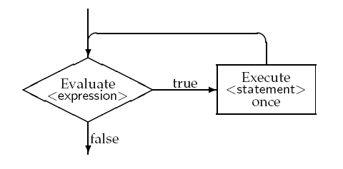
while statement
while ( <expression> )
<statements>
8
Notes:
8

Slide 9
Example: Print n numbers
#include <stdio.h>
int main(void){
int n, number;
number = 0;
printf("Enter n: ");
scanf("%d", &n);
while(number <= n){
printf("%d \n", number);
number++;
}
return 0;
}
برنامه‌اي بنويسيد كه عدد n را از كاربر بگيرد و اعداد 0 تا n را چاپ كند.
9
Notes:
9

Slide 10
Count positive and negative numbers
#include <stdio.h>
int main(void){
int negative_num, positive_num;
int number;
negative_num = positive_num = 0;
printf("Enter Zero to stop \n");
printf("Enter first number: ");
scanf("%d", &number);
while(number != 0){
if(number > 0)
positive_num++;
else
negative_num++;
printf("Enter the next number: ");
scanf("%d", &number);
}
printf("The number of positive numbers = %d\n", positive_num);
printf("The number of negative numbers = %d\n", negative_num);
return 0;
}
برنامه‌اي بنويسيد كه يك سري عدد را از كاربر بگيرد و تعداد اعداد مثبت و منفي آن‌را بشمارد.
اين سري اعداد با صفر تمام مي‌شود.
10
Notes:
10

Slide 11
What We Will Learn
Introduction
while statement
do-while statement
for statement
Arrays
Advanced loops
Bugs and avoiding them
11
Notes:
11

Slide 12
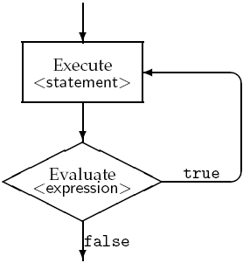
do-while statement
do
<statements>
while ( <expression> );
12
Notes:
12

Slide 13
Example: Sum of series
#include <stdio.h>
int main(void){
int n;
double number, sum;
printf("Enter n > 0: ");
scanf("%d", &n);
if(n < 1){printf("wrong input"); return -1;}
sum = 0;
number = 0.0;
do{
number++;
sum += number / (number + 1.0);
}while(number < n);
printf("sum = %lf\n", sum);
return 0;
}
برنامه‌اي بنويسيد كه عددn را بگيرد و مجموعn جمله اول رشته زير را حساب كند
1.0/2.0 + 2.0/3.0 + 3.0/4.0 + …
13
Notes:
13

Slide 14
Count positive and negative numbers
#include <stdio.h>
int main(void){
int negative_num=0, positive_num=0;
int number;
printf("Enter Zero to stop \n");
do{
printf("Enter next number: ");
scanf("%d", &number);
if(number > 0)
positive_num++;
else if(number < 0)
negative_num++;
}while(number != 0);
printf("The number of positive numbers = %d\n", positive_num);
printf("The number of negative numbers = %d\n", negative_num);
return 0;
}
برنامه‌اي بنويسيد كه يك رشته عدد را از كاربر بگيرد و تعداد اعداد مثبت و منفي آن‌را بشمارد. اين رشته اعداد با صفر تمام مي‌شود.
14
Notes:
14
We should use the if(number < 0) because, in do-while loops, the last iteration will be done with the value that the condition is not true

Slide 15
What We Will Learn
Introduction
while statement
do-while statement
for statement
Arrays
Advanced loops
Bugs and avoiding them
15
Notes:
15

Slide 16
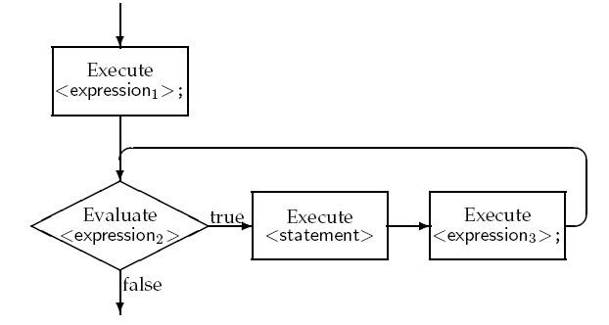
for statement
for(<expression1>; <expression2>; <expression3>)
<statements>
16
Notes:
16

Slide 17
Example: Compute average of grades
#include <stdio.h>
int main(void){
int grade, count, i;
double average, sum;
sum = 0;
printf("Enter the number of students: ");
scanf("%d", &count);
for(i = 0; i < count; i++){
printf("Enter the grade of %d-th student: ", (i + 1));
scanf("%d", &grade);
sum += grade;
}
average = sum / count;
printf("The average of your class is %0.3lf\n", average);
return 0;
}
برنامه‌اي كه تعداد دانشجويان و نمره‌هاي آنها را خوانده و ميانگين را محاسبه كند.
17
Notes:
17

Slide 18
Example: Print even numbers
#include <stdio.h>
int main(void){
int n, number;
printf("Enter n: ");
scanf("%d", &n);
for(number = 2; number <= n; number += 2)
printf("%d \n", number);
return 0;
}
برنامه‌اي كه عددn را از كاربر بگيرد و همه اعداد زوج كوچكتر مساوي آن را چاپ كند.
18
Notes:
18

Slide 19
Combining for and if statements
#include <stdio.h>
int main(void){
int n, number;
printf("Enter n: ");
scanf("%d", &n);
for(number = 1; number <= n; number++)
if((number % 2) == 0)
printf("%d \n", number);
return 0;
}
برنامه‌اي كه عددn را از كاربر بگيرد و همه اعداد زوج كوچكتر مساوي آن را چاپ كند.
19
Notes:
19

Slide 20
Expressions in for statements
Expression1 and Expression3 can be any number of expressions, they execute in the order
for(i = 0, j = 0; i < 10; i++, j--)
Expression2 at most should be a single expression
If multiple expressions → the value of the last one is evaluated as True/False
for(i = 0, j = 0; i < 10, j > -100; i++, j--)
Any expression can be empty expression
for( ; i < 10; i++)
for(;;)
20
Notes:
20

Slide 21
Prime number
# include <stdio.h>
int main (){
int n;
printf ("Enter a natural number:\n");
scanf ("%d", &n);
if (n < 2){
printf ("%d is no prime nor composite \n", n);
return 0;
}
if (n == 2){
printf ("%d is prime \n", n);
return 0;
}
if (n % 2 == 0){
printf ("%d is not prime \n", n);
return 0;
}
…

Slide 22
Prime number (cont’d)
…
int flag = 1;
for (int i = 3; i <= n / 2 && flag; i += 2)
if (n % i == 0)
flag = 0;
if (flag)
printf (" %d is prime \n", n);
else
printf (" %d is not prime \n", n);
return 0;
}

Slide 23
What We Will Learn
Introduction
while statement
do-while statement
for statement
Arrays
Advanced loops
Bugs and avoiding them
23
Notes:
23

Slide 24
Introduction
Algorithms usually work on large data sets
Sort a set of numbers
Search a specific number in a set of numbers
How to read and store a set of data?
To read
Repeat the scanf statement
Use the loop statements
To store the data
Save each data in a single variable??
3000 int variables! ! ! !
24
Notes:
24
24

Slide 25

Array
An ordered collection of same type variables
A nx1 vector of
Integers, chars, floats, …
Example
An array of 8 integer
An array of 5 chars
25
Notes:
25
25
Indices are start from 0,
Element of arrays are saved in successive address, starting from the address of first element

Slide 26
Arrays in C
Array declaration in C
<Elements’ Type> <identifier>[<size>]
<Elements’ Type>: int, char, float, …
<size>
Old compilers (standard): it should be constant
New compilers (standard): it can be variable
Elements in array
From 0 to (size – 1)
26
Notes:
26
26

Slide 27
Example
int num[20];
num is array of 20 integers
num[0] is the first integer variable
num[19] is the last integer
float farr[100];
farr is array of 100 floats
farr[0] is the first float
farr[49] is the 50th float
farr[99] is the last float
27
Notes:
27
27
Indices are always integer while the elements’ type can be any type

Slide 28
Example: Arrays
int number[10];
int i, j = 3;
i = 5; // -1 < i < 10
number[i] = 0; //6th number is 0
number[i + j] = 1; //??
j = number[i]; //?
j = number[i + 1]; //?
j = number[i] + 1; //?
28
Notes:
28
28
int a[10]; // global - all elements are initialised to 0
void foo(void) {
int b[10]; // automatic storage - contain junk
static int c[10]; // static - initialised to 0
}

Slide 29
Example: Array with fixed size
#include <stdio.h>
#define SIZE 20
void main(void){
int number[SIZE];
double average;
int sum, large_size, small_size, i;
sum = large_size = small_size = 0;
for(i = 0; i < SIZE; i++){
int tmp;
scanf("%d", &tmp);
number[i] = tmp;
sum += number[i];
}
average = (1.0 * sum) / SIZE;
for(i = 0; i < SIZE; i++)
if(number[i] >= average)
large_size++;
else
small_size++;
printf("average = %lf\n", average);
printf("Small Size = %d, Large Size = %d\n", small_size, large_size);
}
برنامه‌اي كه ۲۰ عدد را بگيرد و تعداد اعداد بزرگتر و كوچكتر از ميانگين را حساب كند.
29
Notes:
29
29

Slide 30
Example: for statement on arrays
# include <stdio.h>
# include <stdlib.h>
void main(void){
int n;
printf("Enter n: ");
scanf("%d", &n);
int *number = (int *) malloc( n * sizeof(int) );// int number[n];
double average;
int sum, large_size, small_size, i;
sum = large_size = small_size = 0;
for(i = 0; i < n; i++)
scanf("%d", &(number[i]));
for(i = 0; i < n; i++)
sum += number[i];
average = (1.0 * sum) / n;
for(i = 0; i < n; i++)
if(number[i] >= average)
large_size++;
else
small_size++;
printf("average = %lf\n", average);
printf("Small Size = %d, Larg Size = %d\n", small_size, large_size);
}
برنامه‌اي كه تعداد اعداد و يك رشته عدد را بگيرد و تعداد اعداد بزرگتر و كوچكتر از ميانگين را حساب كند.
30
Notes:
30
30

Slide 31
Array Initialization: Known Length
int num[3]={10, 20, 60};
num is the array of 3 integers, num[0] is 10, …
int num[]={40, 50, 60, 70, 70, 80};
num is the array of 6 integers
int num[10]={40, 50, 60};
num is the array of 10 integers
num[0] is 40, num[1] is 50, num[2] is 60
num[3], num[4], ..., num[9] are 0
31
Notes:
31
31
If there are fewer initializers than elements in the array, the remaining elements are initialized to zero.

Slide 32
Array Initialization (cont’d)
int num[2]={40, 50, 60, 70};
/* Compile warning */
int num[5]={[0] = 3, [4] = 6};
/* num[5] = {3, 0, 0, 0, 6} */
32
Notes:
32
32

Slide 33
Initializing Variable Length Arrays
int n;
scanf("%d", &n);
int num[n]={0}; /* Compile error */
Variable length arrays cannot be initialized!
Solution:
for(i = 0; i < n; i++)
num[i] = 0;
int num[5]={[0] = 3, [4] = 6};
/* num[5] = {3, 0, 0, 0, 6} */
33
Notes:
33
33

Slide 34
What We Will Learn
Introduction
while statement
do-while statement
for statement
Arrays
Advanced loops
Bugs and avoiding them
34
Notes:
34

Slide 35
Empty statements
<statement> in loops can be empty
while(<expression>) ;
E.g.,
while(i++ <= n) ;
for(<expression1>; <expression2>; <expression3>) ;
E.g.,
for(i = 0; i < 10; printf("%d\n",i), i++) ;
35
Notes:
35

Slide 36
Nested loops
<statement> in loops can be loop itself
while(<expression0>)
for(<expression1>; <expression2>; <expression3>)
<statements>
for(<expression1>; <expression2>; <expression3>)
do
<statements>
while(<expression>)
36
Notes:
36

Slide 37
Nested loops example
A program that takes n and m and prints a m * n rectangle.
*** ….* (m * in each line)
*** ….*
…
*** ….*
(n lines)
37
Notes:
37

Slide 38
Answer
#include <stdio.h>
int main(void){
int i, j, n, m;
printf("Enter n & m: ");
scanf("%d%d", &n, &m);
for(i = 0; i < n; i++){
for(j = 0; j < m; j++)
printf("*");
printf("\n");
}
return 0;
}
38
Notes:
38

Slide 39
What is the output of this program?
#include <stdio.h>
int main(void){
int i, j, n;
printf("Enter n: ");
scanf("%d", &n);
i = 1;
while(i <= n){
for(j = 0; j < i; j++)
printf("*");
printf("\n");
i++;
}
return 0;
}
39
Notes:
39

Slide 40
Answer
A program that takes n and prints
* (i * in i-th line)
**
***
*** ….*
(n lines)
40
Notes:
40

Slide 41
What is the output of this program?
n = 5
for(i= 1; i <= n; i++){
for(j = 0; j < i-1; j++)
printf(" ");
for(j = 1; j <= i; j++)
printf("*");
printf("\n");
}
for(i= n-1; i >= 1; i--){
for(j = 1; j < i; j++)
printf(" ");
for(j = 1; j <= i; j++)
printf("*");
printf("\n");
}
41
Notes:
41

Slide 42
Answer
A program that takes a number and generates the following pattern
n = 5
*
**
***
****
*****
****
***
**
*
for(i= 1; i <= n; i++){
for(j = 0; j < i-1; j++)
printf(" ");
for(j = 1; j <= i; j++)
printf("*");
printf("\n");
}
for(i= n-1; i >= 1; i--){
for(j = 1; j < i; j++)
printf(" ");
for(j = 1; j <= i; j++)
printf("*");
printf("\n");
}
42
Notes:
42

Slide 43
break statement
Exit from loop based on some conditions
do{
scanf("%d", &a);
scanf("%d", &b);
if(b == 0)
break;
res = a / b;
printf("a / b = %d\n", res);
}while(b > 0);
43
Notes:
43

Slide 44
continue statement
Jump to end of loop and continue repetition
do{
scanf("%f", &a);
scanf("%f", &b);
if(b == 0)
continue;
res = a / b;
printf("a / b = %f\n", res);
}while(a > 0);
44
Notes:
44

Slide 45
Which loop?
When you know the number of repetition
Counter-controlled loops
Usually, for statements
When you do not know the number of repetitions (sentinel loop)
Some condition should be check before starting loop
Usually, while statement
The loop should be executed at least one time
Usually, do-while
45
Notes:
45

Slide 46
What We Will Learn
Introduction
while statement
do-while statement
for statement
Arrays
Advanced loops
Bugs and avoiding them
46
Notes:
46

Slide 47
Common bugs and avoiding them
Loop should terminate
E.g., in for loops, after each iteration, we should approach to the stop condition
for(i = 0; i < 10; i++) //OK
for(i = 0; i < 10; i--) //Bug
Initialize loop control variables
int i;
for( ; i < 10; i++)
47
Notes:
47

Slide 48
Common bugs and avoiding them
Do not modify for loop controller inside the loop body:
for(i = 0; i < 10; i++){
...
i--; //Bug
}
Take care about wrong control conditions
< vs. <=
= vs. ==
int b = 10;
while(a = b){ //it means while(true)
scanf("%d", &a)
…
48
Notes:
48

Slide 49
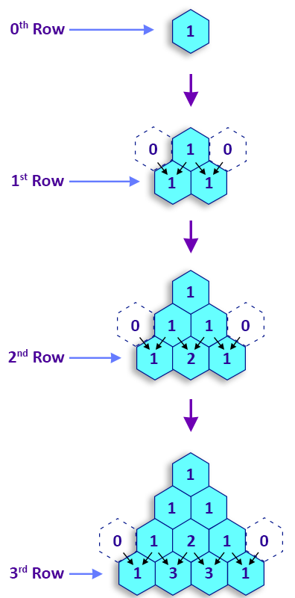
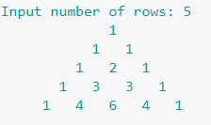
Exercise
Write a C program to display Pascal's triangle.
Answer:
https://www.w3resource.com/c-programming-exercises/for-loop/c-for-loop-exercises-33.php

Slide 50
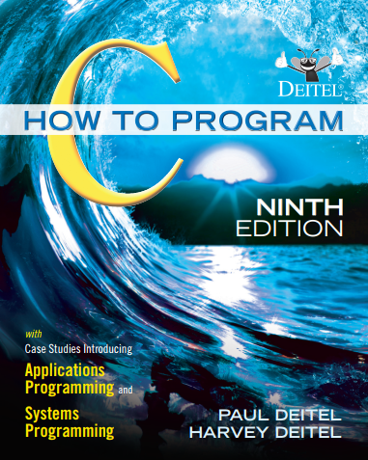
Reference
Reading Assignment: Chapter 4 of “C How to Program”
50
Notes:
50

Slide 51
Questions
What will be the output of the following code?
int i = 0;
while (i < 5)
printf("%d ", i++);
A) 0 1 2 3 4 B) 0 1 2 3 4 5
C) Infinite loop D) No output
Answer: A
51

Slide 52
Questions
What will be the output of the following code?
int main() {
int i = 0; 29
for (; i < 5; i++) {
if (i % 2 == 0){
continue;
}
printf("%d ", i);
}
return 0;
}
1 3
0 2 4
1 2 3
1 3 5
Answer: A
52

Slide 53
Questions
What will be the output of this nested loop?
int main() {
int i, j;
for (i = 0; i < 3; i++) {
for (j = i; j < 3; j++) {
if (i == j)
continue;
printf("%d%d ", i, j);
}
}
return 0;
}
01 02 12
00 01 02
01 12 02
00 01 10
Answer: A
53

