Slide 1
Lecture 6
Making Decisions
Fundamentals of Computer and Programming
Instructor: Morteza Zakeri, Ph.D. (m-zakeri@live.com)
Spring 2024
Modified Slides from Dr. Hossein Zeinali and Dr. Bahador Bakhshi
Computer Enginnering Department, Amirkabir University of Technology
Notes:
1

Slide 2
What We Will Learn
Introduction
Conditions and Boolean operations
if-else statement
switch-case statement
Conditional expressions

Slide 3
Decision
Decisions are based on conditions
If it is snowing → We will cancel the game
If the class is not canceled → I will attend
else → I will go to gym
In programming
Do statements based on conditions
True → The statements will be done
False → The statement won’t be done

Slide 4
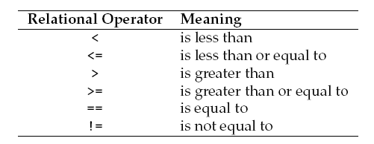
Conditions
Conditions by comparisons; e.g.,
Weather vs. snowing
Variable x vs. a value
Comparing numbers: Relational Operators

Slide 5
Relations
Relations are not a complete statement
int a, b;
a == b; // ERROR
a <= b; // ERROR
Relations produce a boolean value
int a, b;
bool bl; // #include <stdbool.h>
bl = a == b;
bl = a <= b;

Slide 6
Boolean operations
Multiple conditions in decision making
Logical relation between conditions
if you are student and you have the programming course
→ You should read the book
C Boolean operators
and &&
or ||
not !
p | q | p && q | p || q | !p
False | False | False | False | True
False | True | False | True | True
True | False | False | True | False
True | True | True | True | False

Slide 7
Boolean operations (cont’d)
Examples
bool a = true, b = false, c;
c = !a; // c = false
c = a && b; // c = false
c = a || b; // c = true
c = !a || b; // c = false

Slide 8
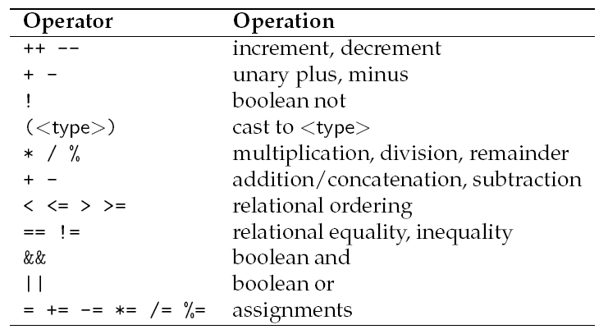
Precedence

Slide 9
Relations, No type effect
int a = 10, b = 20;
float f = 54.677f;
double d = 547.775;
char c1 = 'A', c2 = 'a';
bool b1;
b1 = a == f; // false
b1 = a <= d + 5; // true
b1 = d < c1 * 10; // true
b1 = c1 == c2; // false
b1 = '1' < '2'; // true
b1 = c1 + f < d + a; // true

Slide 10
Casting
In logical operations
0 → False, non-zero → True
In mathematical & comparison operations
False → 0 , True → 1
bool b1, b2;
int i = 0, j = 20;
b1 = i && j; // b1 = false
b2 = j || j; // b2 = true
i = b1 + b2; // i = 1
j = (i < j) + (b1 && b2); // j = 1

Slide 11
Examples
x ∈ [10 , 20]
Wrong Version
10 <= x <= 20
Let x = 30
10 <= 30 <=20 → (10 <= 30) <= 20
→ true <= 20 → 1 <= 20 → true!!!
Correct Version
(10 <= x) && (x <= 20)
Let x = 30
(10 <= 30) && (30 <= 20) → true && false → false

Slide 12
Examples
a,b > 0
Wrong version
a && b > 0
Let a = -10, b = 20
-10 && 20 > 0 → -10 && (20 > 0)
→ -10 && true → true && true → true !!!
Correct version
(a > 0) && (b > 0)
Let a = -10, b = 20
(-10 > 0) && (20 > 0) → false && true → false

Slide 13
Lazy (short-circuit) evaluation
When final result is found, does not evaluate remaining
int i = -1;
bool a = true, b = false, c = true;
bool d = a || b || c
bool d = b && (a || c)
bool d = (i > 0) && (sqrt(i) > 5.6)

Slide 14
What We Will Learn
Introduction
Conditions and Boolean operations
if-else statement
switch-case statement
Conditional expressions

Slide 15
Type of statements
Expression statement (دستور عبارتي)
Single statements
x = y + 10; scanf("%d", &i);
Control statement (دستور كنترلي)
Control the flow of program
Decisions (if, switch) and loops (for, while)
Compound statement (دستور مركب)
Starts with { and ends with }
All statements can be between { and }

Slide 16
if (if-else) statement
Decision making in C
if( <expression> )
<statements1>
else
<statements2>
Expression
A boolean statement: a <= b
A mathematical statement: a + b or a variable: a
zero → false
Non-zero → true

Slide 17
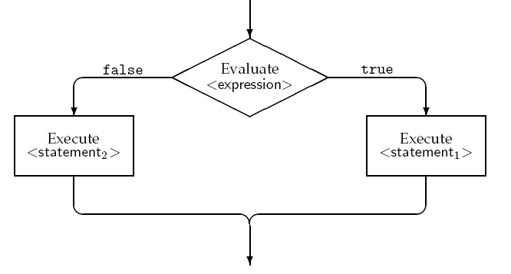
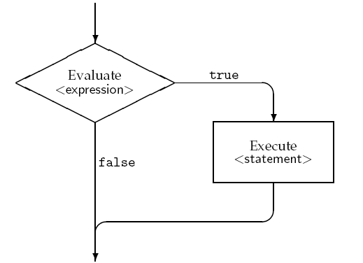
Flowcharts of if-else statement
if(<expression>) if(<expression>) <statement> <statement1>
else <statement2>

Slide 18
Example 1
برنامه‌اي كه يك عدد را از كاربر مي‌گيرد و مشخص مي‌كند كه اين عدد فرد است يا زوج.
#include <stdio.h>
int main(void){
int number_to_test, remainder;
printf("Enter your number to be tested: ");
scanf("%d", &number_to_test);
remainder = number_to_test % 2;
if(remainder == 0)
printf ("The number is even.\n");
else
printf ("The number is odd.\n");
return 0;
}

Slide 19
Statements in if-else
Empty statement
if(a > b)
Printf("A is larger \n");
else
;
Block statements
if(a <= b){
printf("A is less than b or ");
printf("A is equal b\n");
}
else
printf("A is greater than b\n");

Slide 20
Example 2
#include <stdio.h>
int main(void){
int i;
char c;
printf("Enter a char: ");
scanf(" %c", &c);
printf("Enter an int: ");
scanf("%d", &i);
if(i > 0)
printf("Your number is larger than 0\n");
else
printf("Your number is less than or equal 0\n");
if((c >= '0') && (c <= '9'))
printf("Your char is Numeric \n");
return 0;
}
برنامه‌اي كه يك حرف و يك عدد را مي‌گيرد. در مورد عدد مشخص مي‌كند كه آيا بزرگتر از صفر است يا نه. در مورد حرف اگر حرف عددي باشد، پيغام چاپ مي‌كند.

Slide 21
More than two choices
If statement: 2 choices
If conditions are true → if statements
If conditions are false → else statements
How to make decisions when there are multiple choices?

Slide 22
Map numeric grade to alphabetic
int numg;
char alphag;
if(numg < 25)
alphag = 'D';
if((numg >= 25) && (numg < 50))
alphag = 'C';
if((numg >= 50) && (numg < 75))
alphag = 'B';
if(numg >= 75)
alphag = 'A';

Slide 23
More than two choices
To avoid repeating conditions in if statements
To avoid running unnecessary statements
Nested if: check multiple conditions
<Statements 1> becomes an if-else statement
<Statements 2> becomes an if-else statement
Repeat it as many as needed

Slide 24
Nested if-else
if(c1 && c2)
s1
if (c1 && !(c2))
s2
if (!(c1) && c3)
s3
if (!(c1) && !(c3))
s4
if(c1)
if(c2)
s1
else
s2
else
if(c3)
s3
else
s4

Slide 25
Map numeric grade to alphabetic
int numg;
char alphag;
if(numg < 25)
alphag = ‘D’;
else{
if(numg < 50)
alphag = ‘C’;
else{
if(numg < 75)
alphag = ‘B’;
else
alphag = ‘A’
}
}
Notes:
Draw the tree

Slide 26
Nested if-else with else-if
if(<condition 1>)
<statement 1>
else{
if(<condition 2>)
<statement 2>
else
<statement 3>
}
if(<condition 1>)
<statement 1>
else if(<condition 2>)
<statement 2>
else
<statement 3>

Slide 27
Map numeric grade to alphabetic
int numg;
char alphag;
if(numg < 25)
alphag = 'D';
else if(numg < 50)
alphag = 'C';
else if(numg < 75)
alphag = 'B';
else
alphag = 'A';
Notes:
Draw the tree

Slide 28
Map numeric grade to alphabetic
int numg;
char alphag;
if(numg < 50){
if(numg < 25)
alphag = 'D';
else
alphag = 'C';
}
else{
if(numg < 75)
alphag = 'B';
else
alphag = 'A';
}
Notes:
Draw the tree

Slide 29
Nested if: Example 2
Determine a char is alphabetic, Uppercase or not, numeric, less or greater than 5 or none of them
/* ‘0’: 48, ‘9’: 57, ‘A’: 65, ‘Z’: 90, ‘a’: 97, ‘z’: 122 */
char c;
if(((c >= 'a') && (c <= 'z')) || ((c >= 'A') && (c <= 'Z'))){
if(c >= 'a')
printf("The char is Lowercase \n");
else
printf("The char is Uppercase \n");
}
else if((c >= '0') && (c <= '9')){
if(c > '5')
printf("The char is greater than 5\n");
else
printf("The char is less than or equal 5\n");
}
else
printf("The char is not either alphabetic or numeric");
Note: This program can be written in other ways.
Notes:
Tree of branches
Equality in conditions

Slide 30
Nested if: Incomplete branch
1) else part is optional
2) else always associates with the nearest if
1 + 2 can be dangerous specially in incomplete branches
Example: Tell user to move or game over
if(gameIsOver == 0)
if(playerToMove == YOU)
printf("Your Move\n");
else
printf("The game is over\n");
To avoid error you should
Close off your code or Use Empty statements
Notes:
You can use the incomplete branch to motivate about the close off and empty statements

Slide 31
Nested if: close off & empty statement
if(gameIsOver == 0){
if(playerToMove == YOU)
printf ("Your Move\n");
}
else
printf ("The game is over\n");
//--------------------------------
if(gameIsOver == 0)
if(playerToMove == YOU)
printf ("Your Move\n");
else
;
else
printf ("The game is over\n");
This one is better.

Slide 32
Duplicate zero, input is 3 digit
#include <stdio.h>
int main(void){
int n, x1, x2, x3, q1, q2, result;
printf("Enter a 3-digit number: ");
scanf("%d", &n);
if((n < 100) || (n > 999)){
printf("Wrong input\n");
return -1;
}
x1 = n / 100;
x2 = (n % 100) / 10;
x3 = n % 10;
q1 = 100;
q2 = 10;
if(x3 == 0){
q1 *= 10;
q2 *= 10;
}
if(x2 == 0)
q1 *= 10;
result = (x1 * q1) + (x2 * q2) + x3;
printf("result = %d\n", result);
return 0;
}

Slide 33
What We Will Learn
Introduction
Conditions and Boolean operations
if-else statement
switch-case statement
Conditional expressions

Slide 34
switch-case: Multiple choices
Multiple conditions
If-else, if-else if- ….
Select from alternative values of a variable
switch-case
Values should be constant not expression: i, i+j,
Values & Variables should be int or char
switch(variable){
case value1:
<statements 1>
case value2:
<statements 2>
}

Slide 35
How does switch-case work?
Each switch-case can be rewritten by If-else
if-else version of switch-case in the previous slide
if(variable == value1)}
<statements 1>
<statements 2>
}
else if(variable == value2){
<statements 2>
}

Slide 36
switch-case: complete version
switch(variable){
case value1:
<statements 1>
break;
case value2:
<statements 2>
break;
default:
<statements 3>
}
if(variable == value1){
<statements 1>
}
else if(variable == value2){
<statements 2>
}
else{
<statements 3>
}

Slide 37
switch-case: Example
#include <stdio.h>
int main(void){
int res, opd1, opd2;
char opr;
printf("Operand1 : ");
scanf("%d", &opd1);
printf("Operand2 : ");
scanf("%d", &opd2);
printf("Operator : ");
scanf(" %c", &opr);
switch(opr){
case '+':
res = opd1 + opd2;
break;
برنامه‌اي كه دو عدد و يك عملگر را مي‌گيرد، عملگر را بر روي اعداد اعمال و نتيجه را چاپ مي‌كند.

Slide 38
switch-case: Example (Cont’d)
case '-':
res = opd1 - opd2;
break;
case '/':
res = opd1 / opd2;
break;
case '*':
res = opd1 * opd2;
break;
default:
printf("Invalid operator \n");
return -1;
}
printf("%d %c %d = %d\n", opd1, opr, opd2, res);
return 0;
}

Slide 39
switch-case (cont’d)
All values used in case should be different
switch(i){
case 1:
…
case 2:
…
case 1: // Error
…

Slide 40
switch-case (cont’d)
All values must be value, not expression of variables
switch(i){ //Error
case j:
…
case 2:
…
case k+10:
…

Slide 41
switch-case: multiple matches
switch(variable){
case value1:
case value2:
<statements 1>
break;
case value3:
<statements 2>
}
if(
(variable == value1) ||
(variable == value2)
){
<statements 1>
}
else if
(variable == value3)
{
<statements 2>
}

Slide 42
switch-case vs. if-else
if-else is more powerful than switch-case
switch-case is only for checking the values of a variable and the values must be constant
if-else is more suitable in some cases , e.g.,
double var1, var2;
if(var1 <= 1.1)
<statements 1>
if(var1 == var2)
<statements 2>

Slide 43
Nested switch-case
bool b; // b = x && y
switch (x){
case 0:
b = 0;
break;
case 1:
switch(y){
case 0:
b = 0;
break;
case 1:
b = 1;
break;
}
break;
}

Slide 44
What We Will Learn
Introduction
Conditions and Boolean operations
if-else statement
switch-case statement
Conditional expressions

Slide 45
Conditional Expression
Assign value according to conditions
A ternary (سه تايي) operator
int i, j, k;
bool b;
...
i = b ? j : k; /* if(b)
* i = j;
* else
* i = k;
*/

Slide 46
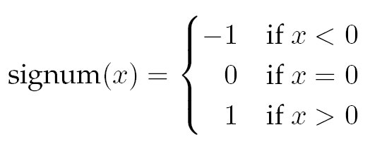
Conditional Expression: Examples
y = abs(x)
y = (x > 0) ? x : -x;
signum = (x < 0) ? -1 : (x > 0 ? 1 : 0)

Slide 47
Map Alphabetic Grade to Numeric
int d = numg / 25
charg = (d == 0) ? ‘D’ : ((d == 1) ? ‘C’ : (d == 2) ? ‘B’ : ‘A’);

Slide 48
Common Bugs
Equality of floating point numbers
Two float numbers may or may NOT be equal
double d1, d2;
d1 = 1e20 + 1;
d2 = 1e20 - 1;
if(d1 == d2)
printf("They are equal :-o \n");
else
printf("They are not equal :D \n");
They are equal :-o
Notes:
یک قاعده ساده (نه خیلی دقیق):
اگر عدد به صورت نماد علمی نوشته شود (قبل از ممیز بین ۱ تا ۹ باشد) برای float تا ۶ رقم بعد از ممیز معتبر است. برای double این تعداد به ۱۵ رقم می‌رسد.

Slide 49
Common Bugs
Danger of empty statement
Danger of assignment (=) and equality (==)
int a = 10;
int b = 20;
if(a=b) // logical but not compile error!!!
Danger of similarity between C and mathematic
if(a < b < c) // Logical Error
if(a && b > 0) // Logical Error

Slide 50
Avoiding Bugs
Precedence of operators
if(!a && b) or if(!(a && b))
Use parenthesis in conditions
Close-off code as much as you can
Put an end to a state or activity.

Slide 51
Debugging by assert
The assert macro is defined in assert.h
assert(an expression)
If the expression is true → nothing
If the expression is false → error message + halt
int x, y, z
…
assert(y != 0);
z = x / y;

Slide 52
Debugging by assert
If the expression is false:
Output error: Assertion failed: y != 0, file test.c, line ??
Assertion vs. Normal Error Handling
Assertions are mainly used to check logically impossible situations.
Assertions are generally disabled at run-time.
Assertions can be completely removed at compile time using the preprocessor NDEBUG.
#define NDEBUG

Slide 53
Reference
Reading Assignment: Chapter 3 of “C How to Program”
53

Slide 54
Questions
What will the value of result be in the following code?
int main() {
int x = 20, y = 10;
int result = (x > y) && (y != 0) || (x % y == 0);
printf("Result: %d\n", result);
return 0;
}
A) 0 B) 1 C) Compilation error D) Undefined behavior
Answer: B
54

Slide 55
Questions
What will happen if the break statement is missing in a switch-case structure?
A) The program will terminate.
B) It results in a compilation error.
C) The code will fall through to the next case.
D) Only the default case will execute.
Answer: C
55

Slide 56
Questions
What will be the output of the following code?
int a = 1, b = 0;
if (a = b || b)
printf("True\n");
else
printf("False\n");
A) True B) False
C) Compilation error D) Undefined behavior
Answer: B
56

