Slide 1
Lecture 1
Introduction
Fundamentals of Computer and Programming
Instructor: Morteza Zakeri, Ph.D. (m-zakeri@live.com)
Spring 2024
Modified Slides from Dr. Hossein Zeinali and Dr. Bahador Bakhshi
Computer Engineering Department, Amirkabir University of Technology
Notes:
1

Slide 2
What We Will Learn
What is this course?
Computer organization
Hardware
Software
Algorithms & Programming
Algorithm
Programming Language
Solving problems
2
Notes:
2

Slide 3
This Course
Introduction to Computer & Programming
How to use computers to solve our problems
The problems are computational problems
3
Notes:
3

Slide 4
This Course (cont’d)
What we learn
Overall overview of computer organization
Problem solving steps
Algorithm design
A programming language: the C
What we don’t learn
In depth computer hardware/software details
Most advanced algorithms
System programming using C
Other programming languages: Java, PHP, …
CA, OS, …
Alg, DS, …
OS, …
4
AP, IE, …
Notes:
4

Slide 5
This Course (cont’d)
Steps to learn a new language (English, French, … C, Java, Python, …)
Present: what is the new language (course slide)
Practice: how to use the new language in practice (the example)
Produce: use the language to create a new things (Lab, HW)
Learning Programming Language
is not a pure theoretical course (mathematics, …)
Reading, reading, reading, ….
is a practical course needs the product step
Class, Reading, programming, programming, programming,…
5
Notes:
5

Slide 6
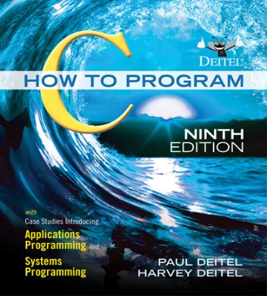
This Course (cont’d)
Course materials
Lecture notes (slides) are in (simple) English
Available in the course homepage:
https://m-zakeri.github.io/CP/
Textbook:
C: How to Program 9th Edition (2022)
https://deitel.com/c-how-to-program-9-e/
https://github.com/pdeitel/CHowToProgram9e
6
Notes:
6

Slide 7
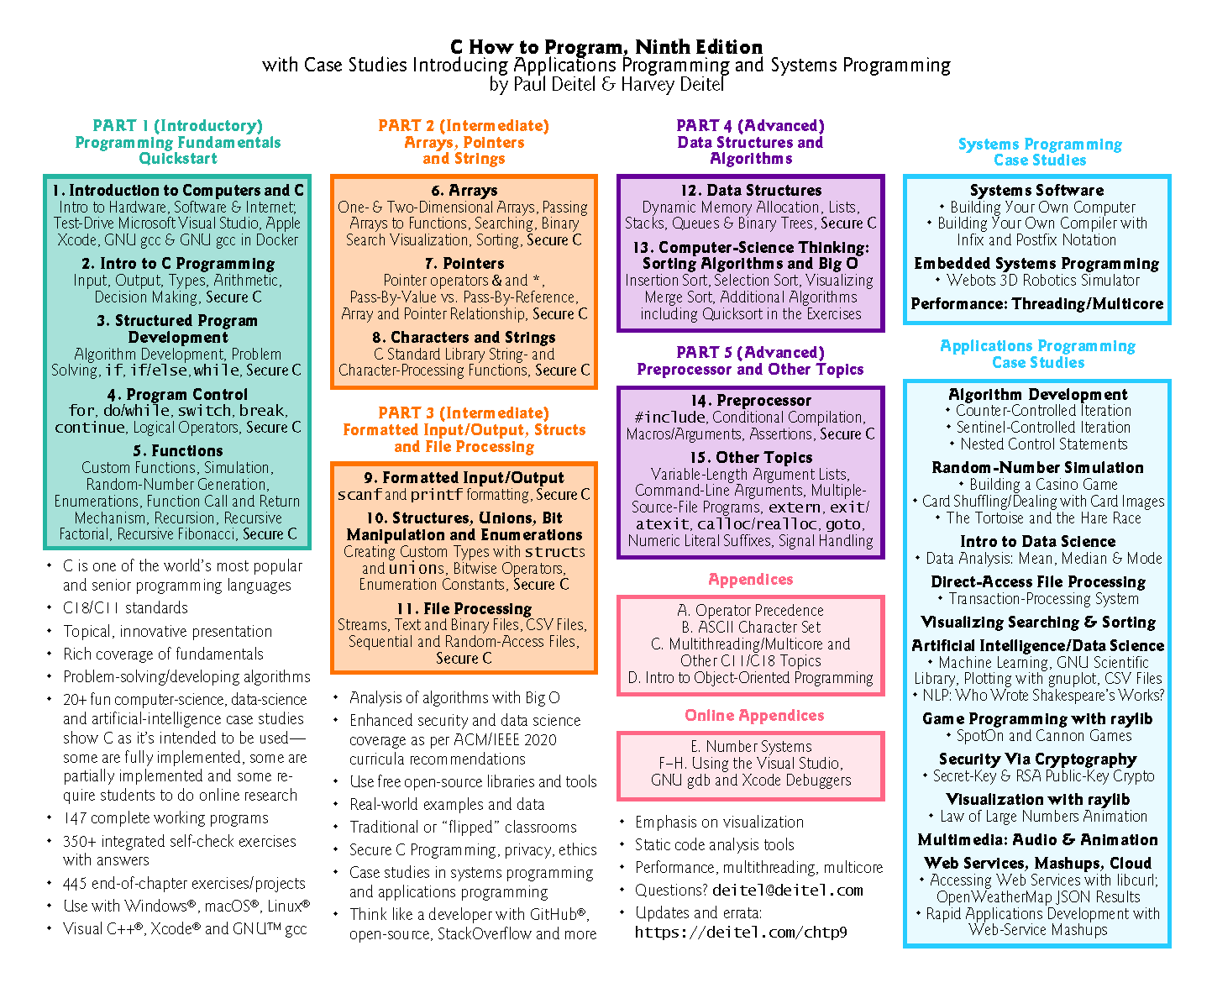

Slide 8
Who Am I?
Morteza Zakeri
Ph.D. in Computer Engineering
Software Engineering Major
Iran University of Science and Technology
Interested in intelligent software engineering, compilers, refactoring, and program analysis.
More info: https://m-zakeri.github.io
8
Notes:
8

Slide 9
How Can You Find Me?
At the department
After each class session.
Email:
m-zakeri@live.com
Skype ID:
zakerim2012
Telegram ID:
@mztel
9
Notes:
9

Slide 10
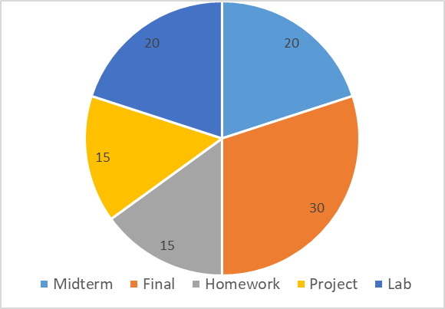
Grading policy and Extra Classes
Five major parts
Midterm 20% (4 of 20)
Final 30% (6 of 20)
Homework 15% (3 of 20)
Project 15% (3 of 20)
Lab 20% (4 of 20)
Lab + TA Classes
Lab: A practical class with writing reports, Mandatory
TA: More details, practical aspects, solving HW, etc.
At least 4 sessions must be attended.
Homework is not accepted after solutions.
10
Notes:
10

Slide 11
Who Will Pass the Course?
Get 4 out of 10 marks from both exams
Get 8 out of 17 marks from the exams, lab, and the project
The homework grades will not pass you!
There are bonuses in different parts of the course
Only for those that have an acceptable correlation between homework and other parts of the course!
11
Notes:
11

Slide 12
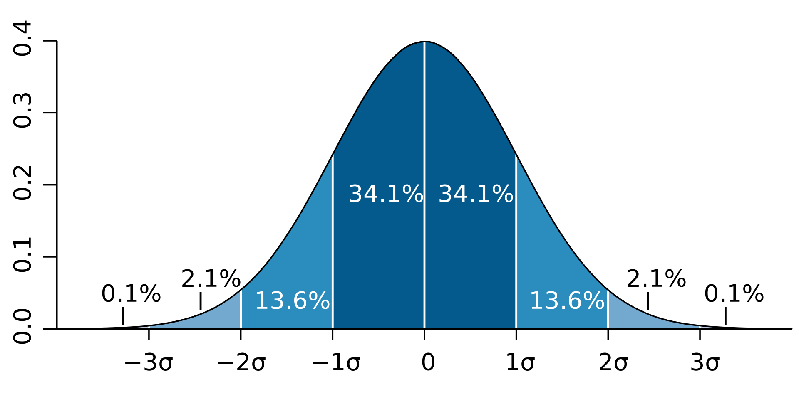
The Normal Distribution
Typically your grades follows …

Slide 13
Any Question?!
Is CE a good dep. of the university?! Yes ☺
Is AUT really a top university?! Yes ☺
Will I be wealthy as a Computer Engineer?! Yes ☺
Do I need to learn C?! Yes!!! ☺
Is CE a simple and easy-going? No ☺
Is the internet free at the university?! Yes ☺
Is lunch free?! No ☹
…
13
Notes:
13

Slide 14
What We Will Learn
What is this course?
Computer organization
Hardware
Software
Algorithms & Programming
Algorithm
Programming Language
Solving problems
14
Notes:
14

Slide 15
Computers: The Computing Machines
Computers classification:
Supercomputers
Weather forecast, Large scale simulation, …
Mainframe computers
The servers in large companies: Google, …
Midsize computers
The servers in CE department
Micro computers (also called PC)
Our laptop
Pocket PCs
Our mobile phones
15
Notes:
15

Slide 16
Computers
Computers are anywhere, anytime. Why?
They can solve many different problems. How?
Computers are programmable machines capable of performing calculations (computation)
Changing program leads to different operation
Special-purpose machines
Calculators, game-playing machines, …
General-purpose computers
Personal computers, notebooks, …
16
Notes:
16

Slide 17
Data Units
Computers are digital machines
Data processed or stored in computer is represented as two-state values
either 1 or 0 - BInary digiTs (BIT)
1 Byte = 8 bits
1 kilobyte (KB) = 1024 bytes
1 megabyte (MB) = 1024 kilobyte
1 gigabyte (GB) = 1024 megabyte
17
Notes:
17

Slide 18
Data Representation/Coding
How to represent our data by 0-1?
In other word, there are some 0 and 1 in the computer, what is the meaning?
Coding (Representation Standards)
Major (common) representations (coding)
Integer numbers: 1, 1000, -123, 0, …
Floating point numbers: 1.1, 11.232, -12.23, …
Characters: ‘A’, ‘ب’, ‘@’, …
s
In other word, there are some 0 and 1 in the computer, what is the meaning?
18
Notes:
18

Slide 19
Integer Number Coding
There are different representations
You will learn them (in details) in other courses (e.g. Computer Architecture)
One of the (simple) coding is sing-magnitude coding
If we have n bit for coding integers
The left bit (the MSB): sign
n-1 bits: magnitude
E.g., 8 bit for coding
4 → 00000100 -4 → 10000100
0 → 00000000 -0 → 10000000 :-P :-D
19
Notes:
19
(Two's complement)
Three-bit integers Bits Unsigned value Signed value
000 0 0
001 1 1
010 2 2
011 3 3
100 4 −4
101 5 −3
110 6 −2
111 7 −1

Slide 20
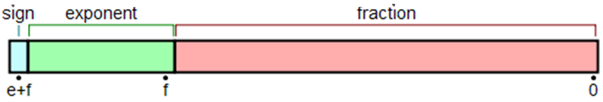
Floating Point Number Coding
Usually, this coding pattern (IEEE 754)
You will see all details in other courses
Two precisions
Single precision
exponent: 8 bit, fraction: 23 bit
Double precision:
exponent: 11 bit, fraction: 52 bit
20
Notes:
20

Slide 21
Character Coding
Common character encoding: ASCII
Character ASCII Code Binary (8 bit)
‘0’ 48 00110000
‘A’ 65 01000001
8 bits can represent 256 characters; but,
There are so many characters (Farsi, Arabic, …)
Solution: UTF (Variable length coding)
0xxxxxxx: 1 byte code
110xxxxx 10xxxxxx: 2 byte code
…
21
Notes:
21
UTF-8 is capable of encoding all 1,112,064 valid character code points in Unicode using one to four one-byte (8-bit) code units.

Slide 22
Computer Organization
Major Components
Hardware
Physical devices that are wired and performs basic operations
Software
Set of programs that run on the hardware
Hardware
CPU (Central Processing Unit)
Main Memory
Secondary Storage
Input/output
22
Notes:
22

Slide 23
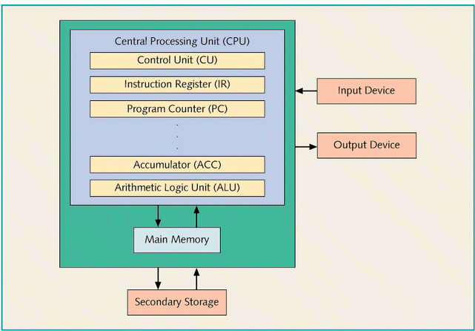
Computer Organization
23
Notes:
23

Slide 24
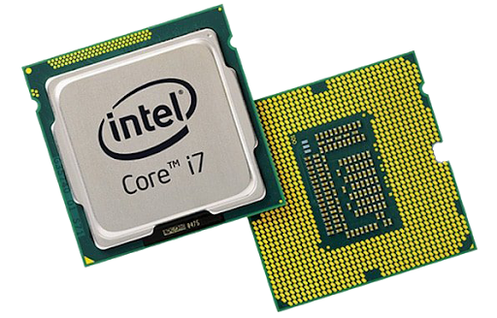
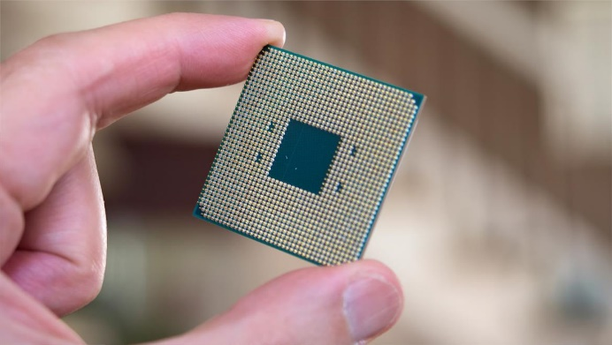
Computer Organization: CPU
ALU (Arithmetic Logic Unit)
Performs mathematic calculations
Makes decision based on conditions
Special Floating Point processors
Set of working area: Registers
Control Unit
Controls system operation
Operation and operands are required
Which are provided by instructions in the main memory
24
Notes:
24

Slide 25

Computer Organization: Main Memory
Ordered sequence of cells (memory cells)
Directly connected to CPU
All programs must be in main memory before execution
When power is turned off,
Main memory is cleared
Volatile memory
25
Notes:
25

Slide 26



Computer Organization: Secondary Storage
Provides permanent storage for information
Examples of secondary storages:
Hard Disks
Floppy Disks
Flash/Cool/USB Disks
CD/DVD
Tapes
26
Notes:
26

Slide 27
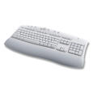



Computer Organization: Input Devices
Devices that feed data and programs into computers
Examples:
Keyboard
Mouse
Network Interface Card
Joystick
Microphone
27
Notes:
27

Slide 28
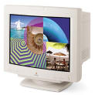

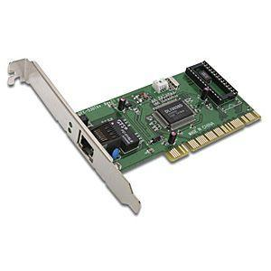

Computer Organization: Output Devices
Devices that computer uses to generate results/outputs
Examples:
Printer
Monitor
Speaker
Network Interface Card
28
Notes:
28

Slide 29
Computer Organization: Software
What can do the Hardware?
No useful operation, if there isn’t any software
We should tell/plan/program it to do something
Software
Programs which are designed for a specific task
Major Software types
Operating System
Libraries
Applications (To be studied in this course)
29
Notes:
29

Slide 30
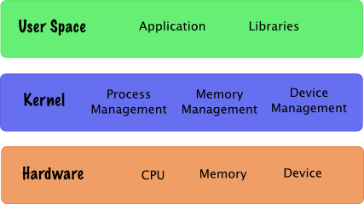
Computer HW & SW Organization
30
Notes:
30

Slide 31
Computer Organization: OS
OS
Manages the hardware
HW is a shared resources
Application programmers can easily use HW
Without knowing the HW details
Common operating systems
Unix, Windows (XP, Vista, 8, 10, 11), Linux, …
31
Notes:
31

Slide 32
Computer Organization: Libraries
The libraries provide the most common functionalities
In mathematic programs
sin(x), cos(x), matrix multiplication/inversion
In graphical programs
Draw a line/cycle, set color, new window
In multimedia programs
Open/close files, jump, …
32
Notes:
32

Slide 33
Computer Organization: Applications
An application program
Users use them to do some specific things
Without knowing the details of the computer
Common application programs
Word, Internet Explorer, FireFox, Messengers
Common applications in mathematic:
Matlab, Mathematica, Maple, GAMS, AIMMS
33
Notes:
33

Slide 34
Programming Execution Phases
Program is loaded from secondary storage to main memory by OS (loader)
OS gives the control to the program
Instructions run
Required inputs are got from input device & saved in main memory & used by CPU
Result is saved in main/secondary memory or sent to output devices
34

Slide 35
Instruction Execution Steps
Basic steps in running instructions
Read instruction from main memory: fetch
“000110…011”
Decode the instruction
add 1 to memory location XYZ save result in ABC
Get required operands from main memory
Read value of location XYZ to temp1
Run the instruction
temp2 = temp1 + 1
Save the result
Write temp2 in memory location ABC
35
Notes:
35

Slide 36
How to be general purpose machine?
Hardware is simple & general purpose
Only a small set of basic instructions (+, -, *, …) are implemented by hardware
Complex tasks (e.g. average, sort, …) are programmed by software
Basic instruction and high-level complex instructions
Software is translated to the basic instructions
Hardware can run it
This is the way that we “program” computers
36

Slide 37
Reference
Reading Assignment: Chapter 1 and Appendix C of “C How to Program”
Learn more about computer hardware
“How Computers Work”
37

Slide 38
What We Will Learn
What is this course?
Computer organization
Hardware
Software
Algorithms & Programming
Algorithm
Programming Language
Solving problems
38
Notes:
38

Slide 39
Algorithm??!!!
Hardware do the basic operations
We want to solve a real problem by computers
Take average, Sort, Painting, Web, Multimedia, …
We need a solution that
Specifies how the real (complex) problem should be solved step-by-step using the basic operations
The solution is the “Algorithm” of the problem
39
Notes:
تا الان ياد گرفتيم كامپيوتر چطور كار مي‌كند. حالا فرض كنيد 100 عدد داريم و مي‌خواهيم ميانه آنها را با استفاده از كامپيوتر پيدا كنيم!
چطور اين كار را انجام دهيم؟ چطور اين اعداد را به كامپيوتر بدهيم؟ چطور كامپيوتر اين كار را انجام دهد؟
توجه كنيد كه سخت افزار كامپيوتر فقط و فقط اعمال پابه ابتدايي را مي‌شناسد!
پس يك كار پيچيده مانند مرتب سازي و پيدا كردن ميانه بايد به مراحل بسيار كوچكتري كه مطابق اعمال پايه‌اي كامپيوتر است شكسته شود --» به آن الگوريتم گوييم

Slide 40
Algorithms (cont’d)
Common Sense (in computer science):
1) The way to do some things
2) An abstract way to solve a problem
Formal Definition:
“An algorithm is a finite list of well-defined instructions for accomplishing some task that, given an initial state, will proceed through a well-defined series of successive states, possibly eventually terminating in an end-state”
40
Notes:
40

Slide 41
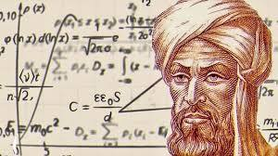
Algorithms: Examples
Finding Common Divisor
Finding 2 largest element in a set
Finding shortest path in a graph
Searching in a sorted array
Sorting a set
Combining 2 sorted set in a sorted set
Solving an equation
Compression algorithms
Cryptography algorithms
….
al-Khwarizmi
41
Notes:
41

Slide 42
Algorithms: Description
Algorithms are the problem solving steps in our mind!!!
How can we document it (don’t forget it)?
How can we explain/teach it to others peoples?
How can we explain it to computers?
We need some methods to describe algorithms!
Flowcharts
Pseudo-codes
Codes / Programs
42
Notes:
42

Slide 43
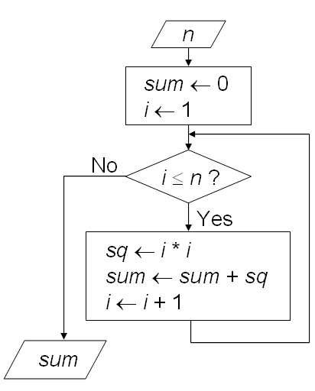
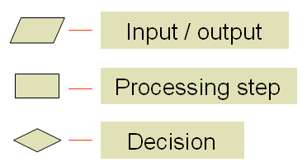
Algorithms: Description (cont’d)
Flowcharts:
Schematic representation
Example:
calculate 1² + 2² + ... + n²
43
Notes:
43

Slide 44
Algorithms: Description (cont’d)
Pseudo-code
A sequence of English and mathematical statements
Algorithm: calculate 1² + 2² + ... + n²
Input: n
Output: sum
sum ← 0
i ← 1
Repeat the following three steps while i ≤ n:
sq ← i * i
sum ← sum + sq
i ← i + 1
44
Notes:
44

Slide 45
Algorithms: Description (cont’d)
Flowcharts and Pseudo-code are for humans not for computer
Computer cannot run them
What can computer run?
Instructions in main memory
The instructions are in “011100001…” format
To use computers
We should describe your algorithm in “01” format
????? ☹ ☹
45
Notes:
45

Slide 46
What We Will Learn
What is this course?
Computer organization
Hardware
Software
Algorithms & Programming
Algorithm
Programming Language
Solving problems
46
Notes:
46

Slide 47
Programming Language
Programming languages are the tools to describe your algorithms for computers
Software is developed by programming languages
New languages which is understandable by computers
Human languages are not used. Why?
When algorithm is described with a programming language
It cannot be run on computer directly if the languages is not 011001001 ☹
There are some other programs that translate the programming language to “010…”
The output “0101…” can run on computers ☺☺
47
Notes:
47
مفهوم كلي زبان! زبان فارسي/انگليسي/...: راهي براي تعامل
در اينجا هم ما راهي براي تعامل با يك ماشين لازم داريم!
تعامل ما با ماشين اين است كه بتوانيم الگوريتم حل مساله را به آن بدهيم

Slide 48
Programming Language: Machine Level
Computer’s native language
What is saved in the main memory
The processor architecture specifies the format of 01s, machine depended
Example
Add two numbers: 00100111 1010 0101
Completely incomprehensible to (most) people
48
Notes:
48

Slide 49
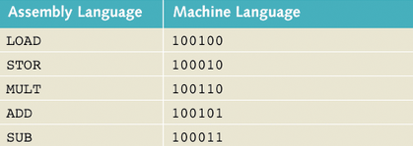
Programming Language: Assembly
Programming based on mnemonics
There are one-to-one mapping between machine language and assembly mnemonics
Example
load r1, [4000] ; read content of address 4000
add r1, 1 ; add 1 to CPU register r1
store [5000], r1 ; save the result in location 5000
49
Notes:
49
یادیارها (به انگلیسی: Mnemonic؛ تلفظ: نِـمونیک، یا: نیمانیک؛ به فرانسوی: Mnémotechnique و Mnémonique
عبارتند از شگردهایی برای یادسپاری که تنها به تکرار مطالب اکتفا نمی‌کند، بلکه با ایجاد رابطه بین مفاهیم تازه و اطلاعات قبلیِ موجود در مغز که به‌راحتی یادآوری می‌شوند (تصاویر، ریتم، آهنگ و...)، در به‌خاطرسپاری و یادآوری مطالب کمک می‌کند.

Slide 50
Programming Language: High Level
Easy for programming, English-like keywords
More similar to natural languages
There isn’t one-to-one relation between high level statements and machine level statements
Example: C, C++, Pascal, Java, PHP, Python,…
Example:
int xyz;
int abc;
abc = xyz + 1;
50
Notes:
50

Slide 51
Translation of High Level Languages
Two types of translators
Interpreter (مفسر)
Compiler (مترجم)
Interpreter
Checks and runs program lines one-by-one
Easy, slow, and we need the interpreter
Compiler
Check all lines, creates executable output file
Fast and Stand alone program
51
Notes:
51

Slide 52
Compiler
Compiler
A set of computer programs do the Compilation
Preprocessor: Prepare file for compiler
Compiler: Create assembly code
Assembler: Convert assembly code to binary code
Linker: Collect all required binary files (from libraries) into a single loadable file
Each language has its own compiler
Usually compiler do all above steps, you just compile the file and get a executable file
52
Notes:
52

Slide 53
Building & Running Program
Compiler
Assembler
Source code
Assembly code
Object code
Linker
Loader
Executable code
Libraries
Running
Operating System
53
Notes:
53

Slide 54
What We Will Learn
What is this course?
Computer organization
Hardware
Software
Algorithms & Programming
Algorithm
Programming Language
Solving problems using computers
54
Notes:
54

Slide 55
Solving Problems
How to solve problems using computers
Develop a program for it
Steps
Analysis: Input, output
Algorithm Design
Coding
Compile → program
Execution → test
Documentation
55
Notes:
55

Slide 56
Solving Problems: Analysis
Problem solving process consists of
Input → Algorithm → Output
Determine what information is available as the input to your algorithm
Determine what information is desired as the output from your algorithm
What needs to be done on the input to produce the output? Algorithm
56
Notes:
56

Slide 57
Solving Problems: Algorithm
Determine a series of steps that transforms the input data into the output results
Find a solution
Break down the steps
Find all the special cases that the must be handled
If necessary modify or redesign your series of steps so that all special cases are handled
Verify (test) your algorithm
57
Notes:
57

Slide 58
Solving Problems: Coding
Describe your algorithm by a programming language
You must code exactly in the programming language syntax
Compiler itself is a program it isn’t a human
It is not intelligent
It just does the steps of the compiling algorithm
It does not understand what do you mean!!!
58
Notes:
58

Slide 59
Solving Program: Execution
Compiler generated the executable file
Run the executable code
First try to use simple
Give the input
Get results
Then try larger and complex inputs
59
Notes:
59

Slide 60
Errors in Solving Problems
Compile / Syntax error: Compiler does not recognize your code
Link error: Linker cannot find the required libraries
Runtime error: Program does not run correctly
Example: Division by zero
Logical Error: Program does not produce the expected result
It is called bug
No one (compiler, assembler) except debugger can help you ☹
Why error?
You do not understand and analysis the problem correctly
You do not develop a right algorithm for the problem
You have mistakes in your coding
60
Notes:
60

Slide 61
Debugging
The process of resolving the errors
Example: A program to divide two numbers
Compile/Syntax error
Compiler tells where it is → check syntax
Link error
Compiler tells what it is → check syntax & libraries
Run time error
Try to find it → use debugger to run step-by-step, print debug messages
Check syntax & semantic of the line
Logical error
Try to find it → use debugger to run step-by-step, print debug messages
Check syntax & semantic of program
Revise the algorithm
61
Notes:
61
Create and debug all error in the code blocks!!
int x,y;
float z;
scanf("%i%f, x, y);
z = x / z;
print("%f", z);

Slide 62
Building & Running Program
Algorithm
Compiler
Assembler
Source code
Assembly code
Object code
Logical Error
Syntax Error
Linker
Link Error
Execution Error
Loader
Executable code
Libraries
Running
Operating System
62
Notes:
62

Slide 63
Desired Features of Programs
Integrity (درستي)
Correctly solve the problem
Clarity (وضوح)
Easy to read
Simplicity (سادگي)
Easy to understand
Efficiency (كارايي)
Speed and memory
Modularity (پيمانه‌اي)
Break down of a large task
Generality (عموميت)‌
Tunable by input as much as possible
63
Notes:
63

Slide 64
Summary
Computer organization
Hardware and Software
Algorithm & Program
What is the difference between them
How to solve a problem using computer
Steps
Errors in problem solving
What is the next: Design algorithm → Program
64
Notes:
64

Slide 65
Reference
Reading Assignment: Chapter 1 of “C How to Program”
65

