Slide 1
Lecture 11
Complex Data Types:
Structures, Enumerators, and Unions
Fundamentals of Computer and Programming
Instructor: Morteza Zakeri, Ph.D. (m-zakeri@live.com)
Spring 2024
Modified Slides from Dr. Hossein Zeinali and Dr. Bahador Bakhshi
Computer Engineering Department, Amirkabir University of Technology
Notes:
1

Slide 2
What We Will Learn
Introduction
struct definition
Using struct
struct and Array
struct and Pointers
struct and Functions
Linked-List
enum and unions
2
Notes:
2
2

Slide 3
What We Will Learn
Introduction
struct definition
Using struct
struct and Array
struct and Pointers
struct and Functions
Linked-List
enum and unions
3
Notes:
3
3

Slide 4
Introduction
Our variables until now
Single variable
int i, char c, float f
Set of same type elements: Array
int a[10], char c[20]
If data are not same type, but related? Example: Information about students
Student Name
Student Family Name
Student Number
Student Grade
4
Notes:
4
4
Other examples such as information about book, university, ….

Slide 5
Introduction
How to save the student information?
1. Use separated variables
char st_name[20];
char st_fam_name[20];
int id;
int grade;
2. Put them altogether, they are related
Use struct
This concept is extended in OOP as the “object”
5
Notes:
5
5

Slide 6
What We Will Learn
Introduction
struct definition
Using struct
struct and Array
struct and Pointers
struct and Functions
Linked-List
enum and unions
6
Notes:
6
6

Slide 7
struct: version 1
Set of related variables
Each variable in struct has its own type
struct in C (version 1)
struct {
<variable declaration>
} <identifier list>;
7
Notes:
7
7

Slide 8
struct (version 1): Example
struct{
char st_name[20];
char st_fam_name[20];
int id;
int grade;
} st1;
We declare a variable st1
Type of st1 is struct
id is a member of the struct
grade is a member of the struct
8
Notes:
8
8

Slide 9
struct (version 1): Example
struct{
char st_name[20];
char st_fam_name[20];
int id;
int grade;
} st1, st2, st3;
We declare three variables: st1, st2, st3
Type of st1, st2, st3 is the struct
In this model, we cannot reuse the struct definition in other location (e.g., input of function)
9
Notes:
9
9

Slide 10
struct: version 2
struct in C (version 2)
struct <tag> {
<variable declaration>
};
struct <tag> <identifiers>;
10
Notes:
10
10

Slide 11
struct (version 2): Example
struct std_info{
char st_name[20];
char st_fam_name[20];
int id;
int grade;
};
struct std_info st1, st2, st3;
We define a struct with tag std_info
We do not allocate memory, it is just definition
We declare variables st1, st2, st3 from std_info
11
Notes:
11
11
Provide more examples

Slide 12
typedef
We can assign a new name for each type
Assign name “integer” to “int”
Assign name “int_array” to “int[100]”
Assign name “int_pointer” to “int *”
New names are assigned by typedef
After we assigned the new name, we can use it in identifier declaration
12
Notes:
12
12

Slide 13
typedef: Examples
/* Assign new name integer to type int */
typedef int integer;
/* Use the new name */
integer i, j, k;
/* Assign new name alephba to type char */
typedef char alephba;
/* Use the new name */
alephba c1, c2;
13
Notes:
13
13

Slide 14
typedef: Examples
/* Assign new name intptr to type int * */
typedef int * intptr;
/* Use the new name */
intptr pi, pj, pk;
typedef int int_arr1[10], int_arr2[20];
int_arr1 array1;
int_arr2 array2;
14
Notes:
14
14
What is the equivalent of these statements

Slide 15
struct: version 3.1
Using the typedef
struct <tag>{
<variables>
};
typedef struct <tag> <new_name>;
<new_name> <variables>;
15
Notes:
15
15

Slide 16
struct (version 3.1): Examples
struct std_info{
char st_name[20];
char st_fam_name[20];
int id;
int grade;
};
typedef struct std_info information;
information st1, st2;
16
Notes:
16
16

Slide 17
struct: version 3.2
struct in C (version 3.2)
Using the typedef
typedef struct {
<variables>
} <new_name>;
<new_name> <variables>;
17
Notes:
17
17

Slide 18
struct (version 3.2): Examples
typedef struct {
char st_name[20];
char st_fam_name[20];
int id;
int grade;
} information;
information st1, st2;
18
Notes:
18
18

Slide 19
Structures as New Data Type
When we define a new struct, in fact we are defining a new data type
Then we use the new data type and define variables
So, we need to learn how to work it
Access to members
Operators for struct
Array of struct
struct in functions
Pointer to struct
19
Notes:
19
19

Slide 20
Size of struct
The size of struct is NOT the sum of size of members!
struct test_size{char c, int i}
sizeof(struct test_size) // = 8 (!!!)
This is because of “Structure Padding”
Computer hard ware cannot (should not) read any arbitrary address
The address should be aligned in word
4 bytes in 32-bit machine
The padding is to align the address
More details and examples: https://fresh2refresh.com/c-programming/c-structure-padding/
20
Notes:
20
20

Slide 21
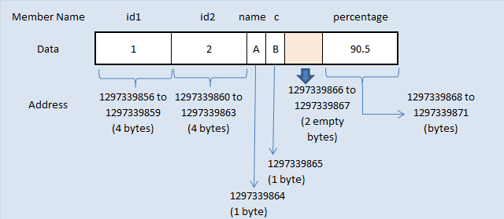
Example for structure padding in C language
struct structure1 {
int id1;
int id2;
char name;
char c;
float percentage;
};

Slide 22
What We Will Learn
Introduction
struct definition
Using struct
struct and Array
struct and Pointers
struct and Functions
Linked-List
enum
22
Notes:
22
22

Slide 23
Using struct
We should declare variables from struct type
Versions 1, 2, 3.1, 3.2
How to access to the members of struct
<struct variable>.<element name>
st1.st_name is a array of char in struct st1
st2.grade is a int variable in struct st2
23
Notes:
23
23

Slide 24
struct initialization
Similar to array initialization
information st1 = {"Ali", "Karimi", 9222, 10};
“Ali” is assigned to st_name,
“Karimi” is assigned to st_fam_name,
9222 is assigned to id,
10 is assigned to grade,
Order of values should be exactly the order of the members
The number of values should be <= the number of members
Initial values cannot be assigned in struct definition
24
Notes:
24
24

Slide 25
Using struct
#include <stdio.h>
typedef struct{
char name[20];
char fam_name[20];
int id;
int grade;
} information;
void main(void){
information st2, st1 = {"Ali", "Hassani", 90131, 20};
printf("After init: \n");
مثالي ساده براي نحوه استفاده از struct
25
Notes:
25
25

Slide 26
Using struct
printf("Name = %s, \nFam. Name = %s, \nid = %d, \ngrade = %d\n", st1.name, st1.fam_name, st1.id, st1.grade);
scanf("%s", st2.name);
scanf("%s", st2.fam_name);
scanf("%d", &st2.id);
scanf("%d", &st2.grade);
printf("Your Input is: \n");
printf("Name = %s, \nFam. Name = %s, \nid = %d, \ngrade = %d\n",
st2.name, st2.fam_name, st2.id, st2.grade);
}
26
Notes:
26
26

Slide 27
Nested struct
struct date_type{
int rooz, mah, sal;
};
typedef struct{
char name[20];
char fam_name[20];
int id;
int grade;
struct date_type date;
} information;
27
Notes:
27
27
How to access the members of outer and inner struct

Slide 28
Nested struct
information st1 = {"A","B",1,10,{2,3,1368}};
information st2;
st2.name = "C";
st2.fam_name = "D";
st2.id = 2;
st2.grade = 15;
st2.date.rooz = 10;
st2.date.mah = 5;
st2.date.sal = 1390;
28
Notes:
28
28
How to access the members of outer and inner struct

Slide 29
struct: Copy and Assignment
struct date_type{
int rooz, mah, sal;
};
struct date_type d1, d2 = {2, 1, 1360};
d1 = d2;
/* d1.rooz = d2.rooz;
d1.mah = d2.mah;
d1.sal = d2.sal;
*/
29
Notes:
29
29

Slide 30
struct: Copy and Assignment
struct test_type{
char name[10];
int id[10];
};
struct test_type d1, d2 = {"ABC", {1, 2, 3}};
d1 = d2;
/* d1.name = "ABC"; d1.id = {1, 2, 3};
*/
30
Notes:
30
30

Slide 31
struct: Comparing
We cannot compare struct variables
==, <=, <, >, >= cannot be used for struct
information st1, st2;
if(st1 <= st2){ // Compile Error
...
}
Why?
What does this mean? st1 <= st2
31
Notes:
31
31

Slide 32
struct: Comparing
We can compare members of structs
if((st1.id == st2.id) && (strcmp(st1.name,st2.name) == 0) &&
(strcmp(st2.fam_name,st2.fam_name) == 0)){
/* st1 == st2 */
}
We can define <, <=, >, >= for struct
if((st1.id > st2.id) && (strcmp(st1.name,st2.name) == 0) &&
(strcmp(st2.fam_name,st2.fam_name) == 0)){
/* st1 > st2 */
}
32
Notes:
32
32

Slide 33
struct: Arithmetic operations
No arithmetic operation (+, -, /, …) is defined for structures
We can define ours operations
We have an example in the following slides
33
Notes:
33
33

Slide 34
What We Will Learn
Introduction
struct definition
Using struct
struct and Array
struct and Pointers
struct and Functions
enum and unions
34
Notes:
34
34

Slide 35
Array of struct: Definition
struct is a type → We can define array of struct
struct std1{
int id;
int grad;
};
struct std1 std_arr[20];
typedef struct{
int id;
int grad;
} std2;
std2 std_arr[20];
35
Notes:
35
35
What happen? std is a struct, each element of std_arr[i] is a variable of struct std. std_arr[i].id is a integer variable

Slide 36
Array of struct: Example
#include <stdio.h>
int main(void){
struct std{
int id;
int grade;
};
const int num = 25;
double sum, average;
int i;
struct std std_arr[num];
for(i = 0; i < num; i++){
printf("Enter ID and grade\n");
scanf("%d", &(std_arr[i].id));
scanf("%d", &(std_arr[i].grade));
}
برنامه‌اي كه شماره و نمره دانشجويان را بگيرد و ليست دانشجوياني كه نمره آنها بيشتر از ميانگين است را توليد كند.
36
Notes:
36
36
. and -> and [] have higher precedence than that of unary &

Slide 37
Array of struct: Example
sum = 0;
for(i = 0; i < num; i++)
sum += std_arr[i].grade;
average = sum / num;
for(i = 0; i < num; i++)
if(std_arr[i].grade >= average)
printf("Student %d passed \n", std_arr[i].id);
return 0;
}
ادامه
37
Notes:
37
37

Slide 38
Array of struct: Example 2
#include <stdio.h>
int main(void){
struct std{
char name[20];
int id;
int grade;
};
const int num = 25;
struct std std_arr[num];
int sid, i;
for(i = 0; i < num; i++){
printf("Enter Name, ID and grade\n");
scanf("%s", std_arr[i].name);
scanf("%d", &(std_arr[i].id));
scanf("%d", &(std_arr[i].grade));
}
برنامه‌اي كه يك ليست از دانشجويان را بگيرد. سپس يك شماره دانشجويي بگيرد و اگر دانشجو در ليست است اطلاعات وي را نشان دهد.
38
Notes:
38
38

Slide 39
Array of struct: Example 2
printf("Enter Search ID: ");
scanf("%d", &sid);
for(i = 0; i < num; i++)
if(std_arr[i].id == sid){
printf("Found:\n");
printf("Name = %s\n", std_arr[i].name);
printf("ID = %d\n", std_arr[i].id);
printf("Grade = %s\n", std_arr[i].grade);
}
return 0;
}
ادامه
39
Notes:
39
39

Slide 40
What We Will Learn
Introduction
struct definition
Using struct
struct and Array
struct and Pointers
struct and Functions
enum and unions
40
Notes:
40
40

Slide 41
Pointer to struct: Definition
A variable of struct type is a variable
It has address, we can have pointer to it
struct std{
int id;
int grade;
};
struct std st1;
struct std *ps;
ps = &st1;
41
Notes:
41
41

Slide 42
Pointer to struct: Usage (version 1)
We can use *pointer method
*ps means the content of the address that ps refers to there → it is struct
(*ps).id is the member of struct that ps refers to it
(*ps).grade is the member of struct that ps refers to it
*ps.id // Compile Error
42
Notes:
42
42

Slide 43
Pointer to struct: Usage (version 2)
We can use “->" method
struct std{
int id;
int grade;
};
struct std st1, *ps;
ps = &st1
int y = ps->id; // (*ps).id
int z = ps->grade; // (*ps).grade
43
Notes:
43
43

Slide 44
What We Will Learn
Introduction
struct definition
Using struct
struct and Array
struct and Pointers
struct and Functions
enum and unions
44
Notes:
44
44

Slide 45
struct and Functions
struct is a type → It can be used
In input parameter list of functions
Call by value
Call by reference
In return type of functions
void f(struct std s1); // call by value input
void g(struct std *s2); // call by reference
struct std h(void); // return type
45
Notes:
45
45

Slide 46
struct and Functions: Example
struct as call by value input parameter
void print_st_info(information st){
printf("Name = %s\n", st.name);
printf("Fam = %s\n", st.fam_name);
printf("id = %d\n", st.id);
printf("grade = %d\n", st.grade);
}
//---- Calling the function ----
information st1;
print_st_info(st1);
46
Notes:
46
46

Slide 47
struct and Functions: Example
struct as call by reference input parameter
void read_st_info(information *pst){
scanf("%s", pst->name);
scanf("%s", pst->fam_name);
scanf("%d", &(pst->id));
scanf("%d", &(pst->grade));
}
//---- Calling the function ----
information st1;
read_st_info(&st1);
47
Notes:
47
47

Slide 48
struct and Functions: Example
struct as output of function
information create_st_info(void){
information tmp;
scanf("%s", tmp.name);
scanf("%s", tmp.fam_name);
scanf("%d", &tmp.id);
scanf("%d", &tmp.grade);
return tmp;
}
//---- Calling the function ----
information st1;
st1 = create_st_info();
48
Notes:
48
48

Slide 49
Scope of struct definition
A struct can be used only
In the defined scope
After definition
→ if struct is defined in a function
It can be used only in the function
No other function knows about it
→ If struct is defined as a global
It can be used in all function after the definition
49
Notes:
49
49

Slide 50
Scope of struct variables
The scope of struct variables are the same as other variables
If struct variable is global
Initialized to zero and visible to the functions after its declaration
If struct variable is automatic local
There is not any initial value, destroyed when the block finishes
If struct variable is static
Kept in memory until program finishs
50
Notes:
50
50

Slide 51
Example: Rational numbers
struct guia{
int sorat, makhraj;
};
void f(struct guia a, struct guia b, struct guia * tafrigh, struct guia * jaam){
int mokhraj_moshtarak = a.makhraj * b.makhraj;
int sub = a.sorat * b.makhraj - b.sorat * a.makhraj;
int sum = a.sorat * b.makhraj + b.sorat * a.makhraj;
tafrigh->sorat = sub;
tafrigh->makhraj = mokhraj_moshtarak;
jaam->sorat = sum;
jaam->makhraj = mokhraj_moshtarak;
}
تابعي كه دو عدد گويا را مي‌گيرد و حاصل جمع و تفريق آنها را توليد مي‌كند.
51
Notes:
51
51

Slide 52
Example: Sorting a set of times
#include <stdio.h>
struct time{
int hour;
int min;
int sec;
};
/* 1: t1 > t2, 0: t1 = t2, -1: t1 < t2 */
int time_cmp(struct time t1, struct time t2){
if(t1.hour > t2.hour)
return 1;
else if(t2.hour > t1.hour)
return -1;
else if(t1.min > t2.min)
return 1;
else if(t2.min > t1.min)
return -1;
else if(t1.sec > t2.sec)
return 1;
else if(t2.sec > t1.sec)
return -1;
else
return 0;
}
برنامه‌اي يك مجموعه از زمان‌ها را بگيرد و آنها را مرتب كند. هر زمان شامل ساعت، دقيقه و ثانيه است.
52
Notes:
52
52

Slide 53
Example: Sorting a set of times
void time_swap(struct time *t1, struct time *t2){
struct time tmp;
tmp = *t1;
*t1 = *t2;
*t2 = tmp;
}
/* Find index of max element */
int rec_max(struct time time_arr[], int start, int end){
int tmp, res;
if(start == end)
res = start;
else{
tmp = rec_max(time_arr, start + 1, end);
if(time_cmp(time_arr[start], time_arr[tmp]) >= 0)
res = start;
else
res = tmp;
}
return res;
}
ادامه
53
Notes:
53
53

Slide 54
Example: Sorting a set of times
/* Recursively sort array from start to end */
void rec_sort(struct time time_arr[], int start, int end){
int max;
if(start == end)
return;
max = rec_max(time_arr, start, end);
time_swap(&(time_arr[start]), &(time_arr[max]));
rec_sort(time_arr, start + 1, end);
}
/* Print Array elements from start to end */
void print_array(struct time time_arr[], int start, int end){
for(int i = start; i <= end; i++)
printf("%d:%d:%d, ", time_arr[i].hour, time_arr[i].min, time_arr[i].sec);
printf("\n");
}
ادامه
54
Notes:
54
54

Slide 55
Example: Sorting a set of times
int main(void){
struct time ta[5] = {{4, 0, 1},
{6, 1, 0}, {2, 2, 1},
{6, 4, 7}, {8, 5, 4}};
print_array(ta, 0, 4);
rec_sort(ta, 0, 4);
print_array(ta, 0, 4);
return 0;
}
ادامه
55
Notes:
55
55

Slide 56
What We Will Learn
Introduction
struct definition
Using struct
struct and Array
struct and Pointers
struct and Functions
Linked-List
enum and unions
56
Notes:
56
56

Slide 57
More Dynamic Data Structures
In Arrays
We know the size of array when you develop code (coding time)
We know the size of array when program runs
What can we do, if we do not know data size even in run time?
We use dynamic memory allocation and resize
Resizing array has cost and overhead
What can we do, if we want to add/remove an element to/from middle of the array?
We use dynamic memory allocation and resize
Resizing array has cost and overhead
Is there any other better approach?
57
Notes:
57
57

Slide 58
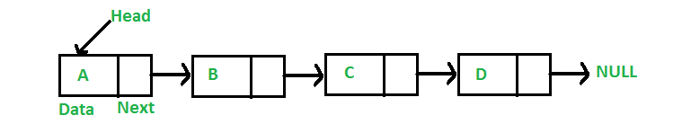
Dynamic Data Structures: Linked List
Linked list data structure can be used to implement the dynamic structures
linked list: Nodes that linked together
info (s): Save the information
next: Pointer to the next node
previous: Pointer to the previous node
58
58
Notes:
58
58

Slide 59
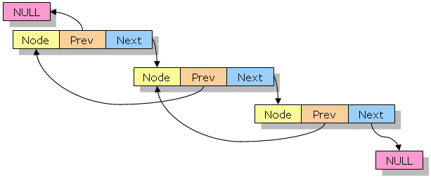
Dynamic Data Structures: Linked List
linked list data structure can be used to implement the dynamic structures
linked list: Nodes that linked together
info (s): Save the information
next: Pointer to the next node
previous: Pointer to the previous node
59
59
Notes:
59
59

Slide 60
Linked List in C
linked list is implemented by struct and pointer to struct
Struct has a member to save the info
Struct has a pointer to point the next node
struct node{
int info;
struct node *next;
};
60
Notes:
60
60

Slide 61
Create nodes
We need a function to create each node in list. The function do
1. Allocate the memory
2. Set the info member
3. Set the next member
4. Return the pointer to new node
61
Notes:
61
61

Slide 62
Create Node
struct node{
int info;
struct node *next;
};
struct node * create_node(int i){
struct node * nn;
nn = (struct node *) malloc(sizeof(struct node));
if (nn == NULL)
return NULL;
nn->info = i;
nn->next = NULL;
return nn;
}
Returning pointer!!!
Is it safe?
Why?
62
Notes:
62
62

Slide 63
Example: 3 Nodes List
struct node * list = NULL;
list = create_node(10);
list->next = create_node(20);
list->next->next = create_node(30);
63
Notes:
63
63
What happen, draw the picture of memory

Slide 64
Operation on linked list
Print the list: print_list
Add new node to end of list: add_end
Add new node to front of list: add_front
Insert new node after some node: insert_next_node
Delete the first node in list: delete_first
Delete the end node in list: delete_end
Delete a node from the middle of list: delete_next
64
Notes:
64
64

Slide 65
add_end: Add new node to end of list
void add_end(struct node *list, struct node * new_node){
struct node *current;
for(current = list; current-> next != NULL; current = current->next);
current->next = new_node;
new_node->next = NULL;
}
65
Notes:
65
65

Slide 66
delete_end (if more than 1 nodes)
void delete_end(struct node * list){
struct node * current = list;
while(current->next->next != NULL)
current = current->next;
free(current->next);
current->next = NULL;
}
66
Notes:
66

Slide 67
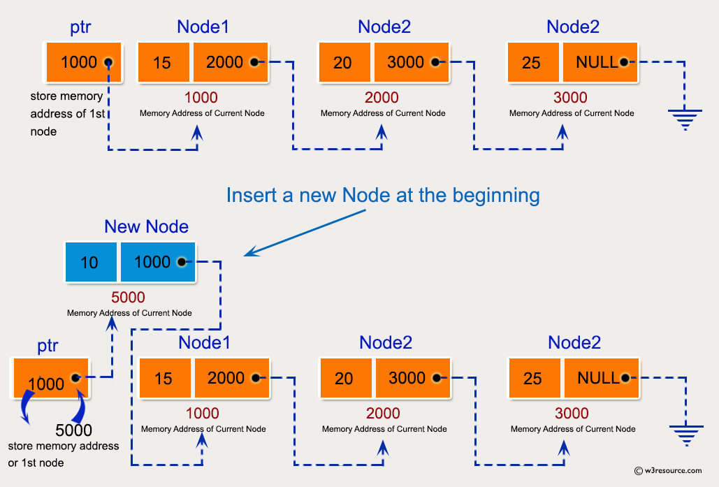
add_front: Add new node in start of list

Slide 68
add_front: Add new node in start of list
void add_front_wrong(struct node *list, struct node *new_node){
new_node->next = list;
list = new_node;
}
68
Notes:
68
68

Slide 69
add_front: Add new node in start of list
void add_front_wrong(struct node *list, struct node *new_node){
new_node->next = list;
list = new_node;
}
Passing Pointers: The original function should take a pointer to the head pointer of the list (struct node** list) instead of a copy of the head node (struct node list).
This allows us to modify the head pointer of the list to point to the new node.
69
Notes:
69
69

Slide 70
add_front: Add new node in start of list
void add_front_wrong(struct node *list, struct node *new_node){
new_node->next = list;
list = new_node;
}
Dereferencing Pointers: When assigning the new_node to the list, you need to dereference the head pointer with *list to update the actual head of the list.
70
Notes:
70
70

Slide 71
Testing add_front function
#include <stdio.h>
#include <stdlib.h>
struct node { int info; struct node * next; };
struct node * create_node(int i){
struct node * nn;
nn = (struct node *) malloc(sizeof(struct node));
if (nn == NULL)
return NULL;
nn->info = i;
nn->next = NULL;
return nn;
};
void print_list(struct node *list){
struct node * current = list;
while(current != NULL){
printf("%p: %d , ", current, current->info);
current = current->next;
}
printf("\n");
}
71
Notes:
71
71

Slide 72
Testing add_front function
void add_front_wrong(struct node * list, struct node * new_node){
new_node->next = list;
list = new_node;
}
int main(){
struct node *tmp, *list = NULL;
list = create_node(20);
list -> next = create_node(30);
tmp = create_node(10);
print_list(list);
add_front_wrong(list, tmp);
print_list(list);
return 0;
}
// 0x55d3387d92a0: 20 , 0x55d3387d92c0: 30 ,
// 0x55d3387d92a0: 20 , 0x55d3387d92c0: 30 ,
72
Notes:
72
72

Slide 73
add_front: Add new node in start of list
void add_front(struct node **plist, struct node *new_node){
new_node->next = *plist;
*plist = new_node;
}
main(){
struct node * list;
…
add_front(&list, new_node1);
}
// 0x558486f382a0: 20 , 0x558486f382c0: 30 ,
//0x558486f382e0: 10 , 0x558486f382a0: 20 , 0x558486f382c0: 30 ,
73
Notes:
73
73

Slide 74
Convert array to set using linked list
#include <stdio.h>
#include <stdlib.h>
struct node{
int value;
struct node *next;
};
int in_list(struct node *list, int i){
struct node *current = list;
while(current != NULL){
if(current->value == i)
return 1;
current = current->next;
}
return 0;
}
برنامه‌اي که يك آرايه را بگيرد و با حذف عضوهاي‌ تكراري آن، يك ليست پيوند ايجاد كند.
74
Notes:
74
74

Slide 75
Convert array to set using linked list
void add_front(struct node *new_node, struct node **list){
new_node->next = *list;
*list = new_node;
}
void add_end(struct node *new_node, struct node *list){
struct node *current;
for(current = list; current-> next != NULL; current = current->next);
current->next = new_node;
new_node->next = NULL;
}
void print_list(struct node *list){
struct node * current = list;
while(current != NULL){
printf("%d ", current->value);
current = current->next;
}
}
ادامه
75
Notes:
75
75

Slide 76
Convert array to set using linked list
struct node *create_set(int arr[], int size){
int i;
struct node *list = NULL;
for(i = 0; i < size; i++)
if(in_list(list, arr[i]) == 0){
struct node *new_node =
(struct node *)malloc(sizeof(struct node));
if(new_node == NULL){
printf("Cannot create node\n");
exit(-1);
}
new_node->value = arr[i];
new_node->next=NULL;
if(list == NULL)
add_front(new_node, &(list));
else
add_end(new_node, list);
}
return list;
}
ادامه
76
Notes:
76
76

Slide 77
Convert array to set using linked list
int main(void){
int myarr[]={1,2,1,3,1,7,8,2,3,4,11,4,9,9,9,10};
struct node * mylist =
create_set(myarr, sizeof(myarr) / sizeof(myarr[0]));
print_list(mylist);
getchar();
return 0;
}
ادامه
// 1 2 3 7 8 4 11 9 10
77
Notes:
77
77

Slide 78
What We Will Learn
Introduction
struct definition
Using struct
struct and Array
struct and Pointers
struct and Functions
Linked-List
enum and unions
78
Notes:
78
78

Slide 79
Introduction
Some data are naturally ordered
Days of week
Months of year
We want to use the order, e.g.
The number of visitors per day
The salary per month
We need an array
visitors[0] → The number of visitors in Saturday
visitors[1] → The number of visitors in Sunday
79
Notes:
79
79

Slide 80
Introduction
Enumeration is a mechanism to assign a name for each number
We can use names instead of numbers
More readable core
E.g.:
visitors[saturday], visitors[friday]
salary[april], salary[june]
80
Notes:
80
80

Slide 81
enum
enum is used to define a set of names and their corresponding numbers
enum tag {name_1, name_2, …, name_N}
tag is the enumeration type
We use it to define variables
name_1 = 0
name_2 = 1
name_i = (Name_(i-1)) + 1
81
Notes:
81
81

Slide 82
enum
enum week {sat, sun, mon, tue, wed, thu, fri};
// sat = 0, sun = 1, mon = 2, …, fri = 6
enum year {feb, jan, mar, apr, may, jun, jul, aug, sep, oct, nov, des};
// feb = 0, jan = 1, …, nov = 10, des = 11
82
Notes:
82
82

Slide 83
enum
We can assign the numbers
enum week {sat = 1, sun, mon, tue, wed, thu, fri};
// sat = 1, sun = 2, mon = 3, …, fri = 7
enum condition {False = 0, True, No = 0, Yes, Ghalat = 0, Dorost};
// False = No = Ghalat = 0
// True = Yes = Dorost = 1
83
Notes:
83
83

Slide 84
enum
After definition of an enumeration
We can use the tag to declare variables
We can use the names to assign values to the variables
enum week {sat, sun, mon, tue, wed, thu, fri};
enum week day = sat;
for(day = sat; day <= fri; day++)
84
Notes:
84
84

Slide 85
Example: Read the number of visitors
enum week {sat, sun, mon, tue, wed, thu, fri};
int visitors[7];
enum week day;
for(day = sat; day <= fri; day++)
scanf("%d", &visitors[day]);
85
Notes:
85
85

Slide 86
Caution
C compiler does not check the value is assigned to the enum variables
enum test1 {t1, t2, t3};
enum test2 {t4, t5, t6};
enum test1 t1v = t1;
enum test2 t2v = t4;
if(t1v == t2v) → true
t1v = t5;
t2v = 100;
86
Notes:
86
86

Slide 87
Unions
The union keyword in C lets you define a derived data type,
Very much similar to the struct keyword.
A union data type in C also that allows to store different data types in the consecutive memory location.
Unlike a struct variable, a variable of union type, only one of its members can contain a value at any given time.

Slide 88
Union declaration
union [union tag] {
member definition;
member definition;
...
member definition;
} [one or more union variables];

Slide 89
Union memory layout
union myunion{
int a;
double b;
char c;
};
sizeof(union myunion)
// 8
struct mystruct{
int a;
double b;
char c;
};
sizeof(struct mystruct)
// 24
Same memory location, can be used to store multiple types of data

Slide 90
Union example
#include <stdio.h>
#include <string.h>
union Data {
int i;
float f;
char str[20];
};
int main() {
union Data data;
data.i = 10;
data.f = 220.5;
strcpy( data.str, "C Programming");
printf( "data.i : %d\n", data.i);
printf( "data.f : %f\n", data.f);
printf( "data.str : %s\n", data.str);
return 0;
}
// 1917853763
// 4122360580327794860452759994368.000000
// C Programming

Slide 91
Union example
#include <stdio.h>
#include <string.h>
union Data {
int i;
float f;
char str[20];
};
int main(){
union Data data;
data.i = 10;
printf( "data.i : %d\n", data.i); // 10
data.f = 220.5;
printf( "data.f : %f\n", data.f); // 220.500000
strcpy( data.str, "C Programming");
printf( "data.str : %s\n", data.str); // C Programming
return 0;
}

Slide 92
Common Bugs
The last “NULL” in Liked-list is very important
Always keep it
Operation of linked-list has many exceptions
When list is empty
When we want to add to the first of list
…
92
Notes:
92

Slide 93
Reference
Reading Assignment: Chapter 10 and Sections 12.1-12.4 of “C How to Program”
93

