Slide 1

Compiler Design Assignment 4
Iran University of Science & Technology
School of Computer Engineering
Spring 2021

Slide 2
Assignment Specifications
Full Name: Mohammadmostafa Rostamkhani
Student ID: 97521306

Slide 3
Q1
Program | ::= | MainClass ( ClassDeclaration )* <EOF>
MainClass | ::= | "class" Identifier "{" "public" "static" "void" "main" "(" "String" "[" "]" Identifier ")" "{" Statement "}" "}"
ClassDeclaration | ::= | "class" Identifier ( "extends" Identifier )? "{" ( VarDeclaration )* ( MethodDeclaration )* "}"
VarDeclaration | ::= | Type Identifier ";"
MethodDeclaration | ::= | "public" Type Identifier "(" ( Type Identifier ( "," Type Identifier )* )? ")" "{" ( VarDeclaration )* ( Statement )* "return" Expression ";" "}"
Type | ::= | "int" "[" "]"
 | | | "boolean"
 | | | "int"
 | | | Identifier
Statement | ::= | "{" ( Statement )* "}"
 | | | "if" "(" Expression ")" Statement "else" Statement
 | | | "while" "(" Expression ")" Statement
 | | | "System.out.println" "(" Expression ")" ";"
 | | | Identifier "=" Expression ";"
 | | | Identifier "[" Expression "]" "=" Expression ";"
Expression | ::= | Expression ( "&&" | "<" | "+" | "-" | "*" ) Expression
 | | | Expression "[" Expression "]"
 | | | Expression "." "length"
 | | | Expression "." Identifier "(" ( Expression ( "," Expression )* )? ")"
 | | | <INTEGER_LITERAL>
 | | | "true"
 | | | "false"
 | | | Identifier
 | | | "this"
 | | | "new" "int" "[" Expression "]"
 | | | "new" Identifier "(" ")"
 | | | "!" Expression
 | | | "(" Expression ")"
Identifier | ::= | <IDENTIFIER>
LL(K)بودن گرامر را بررسی کنید.

Slide 4
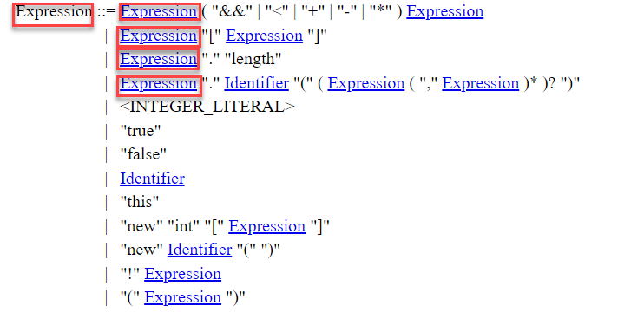
Q1)solution
Answer:
Since the grammar has some left recursive rules(left recursion), this grammar is not LL(1) or LL(K): (also this grammar is ambiguous because it has both left and right recursive in first rule for Expression)
* The red marked sections illustrate the left recursion.

Slide 5
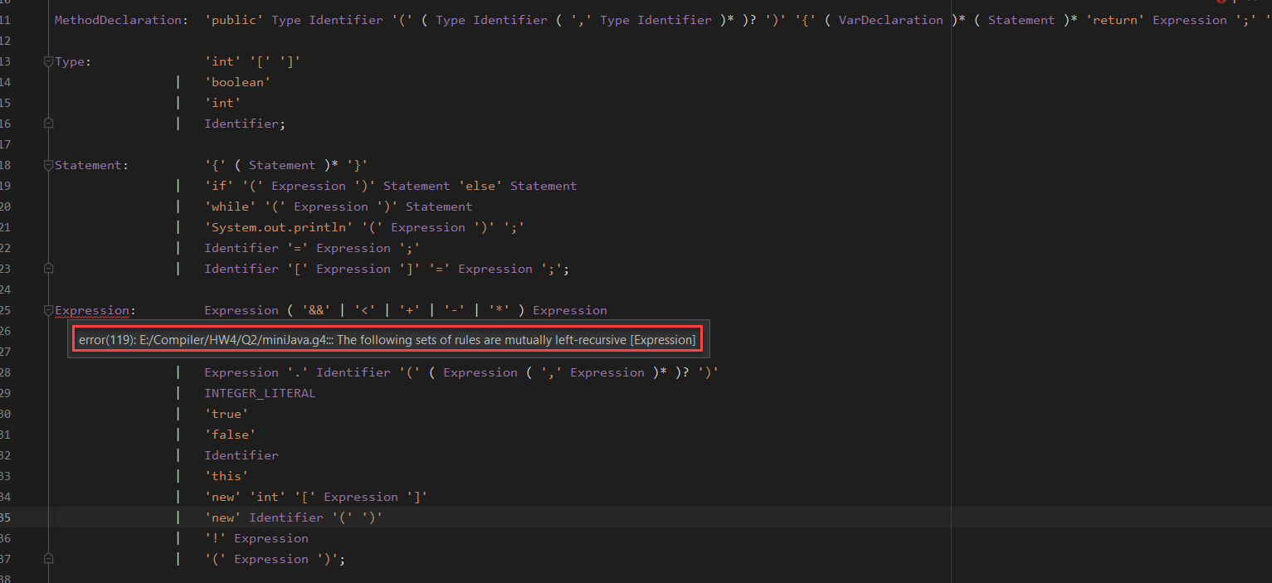
Q1)solution
Also even if we try to convert the grammar to g4 format without changing the grammar, we got error about this issue:

Slide 6
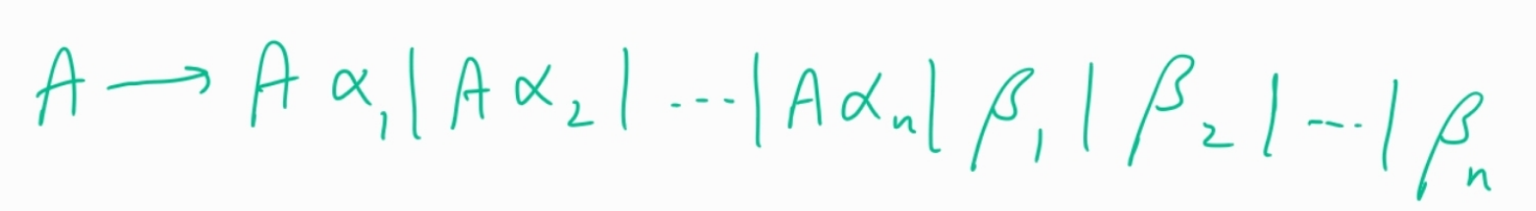
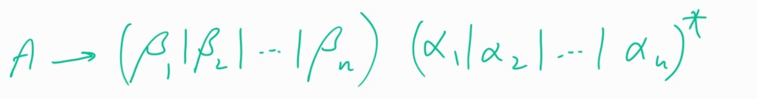
Q2)
گرامر را در قالب g4 (انتلر4) بازنویسی کنید.
For this part we implement the grammar in two way: 1)eliminating left recursion 2)original grammar
For converting this grammar to g4 format first we must eliminate the left recursion:
In general form:
After eliminating left recursion we have:

Slide 7
Q2
Output after eliminating left recursion:
The output image of parse tree is attached in Q2.

Slide 8
Q2_2
Output of original grammar:
The output image of parse tree is attached in Q2_2.

Slide 9
Q3
Output for this question is attached in Q3 as output.txt.

Slide 10
Q4
Output for this question is attached in Q4 as output.txt.

