Slide 1
Introduction to Software Testing (2nd edition) Chapter 2 Model-Driven Test Design
Instructor: Morteza Zakeri
Slides by: Paul Ammann & Jeff Offutt
http://www.cs.gmu.edu/~offutt/softwaretest/
Modified by: Morteza Zakeri
Updated September 2016

Slide 2
Complexity of Testing Software
No other engineering field builds products as complicated as software
The term correctness has no meaning
Is a building correct?
Is a car correct?
Is a subway system correct?
Like other engineers, we must use abstraction to manage complexity
This is the purpose of the model-driven test design process
The “model” is an abstract structure

Slide 3

Software Testing Foundations (2.1)
Testing can only show the presence of failures
Not their absence
Edsger W. Dijkstra

Slide 4
Software Testing
Goal of testing
finding faults in the software
demonstrating that there are no faults in the software (for the test cases that has been used during testing)
It is not possible to prove that there are no faults in the software using testing
Testing should help locate errors, not just detect their presence
a “yes/no” answer to the question “is the program correct?” is not very helpful
Testing should be repeatable
could be difficult for distributed or concurrent software
effect of the environment, uninitialized variables

Slide 5
Testing Software is Hard
If you are testing a bridge’s ability to sustain weight, and you test it with 1000 tons you can infer that it will sustain weight ≤ 1000 tons
This kind of reasoning does not work for software systems
software systems are not linear nor continuous
Exhaustively testing all possible input/output combinations is too expensive
the number of test cases increase exponentially with the number of input/output variables

Slide 6
Testing & Debugging
Testing: Evaluating software by observing its execution
Test Failure: Execution of a test that results in a software failure.
Debugging: The process of finding a fault given a failure.
Fault localization
Repair
Not all inputs will “trigger” a fault into causing a failure

Slide 7
Fault & Failure Model (RIPR)
Four conditions necessary for a failure to be observed
Reachability: The location or locations in the program that contain the fault must be reached
Infection: The state of the program must be incorrect
Propagation: The infected state must cause some output or final state of the program to be incorrect
Reveal: The tester must observe part of the incorrect portion of the program state

Slide 8
RIPR Model
Reachability
Infection
Propagation
Revealability
Test
Final Program State
Observed Final Program State
Reaches
Fault
Incorrect Final State
Infects
Incorrect Program State
Propagates
Reveals
Test Oracles
Notes:
The failures can be revealed when the observed final program state has overlap with the incorrect final program state.
The question is: should testers check the entire program state? How to observe the incorrect program state in a cost-effective manner.
Getting the overlap as big as possible and use the cost as small as possible.

Slide 9
Software Testing Activities (2.2)
Test Engineer: An IT professional who is in charge of one or more technical test activities
Designing test inputs
Producing test values
Running test scripts
Analyzing results
Reporting results to developers and managers
Test Manager: In charge of one or more test engineers
Sets test policies and processes
Interacts with other managers on the project
Otherwise supports the engineers

Slide 10
Traditional Testing Levels (2.3)
Acceptance testing: Is the software acceptable to the user?
main Class P
System testing: Test the overall functionality of the system
Class A
Class B
Integration testing: Test how modules interact with each other
method mA1()
method mB1()
method mA2()
method mB2()
Module testing (developer testing): Test each class, file, module, component
Unit testing (developer testing): Test each unit (method) individually
This view obscures underlying similarities

Slide 11
Object-Oriented Testing Levels
Inter-class testing: Test multiple classes together
Class A
Class B
Intra-class testing: Test an entire class as sequences of calls
method mA1()
method mB1()
method mA2()
method mB2()
Inter-method testing: Test pairs of methods in the same class
Intra-method testing: Test each method individually

Slide 12
System Testing, Acceptance Testing
Alpha testing is performed within the development organization
Beta testing is performed by a select group of friendly customers
Stress testing
push system to extreme situations and see if it fails
large number of data, high input rate, low input rate, etc.

Slide 13
Regression testing
You should preserve all the test cases for a program
During the maintenance phase, when a change is made to the program, the test cases that have been saved are used to do regression testing
figuring out if a change made to the program introduced any faults
Regression testing is crucial during maintenance
It is a good idea to automate regression testing so that all test cases are run after each modification to the software
When you find a bug in your program you should write a test case that exhibits the bug
Then using regression testing you can make sure that the old bugs do not reappear

Slide 14
V Model
Testing levels and software artifacts

Slide 15
Test Plan
Testing is a complicated task
it is a good idea to have a test plan
A test plan should specify
Unit tests
Integration plan
System tests
Regression tests

Slide 16
Exhaustive Testing is Hard
int max(int x, int y)
{
if (x > y)
return x;
else
return x;
}
Number of possible test cases (assuming 32 bit integers)
2³² × 2³² = 2⁶⁴
Do bigger test sets help?
Test set
{(x=3,y=2), (x=2,y=3)}
will detect the error
Test set
{(x=3,y=2),(x=4,y=3),(x=5,y=1)}
will not detect the error although it has more test cases
It is not the number of test cases
But, if T₁ ⊇ T₂, then T₁ will detect every fault detected by T₂

Slide 17
Exhaustive Testing
Assume that the input for the max procedure was an integer array of size n
Number of test cases: 2^{32× n}
Assume that the size of the input array is not bounded
Number of test cases: ∞
The point is, naive exhaustive testing is pretty hopeless

Slide 18
Coverage Criteria (2.4)
Even small programs have too many inputs to fully test them all
private static double computeAverage (int A, int B, int C)
On a 32-bit machine, each variable has over 4 billion possible values
Over 80 octillion possible tests!!
Input space might as well be infinite
Testers search a huge input space
Trying to find the fewest inputs that will find the most problems
Coverage criteria give structured, practical ways to search the input space
Search the input space thoroughly
Not much overlap in the tests

Slide 19
Advantages of Coverage Criteria
Maximize the “bang for the buck”
Provide traceability from software artifacts to tests
Source, requirements, design models, …
Make regression testing easier
Gives testers a “stopping rule” … when testing is finished
Can be well supported with powerful tools

Slide 20
Test Requirements and Criteria
Test Criterion: A collection of rules and a process that define test requirements
Cover every statement
Cover every functional requirement
Test Requirements: Specific things that must be satisfied or covered during testing
Each statement might be a test requirement
Each functional requirement might be a test requirement
Testing researchers have defined dozens of criteria, but they are all really just a few criteria on four types of structures …
Input domains
Graphs
Logic expressions
Syntax descriptions

Slide 21
Old View: Colored Boxes
Black-box testing: Derive tests from external descriptions of the software, including specifications, requirements, and design
White-box testing: Derive tests from the source code internals of the software, specifically including branches, individual conditions, and statements
Model-based testing: Derive tests from a model of the software (such as a UML diagram)
MDTD makes these distinctions less important.
The more general question is:
from what abstraction level do we derive tests?

Slide 22
Types of Testing
Functional (Black box) vs. Structural (White box) testing
Functional testing: Generating test cases based on the functionality of the software
Structural testing: Generating test cases based on the structure of the program
Black box testing and white box testing are synonyms for functional and structural testing, respectively.
In black box testing the internal structure of the program is hidden from the testing process
In white box testing internal structure of the program is taken into account
Module vs. Integration testing
Module testing: Testing the modules of a program in isolation
Integration testing: Testing an integrated set of modules

Slide 23
Functional Testing, Black-Box Testing
Functional testing:
identify the functions which software is expected to perform
create test data which will check whether these functions are performed by the software
no consideration is given how the program performs these functions, program is treated as a black-box: black-box testing
need an oracle: oracle states precisely what the outcome of a program execution will be for a particular test case. This may not always be possible, oracle may give a range of plausible values
A systematic approach to functional testing: requirements based testing
driving test cases automatically from a formal specification of the functional requirements

Slide 24
Structural Testing, White-Box Testing
Structural Testing
The test data is derived from the structure of the software
White-box testing: the internal structure of the software is taken into account to derive the test cases
One of the basic questions in testing:
When should we stop adding new test cases to our test set?
Coverage metrics (test adequacy criteria) are used to address this question.

Slide 25
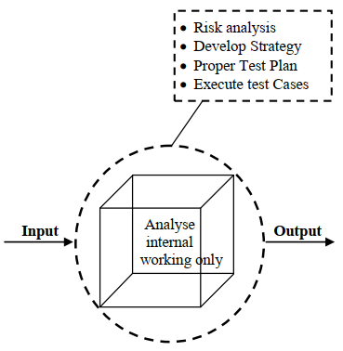
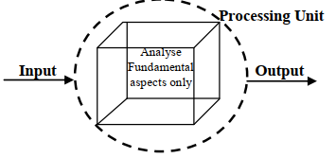
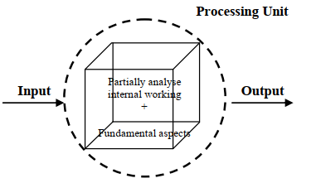
White box, Black box, Gray box
Representations of testing color-boxes
black-box
white-box
Khan, M. E., & Khan, F. (2012). A comparative study of white box , black box and grey box testing techniques. International Journal of Advanced Computer Science and Applications, 3(6), 12–15. https://doi.org/10.1017/CBO9781107415324.004
grey-box

Slide 26
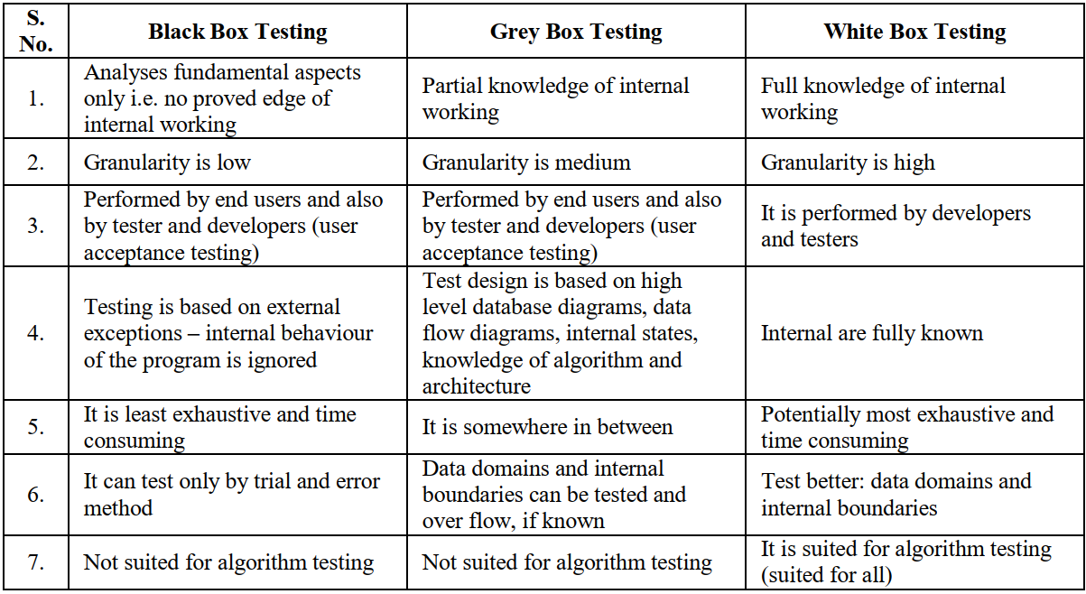
Comparison
Comparison between three forms of testing techniques

Slide 27
Model-Driven Test Design (2.5)
Test Design is the process of designing input values that will effectively test software
Test design is one of several activities for testing software
Most mathematical
Most technically challenging

Slide 28
Types of Test Activities
Testing can be broken up into four general types of activities
Test Design
Test Automation
Test Execution
Test Evaluation
Each type of activity requires different skills, background knowledge, education and training
No reasonable software development organization uses the same people for requirements, design, implementation, integration and configuration control.
1.a) Criteria-based
1.b) Human-based
Why do test organizations still use the same people for all four test activities??
This clearly wastes resources

Slide 29
1. Test Design—(a) Criteria-Based
Design test values to satisfy coverage criteria or other engineering goal
This is the most technical job in software testing
Requires knowledge of :
Discrete math
Programming
Testing
Requires much of a traditional CS degree
This is intellectually stimulating, rewarding, and challenging
Test design is analogous to software architecture on the development side
Using people who are not qualified to design tests is a sure way to get ineffective tests

Slide 30
1. Test Design—(b) Human-Based
Design test values based on domain knowledge of the program and human knowledge of testing
This is much harder than it may seem to developers
Criteria-based approaches can be blind to special situations
Requires knowledge of :
Domain, testing, and user interfaces
Requires almost no traditional CS
A background in the domain of the software is essential
An empirical background is very helpful (biology, psychology, …)
A logic background is very helpful (law, philosophy, math, …)
This is intellectually stimulating, rewarding, and challenging
But not to typical CS majors – they want to solve problems and build things

Slide 31
2. Test Automation
Embed test values into executable scripts
This is slightly less technical
Requires knowledge of programming
Requires very little theory
Often requires solutions to difficult problems related to observability and controllability
Can be boring for test designers
Programming is out of reach for many domain experts
Who is responsible for determining and embedding the expected outputs ?
Test designers may not always know the expected outputs
Test evaluators need to get involved early to help with this

Slide 32
3. Test Execution
Run tests on the software and record the results
This is easy – and trivial if the tests are well automated
Requires basic computer skills
Interns
Employees with no technical background
Asking qualified test designers to execute tests is a sure way to convince them to look for a development job
If, for example, GUI tests are not well automated, this requires a lot of manual labor
Test executors have to be very careful and meticulous with bookkeeping

Slide 33
4. Test Evaluation
Evaluate results of testing, report to developers
This is much harder than it may seem
Requires knowledge of :
Domain
Testing
User interfaces and psychology
Usually requires almost no traditional CS
A background in the domain of the software is essential
An empirical background is very helpful (biology, psychology, …)
A logic background is very helpful (law, philosophy, math, …)
This is intellectually stimulating, rewarding, and challenging
But not to typical CS majors – they want to solve problems and build things

Slide 34
Other Activities
Test management: Sets policy, organizes team, interfaces with development, chooses criteria, decides how much automation is needed, …
Test maintenance: Save tests for reuse as software evolves
Requires cooperation of test designers and automators
Deciding when to trim the test suite is partly policy and partly technical – and in general, very hard!
Tests should be put in configuration control
Test documentation: All parties participate
Each test must document “why” – criterion and test requirement satisfied or a rationale for human-designed tests
Ensure traceability throughout the process
Keep documentation in the automated tests

Slide 35
Organizing the Team
A mature test organization needs only one test designer to work with several test automators, executors and evaluators
Improved automation will reduce the number of test executors
Theoretically to zero … but not in practice
Putting the wrong people on the wrong tasks leads to inefficiency, low job satisfaction and low job performance
A qualified test designer will be bored with other tasks and look for a job in development
A qualified test evaluator will not understand the benefits of test criteria
Test evaluators have the domain knowledge, so they must be free to add tests that “blind” engineering processes will not think of
The four test activities are quite different
Many test teams use the same people for ALL FOUR activities !!

Slide 36
Applying Test Activities
To use our people effectively
and to test efficiently
we need a process that
lets test designers
raise their level of abstraction

Slide 37
Using MDTD in Practice
This approach lets one test designer do the math
Then traditional testers and programmers can do their parts
Find values
Automate the tests
Run the tests
Evaluate the tests
Just like in traditional engineering … an engineer constructs models with calculus, then gives direction to carpenters, electricians, technicians, …
Test designers become technical experts

Slide 38
Model-Driven Test Design
refined requirements / test specs
model / structure
test requirements
test requirements
DESIGN
ABSTRACTION
LEVEL
software artifact
IMPLEMENTATION
ABSTRACTION
LEVEL
input values
pass / fail
test results
test scripts
test cases

Slide 39
Model-Driven Test Design – Steps
criterion
refine
refined requirements / test specs
model / structure
test requirements
generate
analysis
test requirements
domain analysis
DESIGN
ABSTRACTION
LEVEL
IMPLEMENTATION
ABSTRACTION
LEVEL
software artifact
input values
feedback
evaluate
execute
automate
prefix
postfix
expected
pass / fail
test results
test scripts
test cases

Slide 40
Model-Driven Test Design–Activities
refined requirements / test specs
model / structure
test requirements
Test Design
DESIGN
ABSTRACTION
LEVEL
IMPLEMENTATION
ABSTRACTION
LEVEL
software artifact
input values
Test Automation
pass / fail
test results
test scripts
test cases
Test Evaluation
Test Execution

Slide 41
Model-Driven Test Design–Activities
refined requirements / test specs
model / structure
test requirements
Test Design
DESIGN
ABSTRACTION
LEVEL
Raising our abstraction level makes
test design MUCH easier
IMPLEMENTATION
ABSTRACTION
LEVEL
software artifact
input values
Test Automation
pass / fail
test results
test scripts
test cases
Test Evaluation
Test Execution

Slide 42
Small Illustrative Example
Software Artifact : Java Method
/**
* Return index of node n at the
* first position it appears,
* -1 if it is not present
*/
public int indexOf (Node n)
{
for (int i=0; i < path.size(); i++)
if (path.get(i).equals(n))
return i;
return -1;
}
Control Flow Graph
1
i = 0
2
i < path.size()
3
if
5
4
return -1
return i

Slide 43
Small Illustrative Example (Cont.)
Support tool for graph coverage
http://www.cs.gmu.edu/~offutt/softwaretest/
Edges
1 2
2 3
3 2
3 4
2 5
Initial Node: 1
Final Nodes: 4, 5
6 requirements for Edge-Pair Coverage 1. [1, 2, 3] 2. [1, 2, 5] 3. [2, 3, 4] 4. [2, 3, 2] 5. [3, 2, 3] 6. [3, 2, 5]
Graph
Abstract version
1
2
3
Test Paths
[1, 2, 5]
[1, 2, 3, 2, 5]
[1, 2, 3, 2, 3, 4]
Find values …
5
4

Slide 44
Types of Activities in the Course
Most of this course is about test design
Other activities are well covered elsewhere

Slide 45
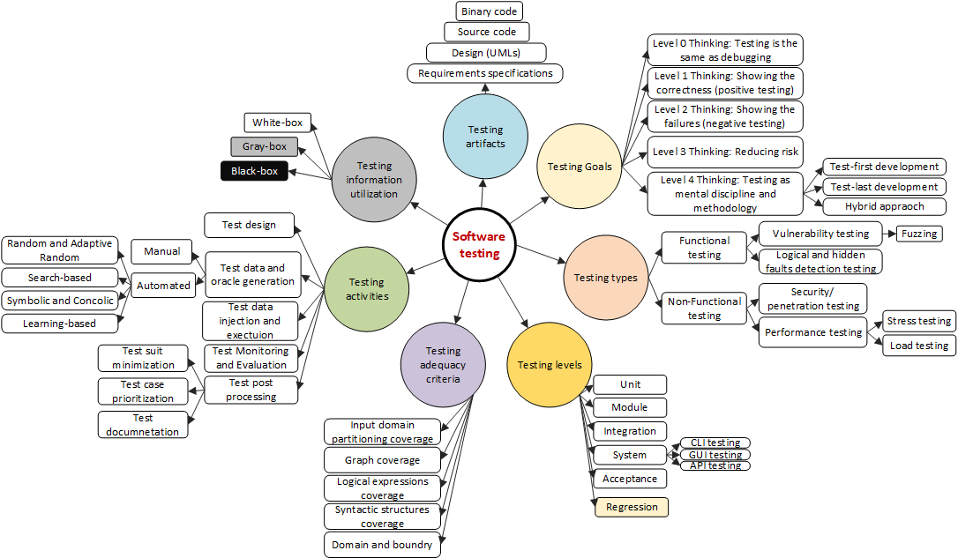
Software Testing Taxonomy and Classification
My proposed classification for software testing (version 1.0)

Slide 46
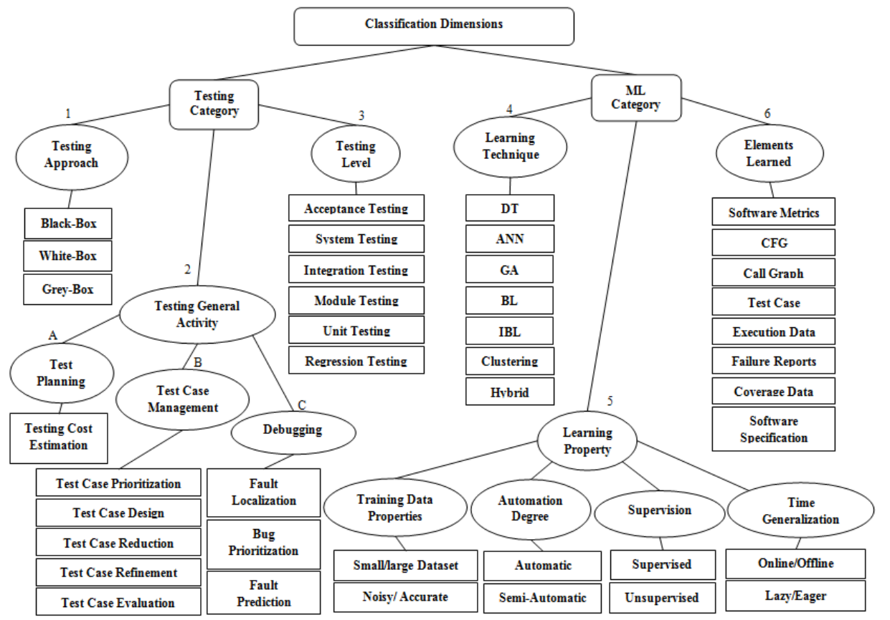
Classification summary
Noorian, M. a, Bagheri, E. a B., & Du, W. a. (2011). Machine learning-based software testing: towards a classification framework. SEKE 2011 - Proceedings of the 23rd International Conference on Software Engineering and Knowledge Engineering, 225–229.

Slide 47
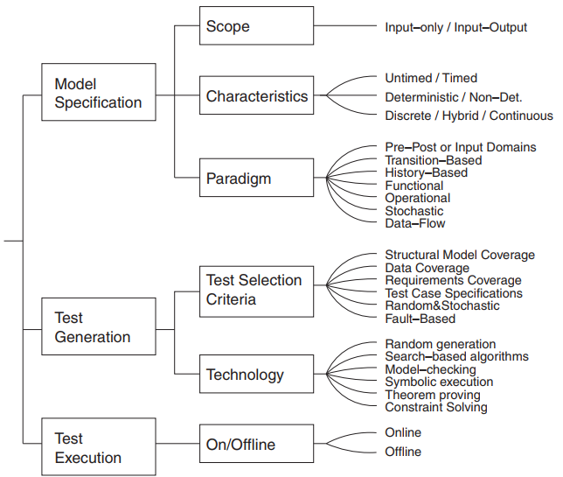

A taxonomy of model-based testing
Utting, M., Pretschner, A. and Legeard, B. (2012), A taxonomy of model-based testing approaches. Softw. Test. Verif. Reliab., 22: 297-312. https://doi.org/10.1002/stvr.456
Mark Utting

