Slide 1
Introduction to Software Testing Lecture 12 Performance Testing
Instructor: Morteza Zakeri
Slides by: Morteza Zakeri
March 2024

Slide 2
Performance Testing Tips and Techniques

Slide 3
TOC
What is performance test?
Fundamentals of effective application performance testing
Process of performance test.
Interpreting results: Effective root-cause analysis
Application Technology and Its Impact on Performance Testing

Slide 4
Why Performance Test
What is it?
Why is so important?
Why carry out performance testing in the first place

Slide 5
What is performance
performance requirements
Service-oriented
Availability
Response time
efficiency-oriented
Throughput
Utilization
they measure how well (or not) an application is providing a service to the end users.
they measure how well (or not) an application makes use of the application landscape
Notes:
Service-oriented indicators are availability and response time; they measure how well (or not) an application is
providing a service to the end users. Efficiency-oriented indicators are throughput and utilization; they measure how
well (or not) an application makes use of the application landscape. We can define these terms briefly as follows:
Availability
The amount of time an application is available to the end user. Lack of availability is significant because many
applications will have a substantial business cost for even a small outage. In performance testing terms, this
would mean the complete inability of an end user to make effective use of the application.
Response time
The amount of time it takes for the application to respond to a user request. For performance testing, one
normally measures system response time, which is the time between the user's requesting a response from the
application and a complete reply arriving at the user's workstation.
Throughput
The rate at which application-oriented events occur. A good example would be the number of hits on a web
page within a given period of time.
Utilization
The percentage of the theoretical capacity of a resource that is being used. Examples include how much
network bandwidth is being consumed by application traffic and the amount of memory used on a server when
a thousand visitors are active.

Slide 6
Levels of performance testing maturity
Notes:
As you can see, three levels of performance testing maturity were identified. The first one, "Firefighting," occurs when
little or no performance testing was carried out prior to application deployment, so effectively all performance defects
must be resolved in the live environment. This is the least desirable approach but, surprisingly, is still relatively
common. Companies in this mode are exposing themselves to serious risk.
The second level, "Performance Validation (or Verification)," covers companies that set aside time for performance
testing but not until late in the application life cycle. Hence a significant number of performance defects are still found
in production (30%). This is where most organizations currently operate.
The final level, "Performance Driven," is where performance considerations have been taken into account at every
stage of the application life cycle. As a result, only a small number of performance defects are discovered after
deployment (5%). This is what companies should aim to adopt as their performance testing model.

Slide 7
Some questions related to application performance
How many end users will the application need to support at release? After 6 months, 12 months, 2 years?
Where will these users be located, and how will they connect to the application?
How many of these users will be concurrent at release? After 6 months, 12 months, 2 years?
How many and what specification of servers will I need for each application tier?
What sort of network infrastructure do I need to provide?

Slide 8
The Fundamentals of Effective Application Performance Testing
Choosing an appropriate performance testing tool
Designing an appropriate performance test environment
Setting realistic and appropriate performance targets
Making sure your application is stable enough for performance testing
Obtaining a code freeze
Identifying and scripting the business-critical transactions
Providing sufficient test data of high quality
Ensuring accurate performance test design
Identifying the server and network monitoring key Performance Indicators (KPIs)
Allocating enough time to performance test effectively

Slide 9
Choosing an Appropriate Performance Testing Tool
Automated performance test tools typically have the following components.
Scripting module
Test management module
Load injector(s)
Analysis module
Notes:
Scripting module
Enables recording of end-user activity and may support many different middleware protocols. Allows modification of
the recorded scripts to associate internal/external data and configure granularity of response-time measurement.
Test management module
Allows the creation and execution of load test sessions or scenarios that represent different mixes of end-user activity.
These sessions make use of nominated scripts and one or more load injectors.
Load injector(s)
Generates the load—normally from multiple workstations or servers, depending on the amount of load required.
Analysis module
Provides the ability to analyze the data collected from each test execution. This data is typically a mixture of
autogenerated reports and graphical or tabular reporting. There may also be an "expert" capability that provides
automated analysis of results and highlights areas of concern.

Slide 10
Typical Performance Tool Deployment

Slide 11
Evaluation of a performance testing tool (continue)
evaluation of a performance testing tool should include the following steps:
Tool vendor support
Licensing model
Proof of Concept (POC)
Scripting effort
Solution versus load testing tool
automated requirements management
automated data creation and management
pre-performance test application tuning and optimization
response-time prediction and capacity modeling
application server analysis to component level
integration with end-user experience (EUE) monitoring after deployment.
In-house or outsource?
Notes:
Tool vendor support
Ensure that the performance testing tool vendor "officially" supports your application technology—specifically, how the
application client talks to the next application tier. For example, a typical browser-based client will in most cases be
using HTTP or HTTPS as its primary communication protocol.
Licensing model
Most performance tools offer a licensing model based on two components.
The largest load test you can execute in terms of virtual users
This may be organized in breaks or bands, perhaps offering an entry level of up to 100 virtual users with
additional cost for higher numbers. You may also find tool vendors who offer unlimited number of virtual users
for a (higher) fixed cost.
The application technologies that the tool can support
You may purchase the tool with support for the HTTP protocol, but a later request to support, for example,
Citrix would incur an additional cost. The application technology may or may not be locked to the virtual users.
Some vendors also offer a term-license model whereby you can temporarily extend your license for one-off or
occasional requirements to test much greater numbers of virtual users.
Proof of Concept (POC)
You need to try the tool out against your application, so insist on a POC. Identify a minimum of two transactions to
record: one that can be considered "read-only" (e.g., a simple search activity that returns a result set of one or more
entries); and one that inserts or makes updates to the application database. This will allow you to check that the
recorded transaction actually replays correctly. If your application is "read only," make sure to check the replay logs
for each transaction to ensure that there are no errors indicating replay failure.
Scripting effort
Many performance tool vendors claim that there is little or no need to make manual changes to the scripts that their
tools generate. This may be true for simple browser transactions that navigate around a couple of pages, but the
reality is that you will have to delve into the code at some point during transaction scripting.
As a result, you may find that many manual changes are required to your recorded transaction before it will replay
successfully. If each set of changes requires several hours per script to implement with one tool but seems to be
automatically handled by another, then you need to consider the potential cost savings and the impact of the extra
work on your performance testing project and the testing team members.
Solution versus load testing tool
Some vendors offer only a load testing tool whereas others offer a performance testing solution. Solution offerings will
inevitably cost more but generally provide a much greater degree of granularity in the analysis they provide. In
addition to load testing, they may include any or all of the following: automated requirements management,
automated data creation and management, pre-performance test application tuning and optimization, response-time
prediction and capacity modeling, application server analysis to component level, and integration with end-user
experience (EUE) monitoring after deployment.
In-house or outsource?
If you have limited resources internally or are working within strict time constraints, consider outsourcing the
performance testing project to an external vendor. Some tool vendors offer a complete range of services from tool
purchase with implementation assistance through to a complete performance testing service, and there are many
companies that specialize in testing and can offer the same kind of service using whatever performance toolset they
consider appropriate. This has the advantage of moving the commercials to time and materials and removes the
burden of selecting the right testing tool for your application. The main disadvantage of this approach is that—if you
need to carry out frequent performance tests—the cost per test will rapidly exceed the cost of buying an automated
performance testing solution outright.

Slide 12
Designing an Appropriate Performance Test Environment
Differences between performance test environment and operational environment
The number and specification of servers (probably the most common reason)
Bandwidth and connectivity of network infrastructure
Number of application tiers
Sizing of application databases
Notes:
The number and specification of servers (probably the most common reason)
It is often impractical, for reasons of cost and complexity, to provide an exact replica of the server content and
architecture in the deployment environment. Nonetheless, even if you cannot replicate the numbers of physical
servers at each application tier then do try to match the specification of the live servers. This will allow you to
determine the capacity of an individual server and provide a reliable baseline for horizontal scaling.
Bandwidth and connectivity of network infrastructure
In a similar vein, it is rare for the target servers to be deployed in the same location as their live counterparts,
although it is often possible to share the same network infrastructure.
Number of application tiers
In many cases, the number of application tiers has greater impact on the validity of performance testing than
simply the number of servers. Therefore, it is crucial to retain the live tier deployment model unless there is no
alternative. For instance, if a proxy server lies between your application server and the user, try to insert a
proxy server in the test environment as well.
Sizing of application databases
The size of the test environment database should closely approximate the live one; otherwise, the difference
will have a considerable impact on the validity of performance test results. Executing tests against a 1 GB
database when the live deployment will be 50 GB is completely unrealistic.

Slide 13
3 Levels of preference when it comes to designing a test environment
An exact or very close copy of the live environment
A subset of live environment with fewer servers but specifications and tire development matches to that of the live environment
A subset of the live environment with fewer servers or lower specification

Slide 14
Some tips for test environment
Use virtualization
Bus Versus LAN-WAN
Physical versus virtual NIC
Capability of load generators
How application reacts to IP address of each incoming virtual user.
Situations that affect how many injectors you will need:
The application technology may not be recordable at the middleware level
Measure performance from presentation layer
From where user access the application:
Available bandwidth
Network latency

Slide 15
Check list for test environment
Number of server
Load balancing strategy
Hardware inventory
Software inventory
Application component inventory
External links

Slide 16
A number of ways to simulate WAN-based users
Modify transaction replay: slowing down the rate of execution
Load injection from a WAN location: load injector machines at the end of real WAN links
Network simulation: simulate WAN conditions from a network perspective, including bandwidth reduction

Slide 17
The groups involved in setting performance targets
Chief information officer (CIO)
Chief technology officer (CTO)
Chief financial officer (CFO)
Departmental heads
The developers
The testers (internal or outsourced):
The testers are the people at the sharp end, so among other considerations they need to know the correct transactions to script, the type of test design required, and the performance targets they are aiming for.
The infrastructure team(s)
The end users

Slide 18
Setting realistic and appropriate performance targets
Availability
Concurrency, scalability, and throughput
Response time
Network utilization
Data volume
Data throughput
Data error rate
Server utilization
CPU utilization
Memory utilization
Disk input/output
Disk space

Slide 19
Making sure your application is stable enough for performance testing
Poorly performing SQL
Large number of application network round trips
Undetected application errors

Slide 20
Obtaining a code freeze
It is absolutely vital to carry out performance testing against a consistent release of code.
automated performance testing relies on scripted transactions. These scripts are version dependent;
An unanticipated new release of code may partially or completely invalidate these scripts
It's often the result of a communication breakdown between test teams and management

Slide 21
Identifying and scripting the business-critical transactions
For each transaction you should complete the following actions:
Define and document each execution step so that there is no ambiguity in the navigation path
Identify all input data requirements and expected responses
Determine the type of user that the transaction involves
What is the connectivity path for this transaction?
Will this be an active or passive transaction?

Slide 22
Some Considerations
Verify single user replay
Verify multi-user replay
decide which parts of the transaction to measure in terms of response time
Decide which parts of a transaction are repeated during test execution
consider is whether your application will exist in isolation or have to share resource with other applications.

Slide 23
Providing sufficient test data of high quality
Three types of test data
input data
User credentials
Search criteria
Associated documents
target database
runtime data
Challenges of creation test database
Sizing
Data rollback
Data management tools

Slide 24
Ensuring accurate performance test design
Baseline test
Load test
up to the target concurrency but usually no further
performance targets
Availability
concurrency or throughput
response time
closest approximation of real application use

Slide 25
Ensuring accurate performance test design
Stress test
determine the upper limits or sizing of the infrastructure.
a stress test continues until something breaks
no more users can log in
response time exceeds the value you defined as Acceptable
the application becomes unavailable
to know your upper limits
Notes:
Spike testing is conducted to test the system suddenly for a short duration. Each surge the system has to face is called a spike.
This testing ensures whether the system will be stable and responsive under unexpected variations in load. If an unexpected surge appears in the user base, the performance of the system should degrade gracefully rather than come crashing down all of a sudden.
A spike is an unexpected load which stresses the system. Unlike increasing the load incrementally and going beyond the specified limit gradually as in case of stress testing, spike testing starts with a less number of users, say one user and then 50 concurrent users and then suddenly the user base is increased. This can make the system become unstable since the system might not be prepared to service a sudden surge of concurrent users. In this case, the possibility of system crashing is very high.

Slide 26
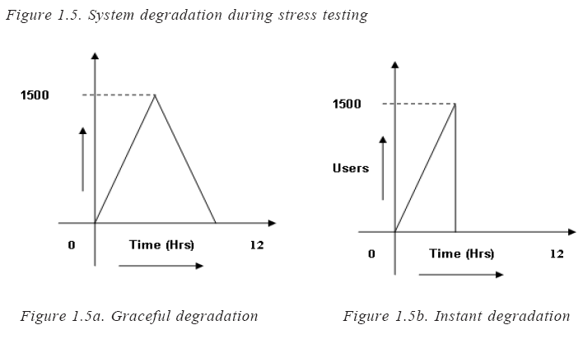
Ensuring accurate performance test design
Stress test
Notes:
If the test completes successfully, then the system should be load tested for 1,200 concurrent users. System performance should be monitored to see if all parameters are stable. If it is not stable, then we understand that the load of 1,200 is not the stable condition for the system. It could be 1,000 or between 1,000 and 1,200, which has to be determined. If it is stable at 1,200, then we move on to the next level of stress testing.

Slide 27
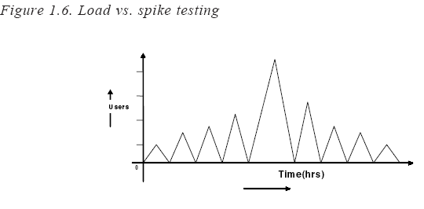
Ensuring accurate performance test design
Stress (Spike) test
Notes:
Spike testing is conducted to test the system suddenly for a short duration. Each surge the system has to face is called a spike.
This testing ensures whether the system will be stable and responsive under unexpected variations in load. If an unexpected surge appears in the user base, the performance of the system should degrade gracefully rather than come crashing down all of a sudden.
A spike is an unexpected load which stresses the system. Unlike increasing the load incrementally and going beyond the specified limit gradually as in case of stress testing, spike testing starts with a less number of users, say one user and then 50 concurrent users and then suddenly the user base is increased. This can make the system become unstable since the system might not be prepared to service a sudden surge of concurrent users. In this case, the possibility of system crashing is very high.

Slide 28
Ensuring accurate performance test design
Soak or stability or endurance test
This sort of test cannot be carried out effectively unless appropriate server monitoring is in place.

Slide 29
Ensuring accurate performance test design
Smoke test
to focus only on what has changed
Isolation test
used to home in on an identified problem

Slide 30
Ensuring accurate performance test design

Slide 31
Some consideration
Think Time
it introduces an element of realism into the test execution.
With think time removed, as is often the case in stress testing, execution speed and throughput can increase tenfold, rapidly bringing an application infrastructure that can comfortably deal with a thousand real users to its knees.
always include think time in a load test.
think time influences the rate of transaction execution
Pacing
another way of affecting the execution of a performance test
affects transaction throughput

Slide 32
Type of injection profile
Big Bang
Stress test
This provides a better simulation of real user behavior.
For Big Bang load injection, caution is advised because large numbers of virtual users starting together can create a fearsome load, particularly on web servers. This may lead to system failure before the performance test has even had a chance to start properly.
Ramp-up
This mode begins with a set number of virtual users (typically 0 or 1) and then adds more users at specified time intervals until a target number is reached.
This is the usual way of testing to see if an application can support a certain number of concurrent users.

Slide 33
Type of injection profile
Ramp-up (with step)
In this variation of straight ramp-up, there is a final target concurrency or throughput, but the intention is to pause injection at set points during test execution.
For example, the target concurrency may be 1,000 users, but there is a need to observe the steady-state response time at 250, 500, and 750 concurrent users;
Ramp up (with step), Ramp down (with step)

Slide 34
Sample Structure of performance test
Baseline test each transaction
This provides an indication of the best performance you're likely to get from whatever activity the transaction represents.
You should run this sort of test for a set period of time or a number of iterations.
There should be no other application activity going on at the same time
Load test each transaction
Decide on the maximum number of concurrent users or throughput you want for each transaction;
I tend to use the ramp-up with step approach, since this allows fine-grain analysis of problems that may occur at a particular level of concurrency or throughput.
Isolation test individual transactions

Slide 35
Sample Structure of performance test
Load test transaction groups
database lock contention
Isolation test transaction groups
Soak test transaction groups
Repeat the individual transaction and/or transaction group performance tests for an extended duration. This should reveal any problems that manifest themselves only after a certain amount of application activity has occurred.
Stress test transaction groups
Repeat the individual transaction and/or transaction group tests but reduce the amount of sleep time and pacing to create a higher throughput than was achieved during the load tests. This allows you to ascertain the upper capacity limits of the application landscape and to determine how the application responds to sudden peaks of activity.
Non-performance tests

Slide 36
Identifying the server and network monitoring key Performance Indicators (KPIs)
It is important to approach server KPI monitoring in a logical fashion—ideally, using a number of layers.
The ideal approach is to build separate templates of performance metrics for each layer of monitoring. Once created, these templates can form part of a reusable resource for future performance tests

Slide 37
key Performance Indicators (KPIs)
depending on the application architecture, any or all of the following models or templates may be required:
Generic templates
Processor utilization percentage
Top 10 processes
Available memory in bytes
Memory pages/second
Processor queue length
Context switches per second
Physical disk: average disk queue length
Physical disk: % Disk Time
Network interface: Packets Received Errors
Network interface: Packets Outbound Errors
Web and application server tier
Database server tier
Mainframe tier

Slide 38
Key Performance Indicators (KPIs)
network monitoring focuses
Packet round-trip time
Detection of any errors that may occur as a result of high data volumes
For the Windows and Unix/Linux operating systems there are performance counters that monitor the amount of data being handled by each NIC card as well as the number of errors (both incoming and outgoing) detected during a performance test execution.
To help better differentiate between server and network problems, some automated performance test tools separate server and network time for each element within a web page

Slide 39
Example

Slide 40
The Process of performance testing

Slide 41
Allocating enough time to performance test effectively
Lead time to prepare test environment
Lead time to prepare the injection environment
Time to identify and script business transactions
Time to identify and create enough test data
Time to prepare and execute performance test runs
Time to deal with any problems identified

Slide 42
Sample of time scale
Scripting performance test transactions: Allow half a day per transaction.
Creating and validating performance test sessions or scenarios: Typically one to two days' work.
Performance test execution: Allow a minimum of five days.
Data collection (and software uninstall): Allow one day.

Slide 43
Necessary information for project plan creation
Deadlines available to complete performance testing, including the scheduled deployment date.
Whether to use internal or external resources to perform the tests.
Test environment design agreed. (An appropriate test environment will require longer to create than you estimate.)
Ensure that a code freeze applies to the test environment within each testing cycle.
Ensure that the test environment will not be affected by other user activity.
All performance targets identified and agreed to by appropriate business stakeholders.
The key application transactions identified, documented, and ready to script.
Which parts of transactions should be monitored separately (i.e.,checkpoints).
Identify the input, target, and runtime data requirements for the transactions that you select.

Slide 44
Necessary information for project plan creation
Make sure that you can create enough test data of the correct type within the time frames of your testing project. Don't forget about data security and confidentiality.
Performance tests identified in terms of number, type, transaction content, and virtual user deployment. You should also have decided on the think time, pacing, and injection profile for each transaction deployment.
Identify and document server, application server, and network KPIs.
Identify the deliverables from the performance test in terms of a report on the test's outcome versus the agreed performance targets.
A procedure is defined for submission of performance defects discovered during testing cycles to development or the application vendor.

Slide 45
performance testing in-house
Do you have a dedicated performance testing team? At a minimum you will need a project manager and enough testing personnel (rarely are more than two needed) to handle the scale of the project.
Make sure the team has the tools and resources it needs to performance test effectively.
Ensure all team members are adequately trained in the testing concepts and tools to be used.

Slide 46
Using previous information for the following
Develop a high-level plan that includes resources, time lines, and milestones based on these requirements.
Develop a detailed performance test plan that includes all dependencies and associated time lines, detailed scenarios and test cases, workloads, and environment information.
Include contingency for additional testing cycles and defect resolution if problems are found with the application during performance test execution.
Include a risk assessment of not meeting schedule or performance targets.

Slide 47
4.Interpreting Results
Response-time data
Transaction throughput
State of load generator
Server, application server and network KPI
Performance threshold
Error occurrence

Slide 48
Types of Output from a Performance Test
Mean and median
It is commonly used
average response times
1, 2, 2, 2, 3, 9
Standard deviation and normal distribution
Response-time distribution

Slide 49
Important Tip
If the application fails to respond in the required time, the performance tool will record some form of time-out error. If this situation occurs then it is quite likely that an overload condition has occurred somewhere in the application landscape. We then need to check the server and network KPIs to help us determine where the overload occurred.
An overload doesn't always represent a problem with the application. It may simply mean that you need to increase one or more time-out values in the transaction script or the performance test configuration.
The think-time delays are not normally included in response time measurement, since your focus is on how long it took for the server to send back a complete response after a request is submitted. Some tools may break this down further by identifying at what point the server started to respond and how long it took to complete sending the response.

Slide 50
Response time

Slide 51
Response time versus concurrent virtual users
You would normally expect an increase in response time as more virtual users become active, but this should not vary in lockstep with increasing load.

Slide 52
Checkpoint
Notes:
Figure 4-5 builds on the previous two by adding response-time data for the checkpoints that were defined as part of the
transaction. As mentioned in Chapter 2, adding checkpoints improves the granularity of the response-time analysis and
allows correlation of poor response-time performance with the specific activities of a transaction. The figure shows that the
spike in transaction response-time at approximately 1,500 seconds corresponded to an even more dramatic spike in
checkpoints but did not correspond to the number of active virtual users.
In fact, the response-time spike at about 1,500 seconds was caused by an invalid set of login credentials supplied as part of
the transaction input data. This clearly demonstrates the effect that inappropriate data can have on the results of a
performance test.

Slide 53
Checkpoint

Slide 54
Response time in each transaction
Notes:
Performance testing tools should provide us with a clear starting point for analysis. For example, Figure 4-7 lists the ten
worst-performing checkpoints for all the transactions within a performance test. This sort of graph is useful for highlighting
problem areas when there are many checkpoints and transactions.

Slide 55
Transaction throughput
This view shows when peak throughput was achieved and whether any significant variation in transaction throughput occurred at any point.
reduced throughput is a useful indicator of the capacity limitations in the web or application server tier.
Notes:
Next to response time, performance testers are usually most interested in how much data or how many transactions can be
handled simultaneously. You can think of this measurement as throughput to emphasize how fast a particular number of
transactions are handled or as capacity to emphasize how many transactions can be handled in a particular time period.
Figure 4-8 illustrates transaction throughput per second for the duration of a performance test. This view shows when peak
throughput was achieved and whether any significant variation in transaction throughput occurred at any point.
A sudden reduction in transaction throughput invariably indicates problems and may coincide with errors encountered by a
virtual user. I have seen this frequently occur when the web server tier reaches its saturation point for incoming requests.
Virtual users start to stall while waiting for the web servers to respond, resulting in an attendant drop in transaction
throughput. Eventually users will start to time out and fail, however you may find that throughput stabilizes again (albeit at a
lower level) once the number of active users is reduced to a level that can be handled by the web servers. If you're really
unlucky, the web or application servers may not be able to recover and all your virtual users will fail.
In short, reduced throughput is a useful indicator of the capacity limitations in the web or application server tier.

Slide 56
Concurrent virtual users correlated with web request attempts
Notes:
looks at the number of GET, CONNECT, and POST requests for active concurrent users during a web-based performance test. These values should gradually increase over the duration of the test, as they do in Figure 4-9. Any sudden drop-off, especially when combined with the appearance of virtual user errors, could indicate problems at the web server layer.
Of course, the web servers are not always the cause of the problem. I have seen many cases where virtual users timed out
waiting for a web server response, only to find that the actual problem was a long-running database query that had not yet
returned a result to the application or web server tier. This demonstrates the importance of setting up KPI monitoring for all
server tiers in the application landscape.

Slide 57
Mechanisms to monitor server and network performance
application technology
capabilities of your performance testing solution
Remote monitoring
monitor many servers from a single location
usually, no need to install any software onto the servers
Installed agent
Notes:
These technologies provide server performance data (along with other metrics) to a remote system. That is, the server being
tested passes data over the network to the part of your performance testing tool that runs your monitoring software.
The big advantage of using remote monitoring is that you don't usually need to install any software onto the servers you
want to monitor. This circumvents problems with internal security policies that prohibit installation of any software that is not
part of the "standard build." A remote setup also makes it possible to monitor many servers from a single location.
That said, each of these monitoring solutions needs to be activated and correctly configured. You'll need to be provided with
an account that has sufficient privilege to access the monitoring software. You should also be aware that some forms of
remote monitoring, particularly SNMP or anything using Remote Procedure Calls (RPC), may be prohibited by site policy
because they can compromise security.

Slide 58
Remote monitoring technologies
Windows Registry
Microsoft's Performance Monitor (Perfmon) application.
Windows operating systems
Simple Network Monitoring Protocol (SNMP)
Java Monitoring Interface (JMX)
JMX is useful mainly when monitoring Java application servers such as IBM WebSphere, ORACLE WebLogic, and JBOSS
Rstatd
It provides basic kernel-level performance information
Notes:
Windows Registry
This provides essentially the same information as Microsoft's Performance Monitor (Perfmon) application. Most
performance testing tools provide this capability. This is the standard source of KPI performance information for
Windows operating systems and has been in common use since Windows 2000 was released.
Web-Based Enterprise Management (WBEM)
Web-Based Enterprise Management is a set of systems management technologies developed to unify the
management of distributed computing environments. WBEM is based on Internet standards and Distributed
Management Task Force (DMTF) open standards: the Common Information Model (CIM) infrastructure and schema,
CIM-XML, CIM operations over HTTP, and WS-Management. Although its name suggests that WBEM is web-based, it is
not necessarily tied to any particular user interface.
Microsoft has implemented WBEM through their Windows Management Instrumentation (WMI) model. Their lead has
been followed by most of the major Unix vendors, such as SUN and HP. This is relevant to performance testing
because Windows Registry information is so useful on Windows systems and is universally used as the source for
monitoring, WBEM itself is relevant mainly for non-Windows operating systems. Many performance testing tools
support Microsoft's WMI, although you may have to manually create the WMI counters for your particular application
and there may be some limitations in each tool's WMI support.
Simple Network Monitoring Protocol (SNMP)
Simple Network Monitoring Protocol (SNMP)
A misnomer if ever there was one; I don't think anything is simple about using SNMP. However, this standard has
been around in one form or another for many years and can provide just about any kind of information for any
network or server device. SNMP relies on the deployment of Management Information Base (MIB) files that contain
lists of Object Identifiers (OIDs) to determine what information is available to remote interrogation. For the purposes
of performance testing, think of an OID as a counter of the type available from Perfmon. The OID, however, can be a
lot more abstract, providing information such as the fan speed in a network switch. There is also a security layer
based on the concept of "communities" to control access to information. Therefore, you need to ensure that you can
connect to the appropriate community identifier; otherwise you won't see much. SNMP monitoring is provided by a
number of performance tool vendors.
Java Monitoring Interface (JMX)
Java Management Extensions is a Java technology that supplies tools for managing and monitoring applications,
system objects, devices (such as printers), and service-oriented networks. Those resources are represented by
objects called MBeans (for Managed Beans). JMX is useful mainly when monitoring Java application servers such as
IBM WebSphere, ORACLE WebLogic, and JBOSS. JMX support is version-specific, so you need to check which versions
are supported by your performance testing solution.
Rstatd
This is a legacy RPC-based utility that has been around in the Unix world for some time. It provides basic kernel-level
performance information. This information is commonly provided as a remote monitoring option, although it is subject
to the same security scrutiny as SNMP because it uses RPC.

Slide 59
Installed agent
When it isn't possible to use remote monitoring—perhaps because of network firewall constraints or security policies—your performance testing solution may provide an agent component that can be installed directly onto the servers you wish to monitor

Slide 60
the number of concurrent virtual users against how busy the server CPU is
Notes:
Figure 4-10 demonstrates a common correlation by mapping the number of concurrent virtual users against how busy the
server CPU is. These relatively simple views can quickly reveal if a server is under stress. The figure depicts a "ramp-up with
step" virtual user injection profile.

Slide 61
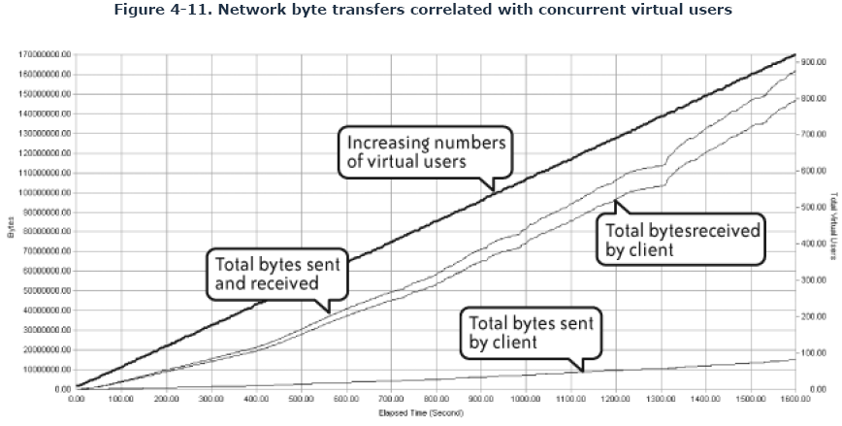
concurrent virtual users with various categories of data presented to the network
In this example it's pretty obvious that a lot more data is being received than sent by the client, suggesting that whatever caching mechanism is in place may not be optimally configured.
Notes:
As with server KPIs, any network KPIs instrumented as part of the test configuration should be available afterwards for postmortem
analysis. The following example demonstrates typical network KPI data that would be available as part of the output
of a performance test.
Figure 4-11 correlates concurrent virtual users with various categories of data presented to the network. This sort of view
provides insight into the data "footprint" of an application, which can be seen either from the perspective of a single
transaction or single user (as may be the case when baselining) or during a multitransaction performance test. This
information is useful for estimating the application's potential impact on network capacity when deployed.

Slide 62
Monitor load injectors
Typical metrics you need to monitor include:
Percent of CPU utilization
Amount of free memory
Page file utilization
Disk time
Amount of free disk space
Notes:
Every automated performance test uses one or more workstations or servers as load injectors. It is very important to monitor
the stress on these machines as they create increasing numbers of virtual users. As mentioned in Chapter 2, if the load
injectors themselves become overloaded then your performance test will no longer represent real-life behavior and so will
produce invalid results that lead you astray. Overstressed load injectors don't necessarily cause the test to fail, but they
could easily distort the transaction and data throughput as well as the number of virtual user errors that occur during test
execution. Carrying out a dress rehearsal in advance of full-blown testing will help ensure that you have enough injection
capacity.
Typical metrics you need to monitor include:
Percent of CPU utilization
Amount of free memory
Page file utilization
Disk time
Amount of free disk space

Slide 63
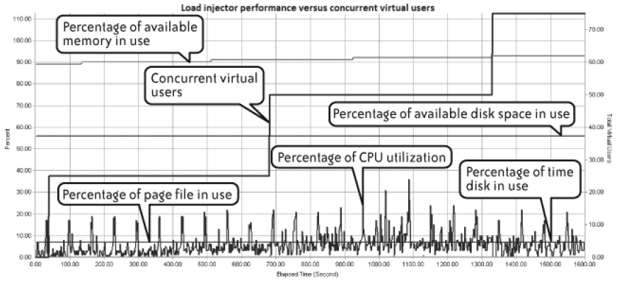
Monitor load injectors
Notes:
Figure 4-12 offers a typical runtime view of load injector performance monitoring. In this example, disk space utilization is
reassuringly stable, and CPU utilization seems to stay within safe bounds even though it fluctuates greatly.

Slide 64
Root-Cause Analysis
A good model of scalability and response time demonstrates a moderate but acceptable increase in mean response time as virtual user load and transaction throughput increase.
A poor model exhibits quite different behavior: as virtual user load increases, response time increases in lockstep and either does not flatten out or starts to become erratic, exhibiting high standard deviations from the mean.

Slide 65
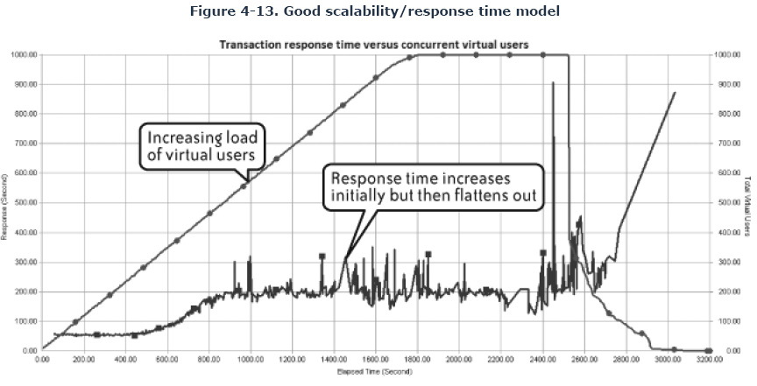
Sample of good scalability
Notes:
Figure 4-13 shows good scalability. The line representing mean transaction response time increases to a certain point in the
test but then gradually flattens out as maximum concurrency is reached. Assuming that the increased response time remains
within your performance targets, this is a good result. (The spikes toward the end of the test were caused by termination of
the performance and don't indicate a sudden application related problem.)

Slide 66
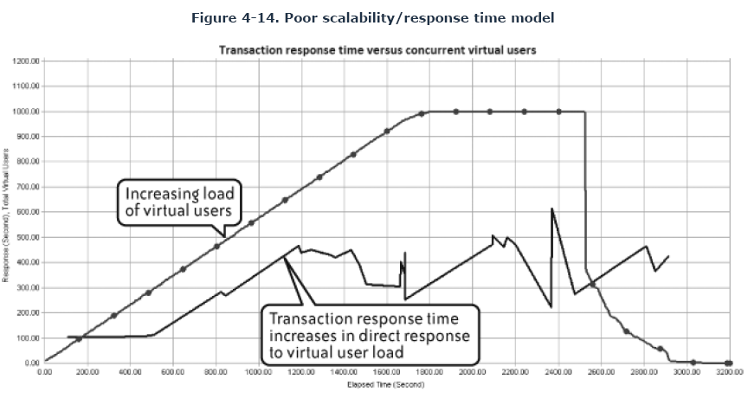
Sample of poor scalability
Notes:
Figures Figure 4-14 and Figure 4-15 demonstrate undesirable response-time behavior. In Figure 4-14, the line representing
mean transaction response time closely follows the line representing number of active virtual users until it hits approximately
750. At this point, response time starts to become erratic, indicating a high standard deviation and a potentially bad end-user
experience.

Slide 67
Sample of poor scalability
Notes:
Figure 4-15 demonstrates this same effect in more dramatic fashion. Response time and concurrent virtual users in this
example increase almost in lockstep.

Slide 68
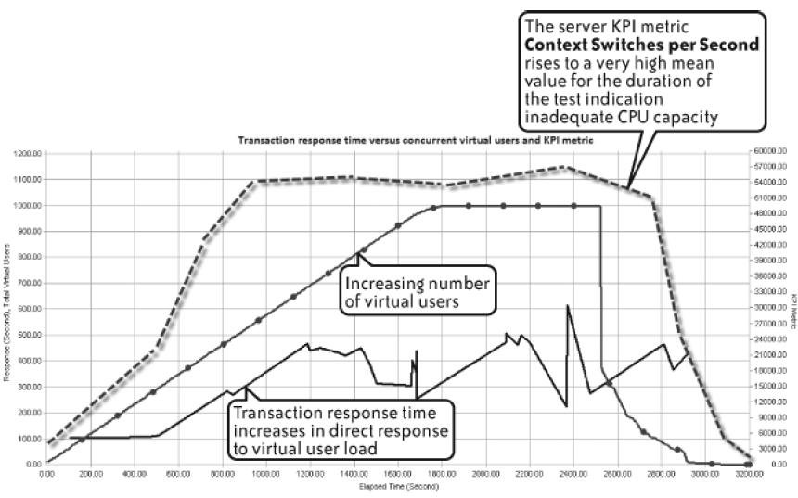
Poor Scalability (Continue)
Notes:
Examine the KPI data to see whether any metric correlates with the observed scalability/response time behavior. Some
performance testing tools have an autocorrelation feature that provides this information at the end of the test. Other tools
require a greater or lesser degree of manual effort to achieve the same result.
The following example demonstrates how it is possible to map server KPI data with scalability and response time information
to perform this type of analysis.
Figure 4-16 builds on Figure 4-14, adding the Windows Server KPI metric called context switches per second. This metric is a
good indicator on Windows servers of how well the CPU is handling requests from active threads. This example shows the
CPU quickly reaching a high average value, indicating a lack of CPU capacity for the load being applied. This, in turn, is
having a negative impact on the ability of the application to scale efficiently and thus on response time.

Slide 69
Application server monitoring
Simple generic monitoring of application servers won't tell you much if there are problems in the application.
In the case of a Java-based application server in a Windows environment, all you'll see is one or more java.exe processes consuming a lot of memory or CPU.
You may also run into the phenomenon of the stalled thread, where an application server component is waiting for a response from another internal component or from another server such as the database host. When this occurs, there is usually no indication of excessive CPU or memory utilization, just slow response time. The cascading nature of these problems makes them difficult to diagnose without detailed application server analysis
Java application server's worst-performing SQL calls
Java application server's worst-performing methods

Slide 70
Application server's worst-performing methods

Slide 71
Dealing with Errors
Notes:
It is most important to examine any errors that occur during a performance test, since these can also indicate hitting some
capacity limit within the application landscape. By "errors" I mean virtual user failures, both critical and noncritical. Your job
is to find patterns of when these errors start to occur and the rate of further errors occurring after that point. A sudden
appearance of a large number of errors may coincide with the knee effect described previously, providing further
confirmation that some limit has been reached. Figure 4-20 adds a small line to Figure 4-14 showing the sudden appearance
of errors. The errors actually start before the test shows any problem in response time, and they spike about when response
time suddenly peaks.

Slide 72
Monitoring & Analysis Checklist
Make sure that you have configured the appropriate server, application server, and network KPIs. If you are planning to use installed agents instead of remote monitoring, make sure there will be no obstacles to installing and configuring the agent software on the servers.
If your performance testing tool provides the capability, set any automatic thresholds for performance targets as part of your performance test configuration. This capability may simply count the number of times a threshold is breached during the test, and it may also be able to control the behavior of the performance test as a function of the number of threshold breaches that occur—for example, more than ten breaches of a given threshold could terminate the test.

Slide 73
Analysis Checklist (continue)
If your performance testing tool provides the capability, configure autocorrelation between transaction response time, concurrent virtual users, and server or network KPI metrics.
If you are using third-party tools to provide some or all of your KPI monitoring, make sure that they are correctly configured before running any tests.

Slide 74
Things to look out for during execution
The sudden appearance of errors
some limit has been reached within the application landscape
reduce the number of active users for a troublesome transaction
Sudden errors can also indicate a problem with the operating system's default settings
A sudden drop in transaction throughput
An ongoing reduction in available server memory
Panic phone calls from infrastructure staff
Notes:
Note: Sudden errors can also indicate a problem with the operating system's default settings. I recall a project
where the application mid-tier was deployed on a number of blade servers running Sun Solaris Unix. The
performance tests persistently failed at a certain number of active users, although there was nothing to indicate
a lack of capacity from the server KPI monitoring we configured. A search through system log files revealed that
the problem was an operating system limit on the number of open file handles for a single user session. When
we increased the limit from 250 to 500, the problem went away.
A sudden drop in transaction throughput
This is a classic sign of trouble, particularly with web applications where the virtual users wait for a
response from the web server. If the problem is critical enough, the queue of waiting users will
eventually exceed the time-out threshold for server responses and the test will exit. Don't immediately
assume that the web server layer is the problem; it could just as easily be the application server or
database tier. You may also find that the problem resolves itself when a certain number of users have
dropped out of the test, identifying another capacity limitation in the application landscape. If your
application is using links to external systems, check to ensure that none of these links is the cause of the
problem.
An ongoing reduction in available server memory
You would expect available memory to decrease as more and more virtual users become active, but if the
decrease continues after all users are active then you may have a memory leak. Application problems
that hog memory should reveal themselves pretty quickly, but only a soak test can reveal more subtle
problems with releasing memory. This is a particular problem with application servers, and it confirms
the value of providing analysis down to the component and method level.
Panic phone calls from infrastructure staff
Seriously! I've been at testing engagements where the live system was accidentally caught up in the
performance testing process. This is most common with web applications, where it's all too easy to target
the wrong URL.

Slide 75
Application Technology and Its Impact on Performance Testing
Asynchronous Java and XML (AJAX)
HTTP Protocol
Java
Oracle

Slide 76
Asynchronous Java script and XML (AJAX)
Most automated performance tools find this sort of technology difficult to handle.
automated test tools are by default designed to work in synchronous fashion.
It becomes a challenge to match requests with the correct responses.
From a programming standpoint, the performance tool must spawn a thread that waits for the correct response while the rest of the script continues to execute
Notes:
How would you go about scripting this situation using traditional automated performance testing tools? You can record
the user logging in, ready to receive calls, but then there's a wait until the calls arrive. This will require some manual
intervention in the script to create some sort of loop construct that waits for incoming calls.

Slide 77
HTTP Protocol
Http protocol
Caching behavior
SSL
Certificates
Increased overhead
Notes:
It is extremely important that the default caching behavior of Internet browser applications be accurately reflected by the performance tool that you use. If caching emulation is inaccurate, then it is likely that the number of requests generated between browser client and web server will be considerably greater than would actually occur in a live environment. This will have the effect of generating a much higher throughput for a given number of virtual users. I can recall a recent example where a few hundred virtual users generated as much throughput as 6,000 "real" users. This may be satisfactory for a stress test when you are simply trying to find the upper limits of capacity, but it is hardly a realistic load test.
Typical default caching behavior involves page elements such as images, style sheets, and the like being stored locally
on the client after the initial request, removing the need for the server to resend this information. Various mechanisms
exist to update the cached elements, but the net result is to minimize the data presentation and network round trips
between client and web server, reducing vulnerability to congestion and latency effects and (we hope) improving the
end-user experience.
Many applications make use of the SSL extension to the HTTP protocol that adds an encryption layer to the HTTP
stack. If your automated performance test tool can't handle SSL then you won't be able to record any transactions
unless you can record them from a non-SSL deployment of the application. There are two other aspects of SSL that
you should be aware of.
Certificates
One way of increasing security is to make use of client certificates, which can be installed into the application
client before access is permitted to an application. This implements the full private/public key model. The
certificates are provided in a number of formats (typically pfx or p12) and must be made available to your
performance testing tool for successful capture and replay. If your application makes use of client certificates,
check that the performance testing tool can deal with client certification; otherwise, you won't be able to record
your application. Typically the certificates are imported into the testing tool prior to capture and then
automatically used at appropriate points within the resulting script.
Increased overhead
Making use of SSL increases the number of network round-trips and the load on the client and web server. This
is because there is an additional authentication request sent as part of every client request as well as the need
to encrypt and decrypt each network conversation. Always try to retain the SSL content within your
performance test scripts, otherwise you may end up with misleading results due to reduced network data
presentation and a lighter load on the web server(s).

Slide 78
Java
Because of the component-based nature of Java applications, it is vital to have access to the internal workings of the application server under load and stress.
The following are some common problems that cannot easily be detected without detailed monitoring at the component and method level:
Memory leaks
Excessive object creation
Stalled threads
Slow SQL
Notes:
Memory leaks
This is the classic situation where a component uses memory but fails to release it, gradually reducing the
amount of memory available to the system. This is one reason why it's a good idea to run soak tests, because
memory leaks may occur for a long time before affecting the application.
Excessive component instantiations
There are often cases where excessive instances of a particular component are created by the application logic.
Although this doesn't necessarily cause performance issues it does lead to inefficient use of memory and
excessive CPU utilization. The cause may be coding problems or improper configuration of the application
server. Either way, you won't be aware of these issues unless you can inspect the application server at
component level.
Stalled threads
This was mentioned briefly in Chapter 4. A stalled thread occurs when a component within the application
server waits for a response from another internal component or (more commonly) an external call to the
database or perhaps a third-party application. Often the only symptom is poor response time without any
indication of excessive memory or CPU utilization. Without visibility of the application server's internal
workings, this sort of problem is difficult to isolate.
Slow SQL
Application server components that make SQL calls can also be a source of performance issues. Calls to stored
procedures will be at the mercy of code efficiency within the database. Note also that any SQL parsed on the fly
by application server components may have performance issues not immediately obvious from casual database
monitoring.
78

Slide 79
Oracle
ODBC
OCI
UPI
Oracle Forms Server (OFS)
ORACLE provides a browser plug-in called JInitiator that manages the connection to the Forms Server, which is a free download from the Oracle web site.

